Slide 1
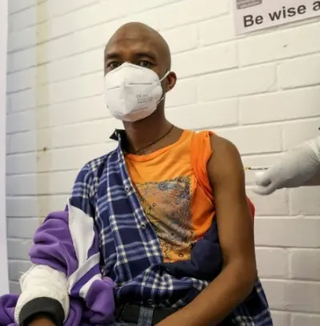
Rapid training:
How to ensure an inclusive
and community-centered
COVID-19 vaccines rollout
Day 1
Welcome!
We will start shortly, please mute your mics.
Notes:
Monica

Slide 2

Learning Objectives
Day 1
By the end of the session, you will understand:
Why the vaccine rollout needs to be inclusive and community-centred
What is Vaccine hesitancy and how to address it
Bite-Sized scenarios, let’s practice!
Tips and examples
Q&As
Notes:
Monica

Slide 3
QUICK POLL
What are your key questions about COVID-19 vaccines?
Notes:
VIV
Ask participants to fill the poll in 2 minutes
Then read loud the results indicating and highlighting if there are a lot of differences or harmonized answers, etc
The poll contains questions that volunteers may be asking themselves to community.
POLL has 5 questions:
If a COVID-19 vaccine were recommended to you, would you get it?
[1] Yes
[2] No
[3] Unsure
How much would you trust the new Covid-19 vaccine if it were available for you now?
[1] Not at all
[2] A little
[3] Moderately
[4] Very much
How safe do you think a COVID-19 vaccine will be for you? Would you say…
[1] Not at all safe
[2] A little safe
[3] Moderately safe
[4] Very safe
How comfortable are you having conversations with community members about vaccinations related to COVID-19?
[1] Very comfortable
[2] Somewhat comfortable
[3] Not comfortable
In your opinion, do you think communities you work/live in would get a Covid-19 vaccine, if it is recommended to them?
[1] Yes – the majority would get vaccinated
[2] Yes – many would get vaccinated
[3] Only a few people would get vaccinated
[4] No – the majority would not get vaccinated

Slide 4
Why the vaccines rollout needs to be
inclusive and community-centered
Notes:
Monica

Slide 5


What is…
community engagement & accountability (CEA)?
Community engagement
Providing fair access and opportunities to participate
Listening to understand people’s needs, solutions vulnerabilities and capacities.
Gathering, responding and acting on peoples’ feedback
Accountability
Shared decision-making with communities
Protecting and preserving the rights and dignity of people we serve
Risk communication and community engagement:
encouraging health-seeking behaviours
strengthening understanding, acceptance and uptake of vaccines and protective behaviours
Notes:
SPEAKERS NOTES (This slide can be hidden if it is not needed and the audience already have a good understanding of community engagement and accountability)
What is community engagement and accountability within the Movement? Above is the definition given on the Movement-wide Commitments to Community Engagement and Accountability, ratified at the 2019 Council of Delegates.
Community engagement
Processes to systematically listen to people in order to understand their needs, vulnerabilities and capacities. This includes gathering, responding and acting on peoples’ feedback and providing equitable access and opportunities to actively participate in decisions that affect them.
Accountability
Putting the interests of the people we serve at the centre of decision-making, thereby ensuring that humanitarian actions lead to the best possible outcomes and results for them, while protecting and preserving their rights and dignity and increasing their resilience to face situations of vulnerability and crisis.
Ensuring that humanitarian actions lead to the best possible outcomes.
LONGER VERSION
Community engagement refers to ways of working collaboratively with people and communities to ensure that Red Cross and Red Crescent actions are effective, inclusive, sustainable and accountable, and that they contribute to supporting and enabling people and communities to lead and shape positive, sustainable changes in their own lives and on their own terms. This includes processes to systematically listen to, engage and communicate with people and communities in order to better understand their diverse needs, vulnerabilities and capacities; to gather, respond to and act on feedback and input about their priorities and preferences; and to provide safe and equitable access and opportunities to actively participate in decisions that affect them.

Slide 6




What is…
Protection, Gender and Inclusion?
Supports the protection and inclusion of groups at risk of violence, discrimination, and exclusion despite their age, gender or disability status.
focuses on dignity, access, participation, and safety of people including those often marginalized.
Dignity
Access
Participation
Safety
Notes:
Brian/VIV?
Protection Gender and Inclusion is an approach designed to address the causes, risks and consequences of violence, discrimination and exclusion in an integrated way.
“Protection” and “inclusion” refer to specific actions that are taken for the benefit of people at risk. “Gender and diversity” refer to the multitude of intersecting factors that we consider in order for this protection and inclusion work to be carried out effectively.
Combining protection, gender and inclusion emphasizes the importance of jointly addressing the interrelated factors that increase or decrease risks and consequences of violence, discrimination and exclusion.
At the heart of the PGI approach is an analysis of how each individual is affected differently by different events, based on pre-existing uneven power relations, structures and access to basic resources and how this leads to different levels of vulnerability, capacity, risks and exposure to violence. Through Dignity Access Participation and Safety, PGI ensure that the needs of different people are addressed in a dignified way, ensures that individuals, despite their age, sex, gender or disability are able to access services, that they are included in decision making. And that special considerations are put in place to ensure communities are not put at risk.
Dignity- ensuring the needs of different people are addressed in a dignified and respectful way.
Access- working with communities To ensure barriers of gender, age, Disability background are addressed.
Participation- raising awareness of the rights and needs of children, Persons with disabilities, minorities so their needs specific needs are addressed
Safety- ensuring the risks all people of different gender identities, ages, disabilities and background are assessed and addressed.

Slide 7
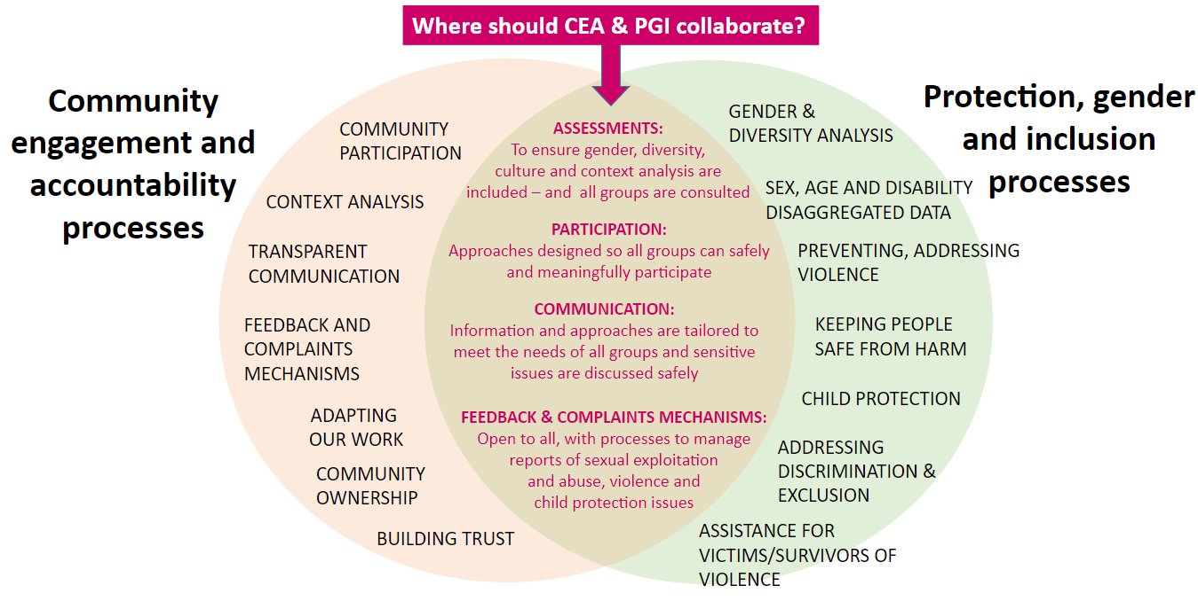
Notes:
VIV
Together: Community Engagement and Accountability Protection, Gender & Inclusion, can design effective community engagement tools, ensuring that our work is responsive to individual needs within a community and that we keep communities safe from harm. This can be done through:
ASSESSMENTS:
To ensure gender, diversity,
culture and context analysis are
included – and all groups are consulted
Facilitate PARTICIPATION:
To ensure different, people and different groups can safely and meaningfully participate
facilitate COMMUNICATION:
So Information is tailored to meet the needs of all individuals, and groups and sensitive issues are discussed safely
Establish FEEDBACK & COMPLAINTS MECHANISMS:
That are Open to all, with processes to manage reports of sexual exploitation
and abuse, violence and
child protection issues

Slide 8
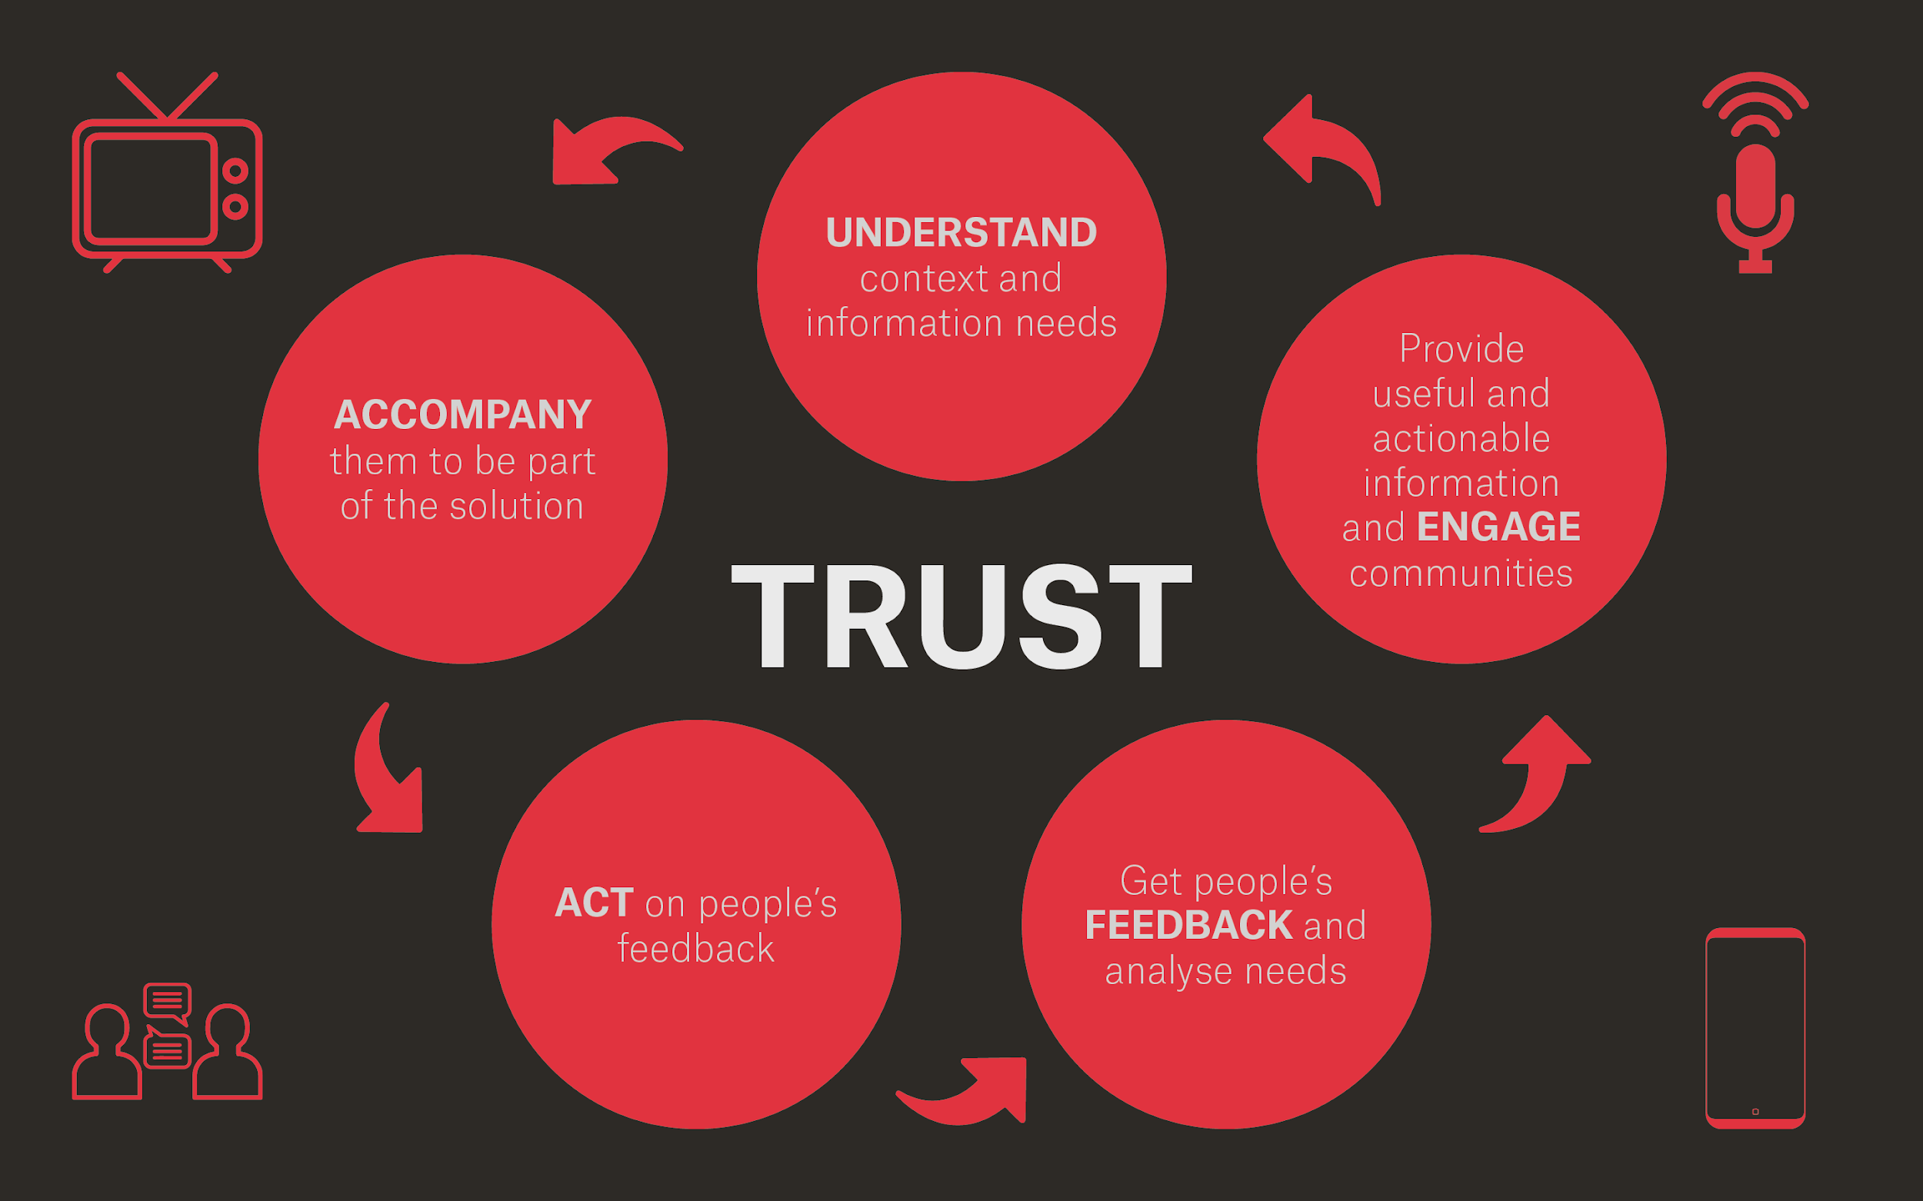

Notes:
VIV

Slide 9
Understanding and Addressing Vaccine Hesitancy
Notes:
Viv handover to Caroline
Next section is on one of the key trends that affect our work in vaccines.

Slide 10


What is Vaccine Hesitancy?
people who may refuse vaccines or be uncertain about taking them even if vaccines are available
complex and context specific, changes across time, place and vaccines
influenced by factors such as convenience and confidence
Source: World Health Organization, Report of the SAGE Working Group on Vaccine Hesitancy, 2014
Notes:
Vaccine hesitancy – what is it? - it is the reluctance or refusal to vaccinate despite the availability of vaccines – threatens to reverse progress made in tackling vaccine-preventable diseases.
This hasn’t just appeared as a result of this pandemic – in fact this was a challenge facing us before COVID-19
WHO last year considered vaccine hesitancy one of the 10 most significant threats in the world in a report looking at threats across the world – document is listed on the bottom of the slide, if you are interested.
The reasons why people choose not to vaccinate are complex – it can be because of various factors such speed of vaccine development which has led to many people being concerned about safety or factors related to convenience or complacency – not caring or seeing the need to get a vaccine.

Slide 11
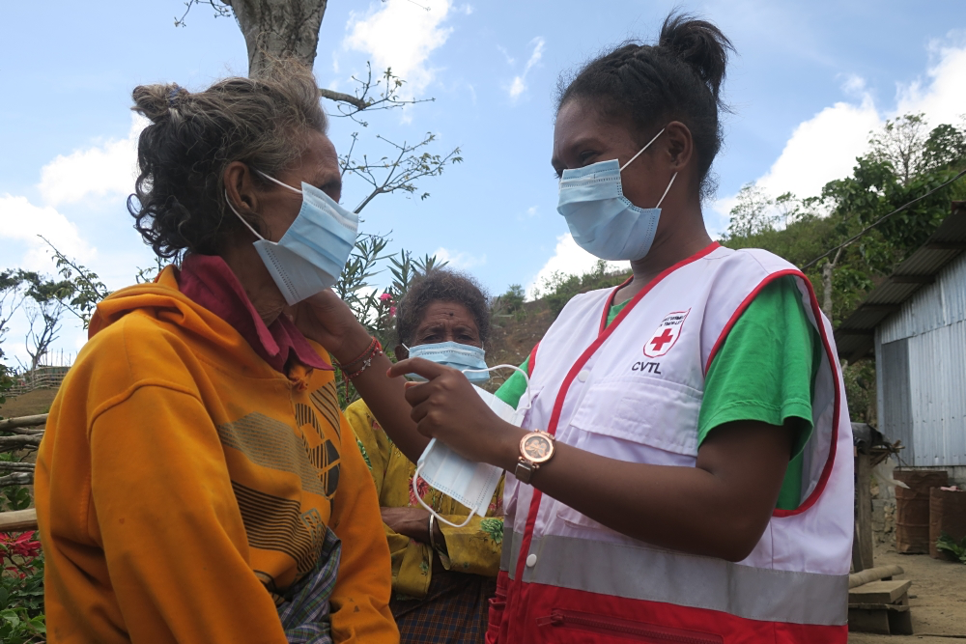
What is wrong with this approach?
But I heard that the vaccines are unsafe.
The new COVID-19 vaccine will be available soon. You should take it!
You’re wrong, vaccines are completely safe, that’s a fact!

Slide 12
Ask first, then give tailored information
You qualify for the new COVID-19 vaccine. Do you have any questions about the vaccine?
I heard these vaccines are dangerous.
I understand your concern.
Let me explain…

Slide 13
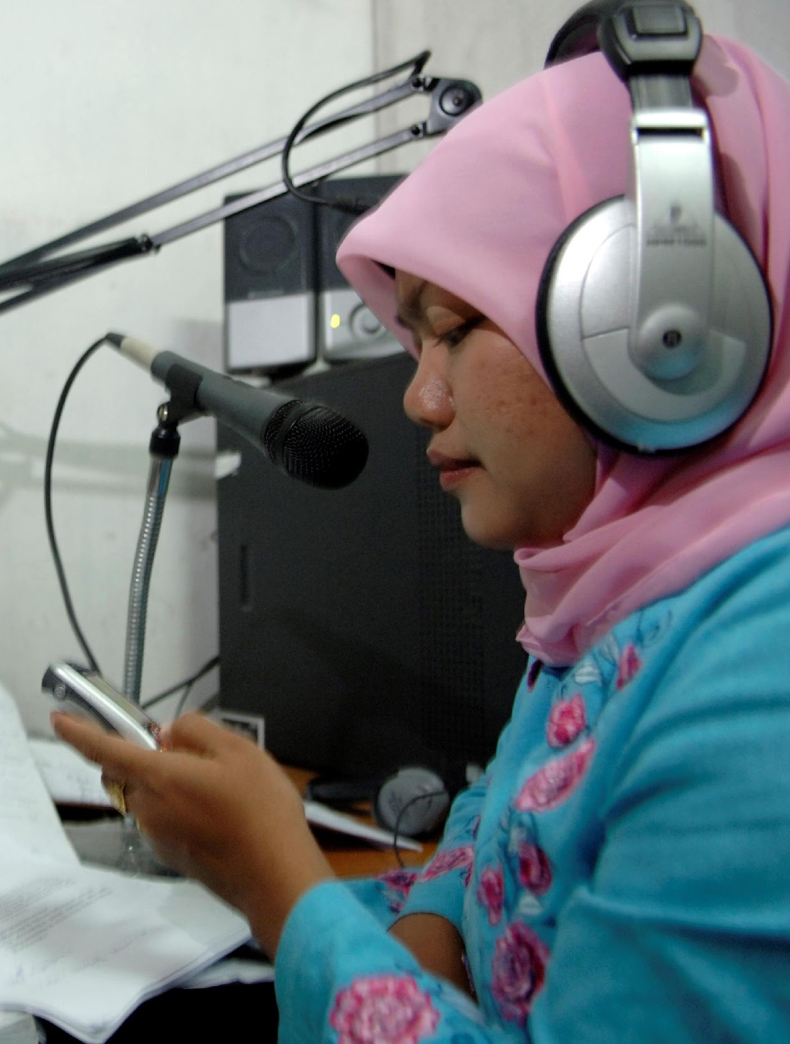
Vaccine Hesitancy Factors:
Mis/Disinformation: can impact people’s attitudes, beliefs, knowledge and intention to take vaccines, can also target specific people and groups.
Motivation affected by perceptions: perceived risk and severity of infection, confidence in vaccines, values and emotions.
Social influences: beliefs about what others in your social group do, approve and disapprove of, including limiting equal access for one group or individuals.
Notes:
Research suggests several key concerns that will be important to address to enable high and equitable vaccine uptake.
These include addressing
Mis/Disinformation: can impact people’s attitudes, beliefs, knowledge and intention to take vaccines, can also target specific people and groups. including conspiracy theories, about vaccines, especially when spread through social media, are major causes of why many may be hesitant about taking a vaccine.
Motivation affected by perceptions: perceived risk and severity of infection, confidence in vaccines, values and emotions.
Social influences: beliefs about what others in your social group do, approve and disapprove of, including limiting equal access for one group or individuals.

Slide 14
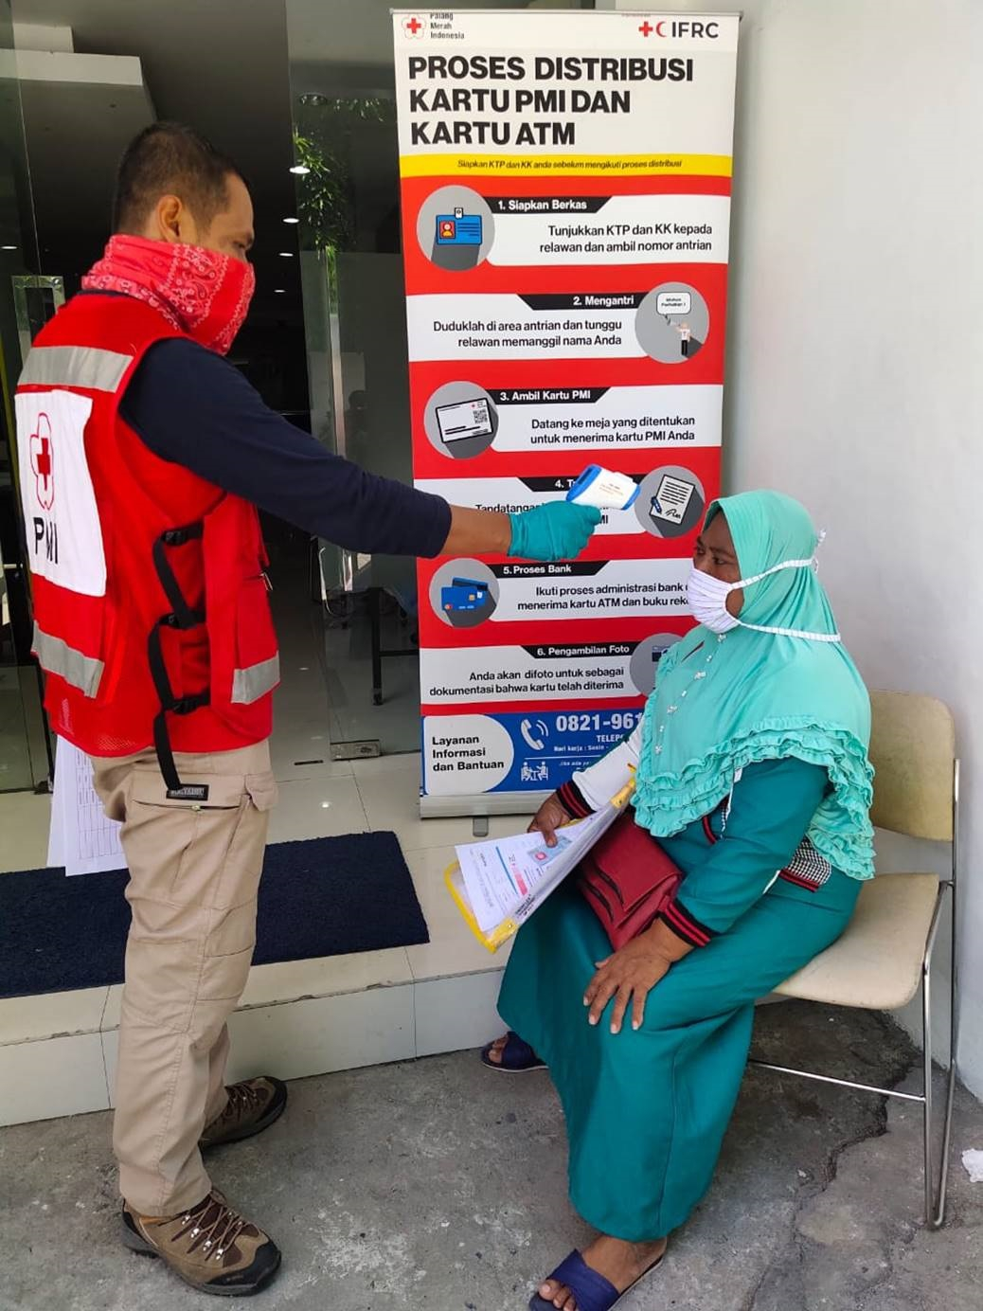
Vaccine Hesitancy Factors
Environmental factors: location, cost, time, equal access to information and/or cultural, religious and political mandates
Gender inequalities: addressing barriers to access healthcare can increase vaccination coverage for women and children
Notes:
Environment factors can affect vaccine uptake. Understanding and learning in real time about what works and what does not in relation to vaccine confidence and hesitancy is crucial. For example, evidence has shown that reducing barriers and making it easy to get vaccinated will increase vaccine uptake, especially for the large proportion of people who are not deliberately avoiding vaccination.⁵
Reducing gender inequalities such as a lack of decision-making power, money and transportation in the family is critical to improving female and child vaccination coverage.
A 2020 gender analysis by CARE of the Ebola response in DRC found: "The influx of Ebola responders and associated cash flow may also inadvertently have created conditions which favourise economic or sexual exploitation and abuse. The visibility and rise of such incidents is likely correlated with parallel increases in community resistance against Ebola response efforts. Ensuring robust prevention and response to sexual exploitation and abuse and gender-balanced emergency teams are ways to reduce SEA risks

Slide 15
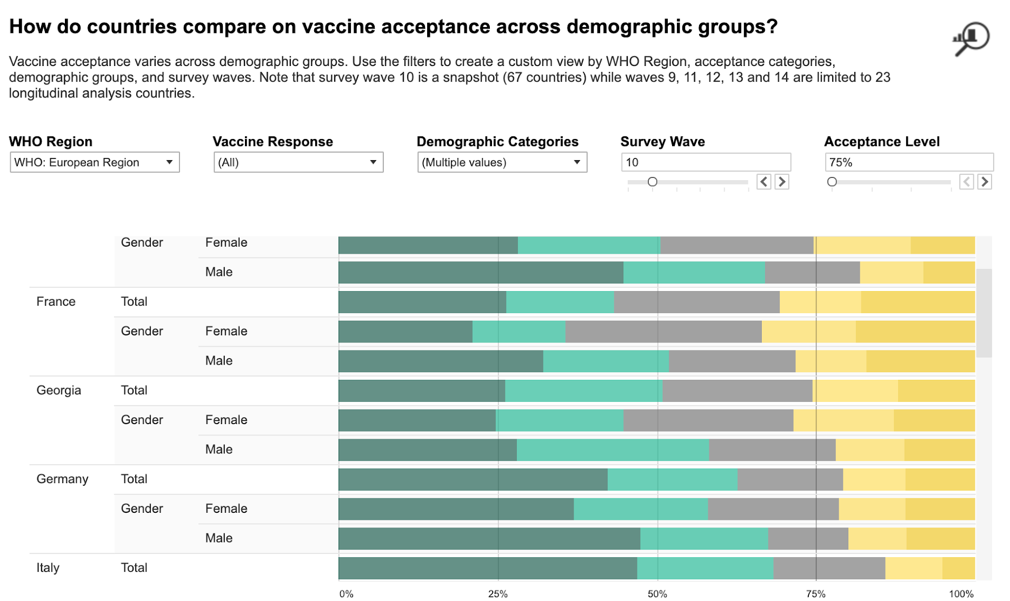
What does recent data tell us?
  Data shows an increase year-on-year for those strongly agreeing to receive of a COVID-19 vaccine
  Only 63 percent of respondents across 23 countries will accept a vaccine
  But still there is the ‘anxious middle’: those who are undecided and can be motivated to get the vaccine.
  Globally, men are more likely to express strong acceptance of the COVID-19 vaccine
Source: Johns Hopkins Center for Communication Program, KAP COVID Vaccine Acceptance Dashboard https://ccp.jhu.edu/kap-covid/vaccine-acceptance/
Notes:
So, what does recent data tell us about vaccine hesitancy?
The data tells that vaccine acceptance is changing, but not in a single direction.
One of the themes that have remained consistent across the entirety of the response is the questions around existing and potential treatments for COVID-19.
For example, we know from recent data from Ipsos shows an increase year-on-year for those strongly agreeing to receive of a COVID-19 vaccine. This was a consistent result for all 15 countries sampled. Italy and Spain showed the greatest change from December 2020 to January 2021 (+28 points). Russia, Australia and South Africa had the smallest increases (+3, +5, +6).
On the other hand, Johns Hopkins University has found that while European and North American countries have increased acceptance since July 2020, vaccine acceptance is down in Asia, the Middle East and South America. [1][2]
Preventative measures show similar patterns as vaccine acceptance. Data on people reporting follow-ing preventative measures such as mask wearing and physical distancing over the past six months has shown a similar decline in Asian and South American countries sampled, with increases in Europe and North America. [3]
Finally men are more likely than women to accept COVID-19 vaccines. Data from multiple studies show that sex is a predictor for vaccine acceptance. Globally, men are more likely to express strong acceptance of the COVID-19 vaccine.[4][5]In the Turkish Red Crescent’s latest COVID-19 KAP survey, for example, nearly 40% of those expressing further information on COVID-19 highlighted vaccines.

Slide 16
What community data shows us
Example: Africa Region: Feedback Report, Jan- Feb 2021
Questions:
“Does this vaccine have side effects?”– Cameroon, National Society radio show, 19 January 2021
“Is this vaccine also effective against the second strain that’s just appeared?” – Cameroon, National Society radio show, 19 January 2021
“is the vaccine compulsory, otherwise no one can go to public places?” – Gabon, Social media (twitter, facebook etc), 05 January 2021
Rumours, observations and beliefs:
“The vaccine they want to inject us with comes from Satan, it contains a microchip, a sign of the mark of the beast it talks about in Revelation”. – Cameroon, From National Society focal points reporting to IFRC, 16 January 2021
“This vaccine is the big unknown, so I don’t see why we need to rush into it.” – Gabon, National Society radio show, 08 January 2021
Notes:
Our own granular data is also confirming this each country and context will have different views on COVID-19 vaccines, as trust in institutions, cultural factors and accessibility and cost issues will vary by populations and occur at different speeds.
This example of Africa feedback report shows community questions, observations and beliefs around vaccines. Even Africa data shows vaccine uptake is high, still questions around vaccine safety and side effects circulates among communities.
Other observations about people not following protection measures on public transport, the belief that foreigners are spreading the disease and governments profiting from the situation are common in Africa region.
This makes a community-driven approach even more vital, however, as National Societies must adjust their programmes and activities not only to local context, but to rapid changes in government plans for vaccine rollouts. The side effects and safety of COVID vaccines have been one of the most popular queries on various social media channels.
This has also been confirmed in several of the perceptions surveys that National Societies have run related to vaccines. In Malaysia, for example, national survey results indicate that only 47% would confidently accept a vaccine, with a significant number reporting some hesitancy. The most mentioned concerns were safety and efficacy (25% and 12%), but also the cost (33%).

Slide 17
Bite-sized Scenarios
What would you do?
Notes:
MONICA – breakouts handling
BREAKout rooms
Divide participants into 5 rooms. Each one will do an scenario.
10 mins / Room
Sending scenarios before?

Slide 18


You will be automatically taken into a breakout room
Decide who will share discussion points with the big group
Read the Scenario
15 mins for discussion
3 mins each group for debriefing
INTERACT, INTERACT, INTERACT!
Notes:
MONICA– breakouts handling
BREAKout rooms
Divide participants into 5 rooms. Each one will do an scenario.
10 mins / Room
Sending scenarios before?

Slide 19
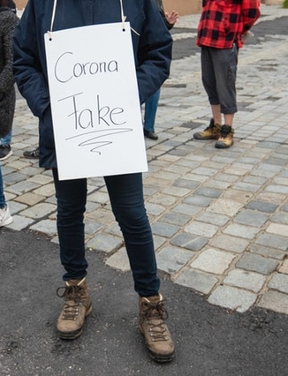
Scenario 1: Conflicting information leading to vaccine hesitancy.
You and your team identify vaccine-hesitant community members during a community talk. The group you are talking to is mixed in age and gender and they explain they have been reading in the social media that vaccines can modify your DNA, that they have been developed too fast and they are not safe enough.
TASK: Think about what actions you and your team in your National Society might plan to address this situation.
Notes:
S1 Facilitators Answer
Context
Understand why this misinformation is occurring, what is the context through feedback, perceptions data or secondary data from other sources.
Communities often derive phycological benefit from misinformation (affirmation, confirmation, reinforcements) understand what benefits they are getting before acting.
Needs assessment to consider political, social, economic and geographic factors that influence misinformation
Consult with relevant experts and specialists to support context analysis
What data (secondary) exists -existing needs assessments, evaluations of community engagement activities in the target communities, national stakeholders already that could inform why the misinformation is occurring.
Planning and Design
Take the concerns people have seriously and address them​
Emphasize that social media and websites can spread false information. ​
Tell people which trusted source you use to get the latest COVID-19 vaccine information.
Plan for coordination - liaise with other partners to achieve greater efficiency in community engagement activities and misinformation activties
Plan to include a feedback mechanism structured to facilitate comprehensive information flow that includes information on what is working in the project, what ideas communities have for improvements and project adjustments, current knowledge, attitudes and practices and reporting of rumours
Implementation
Work through community-based formal structures, informal structures, and social networks to address misinformation
Consider already-present community mobilizers (e.g. community health workers) positioned to lead the community engagement process and address misinformation on vaccines
Learning
Consider what other organizations are working in identifying misinformation. Can your data be shared with them?
Have a plan for disseminating and sharing the findings of learning with communities, government, donors and other partners and stakeholders to stop the spread of misinformation

Slide 20
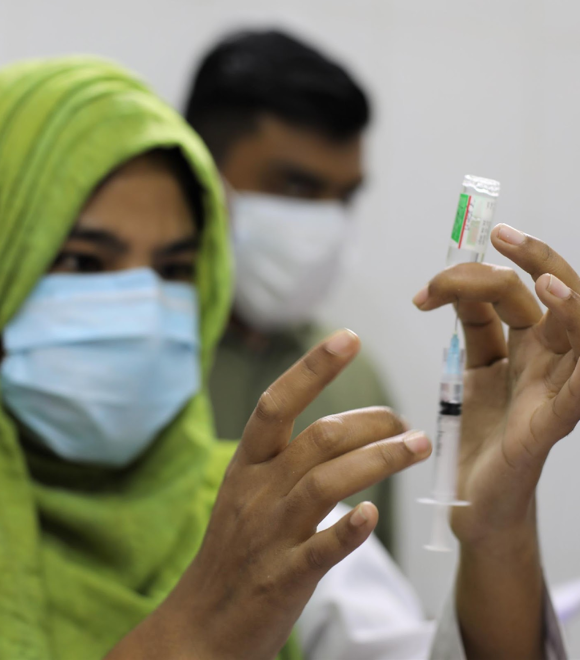
Scenario 2: Environmental factors
In your country, the government has been planning to deliver vaccines from different manufacturers, including vaccines that are not WHO prequalified or have not been approved by a WHO designated Stringent National Regulatory Authority (NRA). You and your team are about to include community engagement and accountability approaches to this vaccine roll out plan.
TASK: Think about what priority activities would you plan to do and with who you would coordinate?
Notes:
S2 Facilitators Answer
Context
Needs assessment to consider political, social, economic and geographic factors of vaccine choices
Consult with relevant experts and specialists to support context analysis
What data (secondary) exists -existing needs assessments, evaluations of community engagement activities in the target communities, national stakeholders on vaccines
Planning and Design
Plan needs to have mechanisms in place for ensuring communication and feedback between communities and powerholders, including government and implementing organizations.
When planning, remember that while National Societies take the decision on whether to support the governments vaccine introduction, the decision on the type of COVID-19 vaccine(s) used in a country rests solely with the government and designated National Regulatory Authorities.
Prepare, together with the Communications team and Health team of your NS, some reactive messages and FAQs that will help you to anticipate possible questions from community members.
Prepare and engage all team members who are actually doing community outreach with clear information and supporting materials.
Implementation
Work through community-based formal structures, informal structures, and social networks.
Learning
Have a plan for disseminating and sharing the findings of learning with communities, government, donors and other partners and stakeholders to strengthen the uptake of vaccines

Slide 21
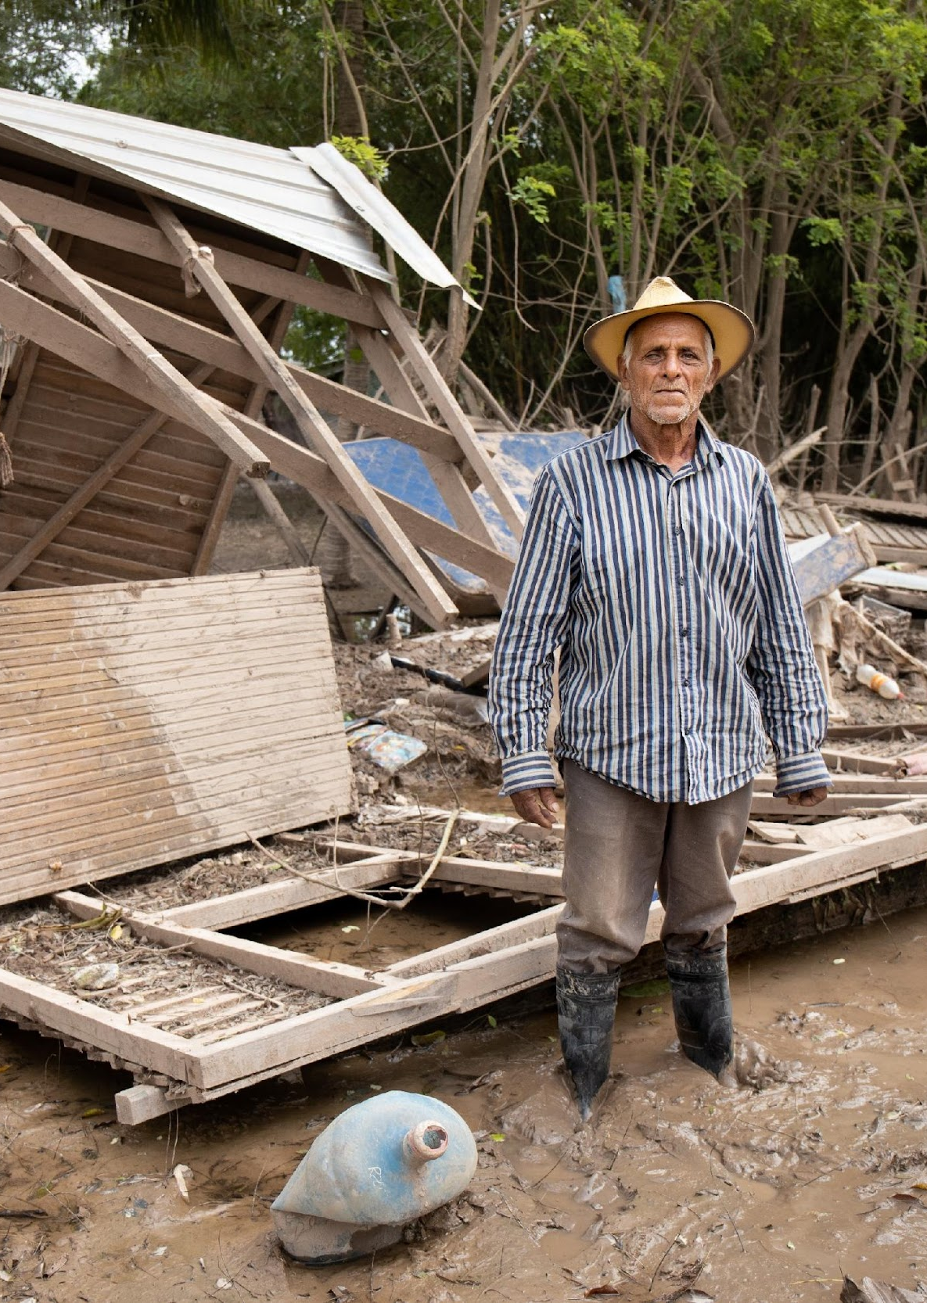
Scenario 3: Motivation affected by perceptions
In your context, the current outbreak is heading towards a third wave that is predicted to be twice as large and long-lasting. An approved vaccine is close to being delivered to the elders of your community. However, after some remote and face-to-face interviews with them, majority are expressing weariness at the lower efficacy (70%) of this vaccine comparing to other ones. They are also expressing fear about possible side effects and mistrust about its safety. Some mentioned they would rather wait more time to get evidence that nothing is wrong with the vaccine.
TASK: Think about what approaches you and your team might use to address these concerns?
Notes:
S3 Facilitators Answer
Context
Understand the context through feedback, perceptions data or secondary data from other sources.
Needs assessment to consider political, social, economic and geographic factors that influence vaccine uptake
Consult with relevant experts and specialists to support context analysis
What data (secondary) exists -existing needs assessments, evaluations of community engagement activities in the target communities, national stakeholders already that could inform why the community is not taking this vaccine.
Planning and Design
Plan to include a feedback mechanism structured to facilitate comprehensive information flow that includes information on what is working in the project, what ideas communities have for improvements and project adjustments, current knowledge, attitudes and practices and reporting of rumours
Implementation
Work through community-based formal structures, informal structures, and social networks to address uptake of vaccines
Consider already-present community mobilizers (e.g. community health workers) positioned to lead the community engagement process
Consider gathering ‘community voices’ and perceptions from others that have already get that vaccine in your or other contexts. Make sure to highlight that having doubts and fear is fine, is normal while explaining in plain language what ‘Safety’ represents and to what extend they should not be worried.
Engage and maintain conversations with relatives and closest circles: family members, friends, beloved ones to act as influencers.
Learning
Have a plan for disseminating and sharing the findings of learning with communities, government, donors and other partners and stakeholders to strengthen the uptake of vaccines

Slide 22
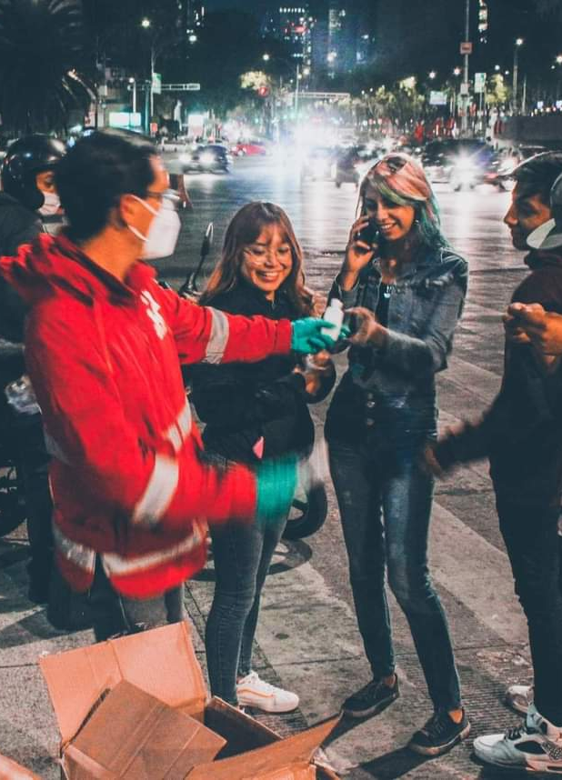
Scenario 4: Vaccine expectations
In your community many have received the COVID-19 vaccine and consequently have stopped following other public health measures. Many, especially young adults, believed that they can’t catch COVID-19 and infect others after receiving the vaccines and feel no need to take precautions after vaccination. You and your team observe and listen how people is no longer willing to wear masks, respecting physical distance or disinfecting their hands thoroughly. Think about what actions you, your team and your NS would plan to address this issue based on your context analysis
TASK: Think about what strategies you would put in place and who you would engage?
Notes:
S4 Facilitators Answer
Context
Understand the context through feedback, perceptions data or secondary data from other sources.
Needs assessment to consider political, social, economic and geographic factors that influence the uptake of PHMs.
Consult with relevant experts and specialists to support context analysis
What data (secondary) exists -existing needs assessments, evaluations of community engagement activities in the target communities, national stakeholders already that could inform why the community is not following PHMs.
Planning and Design
Plan to include a feedback mechanism structured to facilitate comprehensive information flow that includes information on what is working in the project, what ideas communities have for improvements and project adjustments, current knowledge, attitudes and practices and reporting of rumours
Implementation
Work through community-based formal structures, informal structures, and social networks to address uptake of PHMS.
Consider already-present community mobilizers (e.g. community health workers) positioned to lead the community engagement process and address and encourage PHMs being followed after vaccination
Learning
Have a plan for disseminating and sharing the findings of learning with communities, government, donors and other partners and stakeholders to strengthen the uptake of PHMs.

Slide 23
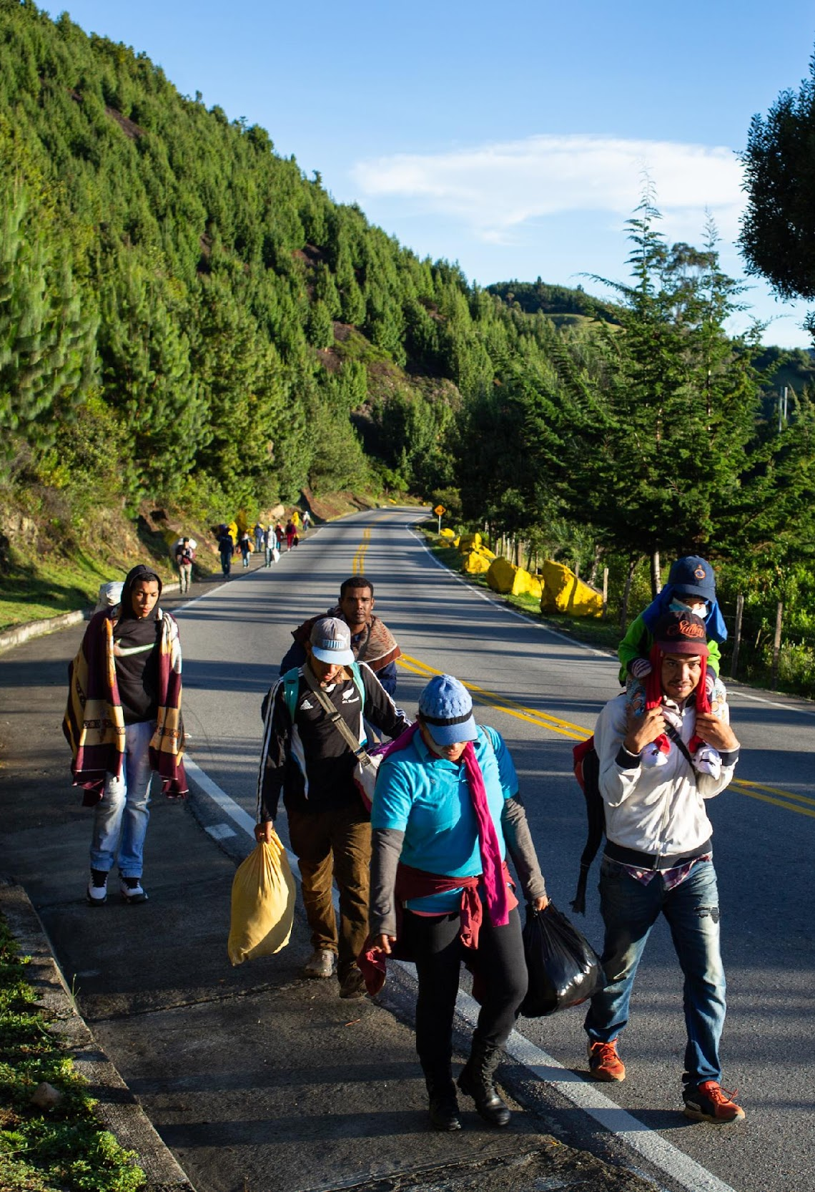
Scenario 5: Vaccine accessibility for migrants and refugees
You and your team are doing a community outreach in border areas where groups of migrants are entering. None of them has documents. During your conversations with migrants, a young adult ask you whether the Red Cross can provide the COVID-19 vaccine for his grandmother who has special medical conditions. He tells you that she is very old and has lost all her documents, including her passport. He also complaints in general about lack of information and that they feel nobody cares about their situation.
TASK: Think about what approaches you would consider to address this situation?
Notes:
S5 Facilitator Answers:
Keep in mind that:
-The Movement approach to migration is strictly humanitarian. This means that as RCRC staff and volunteer we provide assistance according to people needs and vulnerability, and that we do not discriminate for their legal status nor for their reasons to leave their country.
-Each Government defines its national vaccine plan and identify priority groups. These may include elderly people, frontline health workers, individuals with critical health conditions that will get the vaccines in the first roll out phase.
-At the moment, there are countries in which regular migrants (including refugee and asylum seekers) are envisaged to be or are already included in national vaccine plans while undocumented migrants will be probably left out.
-As a volunteer, you are the eyes and ears of the organization in the field: if you identify any kind of discrimination against vulnerable groups, including migrants, it is your responsibility to inform your managers and leadership who may evaluate to engage in humanitarian diplomacy in order to ensure equitable access to services for all.
Tips
•Make sure to know well your Government vaccine roll out. Does it include irregular migrants, regular migrants, asylum seekers or refugees? Always keep an eye on any change.
•Listen to people concerns and explain the Government vaccine plan roll out. Remind them that even if they are not included in the vaccine plan, they can take responsible and informed choices to ensure their wellbeing and that of their loved ones.
•Reinforce the messages on COVID-19 prevention.
•Refer them to trusted source of information, taking into consideration language barriers.
•Refer them through safe referral paths when necessary and when it goes beyond the capacities of the NS or provide assistance if you can (child protection, legal, health, PSS, GBV, RFL, (non) food items, accommodation related issues).
•Involve migrant communities with selection of appropriate communication channels to disseminate COVID-19 messages.
•Make sure that you have representatives from migrant community among your staff and volunteers or you have specialised outreach or means to communicate with them.

Slide 24
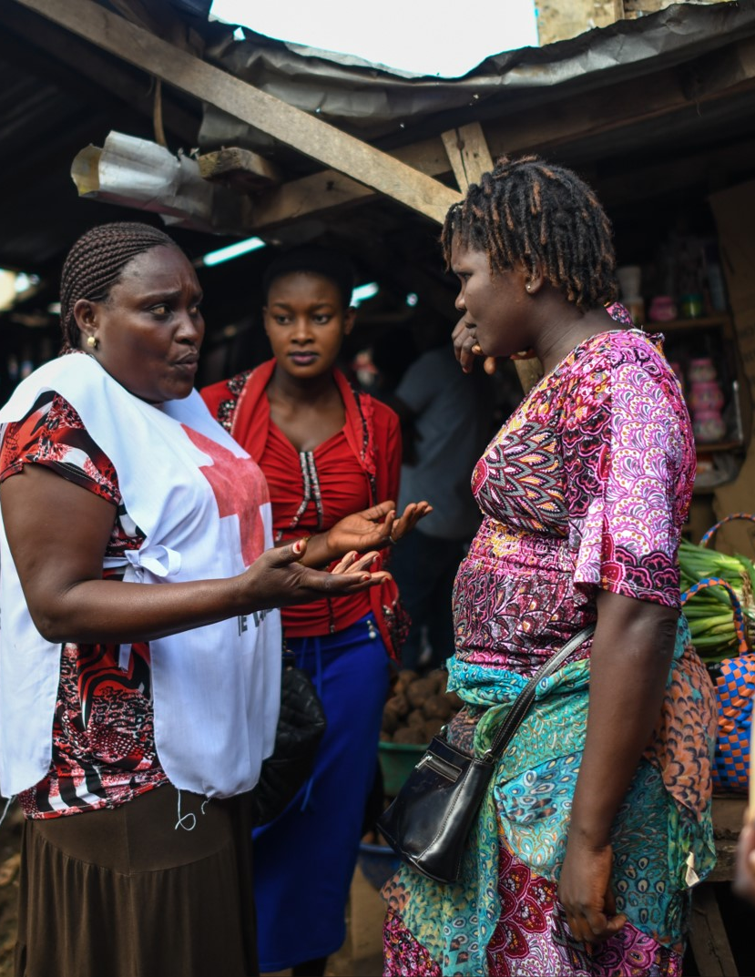
  Inclusive and community-centered approaches can help
  Build Trust and increase vaccine update by:
  Providing actionable timely information, for different people with different needs
  Listening and responding to different group’s beliefs, fears, doubts and hesitancy around COVID-19 vaccines
  Supporting community-led solutions so that different people are included and participate in the vaccination rollout.
Notes:
ZOE
Providing timely, relevant and actionable life-saving information through the most appropriate communication approaches to encourage people to uptake vaccination.
Listening to community feedback to understand the beliefs, fears, rumours, hesitancy around COVID-19 vaccines.
Encouraging behaviour change and take actions to prevent and reduce hesitancy and create vaccination demand.
Strengthening and engaging community-led solutions to ensuring people’s active participation in the vaccination rollout.

Slide 25

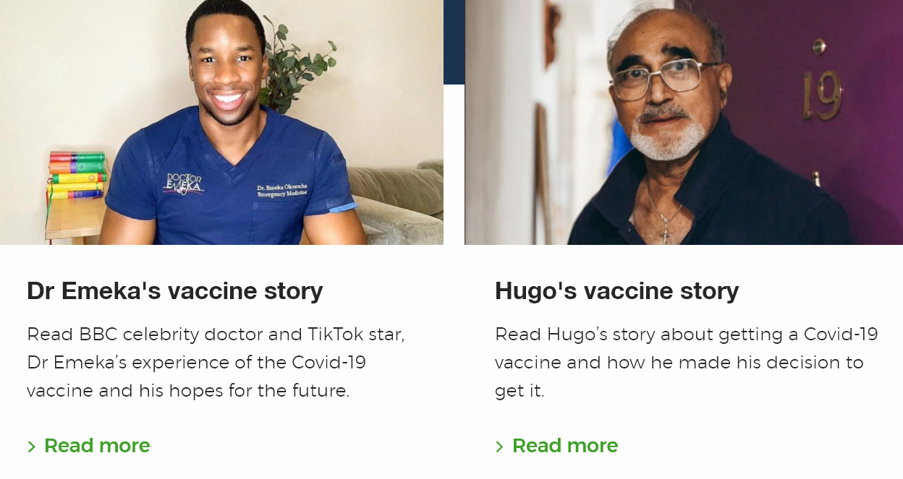
Examples for building vaccine trust
Resources from the British Red Cross
Guidance on having difficult conversations about vaccines. Available here.
Activities to develop ways to manage worries and make informed decisions about COVID-19 vaccines. Available here.
Vaccine Voices: Real stories of people discussing their opinion about the COVID-19 vaccines or their experiences of having one and accompanying activities on managing worries and making decisions.
Notes:
ZOE
There are some great examples of resources to build vaccine trust from the British Red Cross.
They include:
Guidance on having difficult conversations about vaccines which walks you through four steps to prepare yourself: Reflecting on your own feelings and the purpose of the conversation; Considering the other person and the importance of listening and understanding can have; planning the when, how, where, who and what; and finally post-conversation actions and reflections.
https://www.redcross.org.uk/get-help/coronavirus/coronavirus-vaccine/vaccine-voices/how-to-have-a-difficult-conversation-about-vaccines
Activities on the Circle of Control, materials on Making confident decisions (available in English, Arabic, Kurdish and Farsi), and How to Manage your Worries
https://www.redcross.org.uk/get-help/coronavirus/coronavirus-vaccine/vaccine-voices/managing-worries-and-decision-making
Here’s a snippet of one of their videos on making confident decisions (watch from 0:16-40s) https://www.youtube.com/watch?v=b8w_NrRQiCs&feature=emb_logo
The Vaccine Voices Project, which consists of real stories of people discussing their opinion about the Covid-19 vaccines or their experiences of having one and accompanying activities on managing worries and making decisions.
The British Red Cross also just published new research exploring the issue of vaccine hesitancy in the UK, in particular among Black, Asian and Minority Ethnic communities. The data, which highlights vaccine hesitancy is higher in some, but not all, B.A.M.E communities, points to the particular importance of family as a source of information – and misinformation - about the Covid-19 vaccine. They’ve published a corresponding video.
More resources to share with participants in the chat:
British Red Cross materials
Information hub with vaccine materials: https://www.redcross.org.uk/coronavirus-vaccine
How to have difficult conversations: https://www.redcross.org.uk/get-help/coronavirus/coronavirus-vaccine/vaccine-voices/how-to-have-a-difficult-conversation-about-vaccines
Family conversations video: https://www.youtube.com/watch?v=6pLcLqS71PY&feature=emb_logo
Press release about BRC research on vaccine hesitancy in B.A.M.E communities: https://www.redcross.org.uk/about-us/news-and-media/media-centre/press-releases/family-conversations-key-to-increasing-take-up-in-bame-communities-suggests-poll
Managing worries and making confident decisions: https://www.redcross.org.uk/get-help/coronavirus/coronavirus-vaccine/vaccine-voices/managing-worries-and-decision-making
---
Key ingredients reference: https://www.nationalacademies.org/event/12-18-2020/webinar-on-covid-19-vaccine-confidence
Key questions based on scientific research.

Slide 26
Questions?
Thoughts?
Inputs?
Notes:
Nazli
With communities fully engaged and actively participating through the full cycle of planning, delivery and assessment for new biomedical tools, demand for these tools can be increased, leading to widespread and effective uptake and use. The empowerment of people and communities is not an abstract idea and there are concrete and measurable steps that can be taken to ensure citizens are engaged and ready to support new biomedical tools. Though communication needs may be slightly different for each tool, the principles that promote their safe and successful introduction remain the same. The following 10 steps are well established risk communication and community engagement (RCCE) principles that have proven their power. Together, they put communities at the heart of the roll-out of new vaccines, treatments and tests, and promote trust – the critical ingredient for all community action

Slide 27
Thank you!

Slide 28
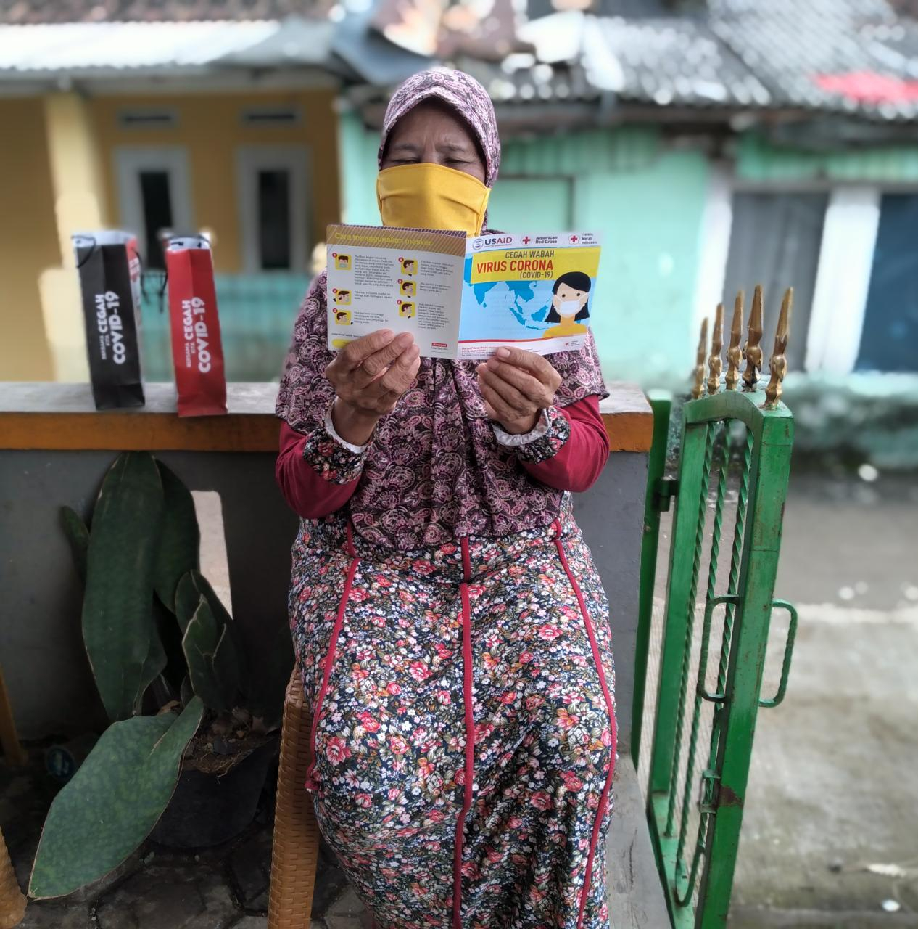
Rapid training:
How to ensure an inclusive
and community-centered
COVID-19 vaccines rollout
Day 2
Welcome back!
We will start shortly, please mute your mics.
Notes:
Monica
So far we have discussed how environmental factors can drive vaccine hesitancy, the perceptions people have of vaccines. Through the scenarios, you have discussed and used some tools to guide you through the planning, delivery and assessment cycle of your vaccine hesitancy campaign.
Now. Not every community is the same, and different people have different needs. Today we will discuss how to ensure an inclusive and community centered plans which are driven by Dignity, Access, Participation and Safety

Slide 29
Learning Objectives
Day 2
By the end of the session, you will understand:
1. Key steps for community readiness
2. How to Ensure Dignity, Access and Safety
3. Bite-sized scenarios
3. How to collect and use vaccines feedback data
4. Available resources
Notes:
Monica
Our aim for today is to walk together through the following steps:
1. Key steps for community readiness
2. How to Ensure Dignity and Safety
3. Bit-sized scenarios
3. How to collect and use vaccines feedback data
4. Available resources

Slide 30

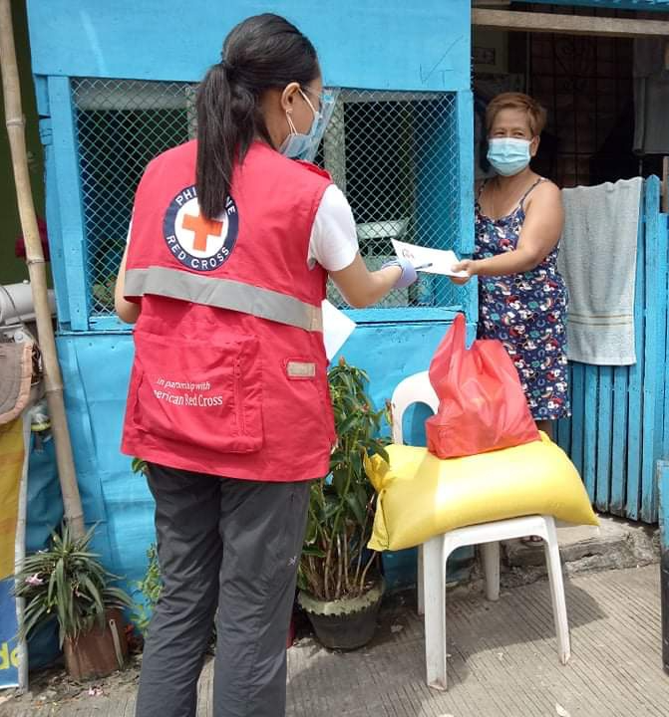
Before starting…
What is the most important thing you remember from yesterday?
Type in the chat box!
Notes:
Monica
Before we get started! What did you takeaway from yesterday’s session?
Facilitator asks participants to write in the chat what is that one single taking point that they considered the most meaningful from previous day training.
It can be anything, a word, a sentence, an example.

Slide 31
How to ensure
Dignity, Access and Safety
during the vaccine roll out
Notes:
Nazli / BRIAN

Slide 32
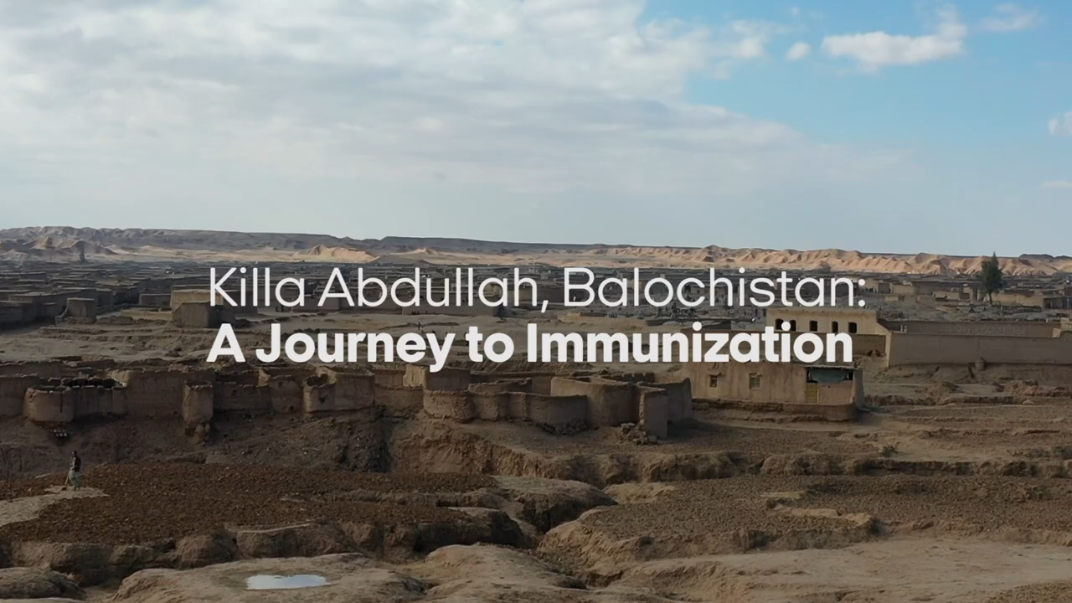
A Journey to Immunization – Balochistan, Pakistan
Notes:
Ask participants to watch this piece of video and write in the chat box (while watching) the key barriers , perceptions, beliefs that this community is facing to uptake vaccines.
Some options:
vaccines are a western propaganda for family planning
Ingredients from vaccines (monkey fat- prohibited in the area)
Females don´t want to be TT injected by male
After secondary effects- they refuse second dose
Some of you might have heard about these misconceptions in your own contexts.

Slide 33
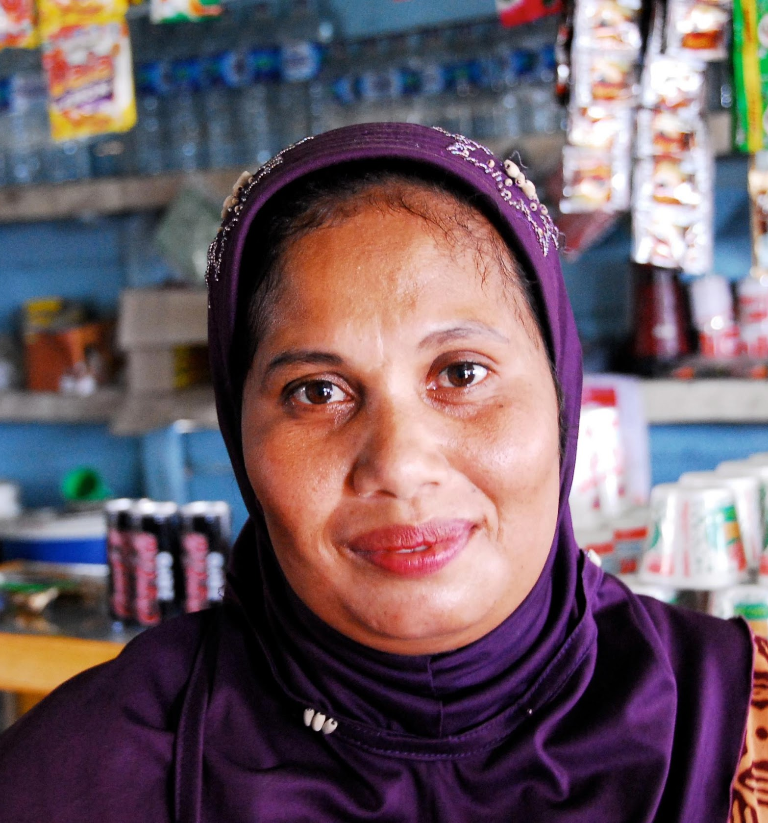
Why do Dignity, Access, Participation and Safety matter?
Four Focus Areas:
Dignity
Access
Participation
Safety
These ensure:
Their rights are respected
They are not left-out
Everyone in the community can actively participate.
People are safe from harm
We understand individual needs and vulnerabilities.
Notes:
Nazli
These focus areas ensure that we keep people safe from harm, that their rights are respected and that they are actively included in decision-making. We do this, by understanding individual needs and individual vulnerabilities. That everyone in the community can participate.

Slide 34
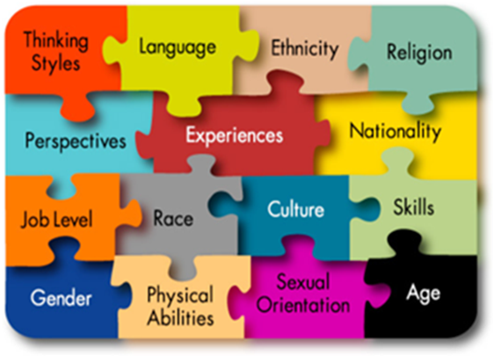
Some barriers to Dignity, Access and Participation are people and systems that discriminate and exclude based on:
Disability
Gender
Income
Age
Ethnicity
Migrant Status
Identified as a Minority
Protection, Gender & Inclusion, when done through the Framework of Dignity, Access and Participation, means, no-one is left behind, no-one is left unsafe, and no-one is left out.
Notes:
Nazli
Disability, gender, being a child or refugee and other characteristics are not vulnerabilities in themselves. These groups are only vulnerable when persons who have the power to protect their rights or deny them, decide to deny them. The responsibility should always be placed on those who violate peoples' rights or protect those who violate them. Placing the onus on these marginalised groups makes it sound like it is almost inevitable that they will be abused or not have access to services or decision-making.

Slide 35
Bite-sized Scenarios
What would you do?
Notes:
BRIAN
BREAKout rooms
Divide participants into 5 rooms. Each one will do an scenario.
10 mins / Room

Slide 36
You will be automatically taken into a breakout room
Decide who will share discussion points with the big group
Read the Scenario
10 mins for discussion
3 mins each group for debriefing
INTERACT, INTERACT, INTERACT!
Notes:
BRIAN- breakouts handling
BREAKout rooms
Divide participants into 5 rooms. Each one will do an scenario.
10 mins / Room
Sending scenarios before?

Slide 37
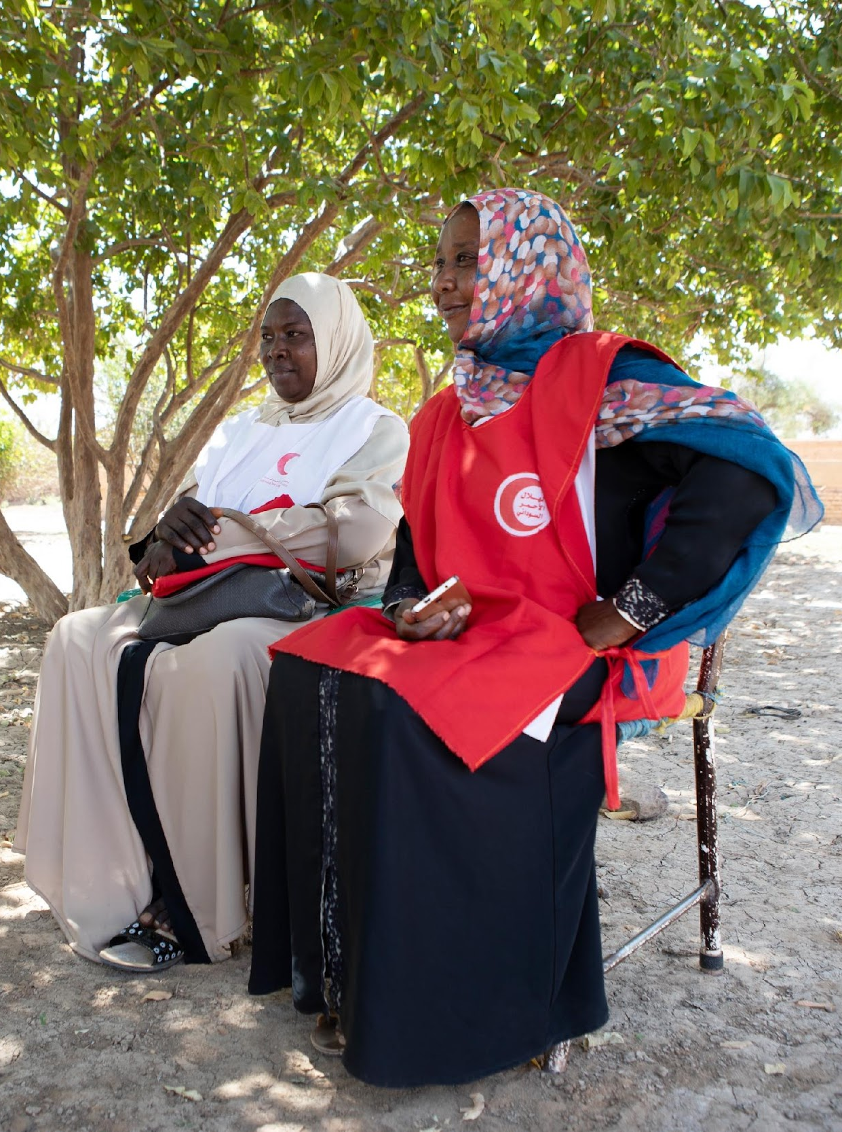
Scenario 6 : Cultural Sensitivity and Diverse Teams
You and your team are hosting a community talk to explain the benefits of immunization. Everyone breaks up into different teams. A female member of your team approaches a male religious leader to engage in a conversation and the community members become upset and agitated because she is speaking to him
TASK: Think about how you or your team can ensure dignity when speaking with communities.
Notes:
S1 Facilitators Answer
Context
Understand why the community is upset by some of the actions that you take, is important to tailor your activities to be sensitive to the needs of the community.
Working with traditional gate keepers such as religious leaders, and especially leaders in women’s groups etc can open doors and inform how you plan and implement your activities
Planning and Design
Have you done a gender and diversity analysis in your assessment? Is this data disaggregated by sex and age and disability? This information will help you plan to have diverse teams, by having as much representation of the community in your teams, you are in a better position to respond to different needs.
Plan to include a feedback mechanism can give you ideas that communities have for improvements and project adjustments
Implementation
Work through community-based formal structures, informal structures, and social networks to address misinformation
This can be gender balanced teams, ethnic groups or speakers of different languages.
Consider already-present community mobilizers (e.g. community health workers) positioned to lead the community engagement process and address misinformation on vaccines

Slide 38
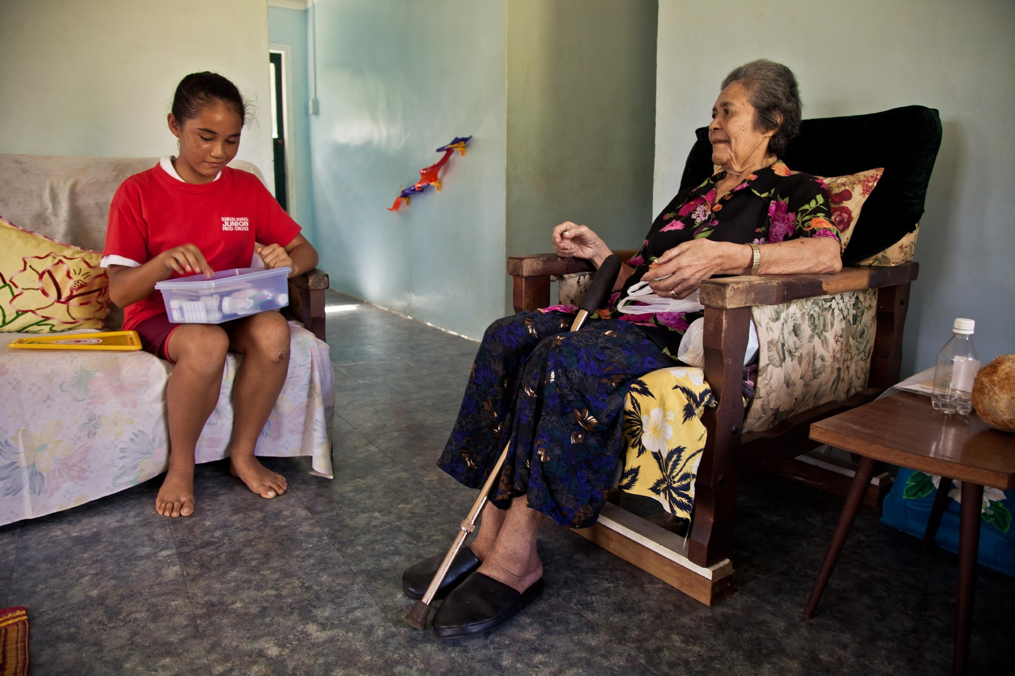
Scenario 7 : Ensuring Dignity and Access
In your community, you know that there are people living with disabilities, you know of a group of adults who are blind that live in a shared space, but you have not seen them when you conduct your vaccine campaign outreach. Your data doesn’t show any feedback from them either.
TASK: What actions can you and your team and the National Society take to ensure persons living with disabilities are engaged?
Notes:
S2 Facilitators Answer
Context
Your needs analysis should inform you of different needs and different demographics within your community. any other potentially vulnerable groups in the community?
Understand how different people, persons with disabilities within a community access information
Planning and Design
Plan to ensure access- this can be through multiple forms of accessible communication, such as text captioning (if you use video), sign language, or translation,.
Provide a tailored approach to meet individual needs, by working with caregivers and support networks
through coordination – understand other partners working with persons with disabilities to ensure dignity and access when conducting your activities.
Implementation
Work through community-based formal structures, informal structures, and social networks to address misinformation
Consider already-present community mobilizers (e.g. community health workers) positioned to lead the community engagement process and address misinformation on vaccines

Slide 39
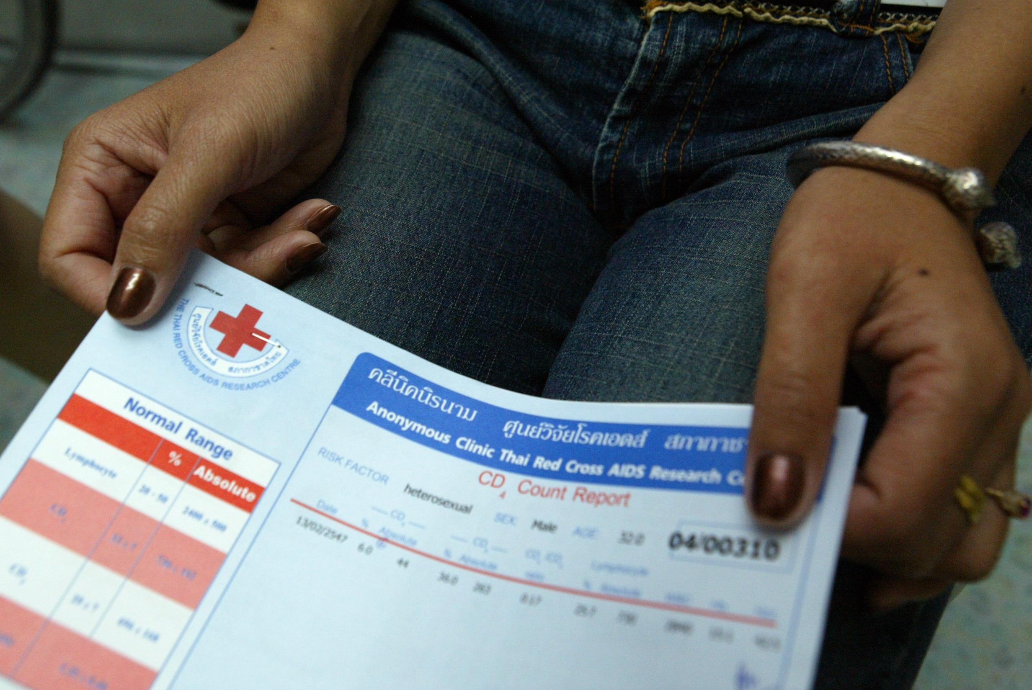
Scenario 8: Protection, Safety
A rumor is spreading that male health workers demand sexual favors for the vaccine, masks and other hygiene products. Some members of the community are worried about speaking with you and your teams about the vaccine for fear they may be forced into these acts.
Task: Discuss the actions you would take to Prevent Sexual Exploitation and Abuse and build trust
Notes:
S3 Facilitators Answer
Context
No matter what we do, when we represent the IFRC, our primary goal is to Do No Harm. Preventing Sexual Exploitation and Abuse (PSEA) is a shared responsibility.
You will need to understand why this misinformation is occurring and plan to address it. It is not your role to investigate, but if there are instances of SEA, consult with SGBV experts and specialists
Our actions and behaviour impact how communities are likely to trust us.
Planning and Design
If possible, ensure you and your teams are aware of the PSEA Policy, revisit the IFRC Code of Conduct
Consider already-present mechanisms to report SEA, you do not have to create something new, ask someone in your National Society what the procedure is
Implementation
Feedback mechanisms for SEA are extremely important here, you and your team should know and inform community members of the feedback mechanisms that exists, that they are safe and confidential.
Inform community members of complaint mechanisms and referral mechanisms for Preventing Sexual Exploitation and Abuse and Safeguarding Children from Violence as well as any other safety procedures in place,
Learning
It is vital to engage from the outset with local women's associations and others who promote rights of marginalized groups,

Slide 40
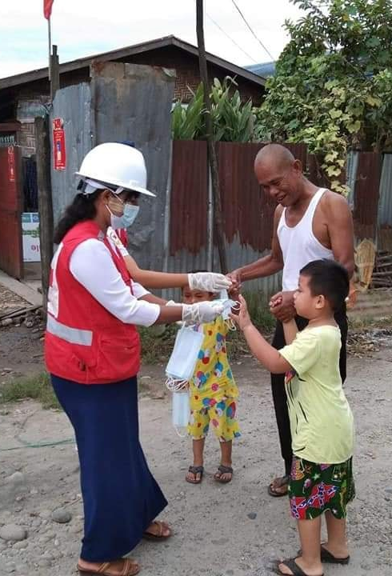
Scenario 9: Protection Risks
During one of your COVID-19 immunization campaign activities in one remote community area, you identify unaccompanied children who do not want to be engaged with RCRC Volunteers or staff because of a lack of trust. Your activities right now are targeted at adults, but this is a concern that you should pay attention to.
Task: Can you think of other situations in which members of the community might not feel safe or want to engage with you? How do you ensure the community trusts you?
Notes:
S4 Facilitators Answer
Context
It is important to know that while you are focusing on vaccine hesitancy, there are other pressures and concerns that may prevent members of the community from engaging with you and trusting you. Some communities are not a part of national strategies and may be facing different pressures related to rumors and hesitancy around the vaccine.
It is possible that even though you have prepared your messaging and plan for adults, that there may be young adults, older people and other members of the community who might not understand what you are doing.
Consult with relevant experts on child protection, SGBV, PSEA on how to refer risks if they arise
What do you do? Work with local child rights agencies to determine key messaging and ways to reach children, even though they won't get the vaccine they still require information.
Planning and Design
Ensure all personnel have signed and been briefed on the IFRC or local NS child safeguarding policy and identify PGI or Child Protection staff for additional support. Are you familiar with these policies?
Working with other colleagues can help you identify potential risks for different people in the community;
Plan to have messages about your activities for everyone in the community. Plan to include a feedback mechanism structured to facilitate comprehensive information flow that includes information on what is working in the project, what ideas communities have for improvements and project adjustments, current knowledge, attitudes and practices and reporting of rumours
Learning
Building trust with the community requires knowing who is in the community! And informing them what is happening!
We can always review the policies that matter to our work to ensure that we, and the comm unities we serve are safe.
Have a plan for disseminating and sharing the findings of learning with communities, government, donors and other partners and stakeholders to stop the spread of misinformation

Slide 41
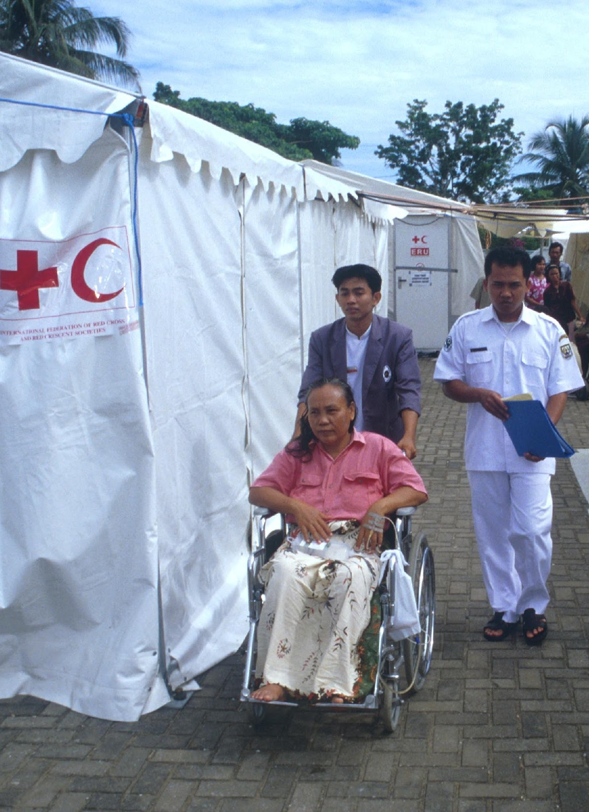
Ensuring Dignity & Safety
Being sensitized on how to communicate respectfully
Equal access to vaccines - different tools/means
Non- technical and understandable information. Getting informed consent.
Privacy and diversity & organizing teams, facilities, tools etc.
Storing data in confidentiality & data protection
Notes:
Scenario Recap:
Ensuring dignity access, safety and participation are core to the DAPS approach in PGI. The scenarios you just practiced aim to show you that there are key considerations you can take to make your activities sensitive to the needs of different people.
Here is a recap:
Ensure that your activities are accessible for persons with mobility limitations, and accessible in the language and tools that you use.
Ensure to engage community groups, women’s groups, people with disabilities, men’s groups, religious groups etc. They can inform you on how to make your communication sensitive to the needs of different individuals and help you build trust.
Where relevant, ensure that your teams are as balanced and representative of the communities you are working with,.
Have gender-split areas for engagement and if necessary, waiting areas, entrance if context requires
Ensure privacy as much as possible –locked rooms for toilets if available etc.
It is important to have culturally appropriate spaces, consult communities for the most appropriate configuration

Slide 42



Ensuring Safety for volunteers and communities
  Code of Conduct, PSEA (Prevention of Sexual Exploitation and Abuse), Child Safeguarding and other policies
  A feedback and complaint system
  Developing and dissemination service mapping
  Having referral mechanism in place
  Ask support from PG focal points
Notes:
Brian/Nazli
It is important to know what the limits are of your ability to help, but you can always find ways to seek additional support,
Identify existing service providers, actors, focal points within your National Society, Region, or Country, and ensure the people we serve, and volunteers know what these mechanisms are and that they are confidential
Remember to review the policies in place! This is always a good reminder to have

Slide 43
How to collect and use
vaccines perceptions & feedback data
Notes:
Rachel
Active methods may be necessary if the elve of trust is not high.

Slide 44
QUICK POLL
What are your key questions about COVID-19 vaccines?
Notes:
VIV
Ask participants to fill the poll in 2 minutes
Then read loud the results indicating and highlighting if there are a lot of differences or harmonized answers, etc
The poll contains questions that volunteers may be asking themselves to community.
POLL has 5 questions:
If a COVID-19 vaccine were recommended to you, would you get it?
[1] Yes
[2] No
[3] Unsure
How much would you trust the new Covid-19 vaccine if it were available for you now?
[1] Not at all
[2] A little
[3] Moderately
[4] Very much
How safe do you think a COVID-19 vaccine will be for you? Would you say…
[1] Not at all safe
[2] A little safe
[3] Moderately safe
[4] Very safe
How comfortable are you having conversations with community members about vaccinations related to COVID-19?
[1] Very comfortable
[2] Somewhat comfortable
[3] Not comfortable
In your opinion, do you think communities you work/live in would get a Covid-19 vaccine, if it is recommended to them?
[1] Yes – the majority would get vaccinated
[2] Yes – many would get vaccinated
[3] Only a few people would get vaccinated
[4] No – the majority would not get vaccinated

Slide 45
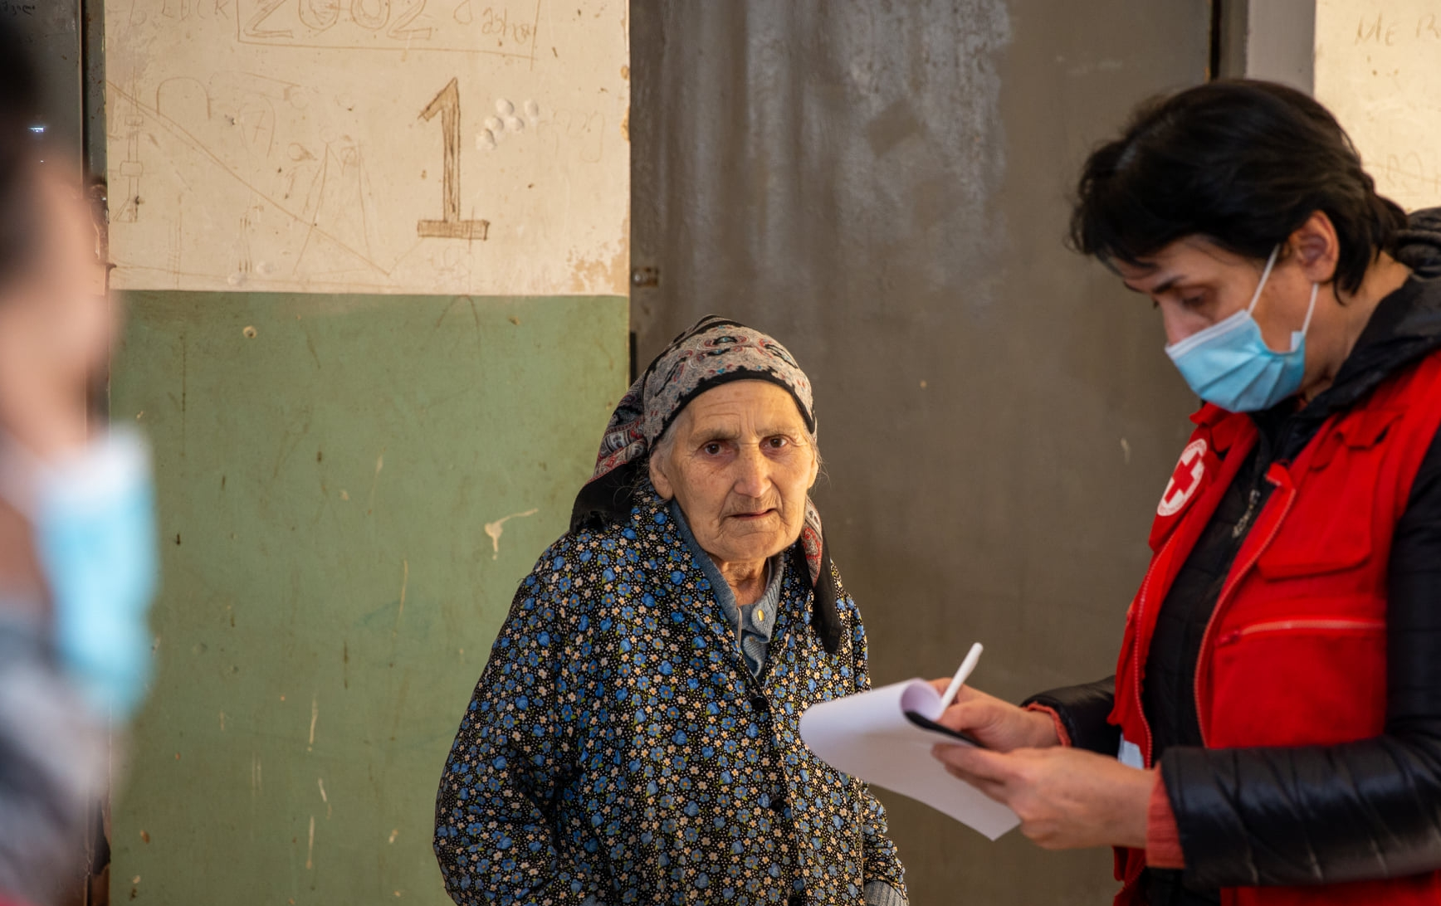
from
Data
to
Information
Notes:
Rachel
Data transformed to information

Slide 46
Levels of disaggregated analysis
Sociocultural or
economic variables
Where the real insights happen
Level 4
Level 3
Age
Minimum standards in Red Cross Red Crescent
(with disability)
Level 2
Gender
Basic unit of reporting
Level 1
Individual
Notes:
Levels of analysis

Slide 47
Why does disaggregation matter? Example
Keep asking why.
Be curious!
Investigate!
Gender
850 (47%) are girls
My reporting obligation is done, and project was successful!
Individual
1800 children going to school
+10% increase from last year
Level 1
Example remixed from real-life projects implemented by iDMC in Sudan, and TRCS in Turkey, both in displaced populations.
Notes:
Rachel
1. Examples: Austrian Red Cross, Americas Region
In conjunction with FGDs.
2. Examples: Democratic Republic of the Congo, Cameroon, Sierra Leone
3. Examples: Nepal, Peru, Venezuela
These are just examples – the point is to choose with purpose and intention the data you collect – know why you’re collecting it before you start.
What will it be used for, how long will it take to analyze, do you have a decision or plan or monitoring goal? If not, take a step back.

Slide 48
Why does disaggregation matter? Example
Keep asking why.
Be curious!
Investigate!
Girls going to school more when younger, but boys going to school when older
1800 children going to school
This is a pretty equal split, great job – I’m done!
Level 2
Gender
950 (53%) are boys
850 (47%) are girls
My reporting obligation is done, and project was successful!
Individual
1800 children going to school
+10% increase from last year
Level 1
Example remixed from real-life projects implemented by iDMC in Sudan, and TRCS in Turkey, both in displaced populations.
Notes:
Rachel
1. Examples: Austrian Red Cross, Americas Region
In conjunction with FGDs.
2. Examples: Democratic Republic of the Congo, Cameroon, Sierra Leone
3. Examples: Nepal, Peru, Venezuela
These are just examples – the point is to choose with purpose and intention the data you collect – know why you’re collecting it before you start.
What will it be used for, how long will it take to analyze, do you have a decision or plan or monitoring goal? If not, take a step back.

Slide 49
Why does disaggregation matter? Example
Keep asking why.
Be curious!
Investigate!
950 boys
850 girls
Girls are dropping out of school. Let’s focus on girls.
Level 3
Age
Girls going to school more when younger, but boys going to school when older
1800 children going to school
This is a pretty equal split, great job – I’m done!
Level 2
Gender
950 (53%) are boys
850 (47%) are girls
My reporting obligation is done, and project was successful!
Individual
1800 children going to school
+10% increase from last year
Level 1
Example remixed from real-life projects implemented by iDMC in Sudan, and TRCS in Turkey, both in displaced populations.
Notes:
Rachel
1. Examples: Austrian Red Cross, Americas Region
In conjunction with FGDs.
2. Examples: Democratic Republic of the Congo, Cameroon, Sierra Leone
3. Examples: Nepal, Peru, Venezuela
These are just examples – the point is to choose with purpose and intention the data you collect – know why you’re collecting it before you start.
What will it be used for, how long will it take to analyze, do you have a decision or plan or monitoring goal? If not, take a step back.

Slide 50
Why does disaggregation matter? Example
Keep asking why.
Be curious!
Investigate!
Sociocultural or
economic variables
Families are making economics-based decisions for their children. Gender matters, but so does income. Now I can plan my targeted intervention.
Level 4
Impoverished boys are dropping out more than wealthier boys, just not as much as girls.
950 boys
850 girls
Girls are dropping out of school. Let’s focus on girls.
Level 3
Age
Girls going to school more when younger, but boys going to school when older
1800 children going to school
This is a pretty equal split, great job – I’m done!
Level 2
Gender
950 (53%) are boys
850 (47%) are girls
My reporting obligation is done, and project was successful!
Individual
1800 children going to school
+10% increase from last year
Level 1
Example remixed from real-life projects implemented by iDMC in Sudan, and TRCS in Turkey, both in displaced populations.
Notes:
Rachel
1. Examples: Austrian Red Cross, Americas Region
In conjunction with FGDs.
2. Examples: Democratic Republic of the Congo, Cameroon, Sierra Leone
3. Examples: Nepal, Peru, Venezuela
These are just examples – the point is to choose with purpose and intention the data you collect – know why you’re collecting it before you start.
What will it be used for, how long will it take to analyze, do you have a decision or plan or monitoring goal? If not, take a step back.

Slide 51
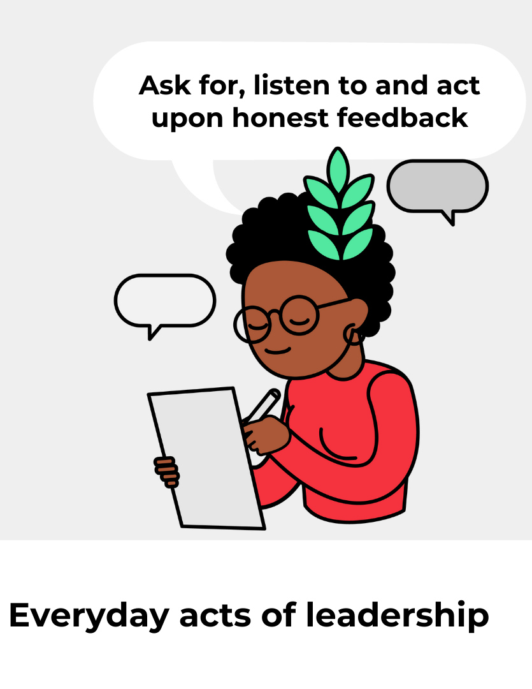
Where to Start
  Be data ready! — Most countries already have data on this topic.
    The biggest challenge is sifting through the data available for what helps you implement your National Society’s plan in your communities.
  Be prepared! — Vaccination perceptions will change rapidly.
    Identify your secondary data sources now so you can monitor
    If collecting your own data, think about what you’ll need to know 2-6 months from now, data collection and analysis takes time.
  Know your goals! — What do you really need to know?
    Be strategic in planning where and how you collect data.
      Don’t collect what you won’t use.
      Where is your National Society’s added value?
      A national survey is great, but a smaller deep dives into communities with specific needs could be more insightful.
Notes:
Rachel

Slide 52






Planning your data-driven approach
  Include data collection into existing plans and activities
    Planning information campaigns?
      A snapshot perception survey could be useful to inform your approach.
    Implementing ECV programmes or social mobilization activities?
      A perceptions survey can help identify misinformation trends or populations with lower trust.
      A systematic feedback mechanism can help document and address the beliefs and questions in the communities where you work.
    Operating a hotline or messaging channel?
      A feedback mechanism can help track trends over time and prepare useful content.
Notes:
Rachel
1. Examples: Austrian Red Cross, Americas Region
In conjunction with FGDs.
2. Examples: Democratic Republic of the Congo, Cameroon, Sierra Leone
3. Examples: Nepal, Peru, Venezuela

Slide 53
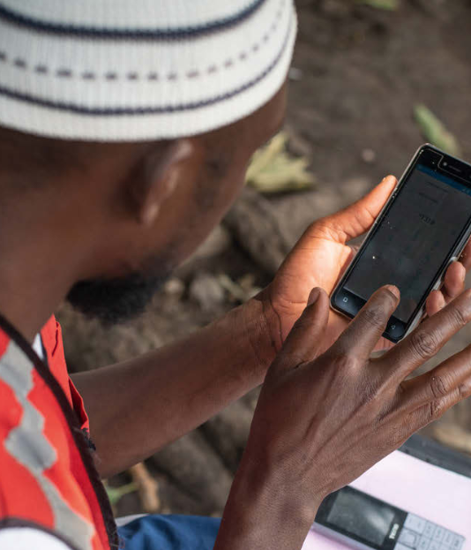
Vaccine Perception Surveys
  Scope (where and why)
    Define your locations and populations
    What are you trying to find out? What’s your research question?
  Sample (who)
    Set targets for sex, age, disability.
    What other gaps in access might exist?
  Methodology (how)
    Web survey: cheaper and faster, but less control of sample, excludes some people
    Face-to-face: more time and costs, but better interactions and control of sample
    Phone survey: good middle ground, but difficult to get phone numbers
Notes:
Rachel
Language, urbanicity, ethnicity, conflict areas, income, education, legal status, etc.
Methodology (how)
Web survey: cheaper and faster, but less control of sample
Face-to-face: more time and costs, but better interactions and control of sample
Phone survey: good middle ground, but difficult to obtain phone numbers of non-beneficiaries and requires more training and costs

Slide 54

    Behavior change framework
    RCCE Core Questions & Indicators
    Recommended survey questions on vaccine uptake & hesitancy
    Vaccine FAQ for staff and volunteers
    COVID-19 Community feedback kit
Setting up a feedback mechanism
Collection of community feedback
Coding of community feedback
Analysis of community feedback & reporting
Translating community feedback into action
Manual
Notes:
Rachel
https://communityengagementhub.org/resource/ifrc-covid-19-community-feedback-package/
Tools and guidance to set up mechanisms for systematically listening and responding to communities in our response to COVID-19. Contains short manual!

Slide 55
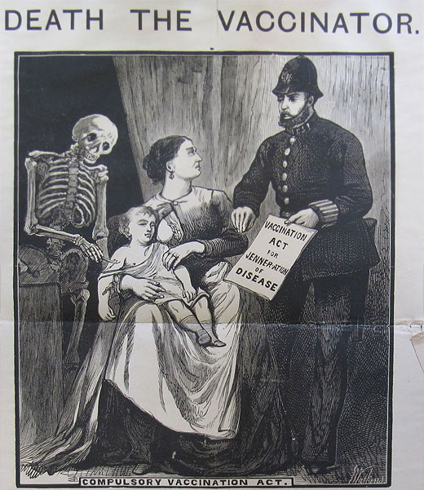
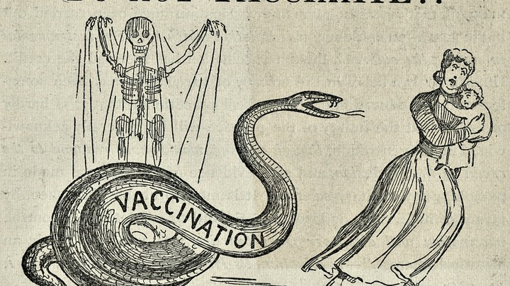
“Vaccine hesitancy is as old as vaccination itself.”
– UNICEF Vaccine Misinformation Field Guide

Slide 56
Key steps for community readiness
Notes:
SUSHAMA
With communities fully engaged and actively participating through the full cycle of planning, delivery and assessment for new biomedical tools, demand for these tools can be increased, leading to widespread and effective uptake and use. The empowerment of people and communities is not an abstract idea and there are concrete and measurable steps that can be taken to ensure citizens are engaged and ready to support new biomedical tools. Though communication needs may be slightly different for each tool, the principles that promote their safe and successful introduction remain the same. The following 10 steps are well established risk communication and community engagement (RCCE) principles that have proven their power. Together, they put communities at the heart of the roll-out of new vaccines, treatments and tests, and promote trust – the critical ingredient for all community action

Slide 57
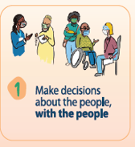
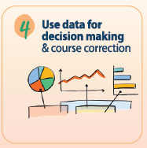
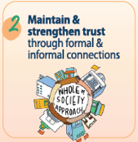
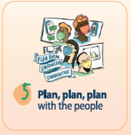
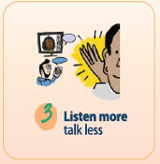
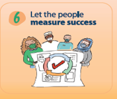
Understanding the drivers of behaviour is critical to understand why people practices or not public health and social measures.
People are more likely to take action if they are involved in decision-making.
Coordinate with others. A whole-of-society approach works best.
Community participation in planning can improve services.
Regularly seek out and respond to feedback from communities.
Community participation in monitoring and evaluation supports programme sustainability, joint accountability and best use of resources.
Notes:
SUSHAMA
STEP 1 MAKE DECISIONs ABOUTTHE PEOPLE, WITH THE PEOPLE People are more likely to take action if they are involved in decisionmaking. Engage communities early and work to involve, collaborate and empower them. Leave no community behind. Initiate discussions with communities to understand sociocultural contexts and power dynamics. Map networks and influencers in the community. g Identify what type of engagement interventions are safe, feasible and acceptable.
STEP 2: Activate or strengthen RCCE coordination mechanisms and use existing health and response structures to support health system readiness at all levels. Ensure representation of civil society and vulnerable groups. Work closely with other committees and advisory groups such as the National Immunization Advisory Group. g Launch or strengthen an independent national “alliance” of influencers and stakeholders who can listen, advocate, educate, address rumours and misinformation, and build vaccine and health literacy.
STEP 3: g Establish community feedback mechanisms to promote accountability and ensure that community beliefs, questions, concerns and suggestions are heard. g Guide the continuous adaptation of the COVID-19 response in an effective, agile, safe and confidential manner.
STEP 4: g Include community feedback, social listening, polling and survey data to best understand community knowledge gaps, perceptions and behaviours. g Use this knowledge to inform decision making at all levels.
STEP 5: g Ensure communities are involved in co-designing solutions. g Use social data analysis to develop and regularly review and update RCCE action plans. g Crisis communication preparedness plans should be developed as part of this process
STEP 6: Promote community participation in developing the monitoring and evaluation process. Include civil society and community groups in monitoring, reporting and joint accountability efforts to increase the likelihood of broad community uptake and responsibility for new interventions.

Slide 58


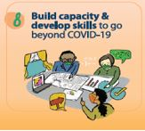
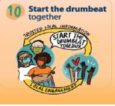
CEA experts can support national authorities in making informed decisions to prepare and protect the health of individuals and the community.
An infodemic means there is too much information – good or bad – that makes it difficult for people to make decisions for their health.
Consistent two-way engagement supported by information from locally trusted channels reinforces positive perceptions and drives action.
Training of the community health workforce allows issues to be solved locally.
Source: 10 Steps for Community Readiness, RCCE Collective Service, 2021.
Notes:
SUSHAMA
STEP 7:g Carefully map where RCCE expertise is needed and recruit immediately. g Establish RCCE leadership at all levels with the necessary authority to coordinate partners. g If not already established, introduce and enforce Standard Operating Procedures (SOPs) for RCCE as a central coordination and quality assurance tool.
STEP 8: Training of the community health workforce allows local issues to be solved locally. Include frontline workers, volunteers, community leaders and community/social mobilizers from civil society organizations, faith-based organizations, local women and youth groups in capacity-building events for long-term sustainability.
STEP 9: Ensure access to trusted information and effectively manage misinformation and rumours. g Activate or strengthen national factchecking and rumour-monitoring capacity recognizing, that rumours and misinformation can be as dangerous as COVID-19.
STEP 10: Establish and agree on priority communication channels with communities as soon as possible. g Where possible, adapt science and health messaging to new contexts with communities.

Slide 59
Tools & Resources
Notes:
ZOE

Slide 60
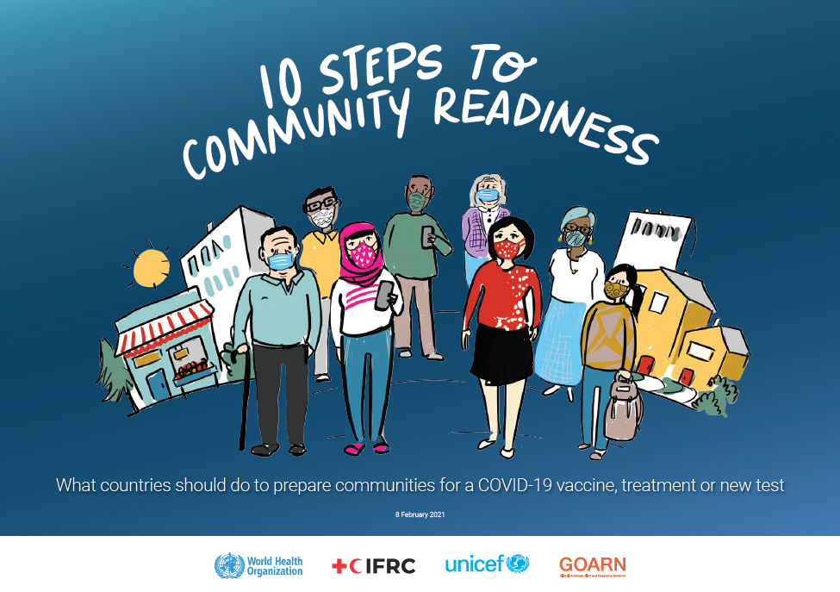
Notes:
SUSHAMA
WHY THESE STEPS ARE IMPORTANT?
With communities fully engaged and actively participating through the full cycle of planning, delivery and assessment for new biomedical tools, demand for these tools can be increased, leading to widespread and effective uptake and use. The empowerment of people and communities is not an abstract idea and there are concrete and measurable steps that can be taken to ensure citizens are engaged and ready to support new biomedical tools. Though communication needs may be slightly different for each tool, the principles that promote their safe and successful introduction remain the same. The following 10 steps are well established risk communication and community engagement (RCCE) principles that have proven their power. Together, they put communities at the heart of the roll-out of new vaccines, treatments and tests, and promote trust – the critical ingredient for all community action
Investments in community engagement and empowerment strategies are not yet sufficient to ensure equitable role out and maintenance of trust
STEP 1- Making decisions about the people with the people starting collaboration as early as possible. Critical step before starting, engage influencers. Is about making decisions together.
STEP 2: Building and maintaining trust through a wide set of stakeholders and as local as possible. This is paramount and a key lesson learned during pandemic: in countries with strong coordination between policy makers, business leaders, grass root orgs and religious leaders, we see that responses are stronger. National alliances, from diverse areas of society. TV, MEDIA, Women groups, youth etc.
STEP 3: Listen more, talk less. This is the golden step, fully established feedback loops are efficient and evidence tell us that we know this builds trust and importance linkages between communities and health systems
STEP 4; Being data-led is an important step to ensure strategies are target and measurable. Social data gives perspective of community ino gaps, perception and behaviors. Social Listening, Feedback , Perceptions, to inform better decision making
STEP 5: Planning: not making decisions for people without the people. Thi cna improve services that will be more equitable. How?
STEP 6: Sustaining programme sustainability. Joint accountability works best.
STEP 7: WE need to map CEA expertise and need, recruit immediately with regards to introduction of vaccines or other treatments and diagnostics. Authority to coordinate the RCCE coordination groups. This has been seen in Ebola. We need to create SOPS for central coordination ensurance tool
STEP 8: build capacity, train community actors including volunteers, community leaders, long-lasting skills and introduce continued peer to peer support.
STEP 9: Managing infodemic ; new challenge and lot of work to catch up to set mechanisms in place and how to address rumours and build resilience.
STEP 10: Start the drumbeat. Ensure we have trusted local messaging and as much participation as possible!

Slide 61

VACCINE RESOURCES PACK
Notes:
ZOE
https://preparecenter.org/toolkit/healthhelpdesk/vaccination-against-covid-19

Slide 62
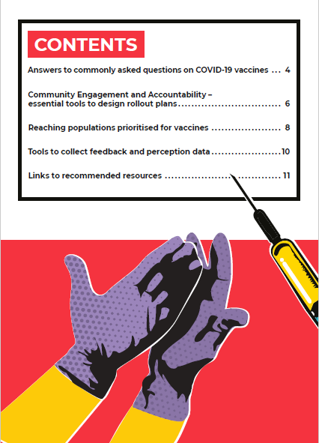
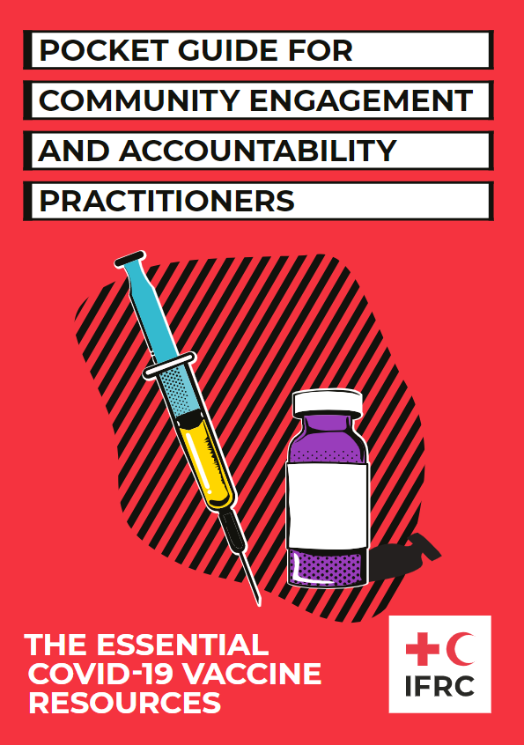
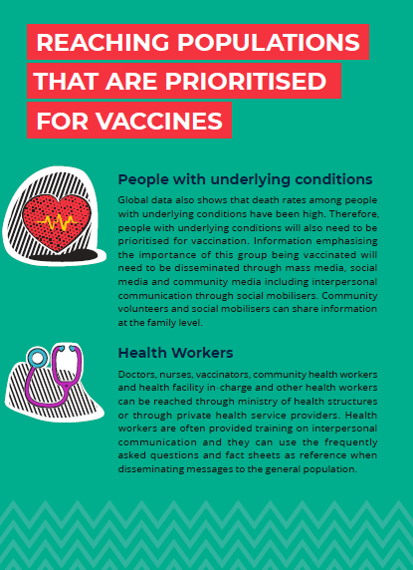
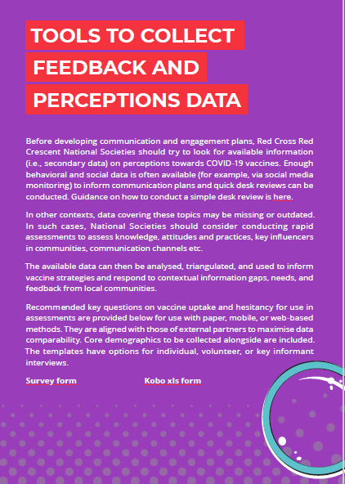
TOOLS FOR COVID-19 VACCINES
Notes:
ZOE
https://communityengagementhub.org/resource/pocket-guide-for-community-engagement-and-accountability-practitioners/

Slide 63
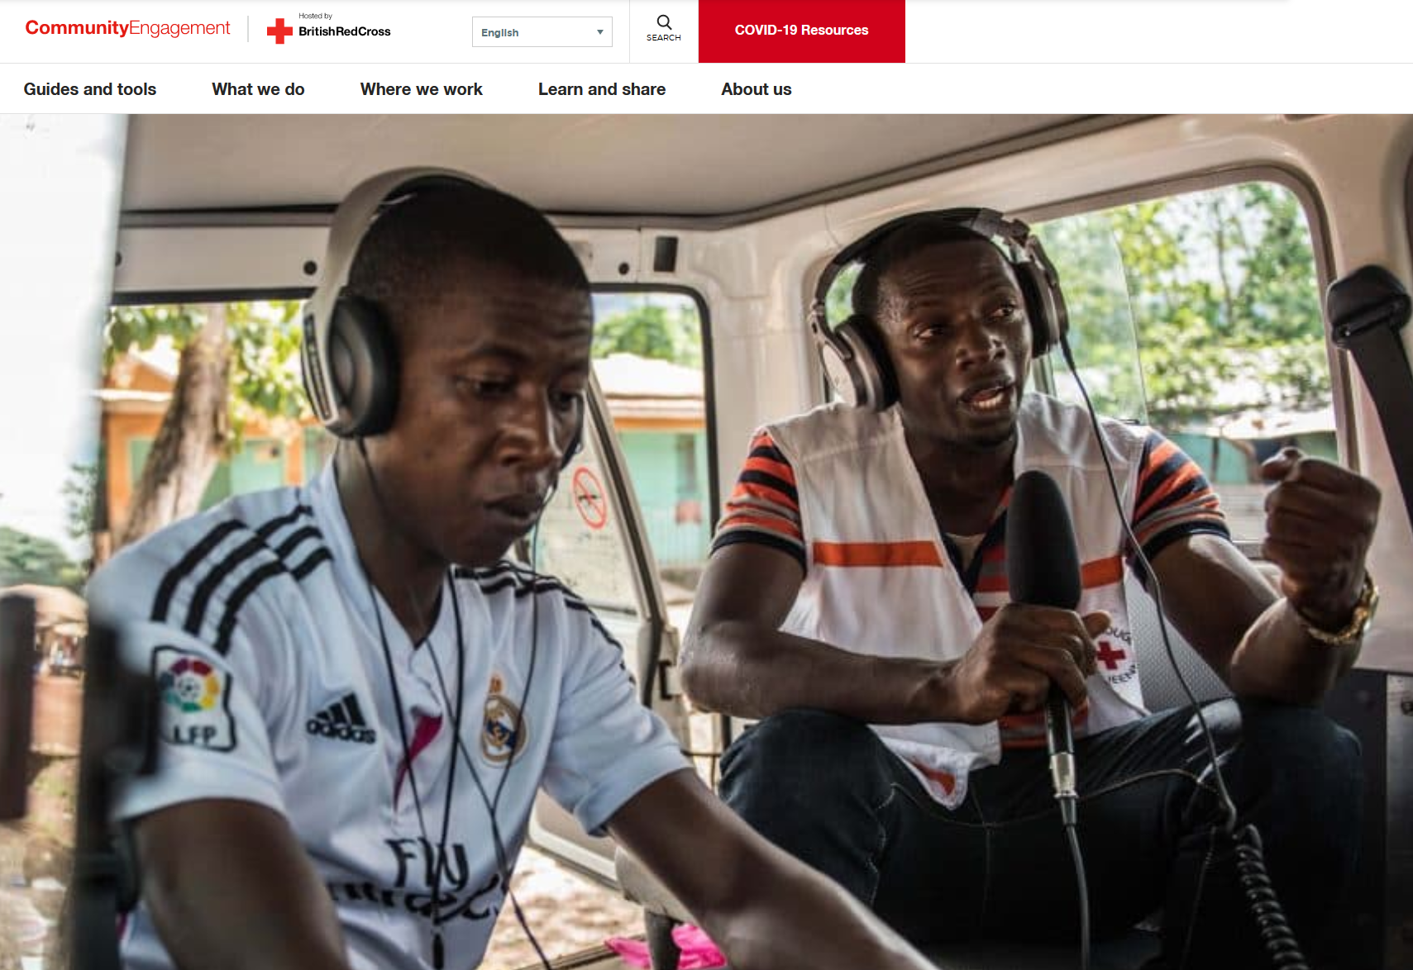


COVID-19 Response - Protection, Gender & Inclusion:
How to consider PGI in the response to COVID-19: https://bit.ly/3dfhXYN
Recommended PSEA actions how to handle & refer sensitive/violent comments received through feedback mechanisms
Your one stop shops:
CEA Hub: https://communityengagementhub.org/
PGI Resource Library: https://bit.ly/3dkJmIA

Slide 64
More resources:
IFRC COVID-19 Compendium: https://preparecenter.org/toolkit/healthhelpdesk/vaccination-against-covid-19/
FAQs: https://preparecenter.org/toolkit/healthhelpdesk/health-help-desk-faqs/#___Vaccination_against_COVID19__
Guidance for vaccine introduction and involvement in clinical trials: https://preparecenter.org/resource/ifrc-guidance-introduction-of-covid-19-vaccines/
COVID-19 Community Feedback Kit: https://communityengagementhub.org/resource/covid-19-community-feedback-kit/
PGI considerations COVID-19: https://media.ifrc.org/ifrc/wp-content/uploads/sites/5/2020/03/Technical-guidance-note-for-PGI-and-health-staff-30March20.pdf
Migration: PRACTICAL GUIDANCE FOR RISK COMMUNICATION AND COMMUNITY ENGAGEMENT (RCCE) for Refugees, Internally Displaced Persons (IDPs), Migrants, and Host Communities Particularly Vulnerable to COVID-19 Pandemic,
Migration: IFRC resource compendium COVID-19, section Migration, Displacement and Detention
Migration Report: Locked down and left out? Why access to basic services for migrants is critical to our COVID-19 response and recovery

Slide 65
Questions?
Thoughts?
Inputs?
Notes:
Monica

Slide 66

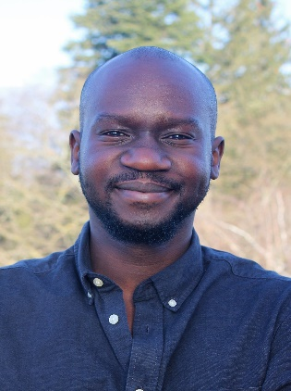

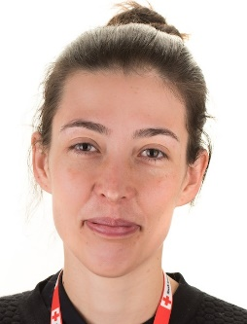

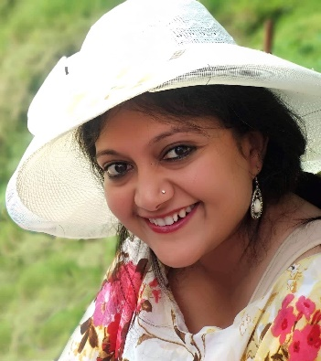
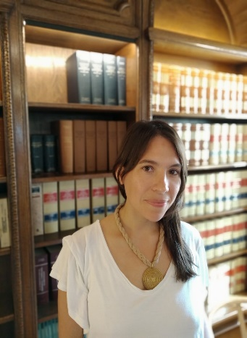



Thank you!
Rachel Yales, Information Management ,
Sr Officer, PGI and CEA, GVA
rachel.yales@ifrc.org
Brian Edward Diah, PGI Officer, GVA
brian.diah@ifrc.org
Nazli Merve Erkan, PGI Coordinator, GVA
pgi.covid@ifrc.org
Zoë Robert, CEA Regional Delegate, Europe
zoe.robert@ifrc.org
Viviane L. Fluck, PhD, CEA Coordinator, Asia Pacific, Viviane.fluck@ifrc.org
Sushama Pandey , CEA Consultant, Asia Pacific
sushama.pandey@ifrc.org
Mónica Posada, CEA Coordinator, GVA
Monica.posada@ifrc.org
Matheus Bizarria, CEA Delegate, Africa
Matheus.bizzaria@ifrc.org
Diana Medina, CEA Advisor, GVA
Caroline.Austin@ifrc.org
Stefania Tranfo, Programe Officer, Migration and CEA, GVA
stefania.tranfo@ifrc.org

