Slide 1

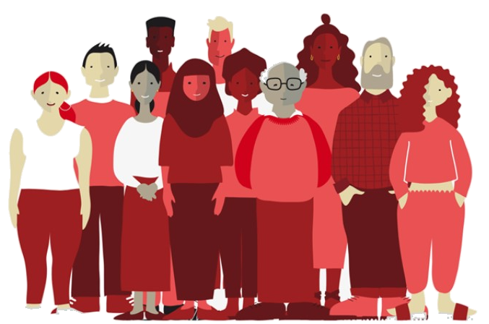
Safe Involvement Guidance

Slide 2




What is the Safe Involvement Guidance?
Representatives from the Stories, VOICES, Psychosocial & Mental Health, and Co-Production teams have co-created this Safe Involvement Guidance to ensure all BRC teams do no harm when amplifying the voices and stories of people with lived experience (PWLE).
This could be a staff member, volunteer, person accessing our services, VOICES Ambassador and/or community member. Remember: everyone has lived experience. It's important that we are specific about which people and communities have relevant lived experiences to our work, in line with our strategic mission to work with people with the greatest unmet or urgent need.
Who does it apply to and when should it be used? Some examples include:
£
When involving PWLE in
Communications
e.g. speaking at conferences, engaging in media interviews, sharing stories with BRC, social media etc
When involving PWLE in
Advocacy
e.g. research, public affairs and policy activities
When involving PWLE in
Fundraising
e.g. major donor events, donor communications etc
When involving PWLE in
Shaping our services
e.g. gathering feedback about service design or co-delivering training
Why is this guidance needed?
We are aware that there is an increasing demand within BRC to involve people with lived experience in our work,, and there is currently no framework or process to support this need proactively and safely. This means there are risks of people being retraumatised through being asked to share their story with us. This is potentially dangerous, reputationally risky and harms relationships and trust.
Note This document is under consistent review and iteration. If you are using it, please contact coproduction@redcross.org.uk

Slide 3
Safe involvement guidance: framework
The safe involvement framework is composed of the below five basic principles. Further detail on each principle is provided in the following pages.
If you can’t commit to any of the requirements detailed within these five principles, you need to consider alternative ways to achieve the aims
of your project.
5. Share power
1. Clarify influence & impact
4. Value their contribution
2. Create the conditions
3. Establish consent

Slide 4
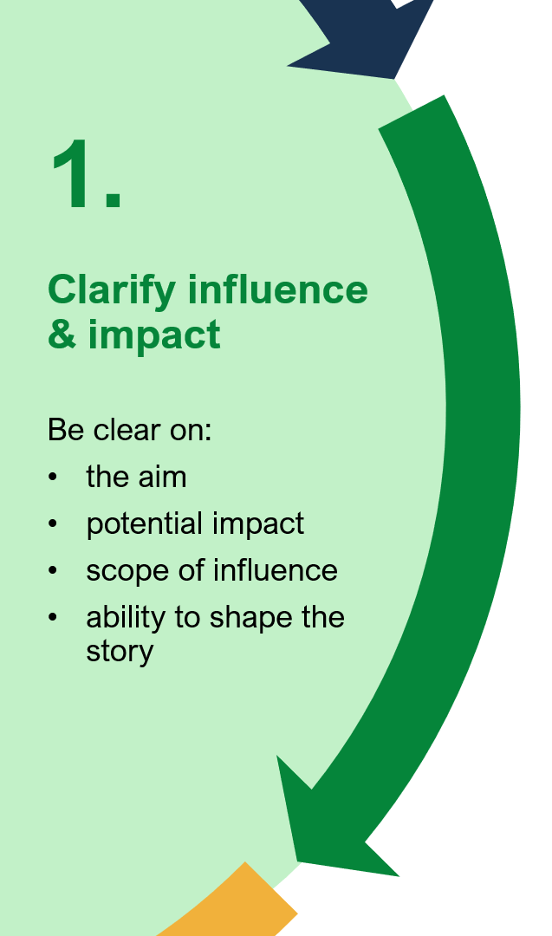





1.
Clarify influence & impact
What is the context of the involvement?
What positive change may happen as a result of people sharing their story or using their voice?
Be clear on:
the aim
potential impact
scope of influence
ability to shape their voice or story
What decisions have already been made that cannot be changed and what can be shaped by the person sharing their story or voice?
How can you focus on strengths and resilience rather than vulnerability?

Slide 5
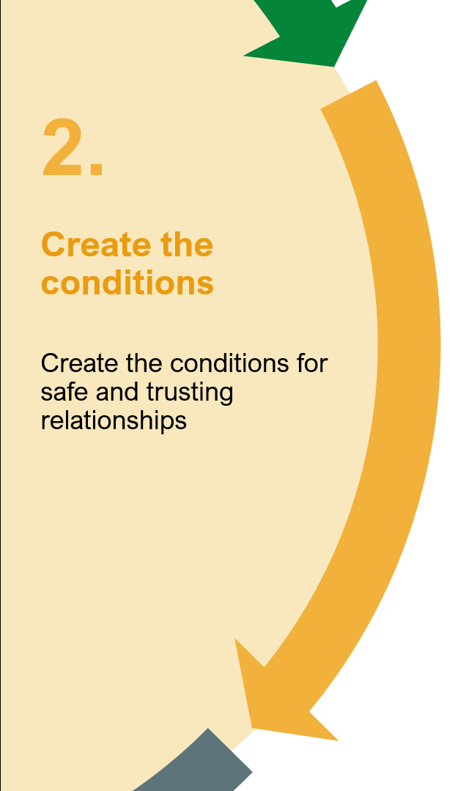





2.
Create the conditions
2.
Create the conditions
What could be the unintended negative impact on the person if sharing their story and are they fully aware of the impact this may have?
Do you have the knowledge and skills within your team to support people to access relevant trauma informed support?
Create the conditions for safe and trusting relationships
Create the conditions for safe and trusting relationships
Do you have enough time and resources to shape the activity with people involved?
Who will be the consistent point of contact responsible for communicating with and supporting the communities involved?
Have you asked people how they would like to be contacted?

Slide 6
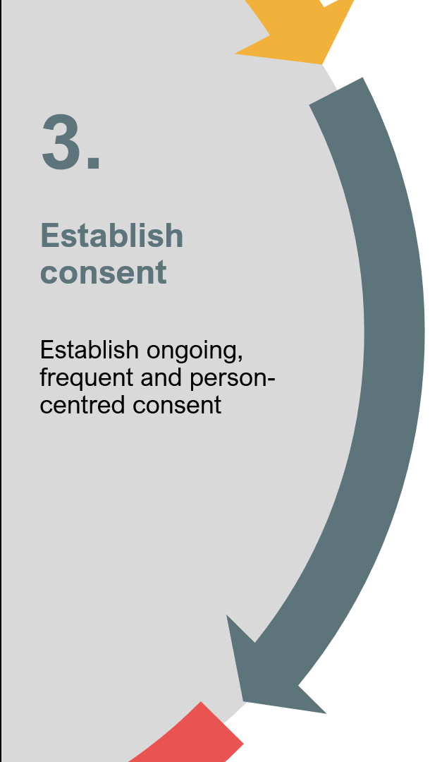


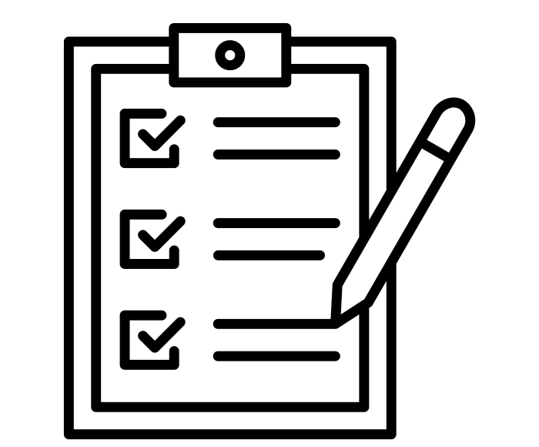
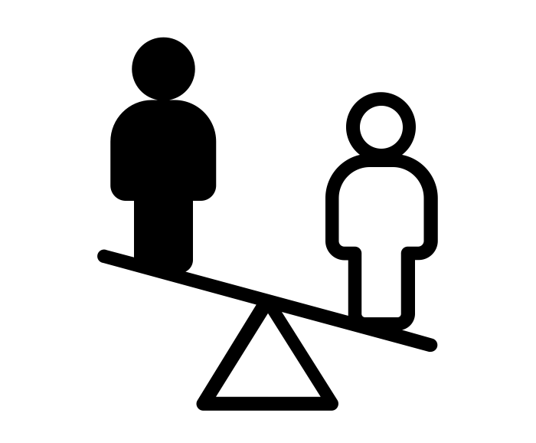

3.
Establish consent
3.
Establish consent
Have you got clear consent from the individual about how their voice or story will be used, including any images?
Have you discussed confidentiality or anonymity, including talking about potential impact on the person’s relationships and status in the UK?
Establish ongoing, frequent and person-centred consent
Establish ongoing, frequent and person-centred consent
Have you thought about the power imbalance that might exist and how the person might feel obligated to the BRC?
Have you got a plan for how their ideas / voice and/or images will be used and stored in the future - what exactly has the person consented to?

Slide 7
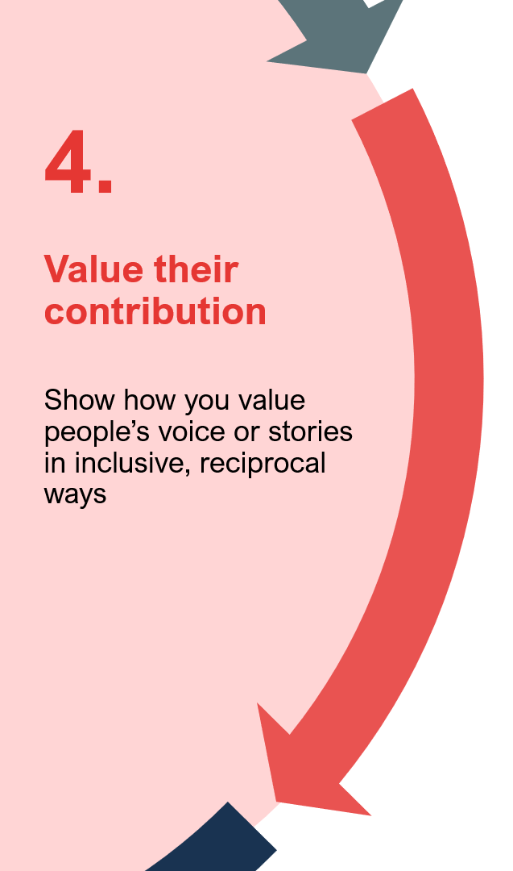



4.
Value their contribution
4.
Value their contribution
£
Are you able to cover the costs up front so they can participate e.g. travel, digital inclusion, childcare, language, refreshments etc.
Have you asked the individuals how they want to be valued, thanked and recognised for their contribution?
Show how you value people’s voice or stories in inclusive, reciprocal ways
Show how you value people’s voice or stories in inclusive, reciprocal ways
How will you keep the person in the loop about the ongoing impact their voice or story has?

Slide 8
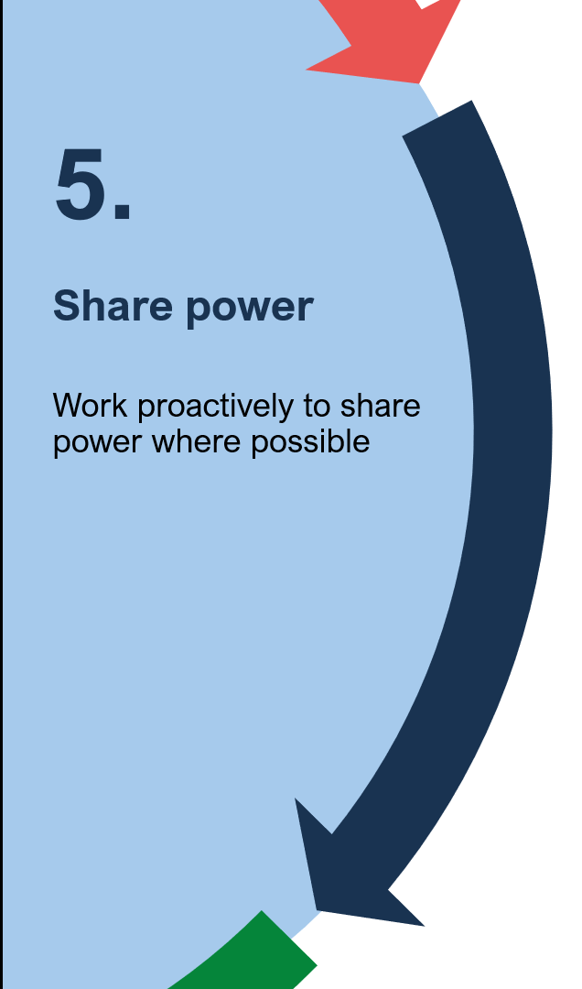



5.
Share power
Is everyone involved clear on the intended outcomes and outputs from the work, who owns it and how it will be used going forward?
How will you evaluate the learning from this activity with the person involved?
Work proactively to share power where possible
How could this be turned into a longer-term relationship for continued work?

