Slide 1
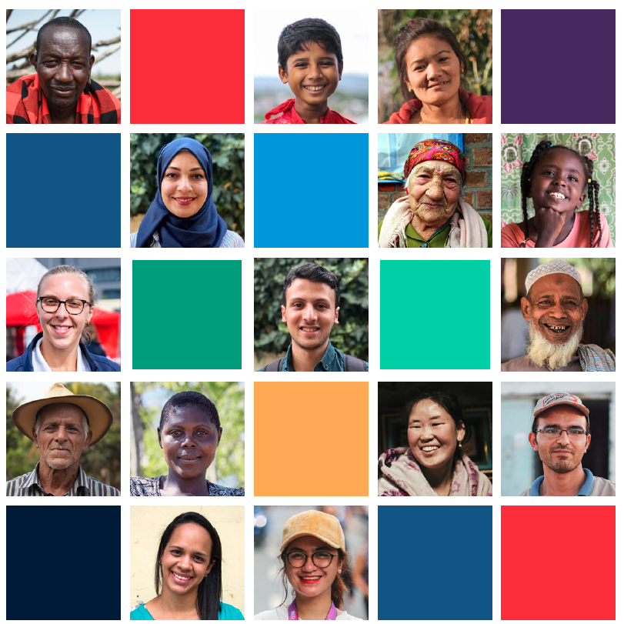
Global CEA Community
of Practice
Peer-Learning Webinar
CEA, Migration &
Integration: What have they got to do with each other?

Slide 2
Running Order
Introduction and welcomes
Keynote Speaker – Virag Viniczai
Bulgarian Red Cross
Humanitarian Service Points to Community Centres + Q&A
Lithuanian Red Cross
Integrating CEA in Orientation + Q+A
Norwegian Red Cross
CEA, Participation and Family Centres + Q+A
General discussion + further examples from participants

Slide 3
Keynote Speaker
Virag Viniczai
Notes:
Virag is the Region of Europe Senior Officer for Migration. Integration and Inclusion Framework?

Slide 4

Route-based approach
DESTINATION
This is not a linear phenomenon
TRANSIT
INTEGRATION & INCLUSION PROGRAMME
Integration and inclusion
Protracted displacement
Return
Scaling up assistance and protection to save lives and protect dignity
Humanitarian Service Points at land and sea
Presence in Reception centers
Service provision from branches
Cross border collaboration
ORIGIN
GLOBAL ROUTE BASED MIGRATION PROGRAMME
Return and reintegration
Climate displacement: Building resilience to acute risks and vulnerabilities (IDP)

Slide 5
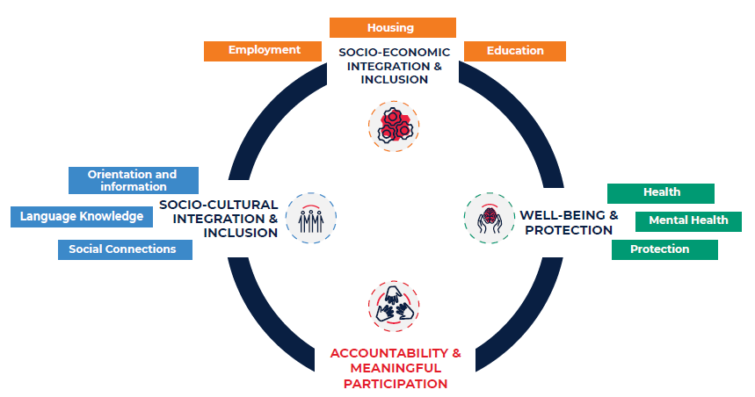
INTEGRATION AND INCLUSION FRAMEWORK
Link to the document

Slide 6

Meaningful participation
What is in the name?
Taking people’s views and feedback into account
Being accountable to the people we serve
Learning from people with lived experience of migration and displacement
Working collaboratively with current and former migrants and displaced people
Sharing ideas, expertise and leading together
Notes:
relevance, impact, and quality of the Movement’s work. Furthermore, all acknowledge the need to engage with affected people in their diversity (including age, gender, and disability) – rather than considering them a homogenous group. Finally, all point to the need for deep, structural transformation in the way the Movement works33 – including how it is led and staffed – to ensure that meaningful participation is an operational reality for the Movement.
Participation (or meaningful participation) is generally considered one of three main components of such approaches, along with clear and open communication (about the Movement’s mandate and activities, lifesaving information, and how affected people and communities can be involved) and mechanisms to seek, listen to and act on feedback from affected people and communities. Within these documents - some of which date back twenty years – terms used range from “engagement” and “involvement” to “participation” and - more recently - “meaningful participation”.
Code of Conduct for the International Red Cross and Red Crescent Movement and Non-Governmental Organisations (NGOs) in Disaster Relief, 1994
(commitment 7, page 4: “Disaster response assistance should never be imposed upon the beneficiaries. Effective relief and lasting rehabilitation can
best be achieved where the intended beneficiaries are involved in the design, management and implementation of the assistance programme. We will
strive to achieve full community participation in our relief and rehabilitation programmes”.
27 Principles and Rules for Red Cross and Red Crescent Humanitarian Assistance, 2013 edition (page 13)
28 2019 Movement-wide Commitments for CEA Commitment 3 (page 6)
29 ICRC Accountability to Affected People Institutional Framework 2020 (page 1)
30 IFRC CEA Strategy 2023–2025 (page 12)
31 IFRC Global Migration Strategy 2018-2022 (page 9)
32 The Enablers reflect the cross-cutting approaches, capabilities, and resources that are vital for delivering on this Migration Strategy and in which the
Movement commits to invest.
33 The IFRC 2030 Strategy, for example

Slide 7
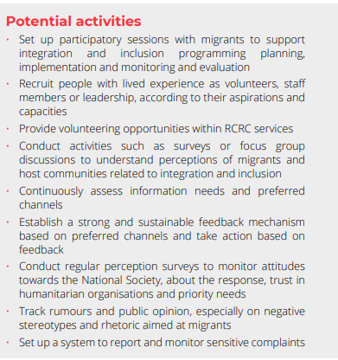


Slide 8
CEA "Community of Practice"
NSs exchange of knowledge and practices
National Society: Bulgarian Red Cross

Slide 9

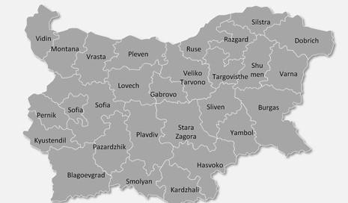
BULGARIAN RED CROSS COMMUNITY CENTERS
Mixed migration flow in Bulgaria (Ukrainians and Global South)
4 Community centres in Burgas, Dobrich, Sofia, Harmanli (Türkiye border)
1 Integration and Information Centre for Refugees since 2014
“One-stop-shop" for in-kind, legal support and PSS;
  Integration & inclusion help;
  Language courses;
  Financial assistance programs;
  Access to Health care and Educational system for vulnerable cases;
  Licensed translation of documents related to integration;
  Community engagement events;
  Information sessions;
  In-kind and humanitarian support;

Slide 10
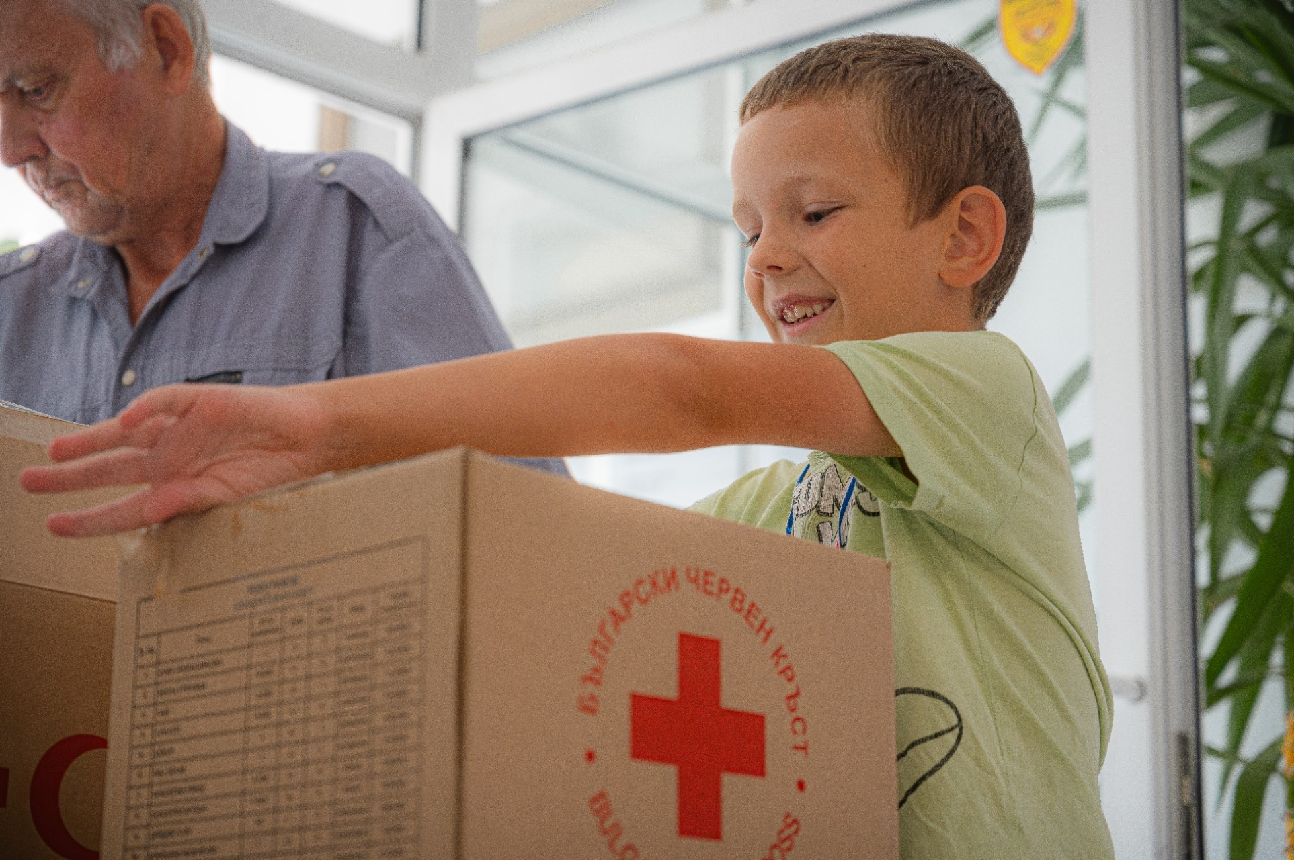
PROCESS
Established as HSPs in early 2022 (Ukraine response) and then naturally transitioned into integration & inclusion centers;
Localization – CCs managed by BRC Regional branches (project-based);
BRC-owned promises/delegated by state or municipalities.
Challenges
Managing expectations and BRC internal mindset:
    Emergency response approach VS Integration and inclusion;
    People on the move transiting VS people who want to stay and integrate;
Different profiles, needs and vulnerabilities of affected communities;
External funding;
Data management;
Host society engagement.

Slide 11
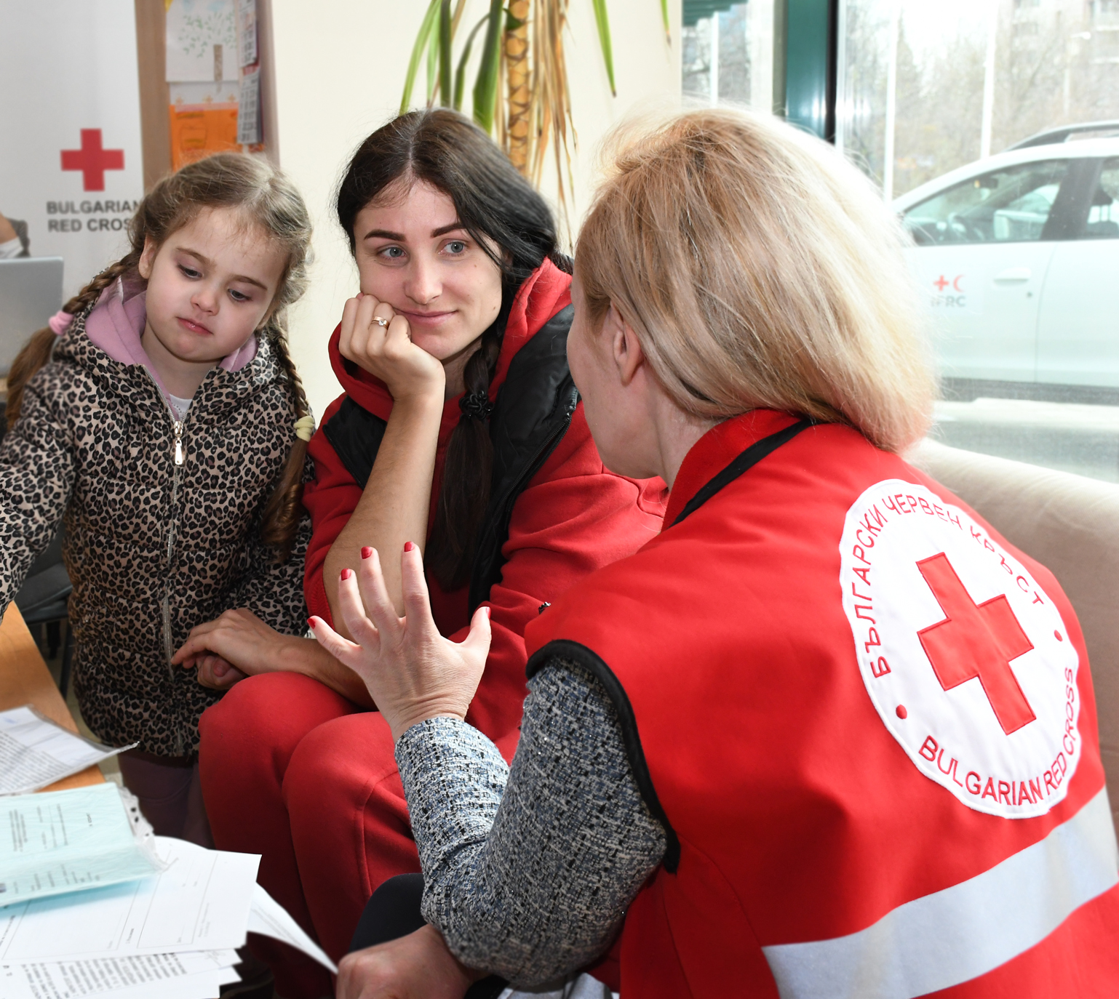
Meaningful participation
Feedback boxes
Information sessions, based on topics, identified by refugees
Community engagement events, proposed and led by refugee communities
Volunteers from refugee communities
Lessons learnt
Consider local population and other refugee/migrants' groups;
Advocate for needs-based programing and support;
Integrate Ref/Migration units into Emergency preparedness, incl. assessments, surge exercises, trainings, etc.
Precise NS portfolio and focus on signature activities, incl. promote visibility on these;

Slide 12
Thank you.
A.Vasileva@redcross.bg

Slide 13
Questions?

Slide 14
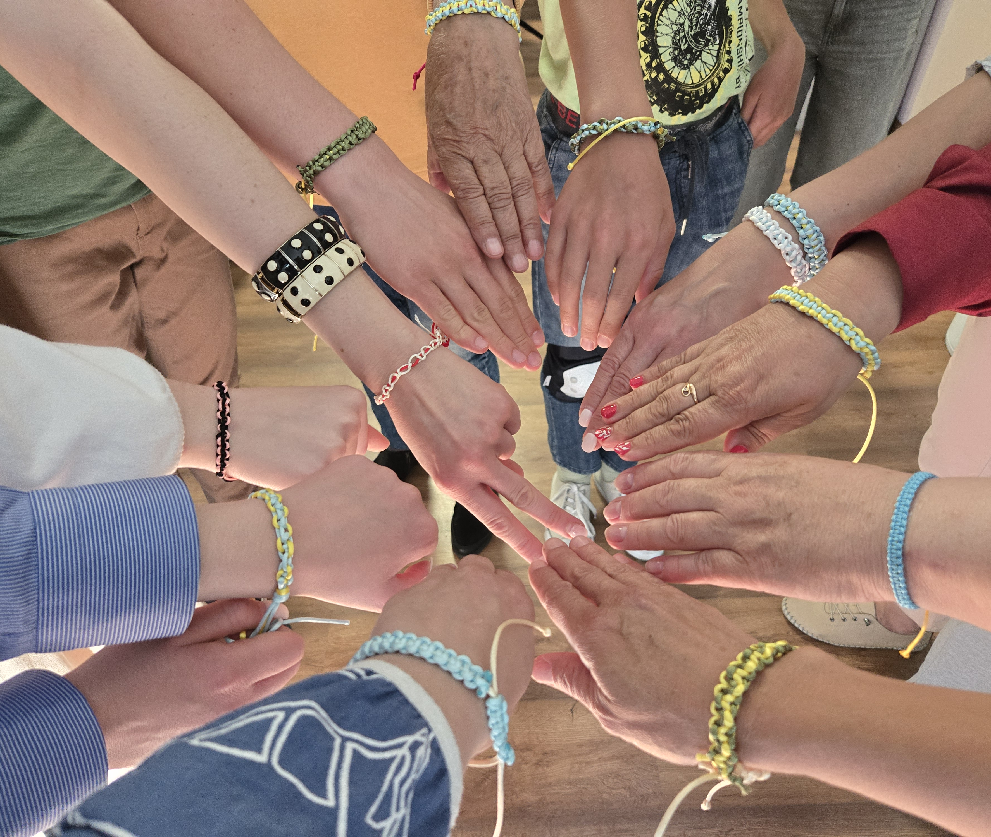
Community Engagement in Action: The Cultural Orientation Course
2025-09-10

Slide 15
What We're All About
Our Mission: Helping migrants successfully integrate into Lithuanian society.
The Tool: The Cultural Orientation Course.
The Goal: Empower newcomers with knowledge and confidence.
The Challenge: How to engage a diverse and busy group of people.

Slide 16

What Is the Cultural Orientation Course?
A series of 7 online sessions.
Each session is 1-2 hours long.
Led by a professional or specialist in the field.
Interpreters and cultural mediators are on hand to help.
Time for Q&A—because real learning happens in conversation.

Slide 17

The Syllabus: From Healthcare to Holidays
The Lithuanian Healthcare System
  The Lithuanian Education System
  The Lithuanian Economics, Labor Market and Labor Law
  Legal Statuses of Foreigners
  Lithuanian History and Identity
  Lithuanian Holidays and Traditions
  Civil Protection: Personal and Home Preparedness for Emergency situations

Slide 18

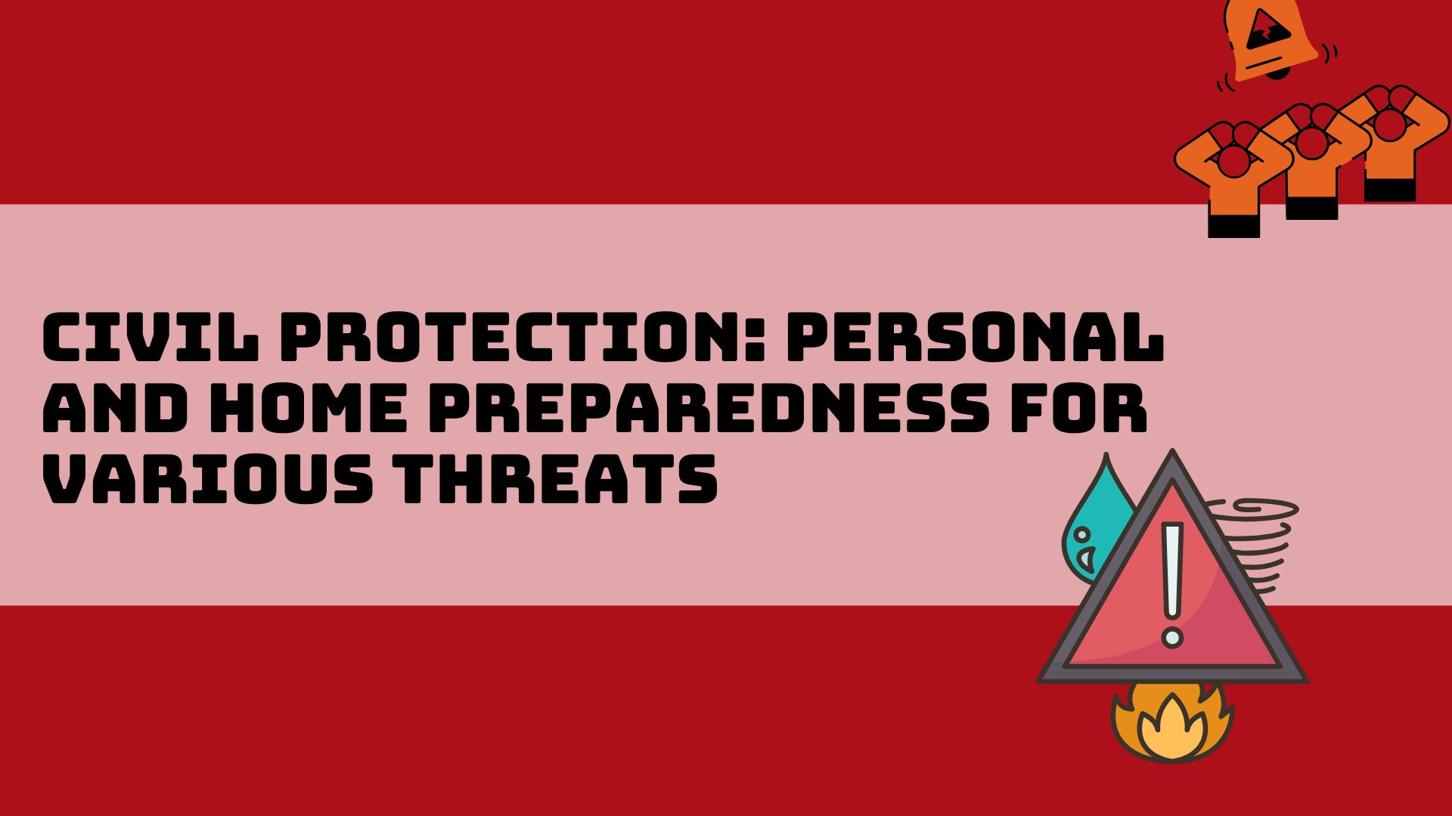
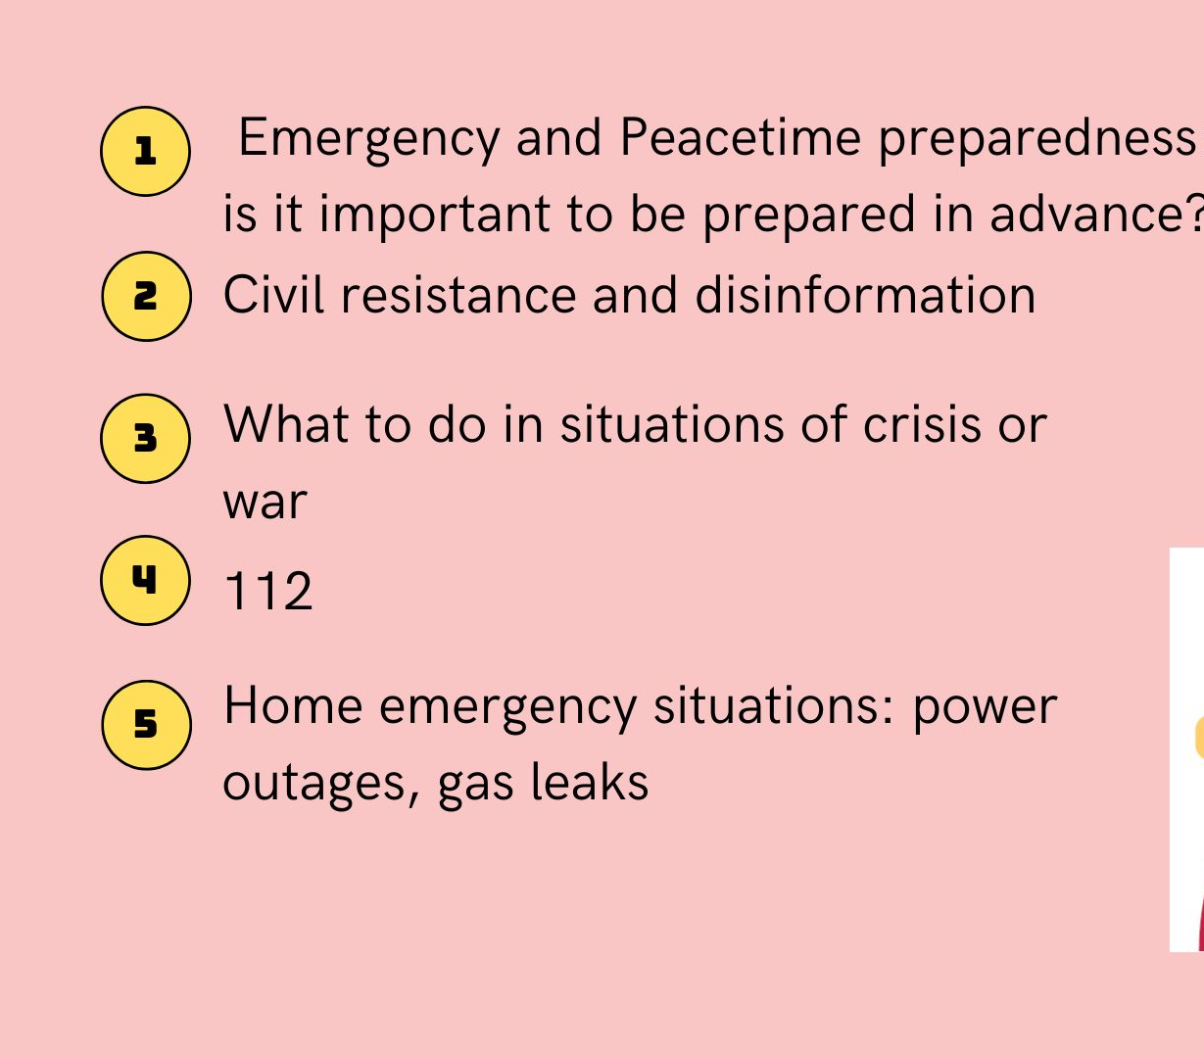

Slide 19
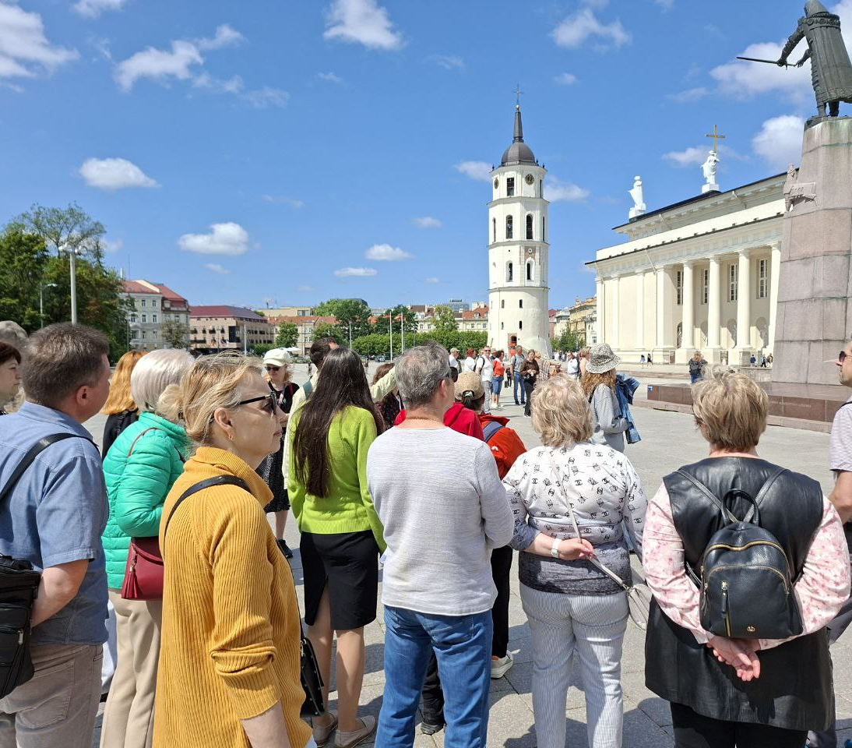
So, How Did We Do?
Launched in September 2024.
994 participants so far.
Attendees from a wide range of countries: Ukraine, Belarus, Afghanistan, Tajikistan, Nigeria, Iran, Israel, and many more.
Materials prepared in Russian, English, Arabic, and Persian. (Ready to be adapted to Spanish, Kurdish, Turkish, Sign language.)

Slide 20
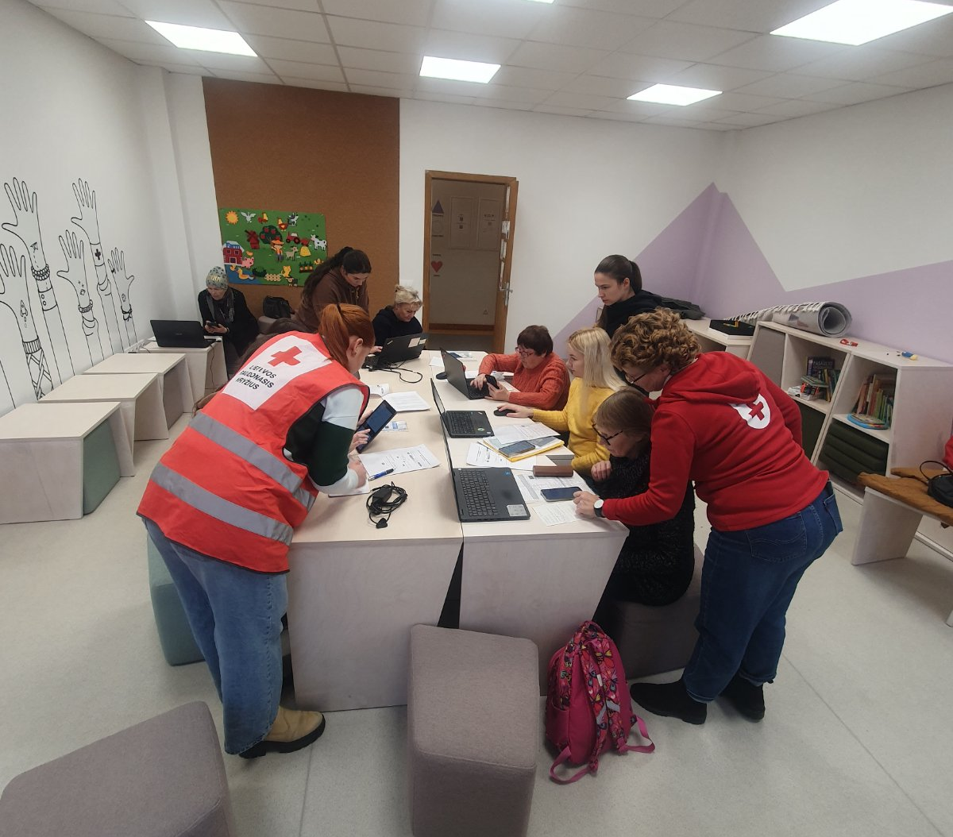
The Challenge
Problem: Low engagement, especially with Middle Eastern communities.
Why? The online format wasn't working for everyone. Tech issues? Preference for face-to-face connection? Lost invitations, wrong channels. Focus on the wrong topics. Low accessibility.
The question we asked ourselves: How do we reach people where they are?

Slide 21
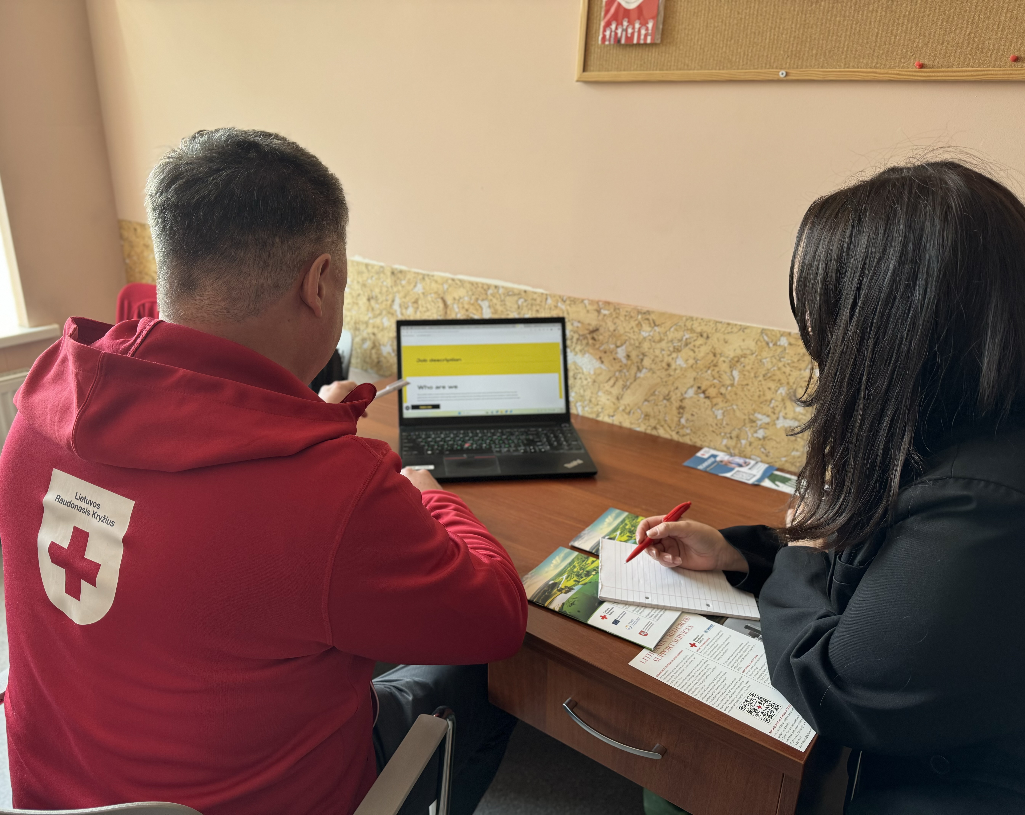
How We Tackled It
Offline is an Option: We added an in-person attendance option.
Right Channels, Right People: We moved beyond just email.
Used channels like WhatsApp, Telegram, and phone calls for invitations.
Listen and Learn: We made feedback a core part of the process.
Saved screenshots of chat messages, emails, and texts to review after each session.
Used this feedback to improve future sessions.

Slide 22

What We Learned
No one-size-fits-all solution exists.
Flexibility is key.
Meeting people on their terms is non-negotiable.
Feedback is a gift—it tells you what's working and what's not.

Slide 23
Thank you
Šeida Kauzonė | seida@redcross.lt

Slide 24
Questions?

Slide 25

Red Cross Family Centers
Strenghtening families, belonging and experiences
10.09.25 CEA Peer Learning Session

Slide 26
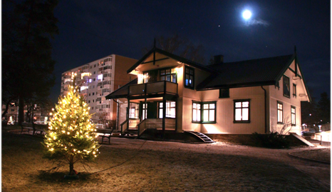

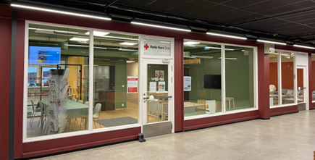
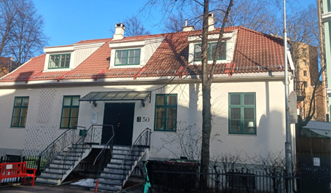
Background
2019: mapping of humanitarian needs. Found that low income families wanted local meeting places with free activities for the entire family
Ownership: all centers are built on the same model, but they still are different from each other – Local ownership
Not a specific migration activity, rather a local community activity
Fast growth: Three centers launched in 2022, 2023 and 2024. High demand from local community and authorities

Slide 27
"It's horrible to say that... I dread the weekends.
We can't afford to do anything together as a family these days”
Mother of two children (2019)

Slide 28
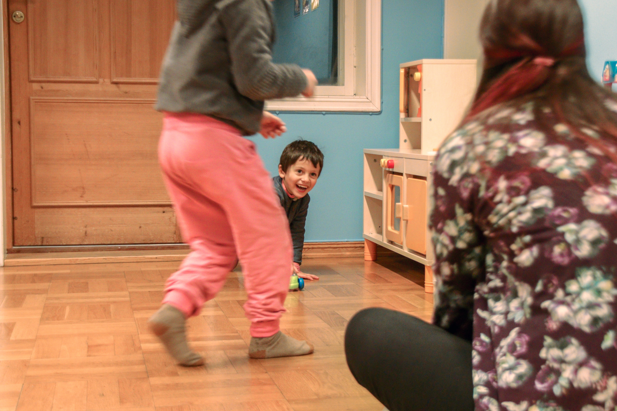
Red Cross Familie Centers at a glance
Family perspective
Local community perspective
Local meetingplace with free, straight-forward activities several days a week and during vacations
Knowledge enhancement, classes and information among parents
Familiy trips and larger events/celebrations
OWNERSHIP!

Slide 29
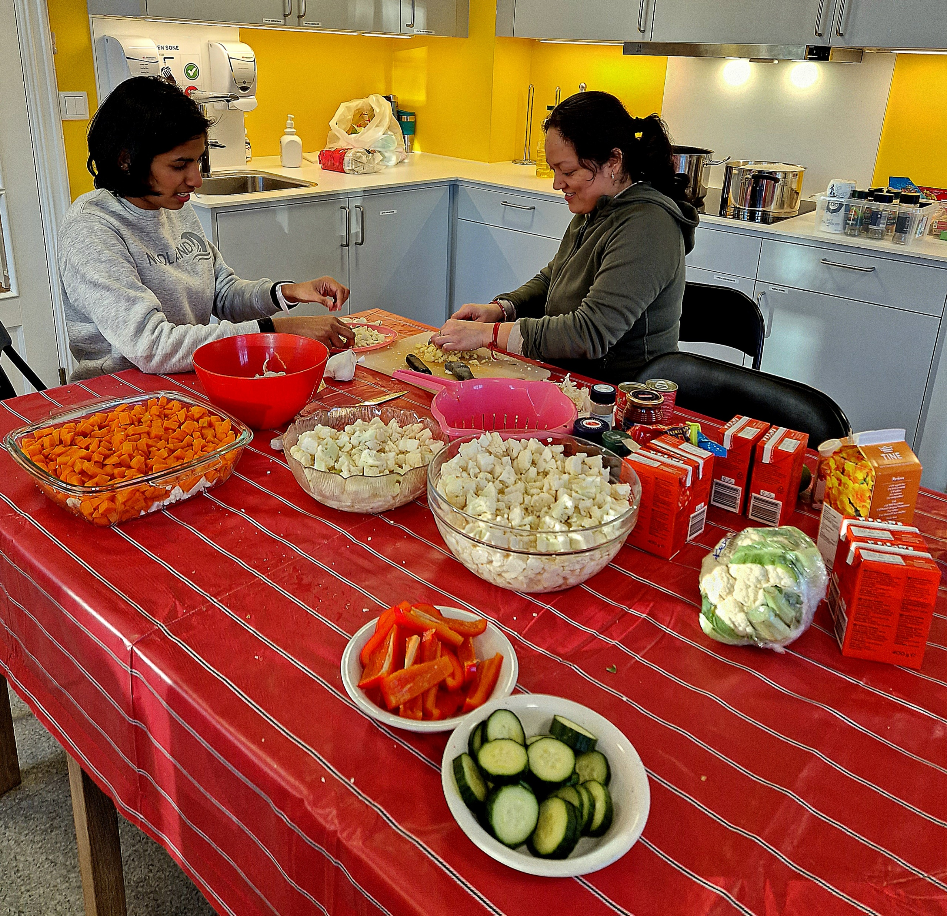
Notes:
:

Slide 30
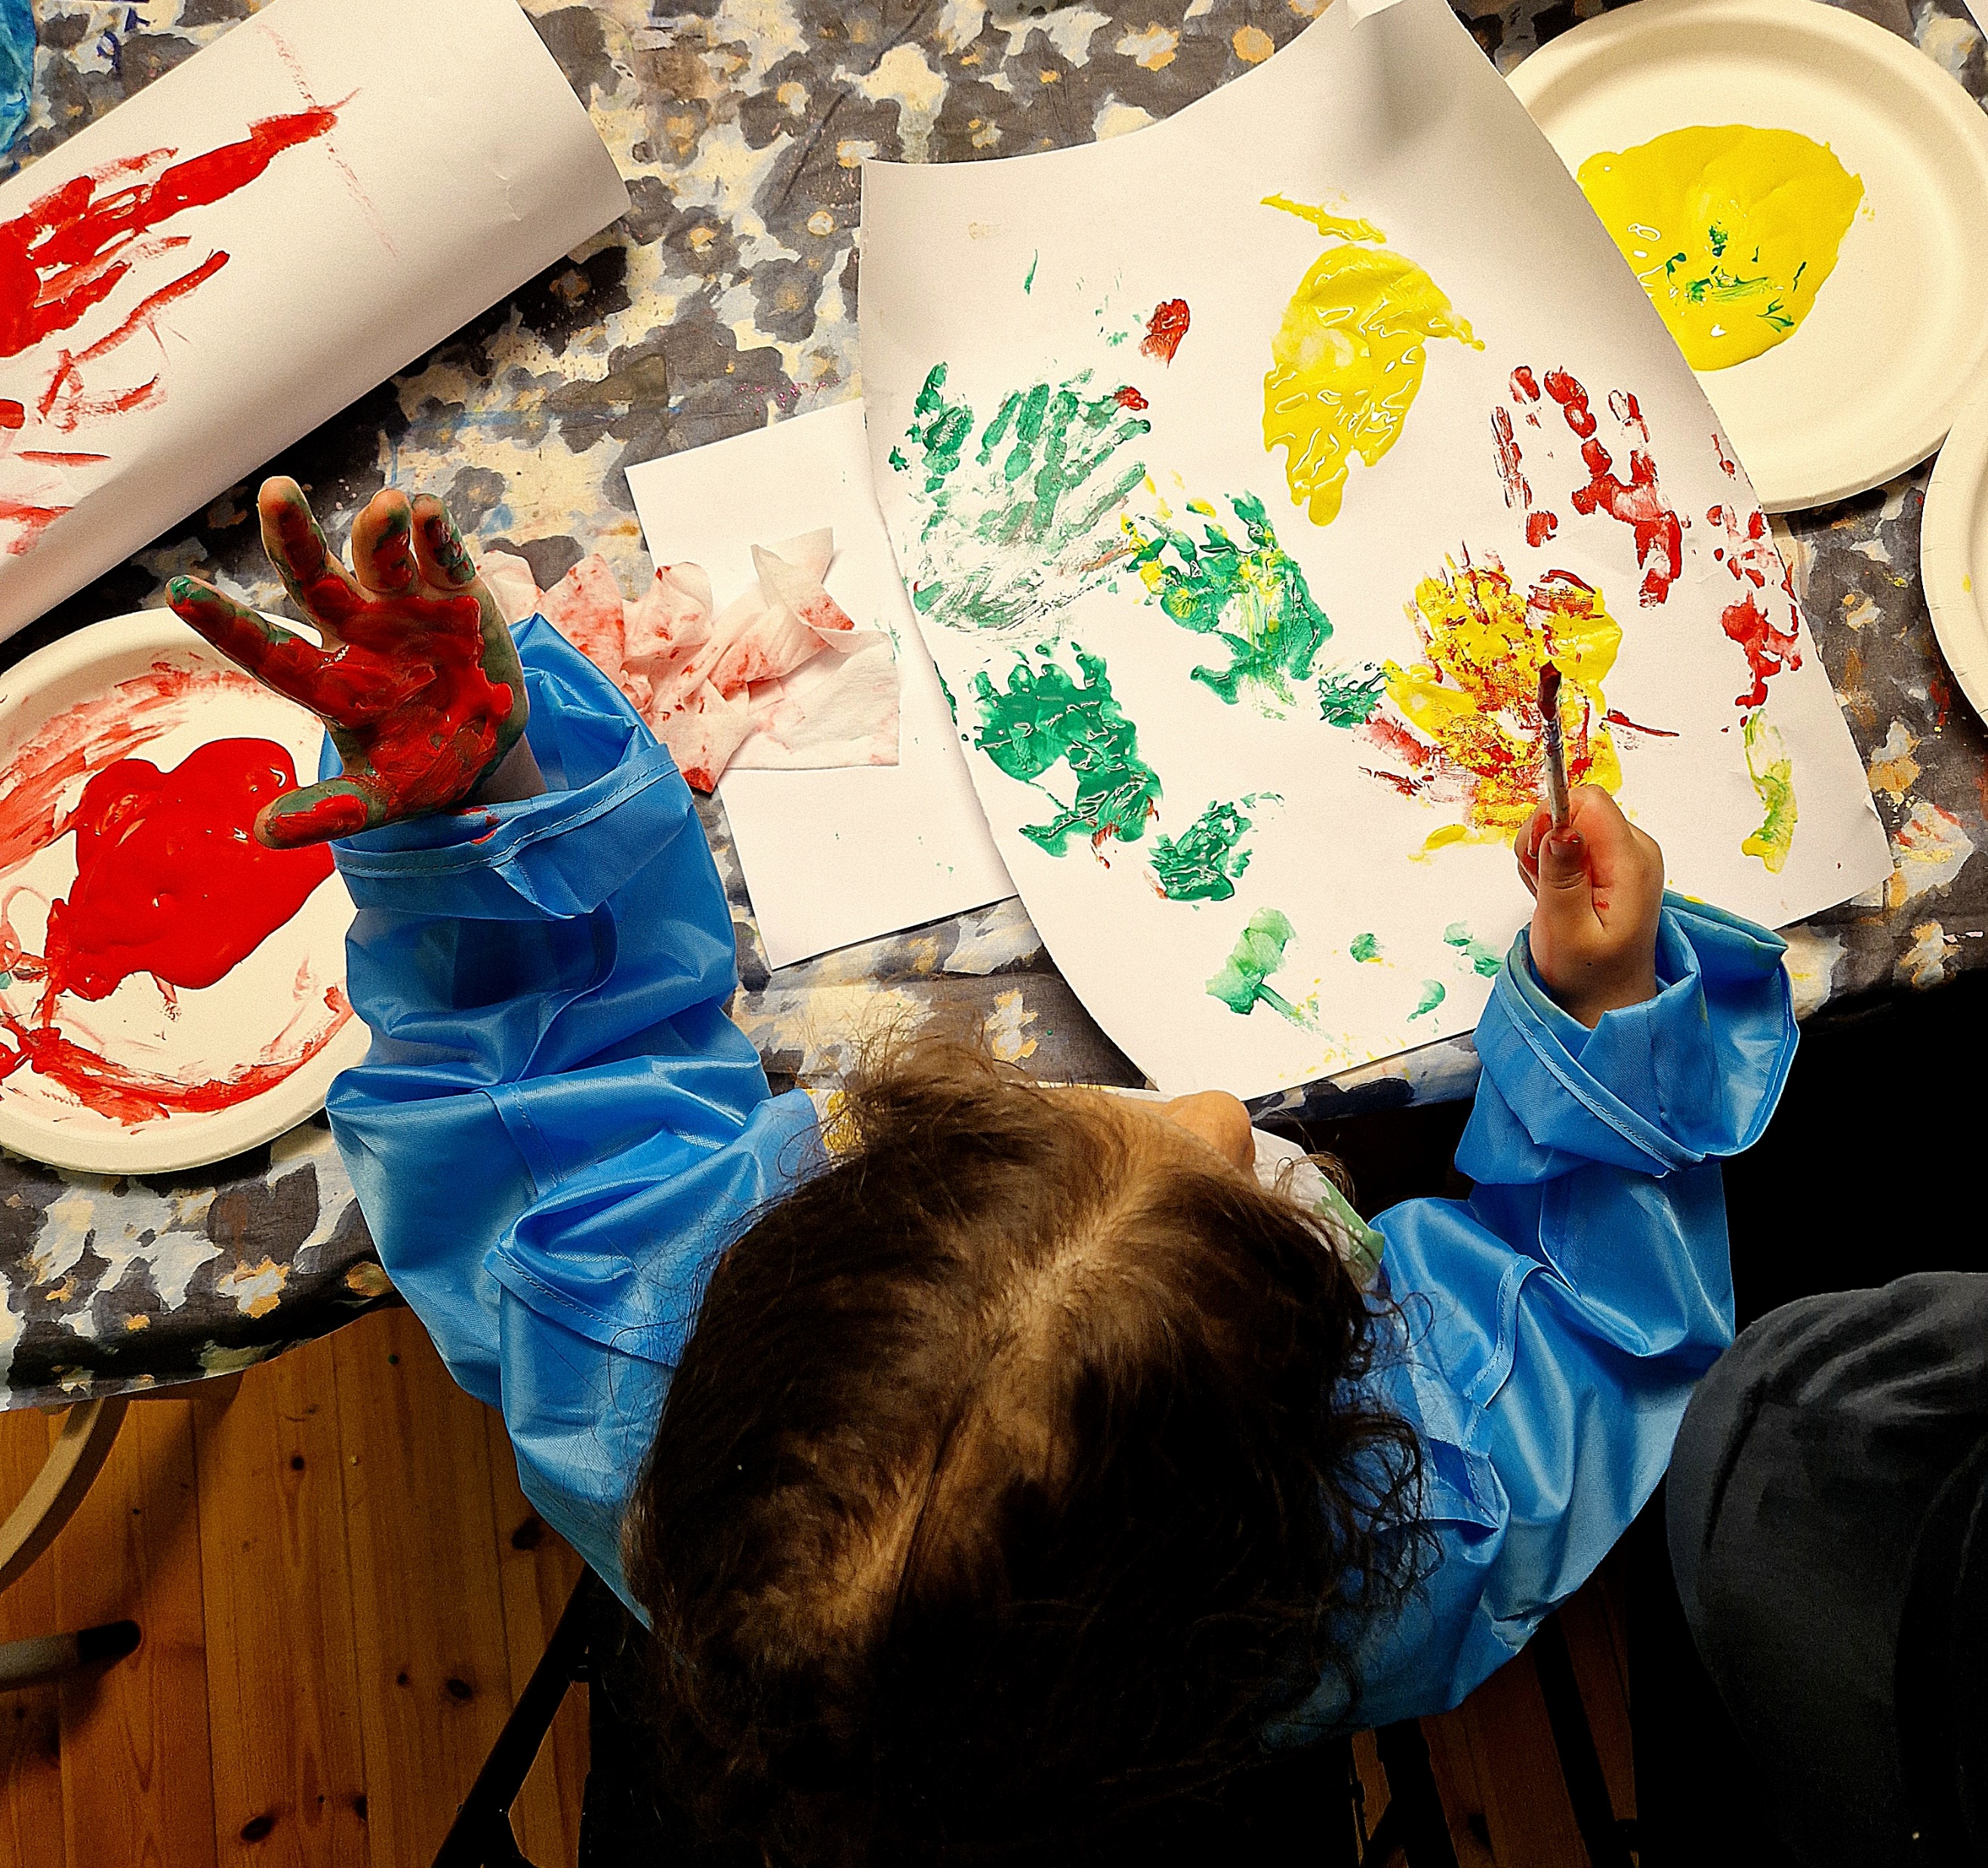
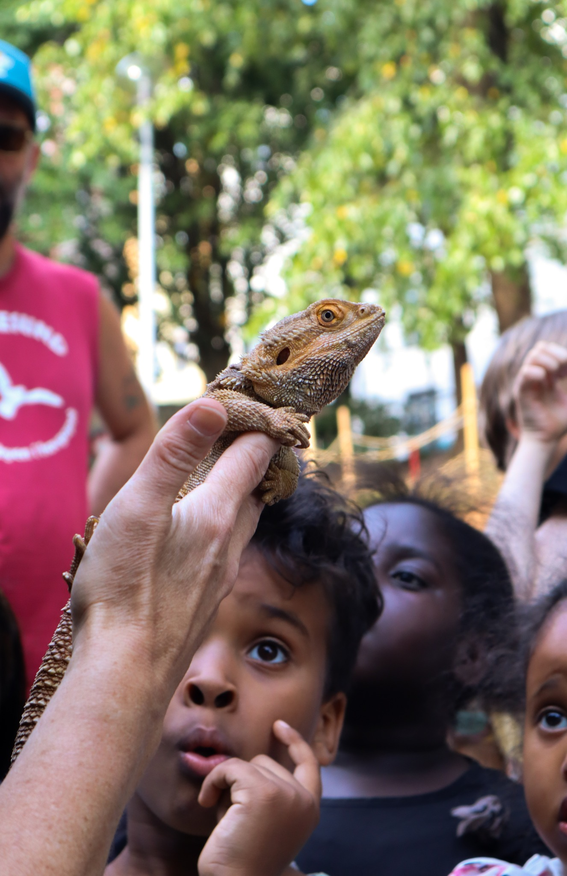
Notes:
:

Slide 31
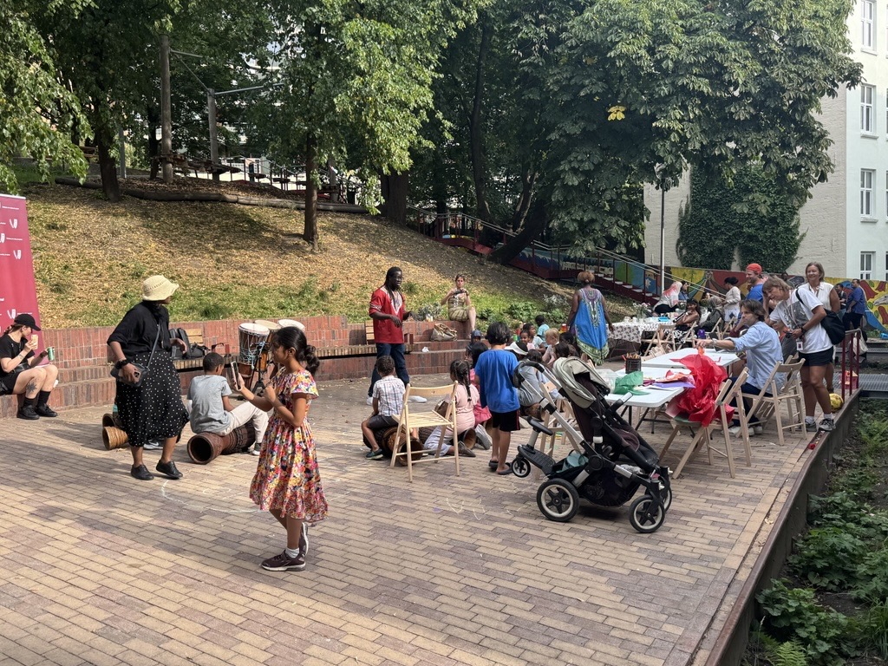

Slide 32
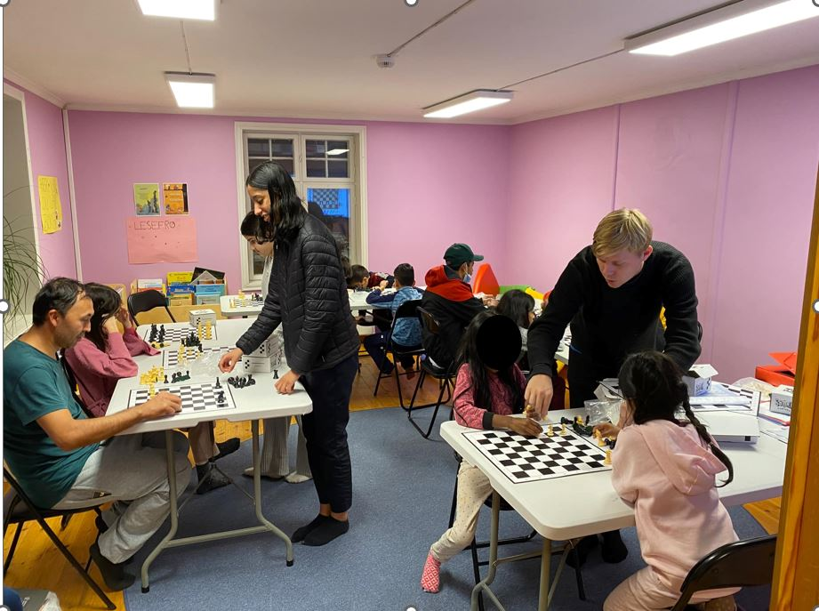
Notes:
:

Slide 33
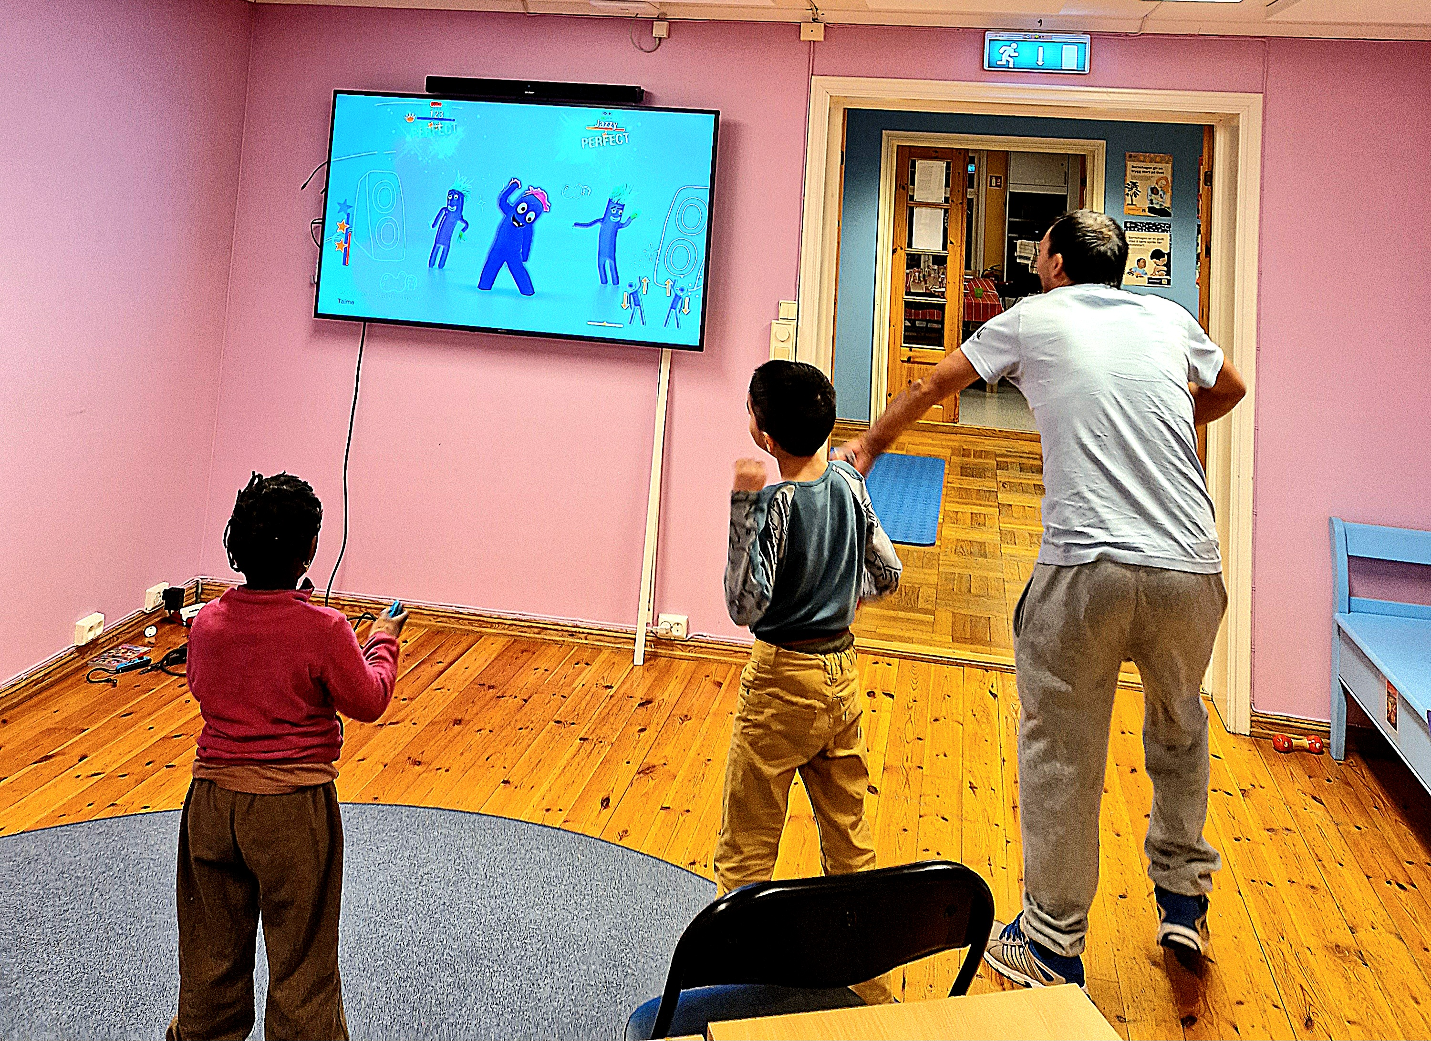
Notes:
:

Slide 34
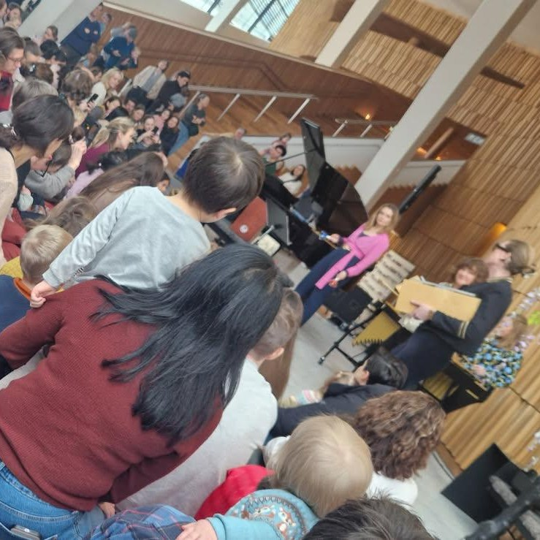
Notes:
:

Slide 35
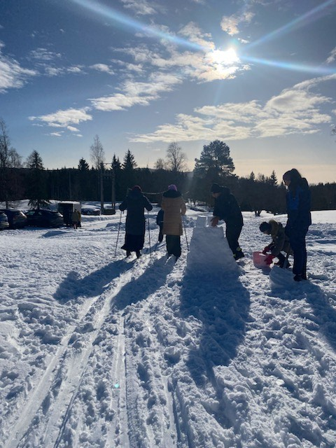
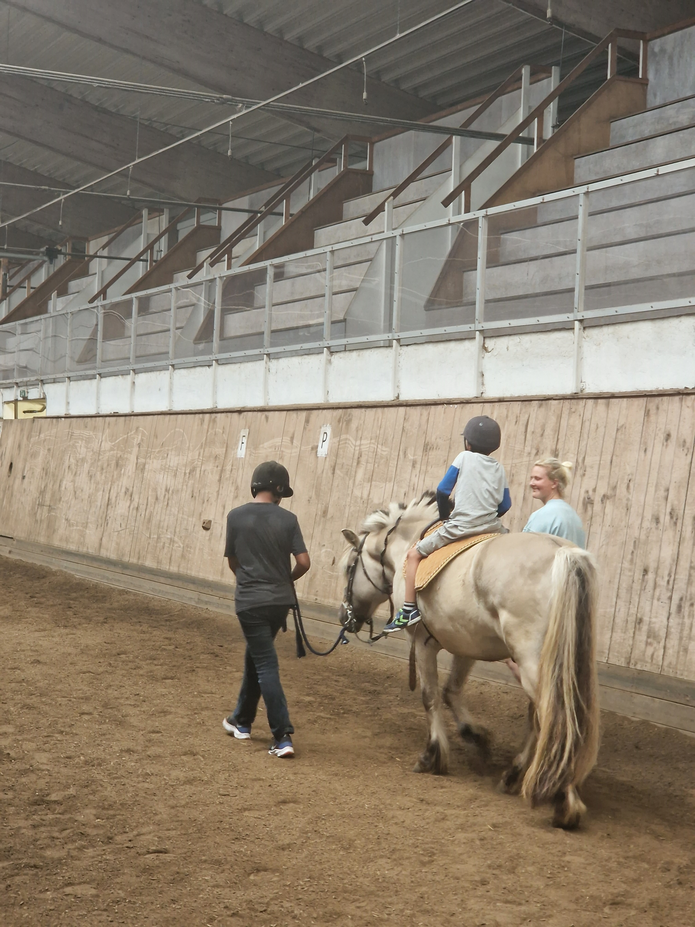
Notes:
:

Slide 36
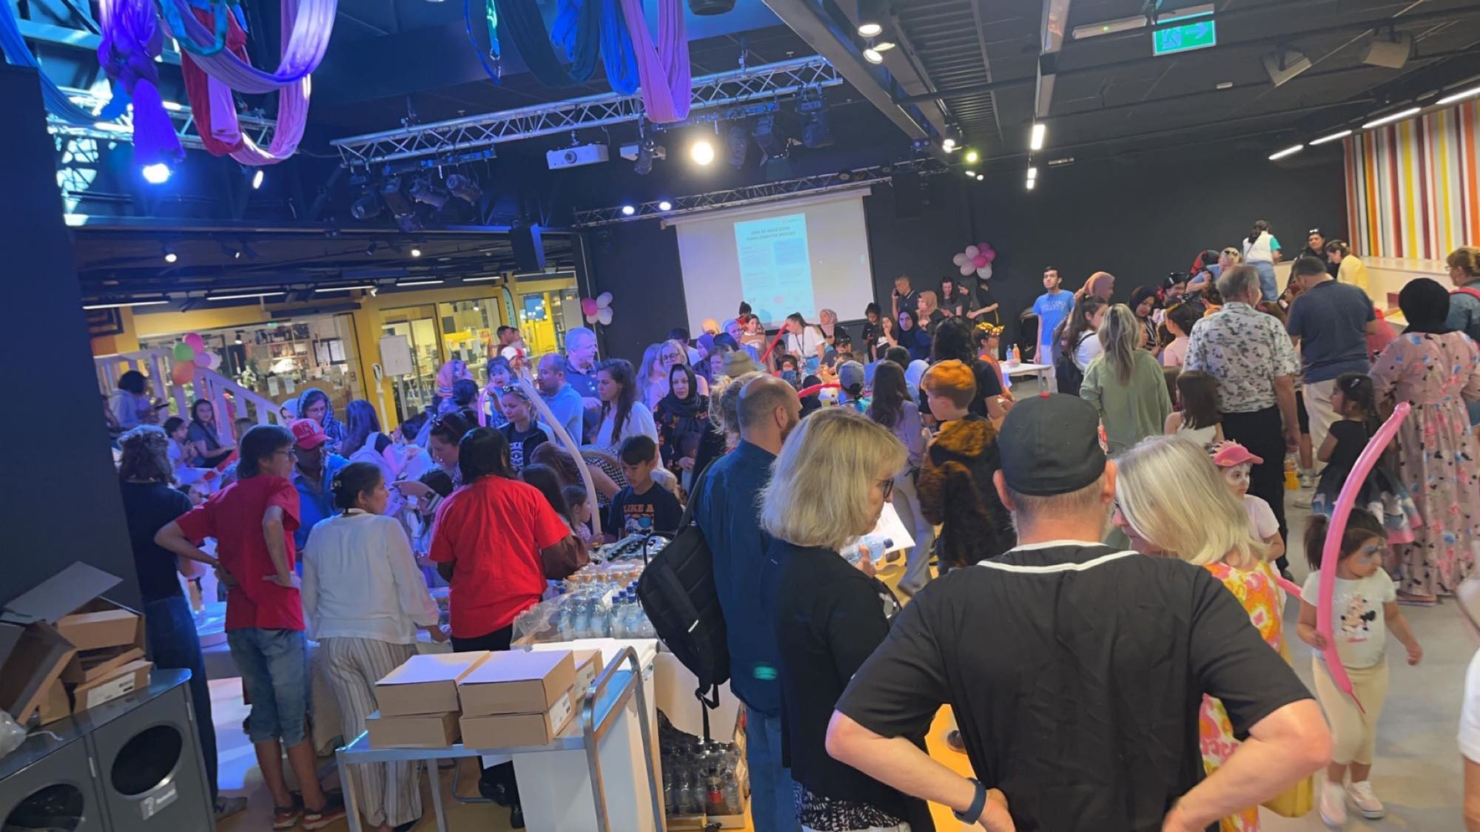

Slide 37
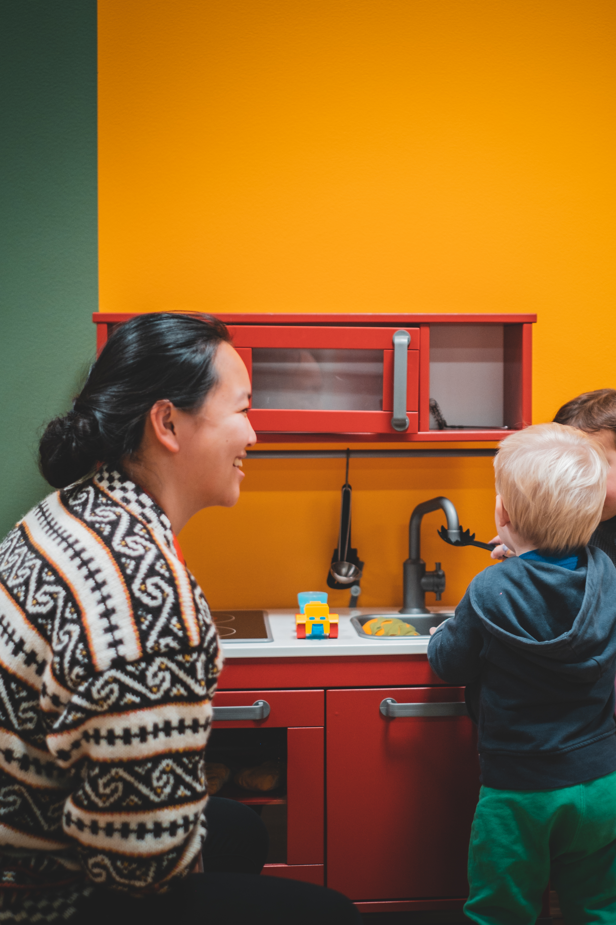
Participation and ownership
Oslo Red Cross emphasizes participation in all our 30 activities.
Plan for participant boards at each Family Centre to formalize their role
Participating empowers in addition to creating real ownership. Many participants have skills we encourage them to share with the other families.
Volunteers encourage participants to share their ideas and provide their feedback in daily logs
The Red Cross Family centres are all about interaction and building community
Challenges: sufficient volunteers and funding

Slide 38
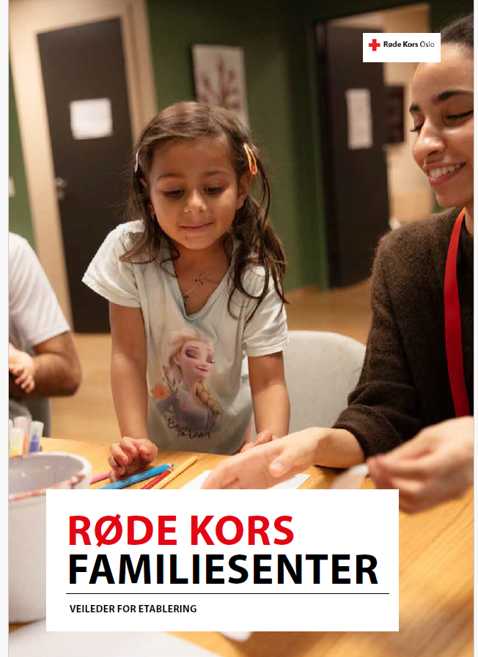
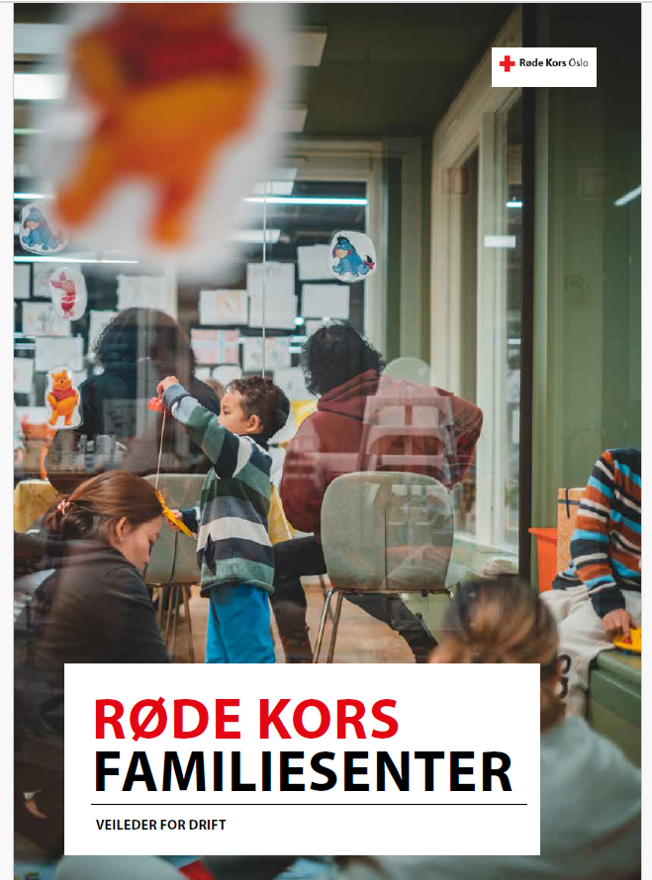

Slide 40
Questions?

Slide 41
Broader Discussion
Any other Region of Europe National Societies with examples or experiences they would like to share of integrating CEA into migration and inclusion work?
Anyone from outside the region of Europe who’d like to share their experiences and ways of working?
Have any of these examples today sounded familiar – are they things you are already doing?
Are there any examples that you’ve heard today that are new that you’d like to try and replicate?
Are there any examples shared today that you think just wouldn’t work in your context? Why not?
Drawing from your own experiences, do you have any ideas or advice on how we can better embed CEA principles in migration and integration work?
More broadly, is anyone facing any challenges that our presenters today – or anyone else on the call – may be able to help with?
Any final questions or comments?

Slide 42
KoBo Survey
Click Here to Access the Feedback Survey
Notes:
Hopefully the link works on people’s screens –also post in the chat. https://ee.ifrc.org/x/cso0VdvN
Institutionalisation Survey Link - https://ee.ifrc.org/x/rxwrwdbL

Slide 43

Thank you and goodbye – look forward to seeing you next time!

