Slide 1
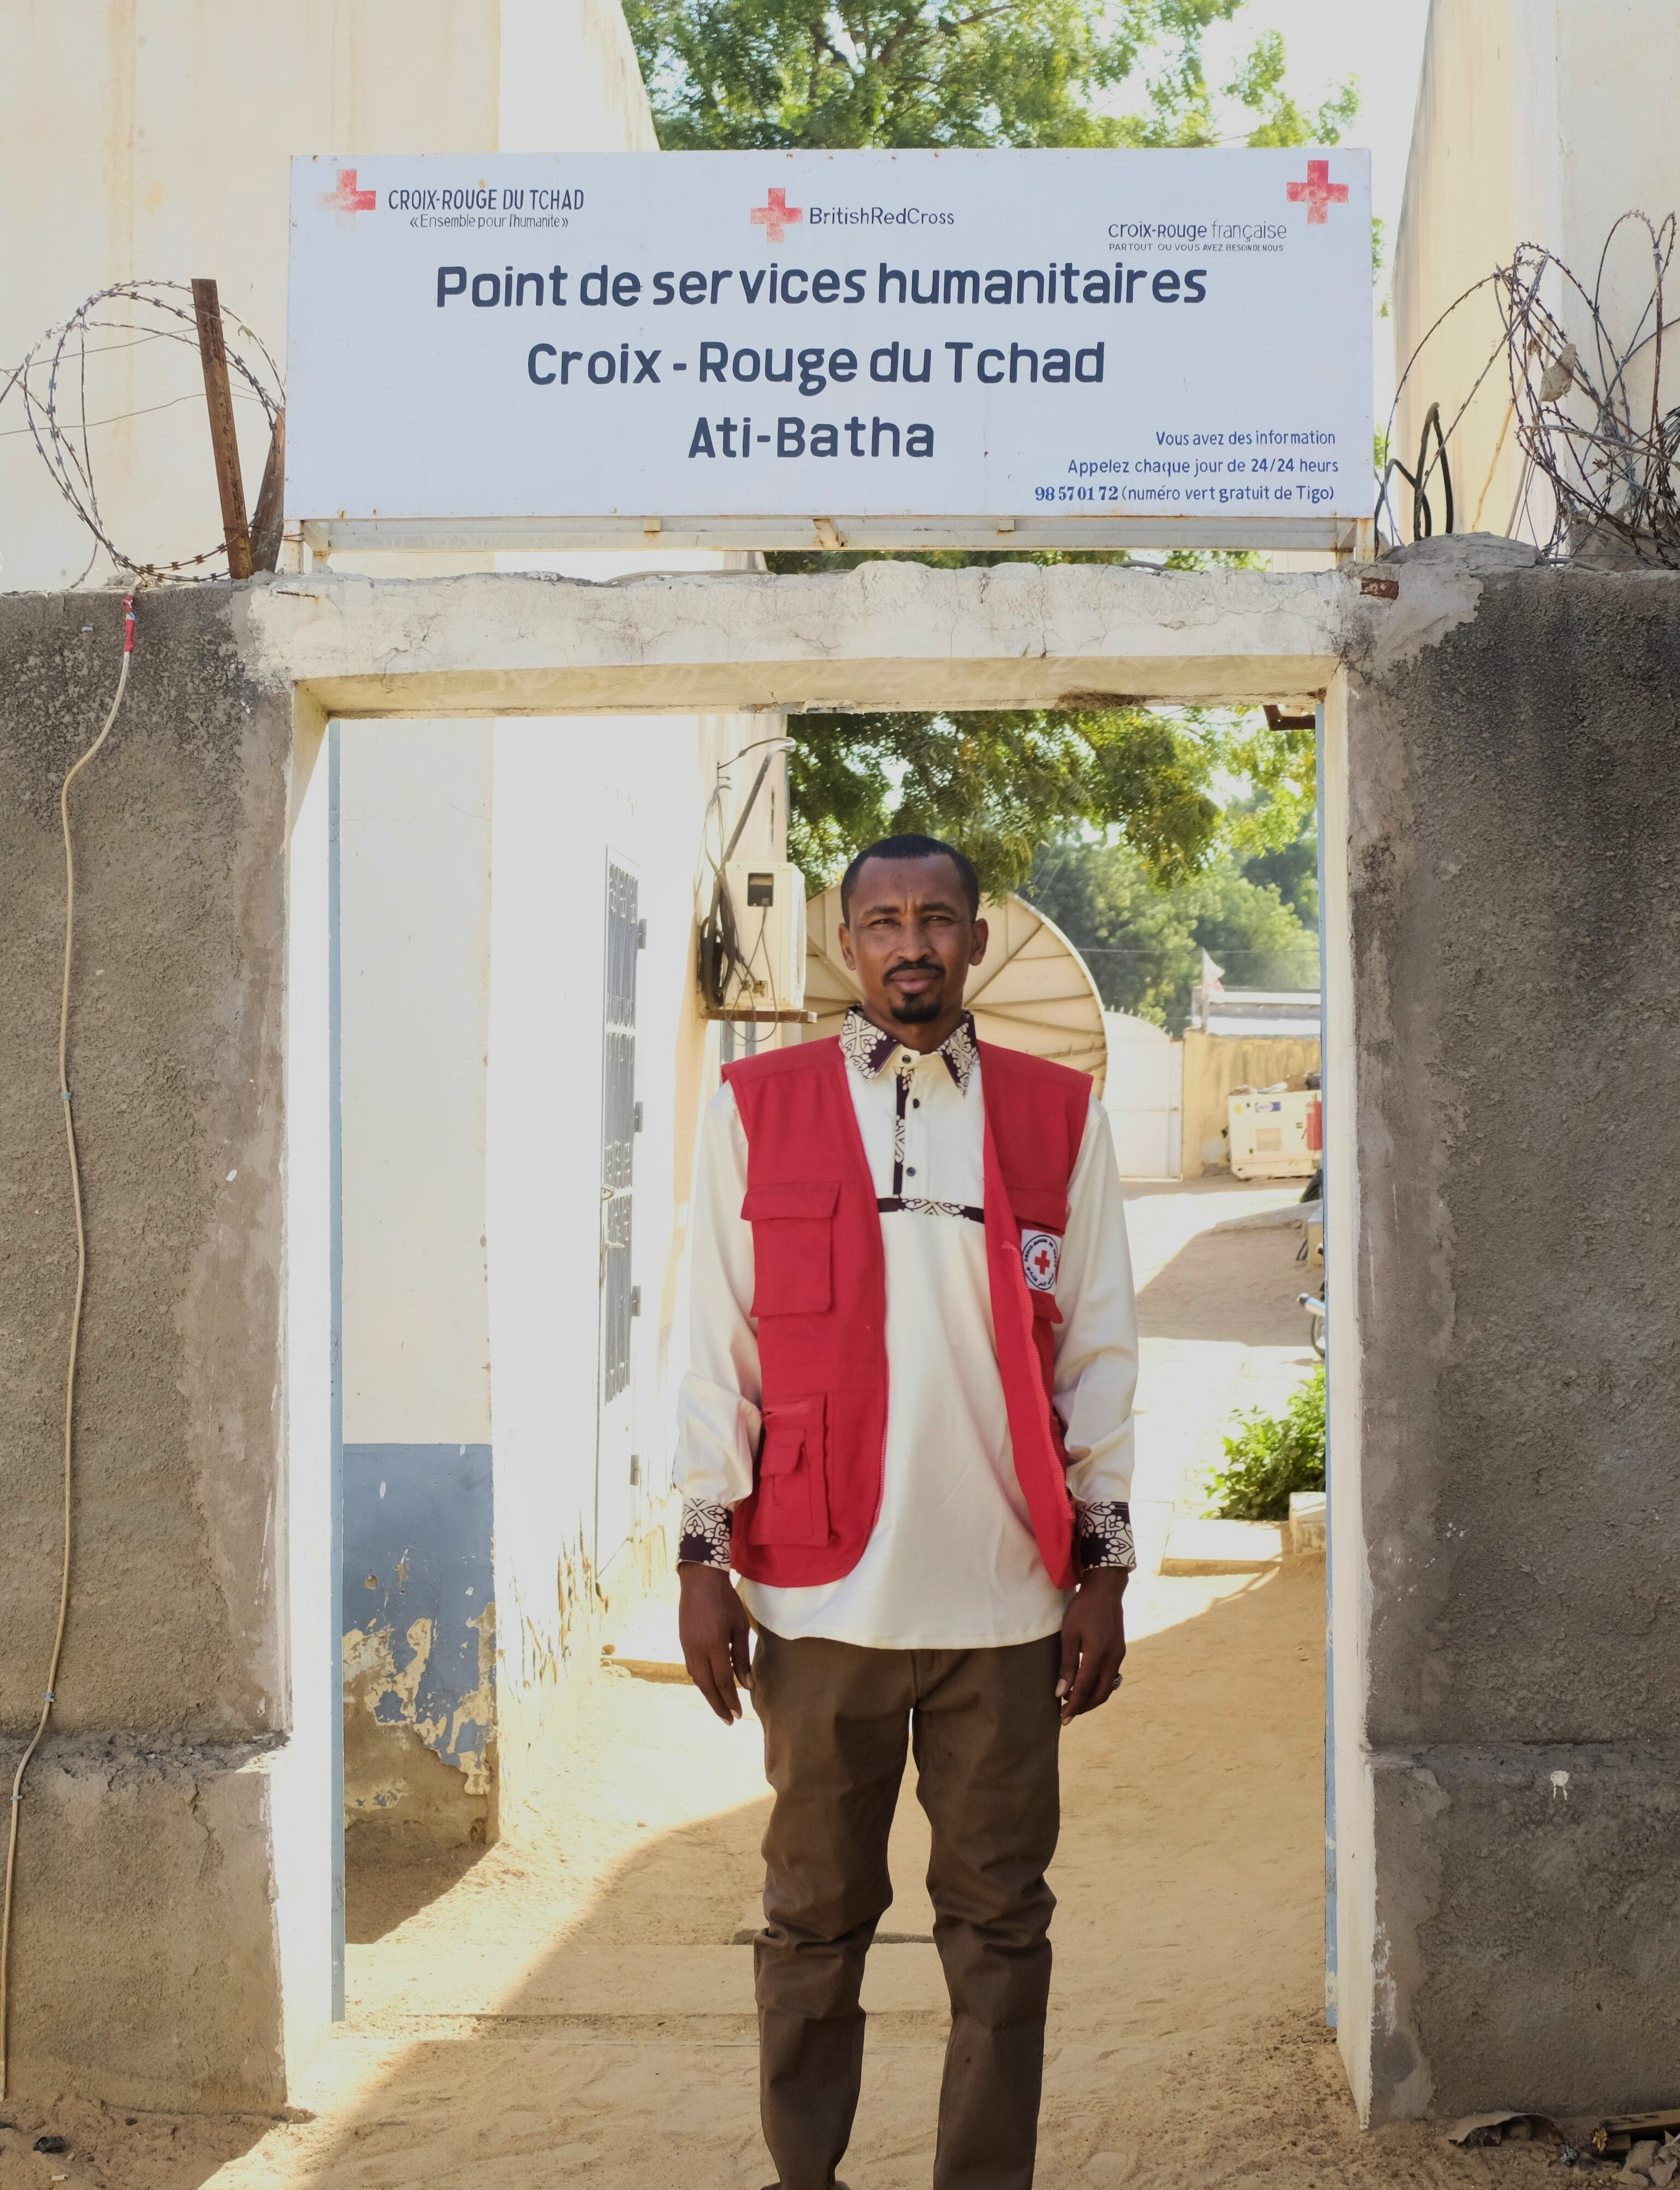
Listening and Adapting: How the Red Cross of Chad is leveraging community feedback to enhance and adapt its support for migrants in Chad
The Red Cross of Chad has implemented an innovative program to support migrants in transit through the country. At the heart of this initiative is the Community Engagement and Accountability (CEA) approach, which allows services to be continuously adapted to the real needs of migrants.
This presentation explores how feedback mechanisms are transforming humanitarian action, strengthening beneficiaries' trust, and improving the effectiveness of field interventions.
by Allamine Mahamat Senoussi

Slide 2
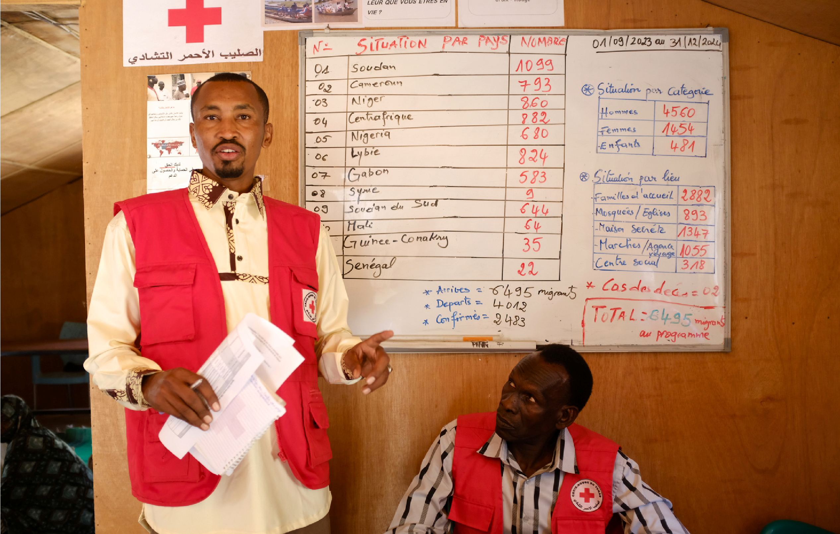
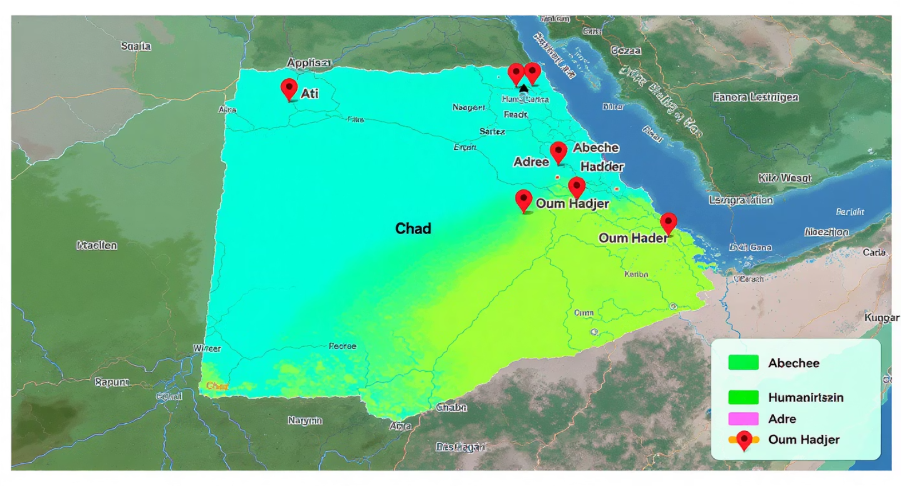
Migration context in Chad
Chad is a major transit country for migrants coming from Niger, Cameroon, the Central African Republic, and Sudan. These individuals face considerable challenges:
Lack of access to basic services
Insecurity and precarious health conditions
Social isolation and vulnerability
Local communities play a key role in this system, particularly traditional leaders who help facilitate the reception of migrants. Migrants are often temporarily hosted by local families, providing them with a safe space and social support before continuing their journey.
Since 2023, the Chad Red Cross (CRC) has implemented a humanitarian assistance program through Humanitarian Service Points (HSPs) in four strategic areas: Ati, Abéché, Adré, and Oum Hadjer.

Slide 3
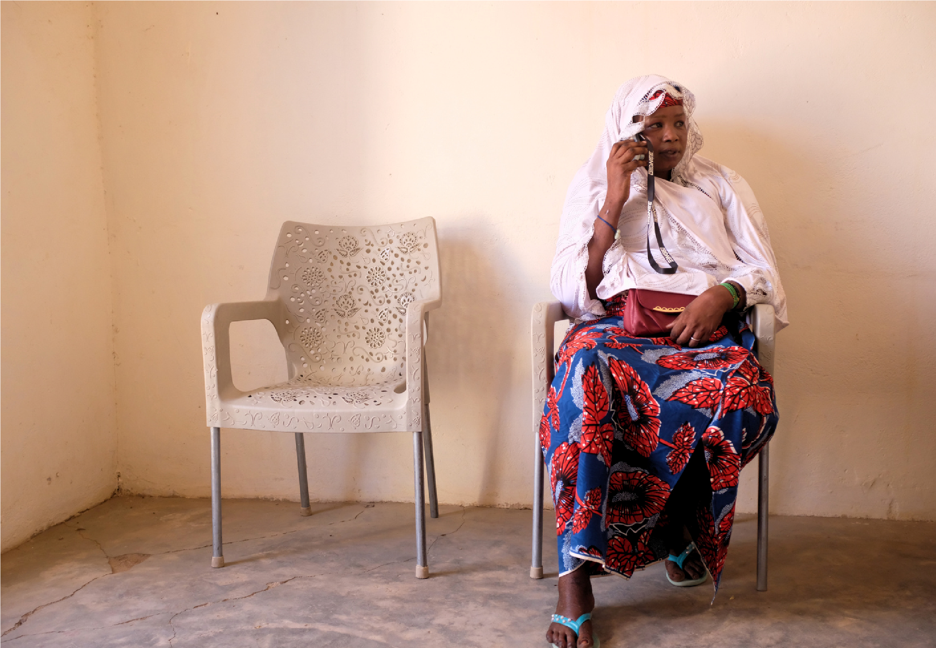
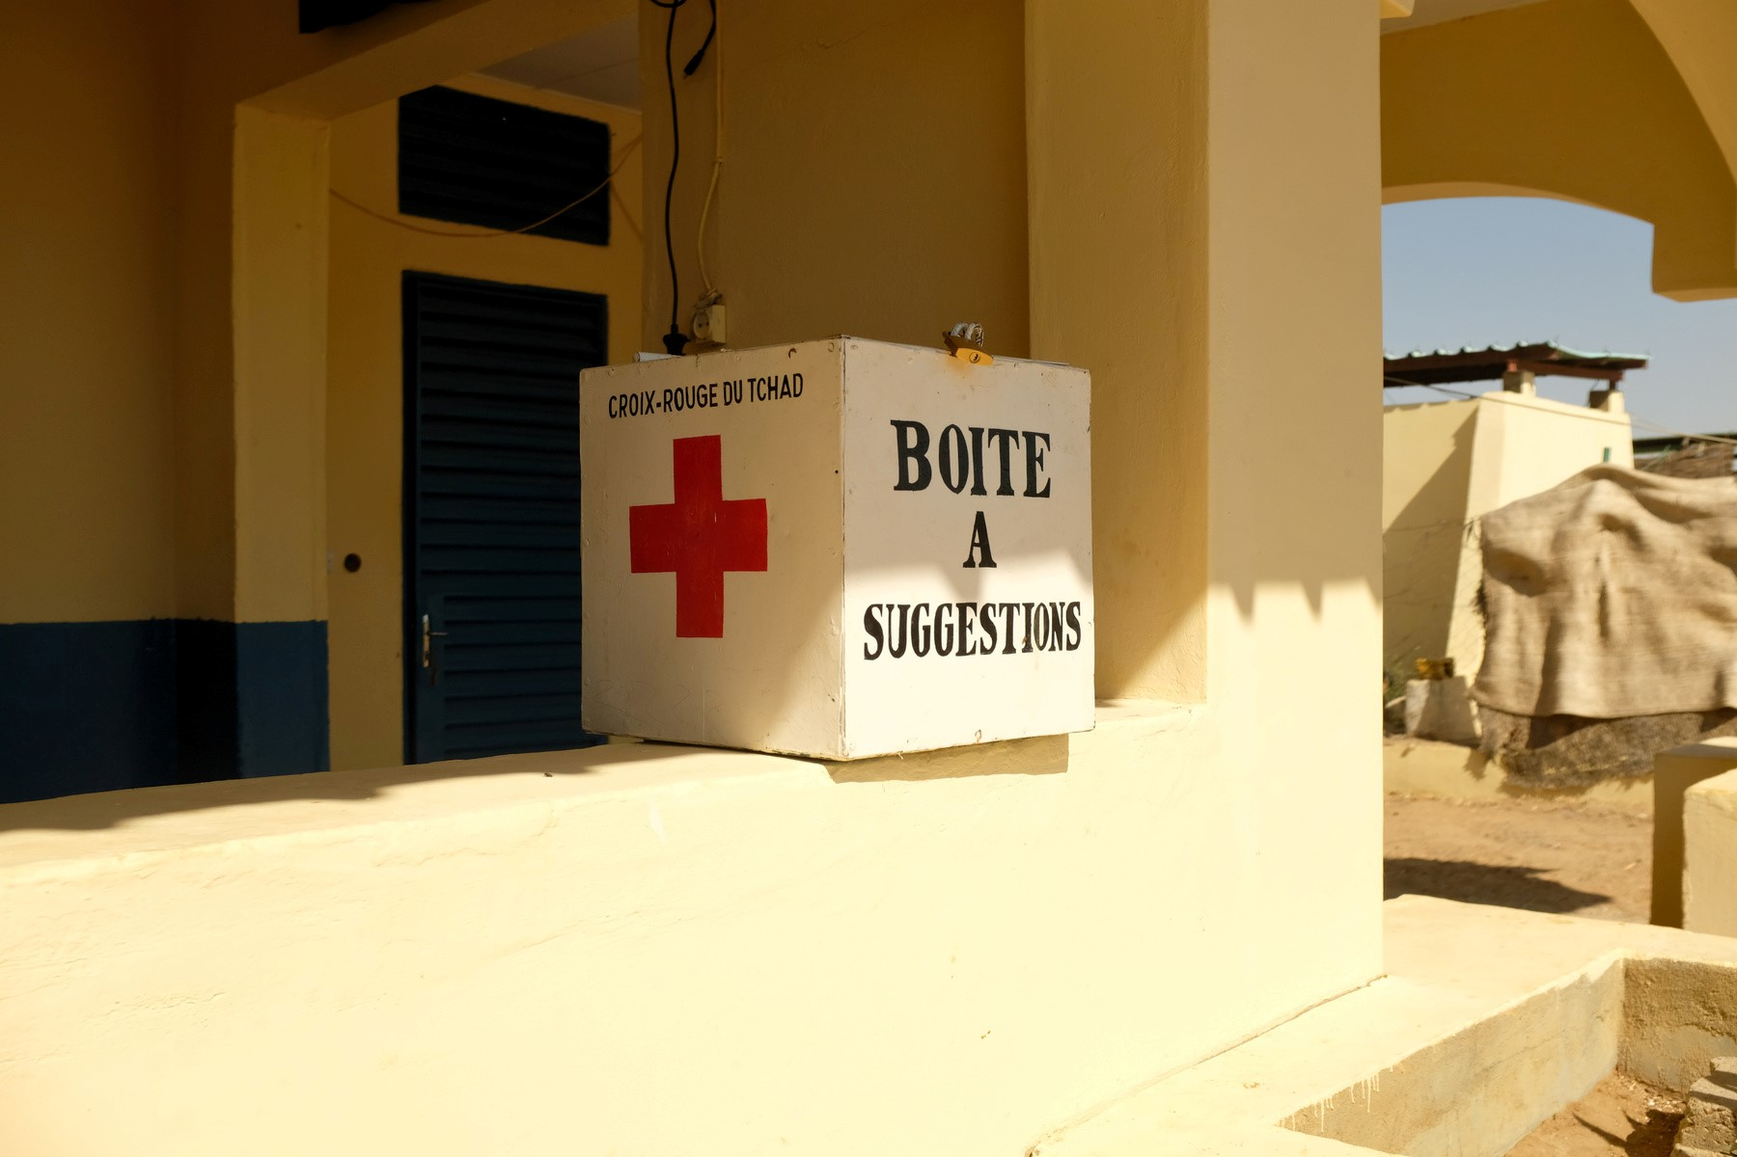
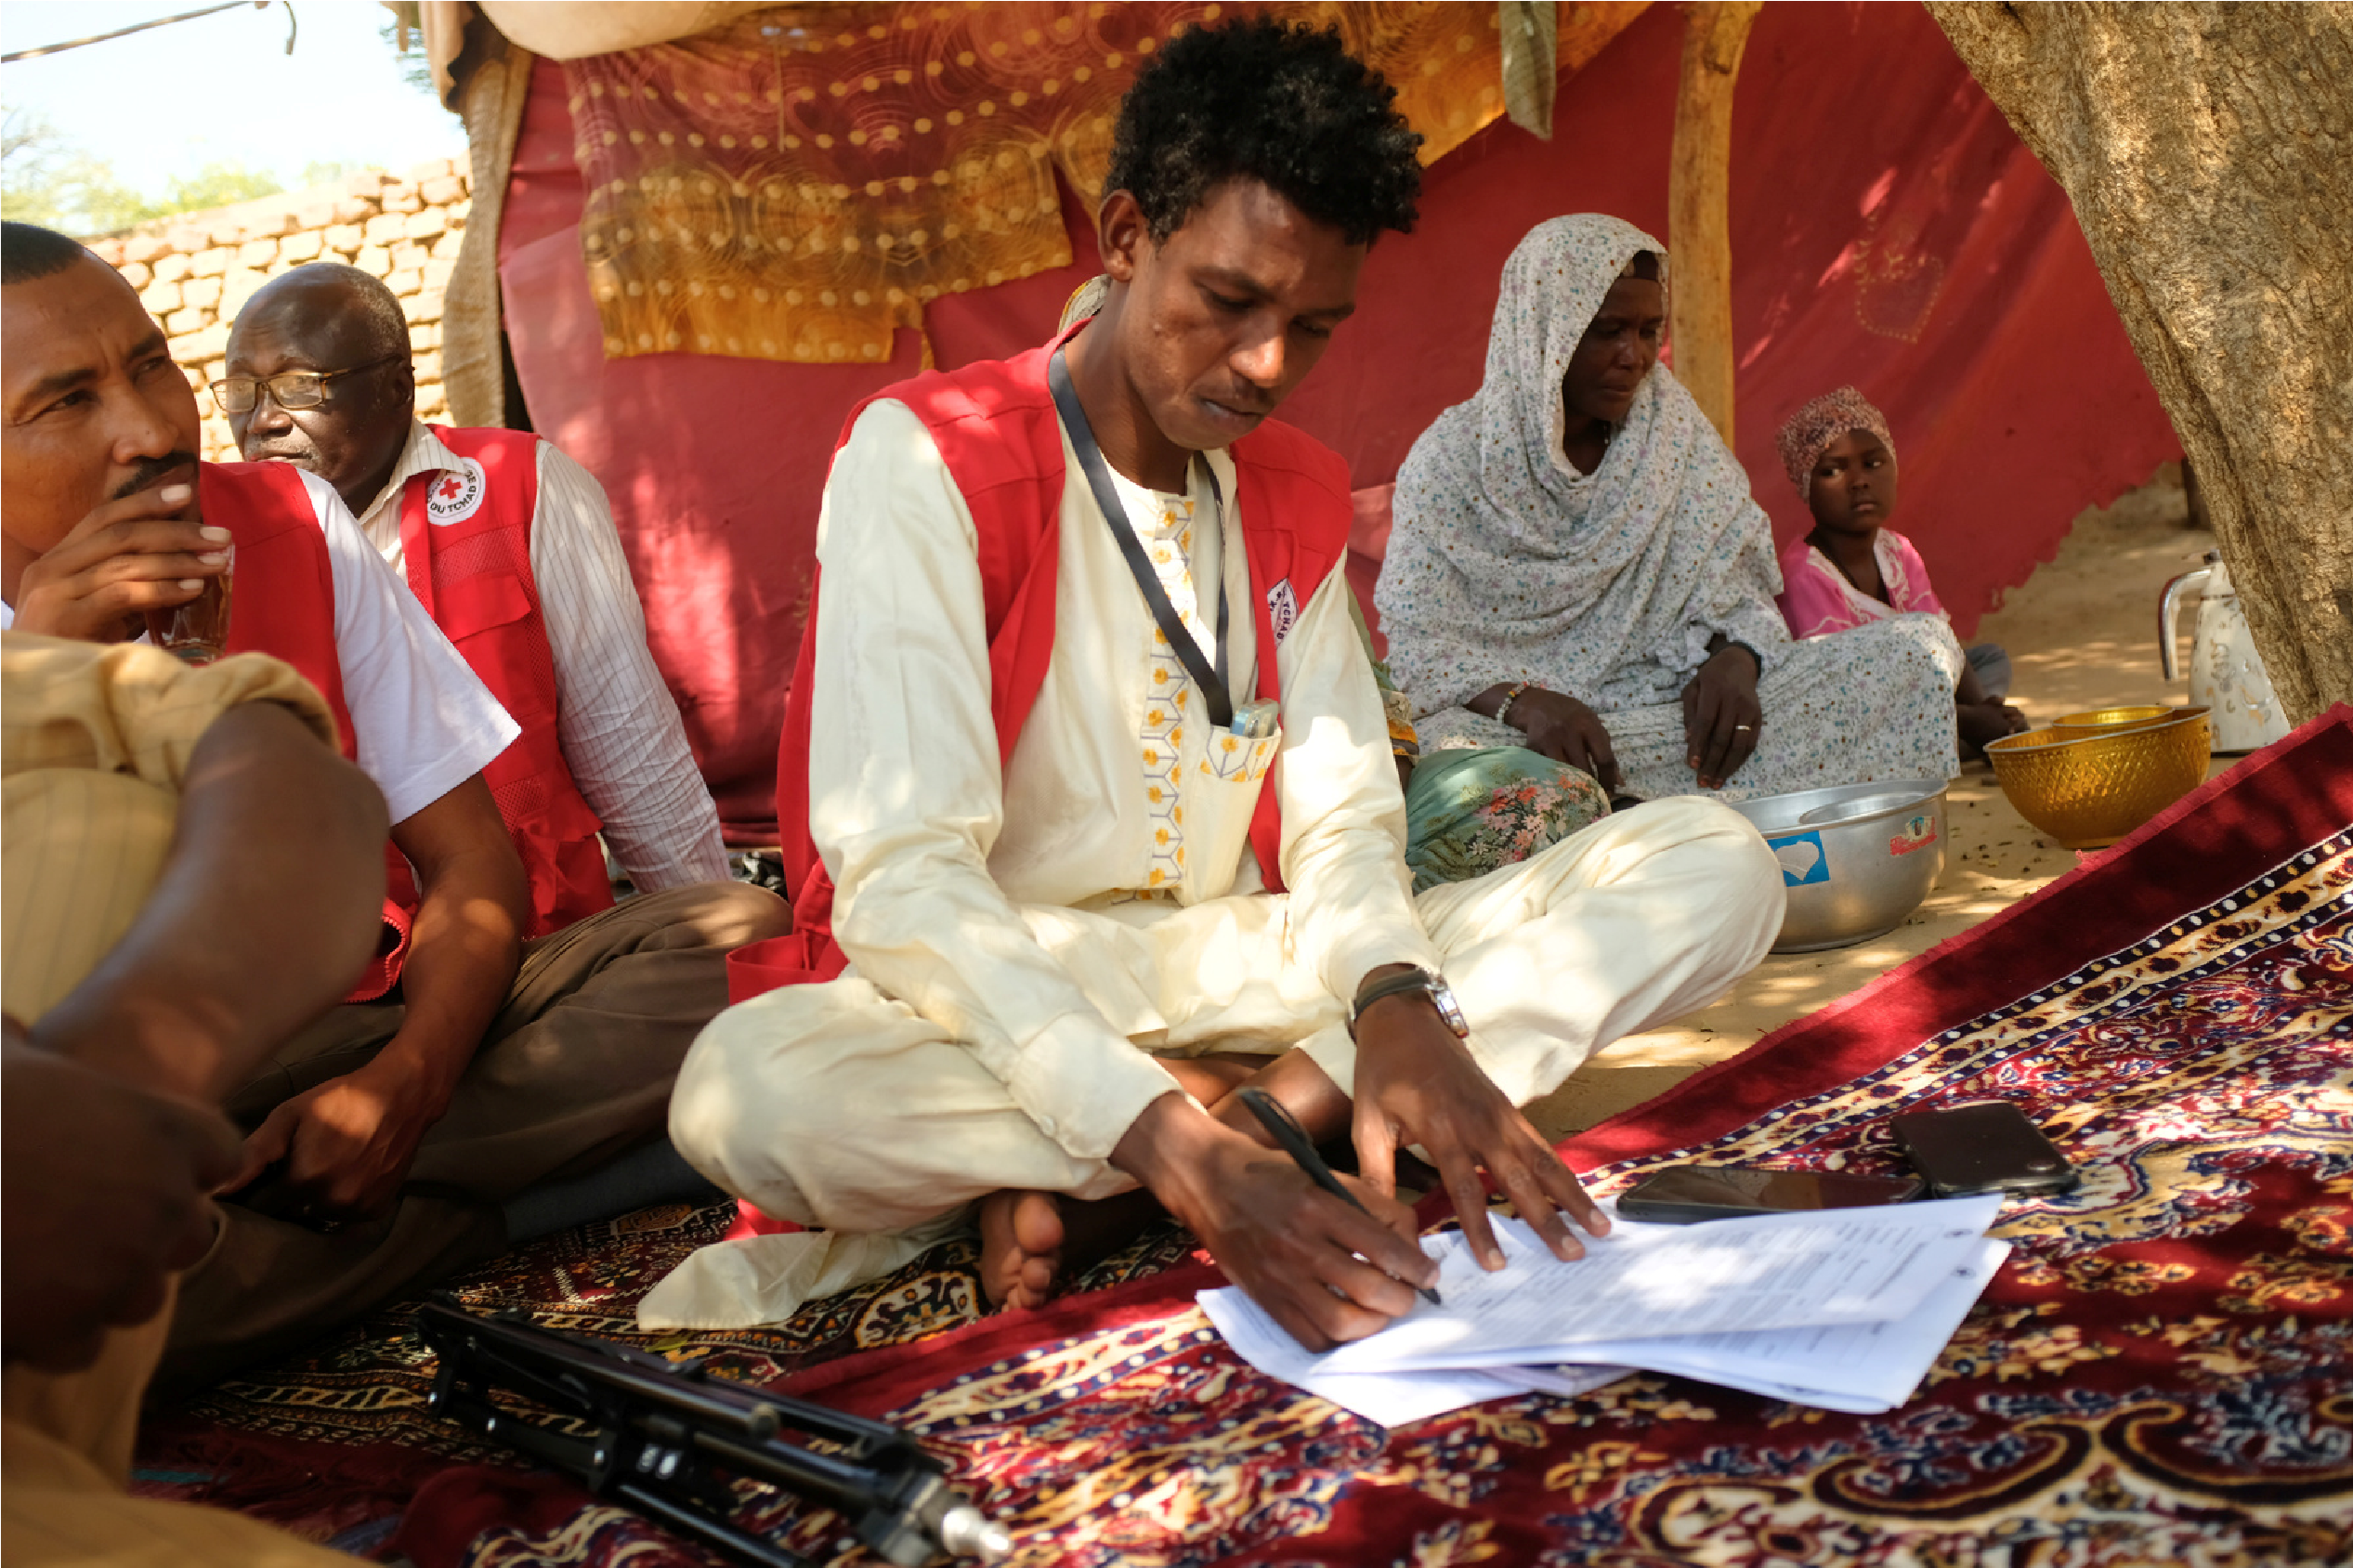
Feedback mechanisms
Suggestion boxes
Set up in partner health centres, these mechanisms allow migrants to anonymously submit their feedback. Management committees meet every two weeks to analyse the input and coordinate appropriate responses.
Toll-free hotline
A toll-free number is available, allowing migrants to express themselves remotely. This is especially useful for those on the move or who prefer the confidentiality of a phone call over in-person interaction.
Interviews and focus groups
Satisfaction surveys
Volunteers regularly conduct individual interviews and group discussions to gather qualitative information about migrants' experiences and identify emerging needs.
Conducted every two months using the Kobo Collect tool, these surveys systematically measure beneficiary satisfaction and identify areas needing improvement.

Slide 4
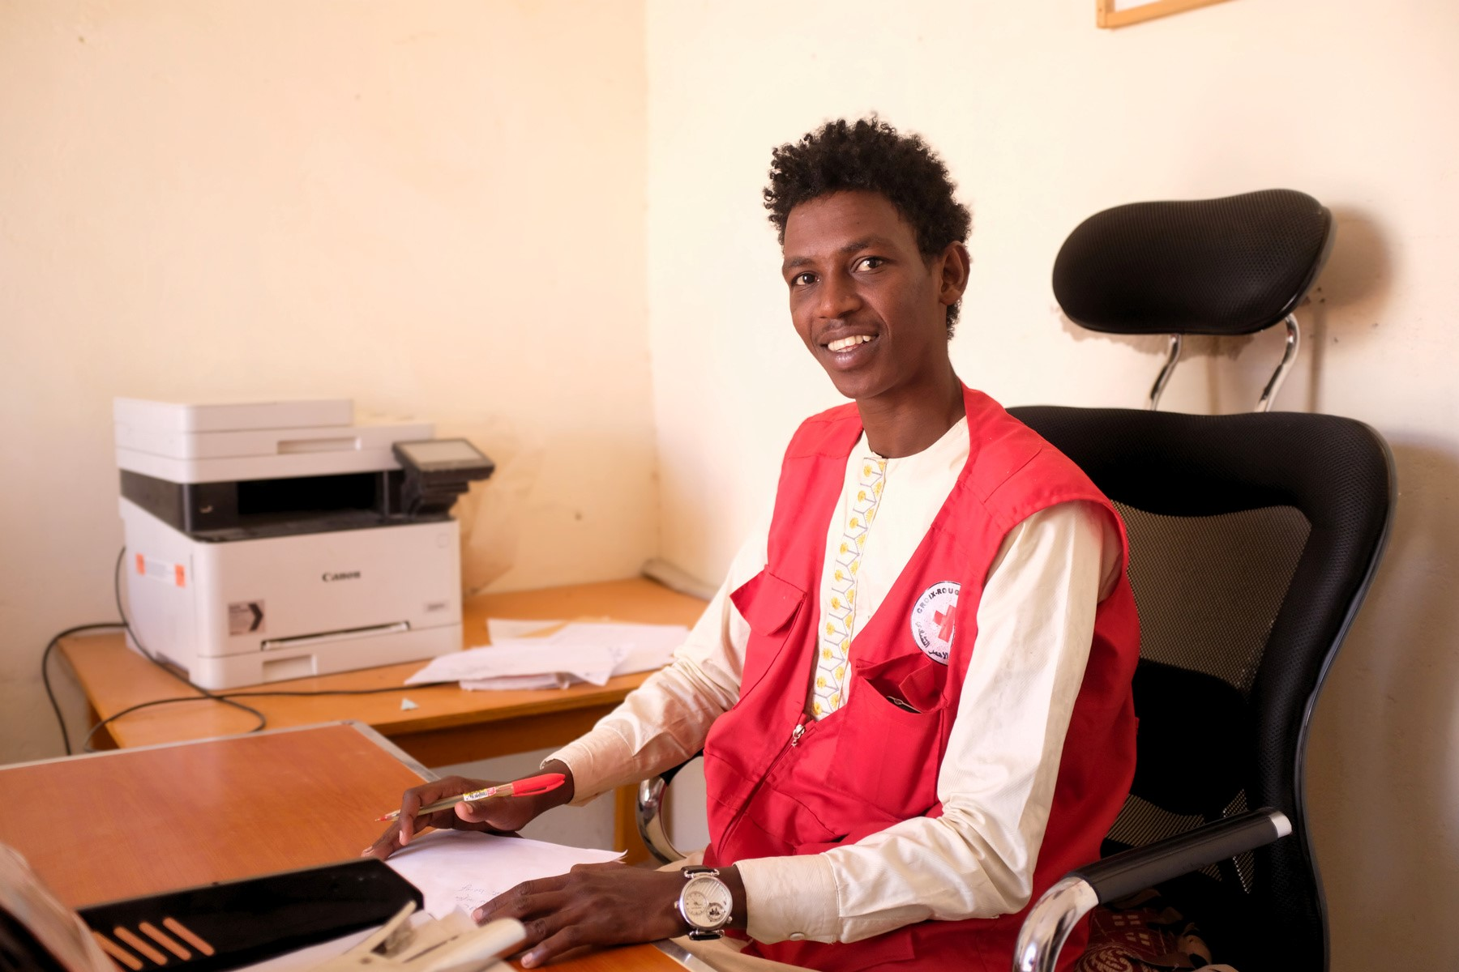
Impact of Feedback on Services
Feedback mechanisms have enabled migrants to express a wide range of concerns, from the quality of care to the need for material assistance. This data is analysed by program managers, leading to concrete improvements:
Increase in medical allowances
In agreement with the Ministry of Health, the care allowances were increased to better meet the needs of migrants.
Geographical expansion
New Humanitarian Service Points have been opened in Oum Hadjer and Abéché to improve territorial coverage.
The host family reported an issue regarding the arrest of a migrant following a misunderstanding. Thanks to this information, we were able to intervene quickly and secure their release.” — Supervisor of the Humanitarian Service Point
More effective referrals
Urgent cases now receive faster referrals to health or protection services.

Slide 5
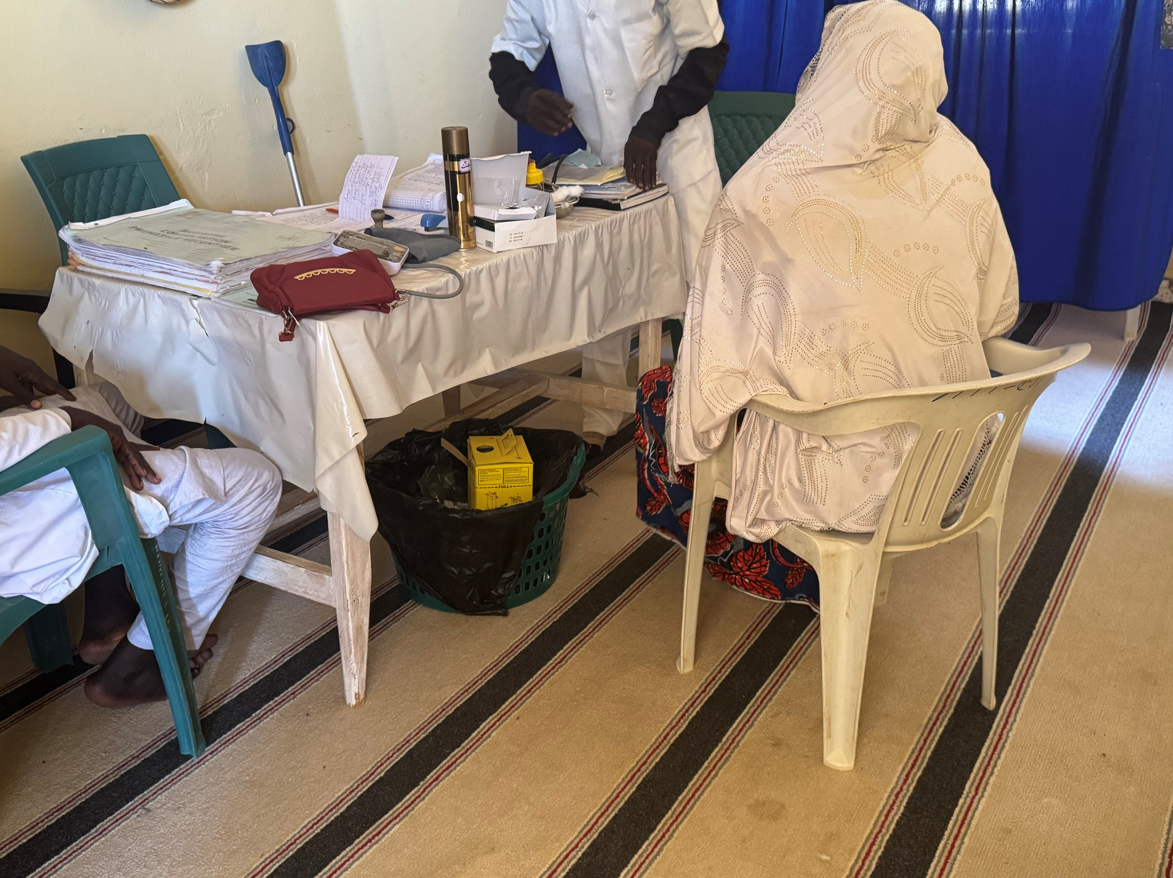
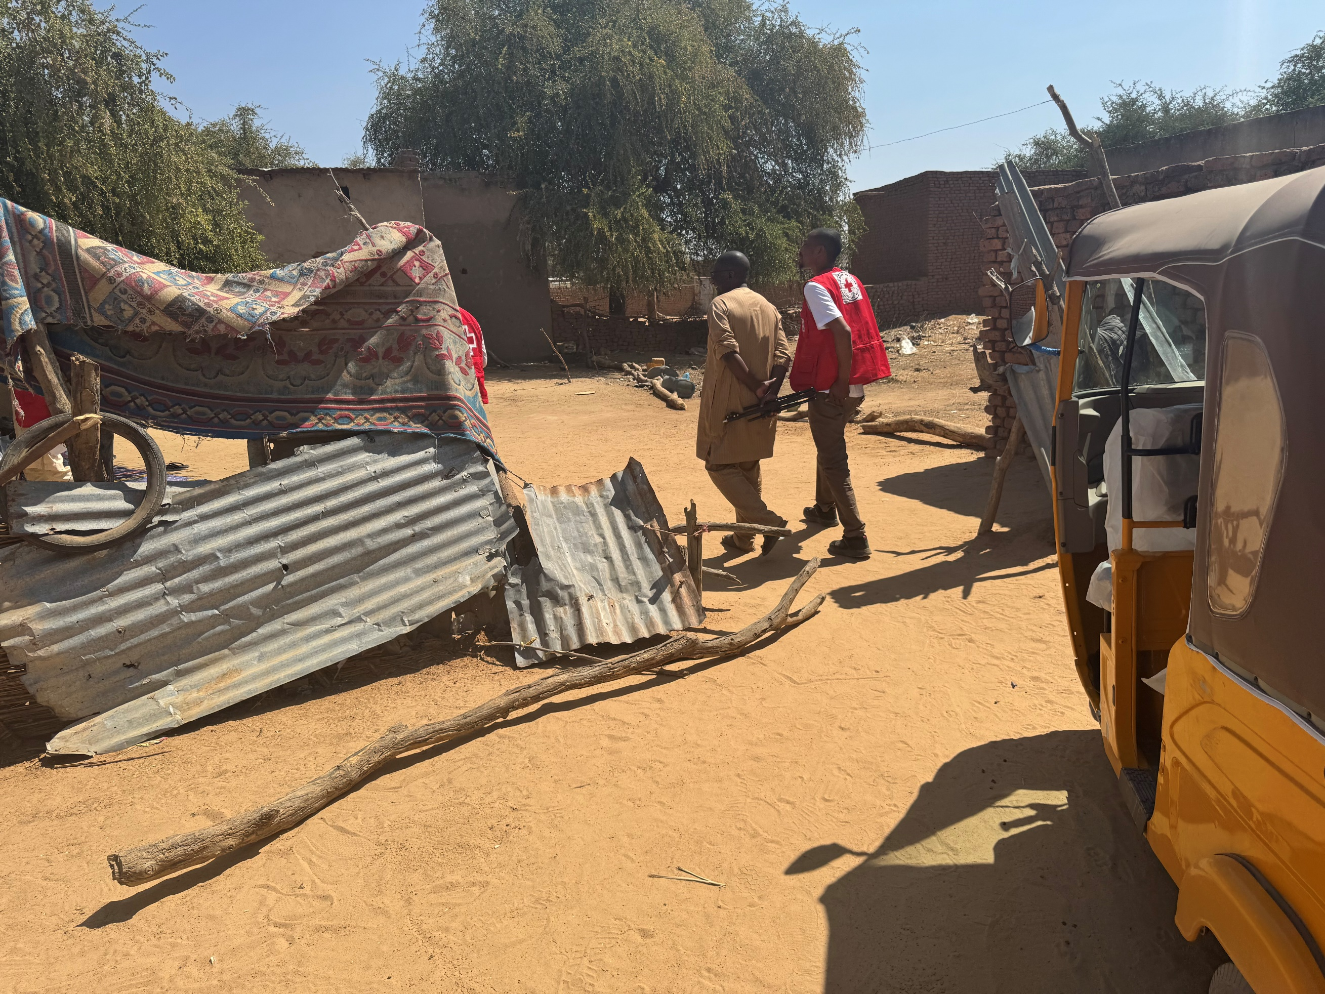
Essential Role of Host Communities
Host families
Community leaders
They provide temporary shelter, meals, and essential social support. These families often accompany migrants to health centers and act as intermediaries in case of language barriers.
These community leaders alert the Red Cross about new arrivals and facilitate their integration. Their involvement is especially strong as many of them have often been migrants themselves in the past.
“We were invited to N'Djamena to participate in a capitalization workshop. It allowed us to express our needs for the first time.” — Hamani Hamane, manager of a host home
When I arrived, I was helped. Now, it’s my turn to help those who arrive.” – Nigerien community leader

Slide 6
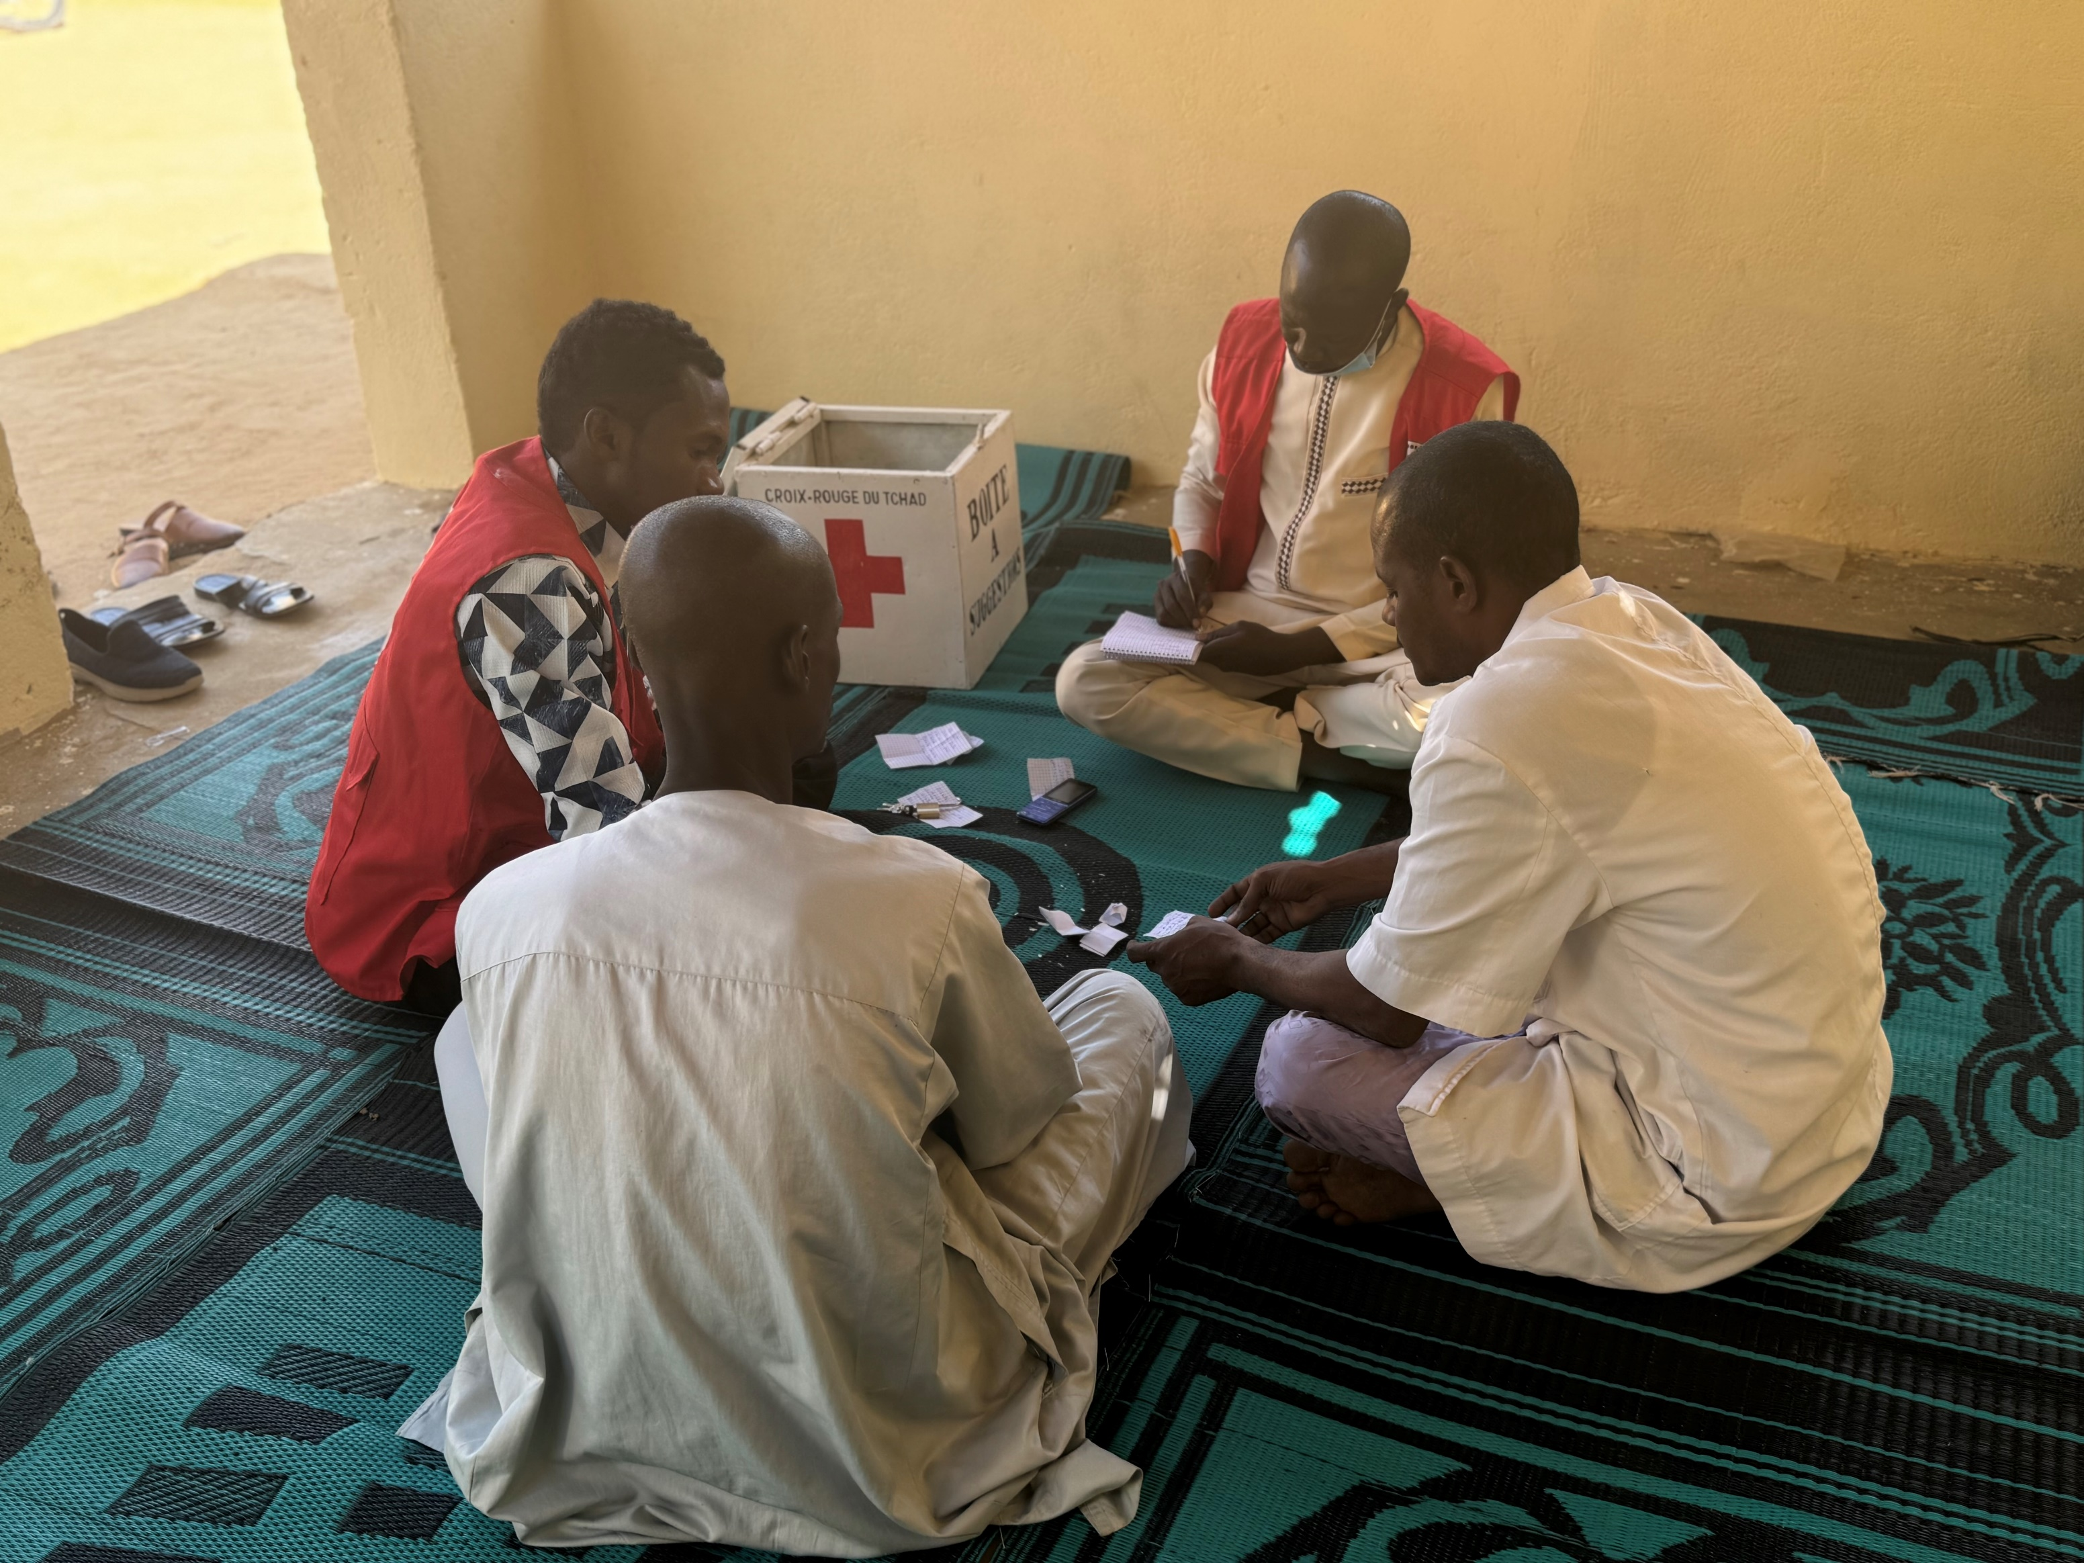
Results and Positive Impacts
Strengthened trust
Improvement of services
Active listening has fostered a climate of trust and strengthened the dignity of migrants:
The feedback has led to concrete adjustments in the services provided:
Increase in medical allowances
Frequent messages of thanks
Strengthening of protection services
Direct requests to volunteers
Geographical expansion of humanitarian service points
Expressed satisfaction with the reception
Identification of obstacles
Community involvement
The analysis of feedback revealed challenges to overcome:
Local actors are now recognised as essential partners:
Limited placement of suggestion boxes
Participation in management committees
Lack of awareness about the toll-free number
Invitation to capitalization workshops
Barriers related to illiteracy
Recognition of their expertise

Slide 7
Lessons Learnt
1
Diversity of channels
1
Inefficient manual processing
Offering multiple feedback mechanisms helps reach diverse migrant profiles but requires adequate resources to process the information.
Manual entry of complaints causes delays and undermines migrants’ trust as they expect prompt responses.
2
Importance of Collective Feedback
2
Language barriers
For anonymous complaints, collective feedback is essential to demonstrate that concerns are being addressed.
Illiteracy limits the use of written channels, especially among migrant women, requiring oral or visual alternatives.
3
Community Anchoring
3
Insufficient visibility
The involvement of community leaders and host families strengthens the legitimacy of actions and creates a lasting anchor within the communities.
The toll-free hotline remains little known and poorly understood by many migrants, highlighting a need for tailored communication.

Slide 8
Recommendations
Expand Coverage
Adapt materials
Install suggestion boxes in all places frequented by migrants (bus stations, host homes) and create listening points staffed by volunteers.
Design visual posters with pictograms and translations, tailored to different literacy levels, involving migrants in their creation.
Systematise Collective Feedback
Digitalise the process
Organise monthly sessions to share information on received complaints and solutions provided, communicated through volunteers and community leaders.
Use digital tools like KoboCollect to record and analyze feedback more efficiently, with a dashboard for real-time monitoring.
This experience of the Chad Red Cross demonstrates that with limited resources but a genuine commitment to listening, it is possible to have a significant impact on the quality of services and migrants’ perceptions. It can serve as a model for other National Societies seeking to integrate Community Engagement and Accountability (CEA) into their programs.
“This is a successful program, and I hope it continues, insha’Allah. Migrants really need it.” — RLF Volunteer

