Slide 1
Community Perspectives on Mpox: Insights from Four African Countries
November - December 2024

Slide 2
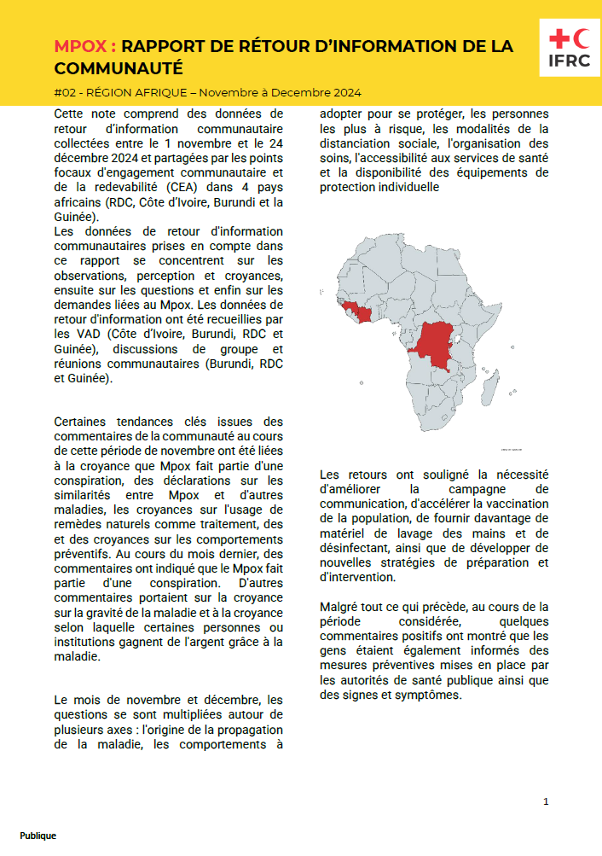
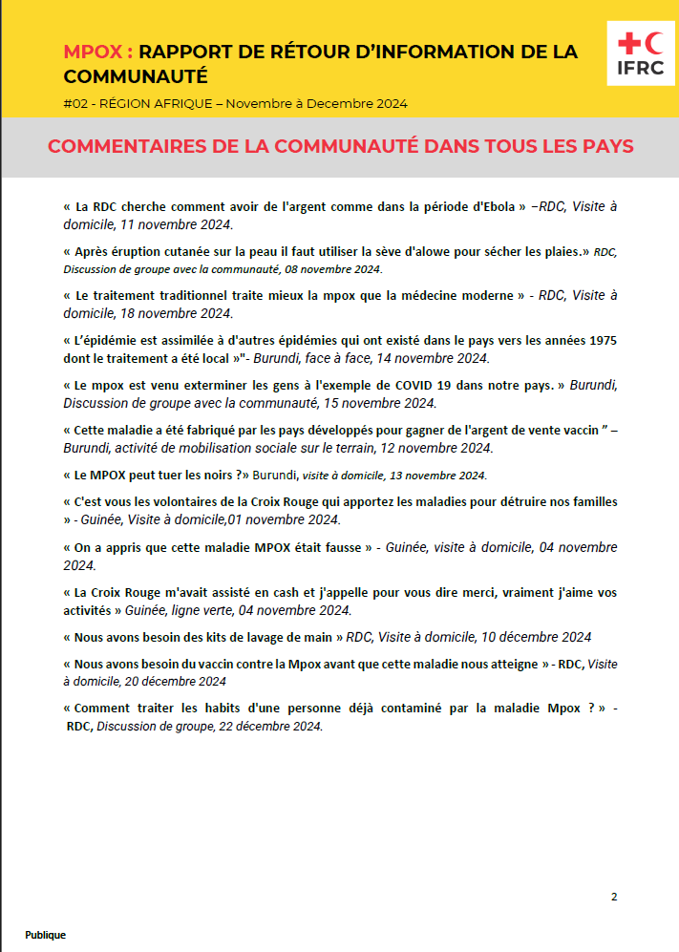
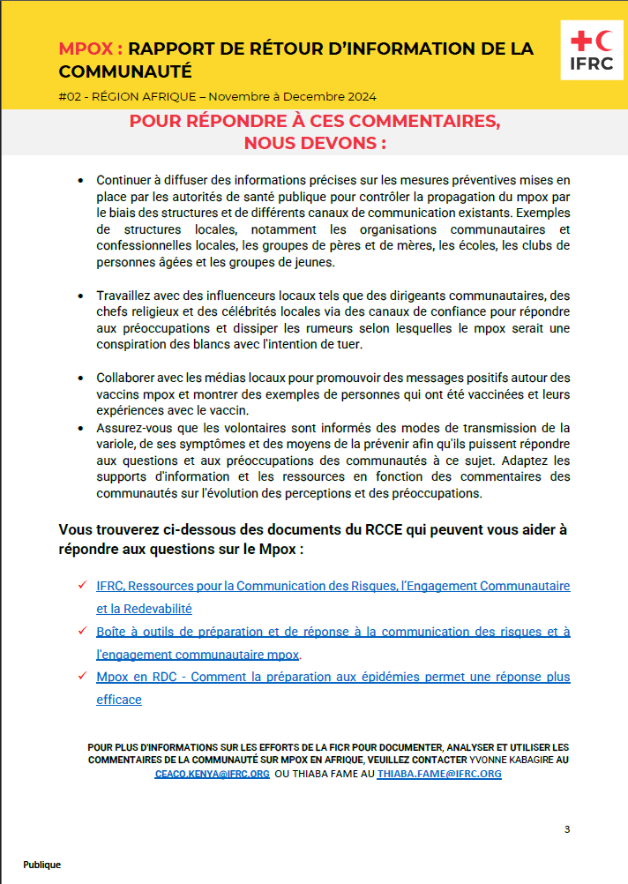
Purpose: To present key findings from community engagement on Mpox in four African countries.
Methodology: Data collected through VADs, group discussions, and community meetings.
Key themes: Beliefs, concerns, and requests.
Community brief

Slide 3
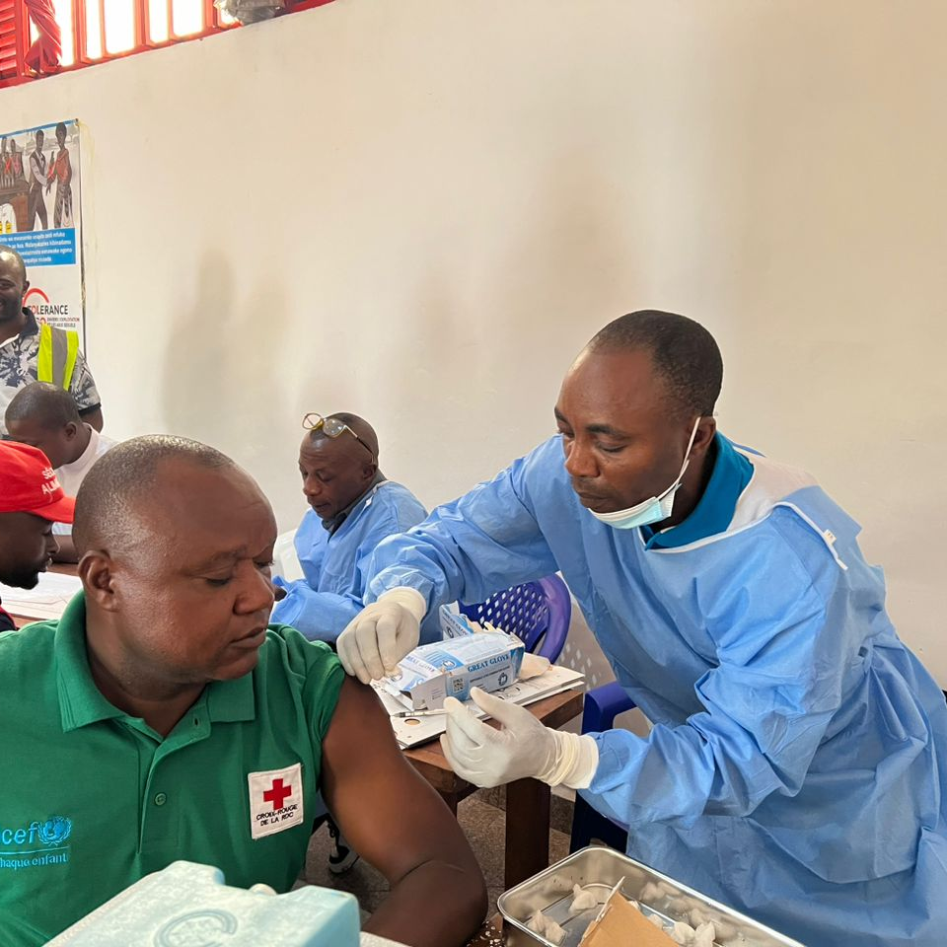
Key Findings: Beliefs
Conspiracy theories: Mpox as a conspiracy to harm specific populations.
Traditional medicine: Belief in the efficacy of traditional remedies.
Severity: Perceptions of the disease's severity.
Financial gain: Beliefs about individuals or institutions profiting from the outbreak.

Slide 4
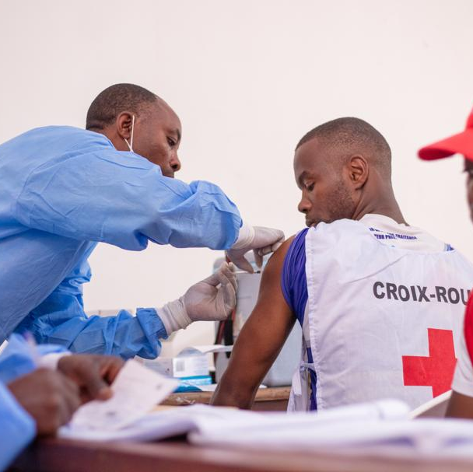
Key Findings: Concerns
Transmission: Questions about the origin and mode of transmission.
Prevention: Inquiries about protective behaviors, social distancing, and PPE.
Access: Concerns about healthcare access and availability of supplies.
Visual: A simple chart or graph representing the frequency of different types of questions.

Slide 5
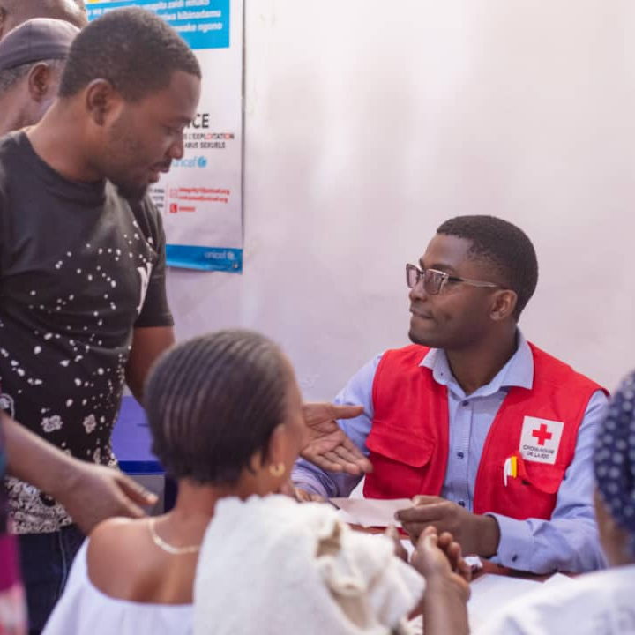
Key Findings: Requests
Improved communication: Need for clear, accurate, and culturally sensitive information.
Accelerated vaccination: Calls for increased vaccination rates.
Increased supplies: Requests for more handwashing materials and disinfectants.
New strategies: Suggestions for innovative approaches to preparedness and response.

Slide 6
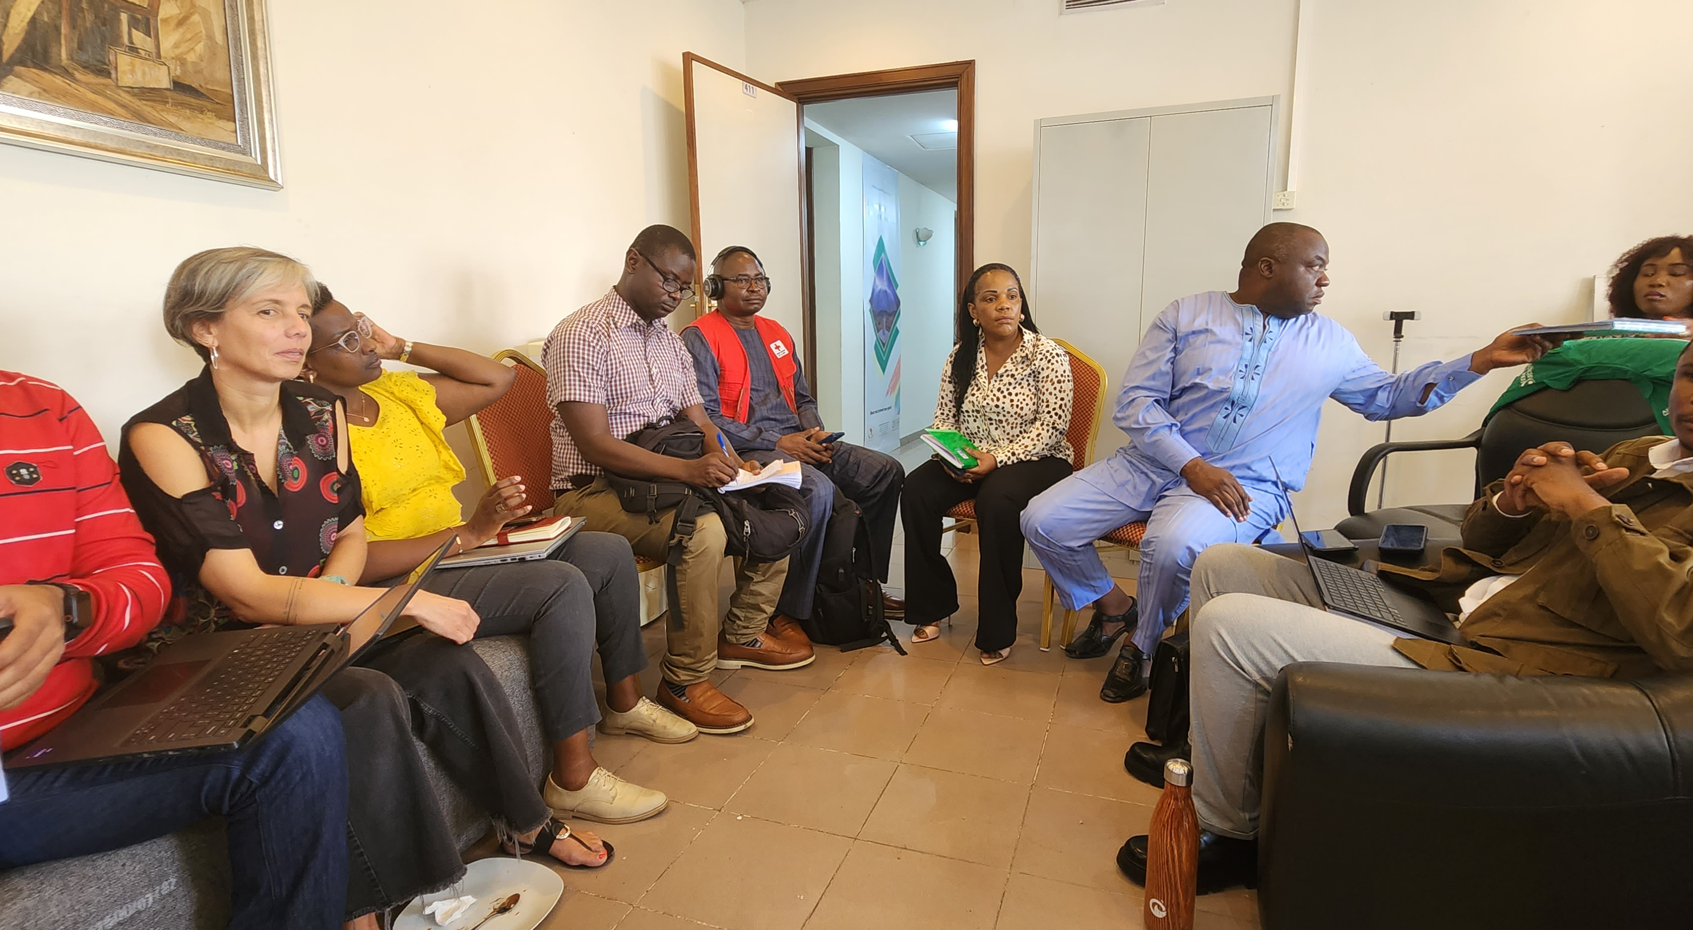
Community Quotes
La RDC cherche comment avoir de l'argent comme dans la période d'Ebola » –RDC, Visite à domicile, 11 novembre 2024
c
Le traitement traditionnel traite mieux la mpox que la médecine moderne » - RDC, Visite à domicile, 18 novembre 2024
c
Cette maladie a été fabriqué par les pays développés pour gagner de l'argent de vente vaccin ” –Burundi, activité de mobilisation sociale sur le terrain, 12 novembre 2024

Slide 7
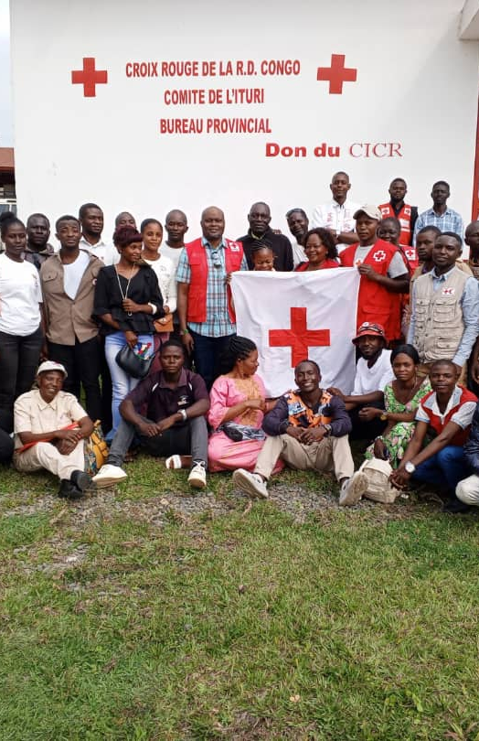
Addressing Challenges
Misinformation: Strategies to counter misinformation and build trust.
Mistrust: Building relationships with communities and addressing historical concerns.
Gaps in understanding: Tailoring messages to different audiences and addressing specific concerns.

Slide 8
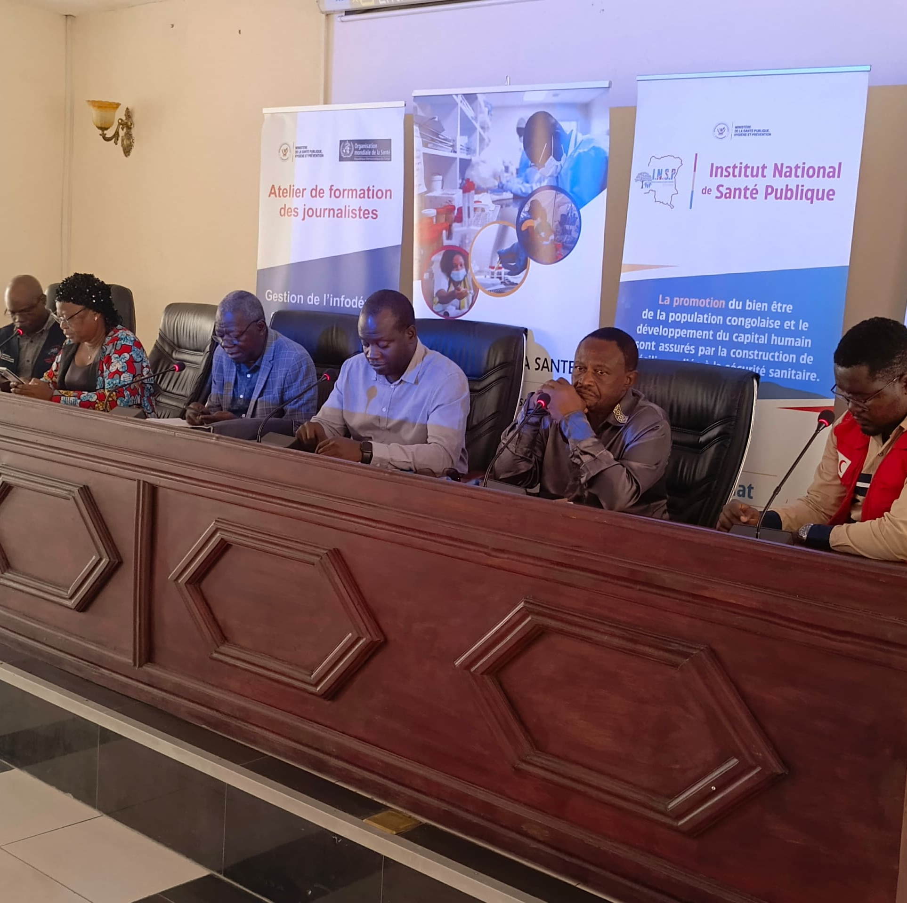
Recommendations
Continued communication: Utilize various channels and involve community leaders.
Accelerate vaccination: Collaborate with partners to increase vaccine coverage.
Provide essential supplies: Ensure adequate supplies of handwashing materials and PPE.
Develop new strategies: Explore innovative approaches based on community feedback.

Slide 9


