Slide 1
URCS Digital Feedback Mechanism Presentation –CEA COP-30th/01/2025
11-12-2024

Slide 2
Introduction
The Uganda Red Cross Society (URCS) is actively involved in leveraging data and digital products to enhance the speed and quality of delivering humanitarian assistance to communities in need.
The data and digital activities need to be implemented under the thematic areas of Community Engagement and Accountability (CEA).
URCS on the hand has lately adopted the Essential Themes where the other two themes of Protection Gender and Inclusion (PGI) and Safer Access Framework (SAF) are now systematically integrated as a trio in the running PPP project activities.

Slide 3
Objective:
Present outline Digital Feedback Mechanism
Discuss potential of mainstreaming within URCS

Slide 4
Why a digital community feedback mechanism?
Cross cutting
One feedback mechanism for all projects, activities and emergencies
One central place for multiple feedback channels
Closing the loop
More efficient process for answering feedback
More insight into feedback data, making it easier to report and act on feedback
Opportunities for scale
Possible to integrate with other (digital) channels
Easy to scale up/down based on needs

Slide 5
Rational
URCS 5-year strategy: Linked to URCS strategic priority of ‘Implementation of efficient mechanisms that support quality programming’
Improve the quality of engagement
Strengthen the PMER function of the National Society
Strengthen Information Management across all levels in the organization
URCS Digital Transformation strategy: Objective to digitalize the feedback collection and visualization process
URCS Essential Themes strategy: One of the objectives is to develop and implement a digital feedback mechanism to ‘close the feedback loop’

Slide 6
Branch Field visits to Bunyagabo and Kasese
Objective:To Identify feedback collection processes at community level
Meeting with branch managers to discuss current Community Engagement activities under PPP recent interventions on specifically Floods response
FGDs with community members
FGDs with local leaders
FGDs with branch volunteers
Courtesy calls with district officials especially DDMCS.

Slide 7
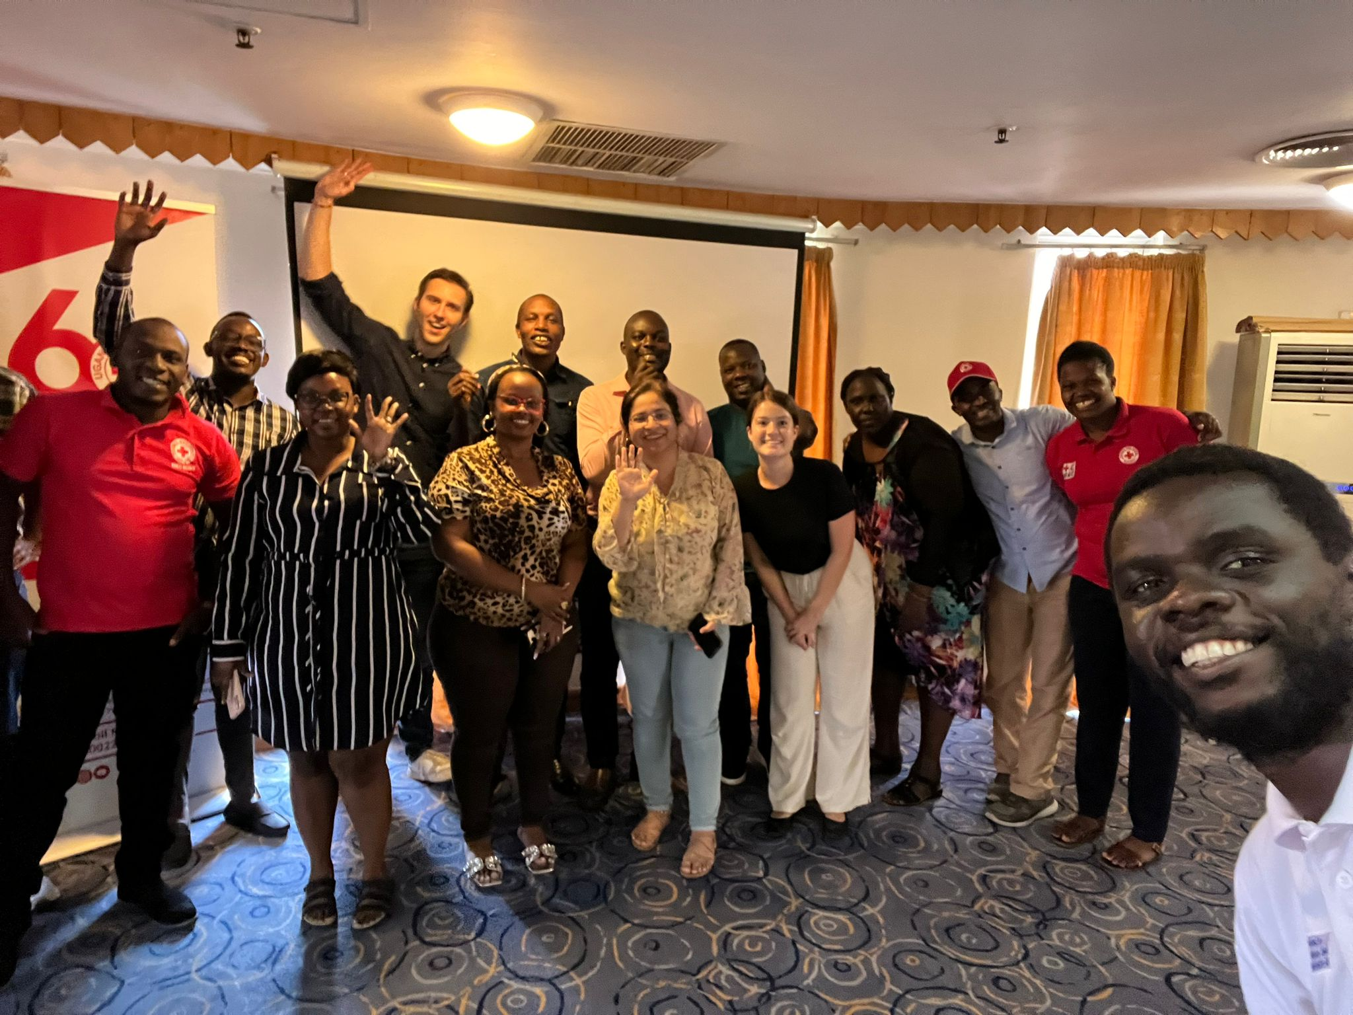
What happened next???
Co-development of the Digital feedback mechanism during 2-day workshop in Kampala.
Before workshop:
Getting an understanding of the IT capacities of the URCS IT team
Identification of available servers in the URCS
Preparation of workshop with CEA focal point
During workshop:
Analyse branch/community insights about feedback collection
Identify the communication channels, data collection processes and challenges
Identify the URCS users of the feedback mechanism and their data needs
Define the input for the feedback mechanism, aligned with URCS processes
Set up the first version of the feedback mechanism with the IT team using a designed Kobo Tool and link it to EspoCRM webbased app.

Slide 8
Feedback Channel Categorisation
Available feedback channels
Analogue’ channels
Digital channels
Face to face communication
Helpdesk/ feedback kiosk
SMS
Short code/Emergency/CEA Toll free lines
Community meeting
Radio talkshow
Whatsapp
PSEA complaints email
Suggestion box
Phone call

Slide 9
Users of the feedback mechanism
Branch level
HQ level
Community members
Program staff and branch field level deployed teams
CEA focal point
Program managers
IT team
Volunteers, third parties
PGI focal point
URCS departments
PMER focal point
Branch managers,BYC and BGB
SAF focal point
Partner organizations,Internal and External

Slide 10
Timeline
2023 Kick-off essential themes strategy
June - Nov 2024 Activation of CEA toll free line
December 2024 Start draft of digital CEA SoP
Continuation of strategy draft
February 2024 Digital CEA workshop
November 2024 Design & development of feedback mechanism

Slide 11
The digital feedback mechanism
URCS directorates
Directly calling toll free CEA line
Referall to URCS focal points/directorates to request follow-up
PGI focal point
IT team
SAF focal point
Digital & analogue communication channels
Collect and share community feedback through Kobo form
Community members
Branch managers, staff and volunteers
CEA focal point
Feedback is stored in central feedback mechanism
Follow-up on feedback with community members
Follow-up on feedback with branch staff
PMER
Using data from feedback mechanism for monthly/quarterly reporting

Slide 12
Costs for institutionalization of system
EspoCRM advanced package: 1,035,400 UGX ( Appr 280 USD) for 2 years
Azure cloud hosting: around 2,440,600 UGX (Appr 660 USD) additional credits required yearly
Kobo IFRC account: Free
HR: additional CEA/IT operator to support with managing the system and the CEA toll free line

Slide 13
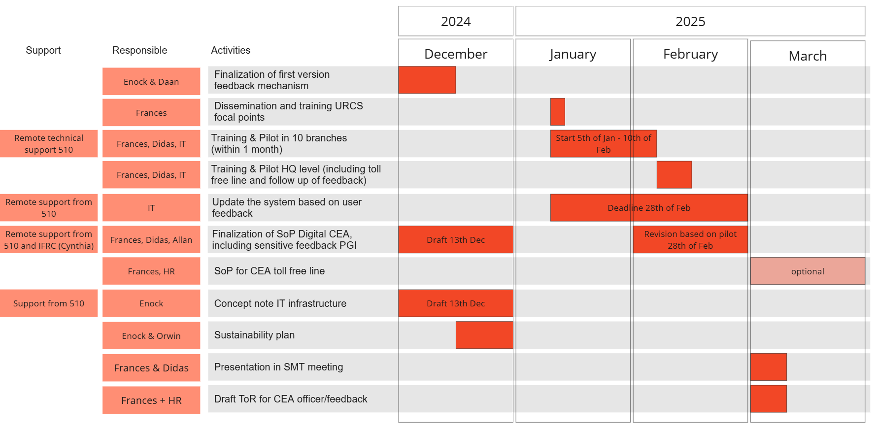
Roll out plan

Slide 14
Thank you- Presented by Frances Amulen- CEA Officer-URCS

