Slide 1

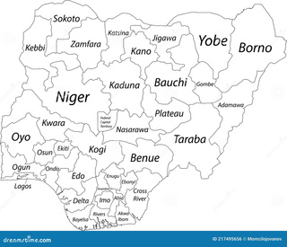
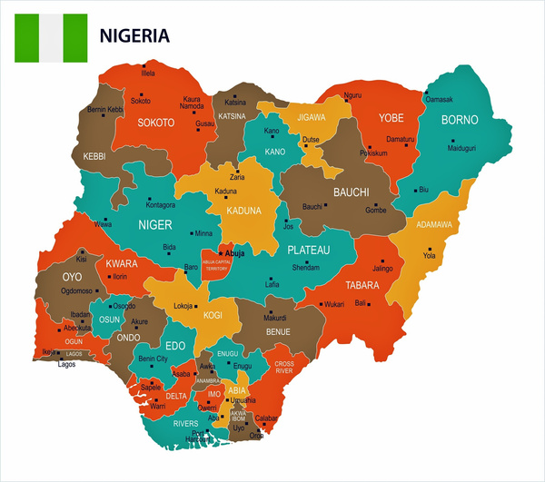
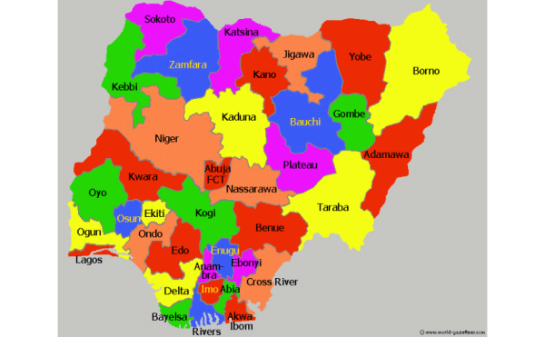
Where We Are.....
Manual/Non-Existent
Manual
Digital
Digital/Evidence based

Slide 2
How?
  Manual Community Meeting Form
  Excel Sheet/period implementation meetings/setting up of more feedback channels
  IFRC Feedback Log
  Adoption of the NRCS Master feedback form
  Development of and Approval of NRCS CEA Policy
  PowerBi
  Branch Focal points/Sharing for adaptation.
  Community led impact stories

Slide 3
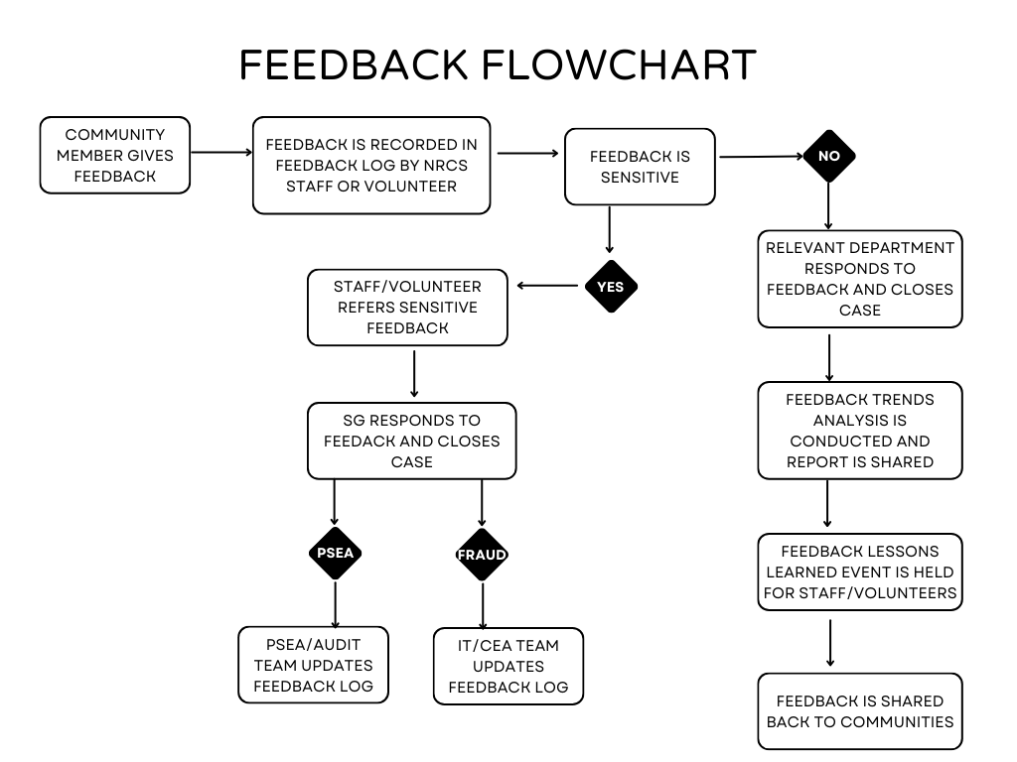

Slide 4
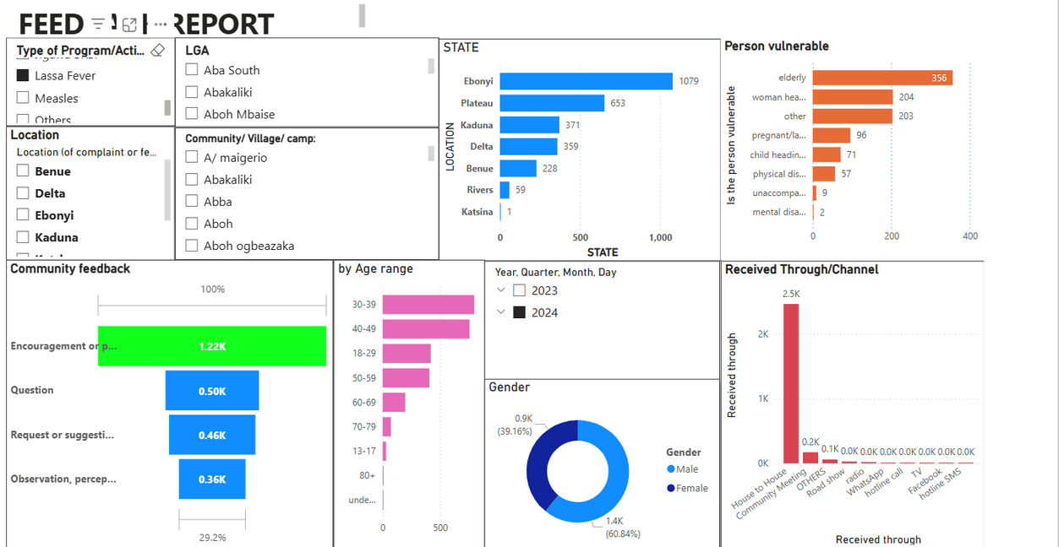
NRCS Feedback Dashboard

Slide 5


Slide 6
Key Areas for improvement
  Data entry
  Properly closing the loop
  Increased adaptation

