Slide 1
Community Feedback Design Workshop
[date]

Slide 2
Purpose of this workshop
Clarify what we mean by a feedback mechanism, and why we need it
Review what has been achieved and can be built on, and determine where we want to go
Agree on concrete roles and responsibilities, and how to work together
Develop an action plan
Notes:
FACILITATOR NOTES
Explain the purpose of the self-assessment and planning workshop:
Clarify what we mean by a feedback mechanism, and why we need it
Understand what we have achieved already and what we can build on and determine where we want to go
Agree on concrete roles and responsibilities, and how to work together
Develop an action plan for setting up or strengthening a feedback mechanism

Slide 3
In pairs discuss…
(5 mins)
Expectations for this workshop
What you expect from a functioning feedback mechanism
Notes:
FACILITATORS NOTES
Ask participants to discuss with the person next to them the questions on the slide – give them 5mins
Then ask each pair to share one thing they said that surprised them, or they really agreed with – ask people to do this quickly

Slide 4
QUESTIONS?

Slide 5
What is a feedback mechanism?
Notes:
SPEAKERS NOTES

Slide 6
A feedback mechanism
comprises the tools and processes for
receiving feedback
managing, analysing, and sharing feedback data,
ensuring feedback is acted upon and
providing communities with a response and informing them of the actions taken
“central” means that it can be used for any project or operation

Slide 7
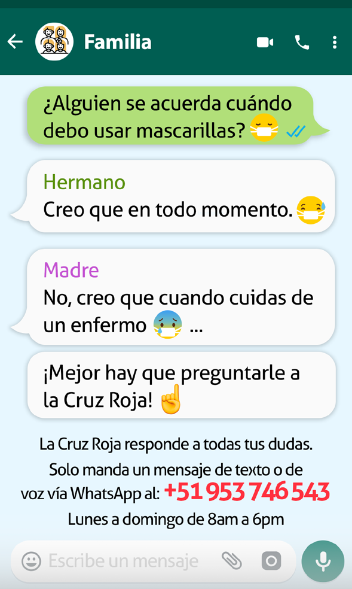
Examples of feedback mechanisms?
Discuss…
Face to face feedback collection in DRC for Ebola
WhatsApp in Peru for COVID-19
Hotline for hurricane Dorian in the Bahamas
Notes:
FACILITATOR NOTES
These examples can be changed for ones from your country or region
BEFORE showing the contents, ask if anyone in the room has an example of a feedback mechanism they can share
WhatsApp in Peru for COVID-19
When the COVID-19 pandemic forced the Peruvian Red Cross (PRC) and IFRC to suspend face-to-face activities with the Venezuelan migrant population, they needed to find a new remote way to provide assistance and respond to feedback. A previous assessment had found that 78 percent of Venezuelan migrants in Peru have access to a mobile phone and 99% use WhatsApp and Facebook to receive information.
So, a WhatsApp business line was set up to answer questions or doubts about the pandemic, provide information on prevention, and identify, monitor, and address rumours or fake news related to COVID-19.
A set of key messages on COVID-19 prevention and response, along with a question-and-answer sheet, were prepared in advance to be used by the WhatsApp line operators. Initially the line was launched with two community engagement operators, but later medical staff were brought in to support with certain questions.
A WhatsApp group was also created between operators to help coordinate replies and guidelines developed to log and track responses. Since its launch, the line has proven very popular and now responds to a much wider range of enquiries, including supporting the Peruvian population
Face to Face Feedback Collection in DRC for Ebola
DRC Red Cross and IFRC, with the support of US Centres for Disease Control, established a system to systematically collect, analyse and act on community feedback relating to the Ebola operation in Eastern Congo.
During house visits and community meetings, volunteers captured concerns, rumours and questions using paper forms.
The feedback data is coded and analysed locally and shared with local government-led risk communication commissions and Ebola response leaders as well as regional and global partners, to inform strategic discussions and decisions.
By the end of the Ebola response, more than 1 million feedback comments had been collected by over 800 Red Cross volunteers. The feedback data helped the Red Cross operation to respond to community concerns and suggestions in real-time, which built trust and acceptance for health interventions. For example, comments received about family members’ need for visual confirmation that their loved one was in the body bag led the Red Cross to acquire transparent bags. Using transparent bags also helped address perceptions that the bags were filled with rocks or dirt because body parts have been removed and sold

Slide 8
Examples of feedback mechanisms
Video endline from Bangladesh documenting their experiences of setting up a community feedback mechanism for a disaster risk reduction programme
https://www.youtube.com/watch?v=DcxccMPe3AE&list=PLrI6tpZ6pQmTuWgH38XkEoLGjZytfUdAR&index=21
Notes:
FACILITATOR NOTES – optional slide with a video documenting a feedback mechanism in Bangladesh. Video is 10mins long

Slide 9
Types of feedback mechanism
People contact us
E.g. hotlines, helpdesks
We ask for feedback
E.g. FGDs, surveys
Available on demand
Can capture any kind of feedback
Can collect feedback on specific topics
Some cultures prefer to be asked
Needs to be advertised and explained
We rely on people contacting us
Can miss feedback on other issues
Not available when people need it
For permanent feedback mechanisms
If people need to be able to contact us
Understanding the community
For tracking perceptions e.g., a disease
The best feedback mechanisms will use a mix of reactive and proactive approaches
Notes:
FACILITATOR NOTES
There are two main ways to collect community feedback. Through a reactive system where people come to us when they have feedback to share (e.g., a telephone hotline, helpdesk. SMS system, suggestion boxes), or a proactive system, where we actively solicit feedback (e.g., FGDs, house-to-house visits, surveys, KIIs). Though, some channels can be reactive as well as proactive (e.g. volunteers in communities, community committees, social media, etc.)
Advantages/Disadvantages:
Reactive Channels:
They are available when people need to use and it can capture any kind of feedback that people want to share.
It’s often more structured, so it’s easier to follow when issues are raised.
However, the system needs to be advertised and explained well, otherwise people may not know how to share feedback.
If people don’t use the system, then we don’t get any feedback.
Proactive Channels
these channels can be used to collect feedback on specific issues that we want to know more about.
They also work well with people and in cultures where they may feel uncomfortable raising feedback without being asked for it.
However, when we ask specific questions, we might miss feedback on other topics.
If people don’t have regular access to channels, they might not be able to report issues when they need to.
Proactive cannels are often used when we want to have a more in-depth understanding of the community to track for example their perceptions of a disease so it can be harder to track and follow up with issues.
Both are important and the best feedback mechanisms will use a mix of proactive and reactive methods.

Slide 10
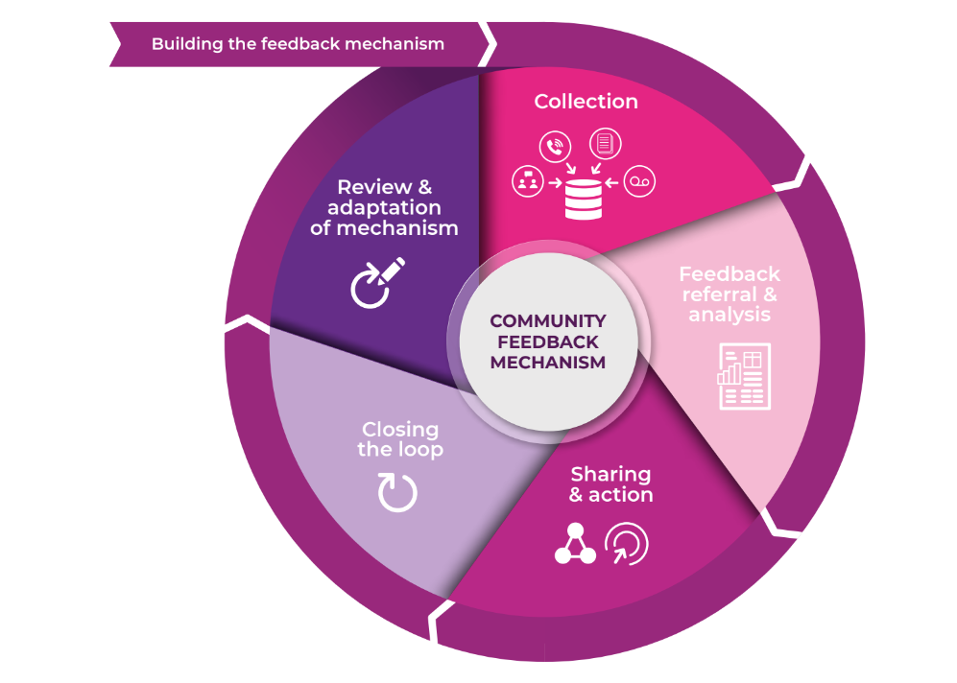
Notes:
FACILITATOR NOTES
The stages of a feedback cycle:
Building the Feedback Mechanism: We determine what kind of information is already received by the community, what additional channels might be required (based on the context and the community preference) and plan the feedback process together with the community. We need to clearly identify the processes to collect, manage, and share the community feedback and the roles and responsibilities of everyone involved.
Collecting Feedback: Feedback from the community can come through a formal channel (like a hotline or suggestion box) or through informal channels (like conversations with staff during other activities). No matter what form of feedback, it needs to be collected, recorded, and processed. This also means recording information about when and where it was collected and some information about who the feedback came from.
Feedback referral and analysis: Some feedback comments might be addressed immediately; others might have to be escalated to program teams or leadership. Once feedback has been recorded, need to sort and treat the different types of feedback according to the nature of the feedback (level of sensitivity or criticality). The feedback also needs to be analysed for immediate action and understanding longer-term trends.
Sharing and acting on feedback: The most essential step of the feedback cycle is gathering together to discuss what you have been hearing, what it means, and what we can do to address it. To facilitate this process, we need to share and discuss the findings with those who are in the position to act on the feedback. This includes internal discussions, external discussions (with peers and others) and, importantly, meetings with the community.
Closing the Loop: A fully functioning feedback mechanism is one in which the community knows what happens with the feedback they gave, a process referred to as “closing the feedback loop”. To close the feedback cycle, document the agreed action points and provide updates on what has been done with the feedback to the community.
Reviewing and adapting the mechanism: Carry out regular checks to make sure the feedback mechanism is working, and people still feel comfortable using it. This includes looking at who has been using the feedback mechanism, and who might not have access or trust in the system. This stage allows us to make improvements to the process and adapt to changes in the context and programming.

Slide 11
Why do we need a central feedback mechanism?
To more systematically understand the community context and needs
For better, more effective programmes and operations
To build trust, access and acceptance with communities
To uphold our own commitments
To help with fundraising
Notes:
There could be more correct reasons than those on the slide, but the five on the slide are the main ones
Why do we need to engage communities?
1. To understand the community context and needs
We need to engage with all groups and individuals in the community to understand their specific needs, preferences, and context. If we assume we know what people need or how things work in their community, we risk getting it wrong and providing support that doesn’t help, or even worse, doing harm. For example, by inflaming existing tensions or excluding already marginalized groups.
2. For better, more effective programmes and operations
Nobody knows the community better than the people who live there. When we draw on that local knowledge and expertise to plan and manage programmes and operations, we’re much more likely to get it right and provide support that is useful, timely, relevant and of a high quality. Listening to community feedback gives us an early warning when things aren’t working and provides valuable insights on how we can improve.
3. To build trust, access, and acceptance with communities
Open, honest communication and listening and acting on what people tell us, is a mark of respect which builds trust. Without trust people may not want to speak to us, use our services, believe the information we share or welcome our volunteers and staff safely into their community. When people don’t trust us, our ability to help them becomes harder and even impossible.
4. To strengthen community ownership and resilience
People affected by crisis are not helpless. They are usually the first responders in a crisis and have knowledge, skills and capacities which can help to ensure aid is relevant and sustainable. When we design and manage programmes and operations in partnership with communities, it facilitates local ownership and self-reliance. When we don’t engage them, we are treating them as passive recipients of aid, which undermines our efforts to strengthen community resilience.
5. To uphold our own commitments
Working in partnership with communities is at the core of who we are. The Principles and Rules for Red Cross and Red Crescent Humanitarian Assistance commit to feedback mechanisms in emergency responses. In December 2019, the first set of ‘Movement-wide Commitments for Community Engagement and Accountability’ was approved at the Council of Delegates (see page 21), and at the core of these commitments is to set up systems to systematically collect, analyse and act on community feedback
6. To help with fundraising
Feedback mechanisms are more and more a donor requirement. A feedback mechanism helps us to fulfill the criteria of a feedback mechanism and ensure accountability to our donors.
It also helps to showcase our comparative advantage. Most other organisations do not have a direct link to communities. The information community members share with us is relevant to various other stakeholders. A feedback mechanism enables s to play an active role in inter-agency coordination structures and to advocate on behalf of the communities we are aiming to serve.

Slide 12
QUESTIONS?

Slide 13
Overview of previous and current efforts

Slide 14
Previous and ongoing activities
[existing or previous feedback mechanisms]
[existing or previous staff supporting feedback work]
[existing tools]
[relationships with other partners collecting feedback]
[conducted trainings or workshops]
Notes:
FACILITATOR NOTES:
Update this slide to reflect any relevant activities and achievements, suggested points can include:
[existing or previous feedback mechanisms]
[existing or previous staff supporting feedback work]
[existing tools]
[relationships with other partners collecting feedback]
[conducted trainings or workshops]

Slide 15
Main steps of the feedback mechanism:
Collection
[eg: Feedback can be collected through any channel and entered using a KoBo form]
Referral and individual action
[eg: The system sends an email to the focal point to review and take action]
Analysis
[eg: All feedback comments are stored in central databases and visualized in a PowerBI dashboard]
Sharing & action
[eg: The dashboard can be used to discuss general trends and share highlights externally]
Closing the loop
[eg: Communities hear back about how the NS is addressing their feedback]
1.
2.
3.
4.
5.
Notes:
FACILITATOR NOTES:
If a feedback mechanism is already in place, provide an overview of how it works:
Collection
[eg: Feedback can be collected through any channel and entered using a KoBo form]
Referral and individual action
[eg: The system sends an email to the focal point to review and take action]
Analysis
[eg: All feedback comments are stored in central databases and visualized in a PowerBI dashboard]
Sharing & action
[eg: The dashboard can be used to discuss general trends and share highlights externally]
Closing the loop
[eg: Communities hear back about how the NS is addressing their feedback]

Slide 16
Determining the scale of our feedback mechanism

Slide 17
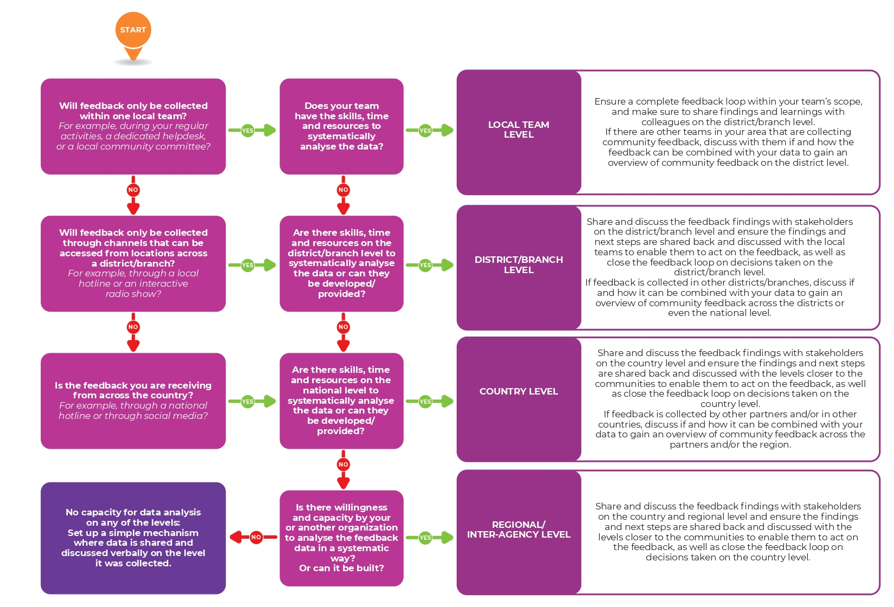
Notes:
FACILITATOR NOTES:
Print out the tool “Determining the scale of a feedback mechanism for the workshop participants”
Go through the decision tree together and discuss which level you reach

Slide 18
Defining the feedback channels

Slide 19
Communication channels for a feedback mechanism
INFORMATION PROVISION CHANNELS | FEEDBACK CHANNELS | RESPONSE CHANNELS
Are channels through which we can share information about our organisation, partners, programs, and response plans with the community in the areas where we work. These channels can be used to advertise the feedback mechanism, as well as share requested information. | Are channels through which we collect insights from communities about our work and services, about specific concerns including complaints, and anything else of importance to the community. This can include broad information about cultural and contextual conditions for the target population and misinformation spreading as rumours in the community. | Are the channels through which we respond to community feedback, usually during our process of “closing the loop”. It is important to remember that channels for collecting feedback are not always the appropriate channels to respond to the feedback.
Notes:
FACILITATOR NOTES
Depending on the stage you are in the feedback process, you will need channels for providing information, for receiving community feedback, and for responding to the community feedback:
INFORMATION PROVISION CHANNELS
Are channels through which we can share information about our organisation, partners, programs, and response plans with the community in the areas where we work. These channels can be used to advertise the feedback mechanism, as well as share requested information.
FEEDBACK CHANNELS
Are channels through which we collect insights from communities about our work and services, about specific concerns including complaints, and anything else of importance to the community. This can include broad information about cultural and contextual conditions for the target population and misinformation spreading as rumours in the community.
RESPONSE CHANNELS
Are the channels through which we respond to community feedback, usually during our process of “closing the loop”. It is important to remember that channels for collecting feedback are not always the appropriate channels to respond to the feedback.

Slide 20
Ways to collect community feedback
written communication
face to face
phone calls
voice recorder
Notes:
FACILITATOR NOTES
Every channel will be more or less accessible to different groups in a community, therefore only a combination of these can ensure the process is inclusive, and all community groups can be heard and are able to contribute.
Go through the different ways and mention the specific channels:
Channels can include:
Face to face interactions, eg. via a helpdesk, during community meetings or focus group discussions, in-person surveys or interviews.
Phone calls, e.g., via a hotline, phone surveys or interviews, radio show with call-in, or interactive voice response.
Voice recorder is placed at a safe place for community member to use them independently.
Written communication – either online e.g., e-mails, social media, chat bots or other online messaging applications, or offline, e.g. letters, suggestion boxes, SMS messages
Discuss the advantages and disadvantages of the different ways to collect feedback

Slide 21
WHAT kind of information do we receive?
Sensitive feedback
Any information that can put the person sharing it or other people linked to it at risk and needs to be handled with care.
Critical feedback
Any feedback that requires urgent/timely follow-up.
Notes:
Consider the sensitivity and criticality of the feedback
When thinking about your channels for communication, you should also consider the sensitivity and criticality of the feedback that you will be sharing, receiving, and responding to. Here is what we mean by that:
Sensitive Feedback – Any information that can put the person sharing it or other people linked to it at risk and needs to be handled with care. This involves any allegation related to serious violations of national or international law pertaining to the rights of the individual; any breach of the code of conduct or safeguarding policies; and/or safety and security threats targeting the humanitarian community. Sensitive feedback can be received as any type of feedback, such as report, a question, or a suggestion as it depends on the specific situation if it puts a person at risk if shared with others.
Critical feedback – Any feedback that requires urgent/timely follow-up. This can include issues like the delivery of spoiled food, potential security risks, signs of an outbreak of disease, or new rumours in the community that might directly threaten upcoming programming. Critical feedback comments need to be shared immediately with the person in the best position to address the comment.
Any feedback channel you open might receive feedback that is sensitive in nature, and/or that needs to be handled urgently, but some channels might be better suited than others. Again, a variety of channels helps us to handle all kinds of community feedback appropriately.

Slide 22
Key questions to answer before setting up a new communication channel
Which channels are we currently using to share information, receive feedback, and respond to communities?
Are there structures managed by the community or other partners that you can use?
Are these channels suitable and working?
Do you need additional channels?
Notes:
FACILITATOR NOTES:
Split up the participants into groups or conduct a discussion in plenary. Discuss the following questions.
Which channels are you currently using to share information, receive feedback, and respond to communities?
Which colleagues are already in regular contact with communities?
Do we have feedback channels for specific programmes and operations?
Are there structures managed by the community or other partners that you can use?
Do partners have feedback channels?
Does the Government have feedback mechanisms?
Which community structures are in place to communicate and manage grievances?
Are these channels suitable and working?
Are they used by the community?
Are these channels the preferred and trusted channel of the community? How satisfied are community members with these channels?
Are these channels suitable for feedback that might be sensitive or critical?
Is feedback treated confidentially? Are channels open at all times so that urgent feedback can be shared?
Are there groups of the community which might not be able to access the existing channels?
Do you need additional channels?
Can current channels be strengthened?
Are additional channels needed to address gaps?
Are there changes in the context that require new channels?
Are the roles that can be taken over by the community?

Slide 23
Results of data collection on communication channels
Notes:
FACILITATOR NOTES:
Present the data collected using the tool “Defining the channels for a feedback mechanism”

Slide 24
Mapping the
information flow

Slide 25
1. WHAT kind of information do we receive?
Operational feedback
This is feedback that directly relates to ongoing projects, programs, activities, or operations that are being undertaken by the ARCS.
Big-picture feedback
This is feedback about issues that fall outside of your specific projects or interventions and is often about strategic issues or broader challenges with the response efforts.

Slide 26
1. WHAT kind of information do we receive?
Sensitive feedback
Any information that can put the person sharing it or other people linked to it at risk and needs to be handled with care.
Critical feedback
Any feedback that requires urgent/timely follow-up.

Slide 27
1. WHO needs to see what kind of information?
Which technical sectors does the operational feedback refer to?
Who of your colleagues is best placed to act on feedback relating to these sectors?
If you don’t have a colleague, which other partners or stakeholders can you share the feedback with?
Does the operational feedback require individual follow up?

Slide 28
1. Drawing the information flow
Take into account:
how the information is collected
where it will be saved
who the different types of information need to be shared with
where this information will be discussed
how the feedback loop will be closed with the community

Slide 29
Mapping roles, responsibilities and resources
Notes:
FACILITATOR NOTES
Open the tool “Mapping and agreeing on necessary roles, responsibilities, and resources for a feedback mechanism” and project it on a screen
Review and adapt the tasks where necessary, assign a focal point for each task and identify necessary resources and support for implementing the tasks

Slide 30
Thank you for attending
Final questions?
Notes:
SPEAKERS NOTES
Ask if anyone has any questions.

