Slide 1
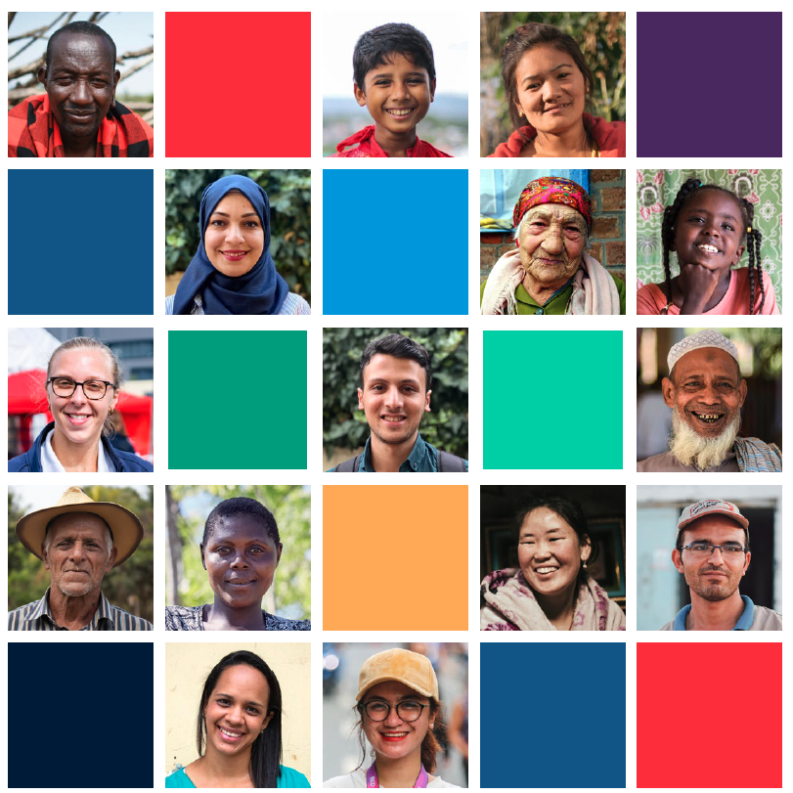
Community Engagement and Accountability for SDB in Marburg
1-hour module
Notes:
FACILITATORS NOTE ON THIS MODULE
This is a 1-hour training module covering the basics of integrating community engagement and accountability into Ebola operations, with a specific focus on Safe and Dignified Burials
It is adapted from the RCCE EVD for ECV training piloted in 2021, which is a full day long
The module comprises a PPT session, which includes short group exercises and plenary discussion with participants
You will notice that many of the slides are hidden. This is to allow you to shape this module to suit the time available and existing knowledge of participants, and what is most relevant for their role.

Slide 2
Learning objectives
By the end of the session the participants will understand:
The importance of RCCE in the response to Marburg
Risk Communication
Collecting and responding to community feedback
Community participation
Key CEA activities for successful Safe and Dignified Burials

Slide 3
Session 1 The importance of RCCE in the response to Marburg
Notes:
During this session, we will explain what risk communication and community engagement is within the EVD response.

Slide 4
What is
RCCE?
WHO
WE ARE

Slide 5
RCCE is the agreed interagency terminology for CEA for epidemic response
Risk Communication and Community Engagement
RCCE
Operational Communications
Communication for development
C4D
Beneficiary Communication
Community ​
Engagement &​
Accountability (CEA)
Community engagement
Accountability to Affected Populations
AAP
Community Communication
Communicating with disaster affected communities
CDAC
Communicating with communities
CWC
Accountability to beneficiaries/ communities
A2B
Beneficiary accountability
Notes:
FACILITATOR NOTES
RCCE is the term used to describe community engagement and accountability during a health response.
We use this term to be in line with WHO and UNICEF
But it doesn’t matter what you call it – as long as you do it
The main pillars of CEA:
Live-saving information: Employing a variety of community engagement approaches and trusted communication channels to reach and engage communities with accurate, easily understood and trusted health information about Ebola risk and transmission, causes, symptoms, prevention and treatment through trusted communication channels. This also includes sharing factual information to counter rumours and misinformation and reduce fear and stigma around the disease.
Feedback: Establishing systematic community feedback mechanisms to understand the beliefs, fears, rumours, questions and suggestions circulating in communities about Ebola so that we can stay in touch with communities and address what their real concerns are. Community feedback needs to be analysed and acted upon. For example, by changing the information we share to address rumours or fears, by changing our activities to better meet community’s needs and be more effective. It is important to give opportunities and open channels of communication for people and communities to ask questions and debate issues of concern.
Encourage behavioral change: CEA approaches need to go beyond information sharing and awareness raising and motivate people to ACT by adopting safe health practices or complying with infection prevention measures like staying at home. This means using two-way forms of communication to engage communities in discussions about Ebola and how it can be prevented.
Community-led solutions: It’s important to build community ownership of the Ebola response by identifying and supporting community-led solutions for preventing the spread of infection and bringing the outbreak under control, ensuring people’s active participation in the response. Asking people what they know, want and need, and involving them in designing and delivering Ebola-related services and prevention approaches improves the effectiveness of our community interventions and sustains the changes we promote.

Slide 6
Why
RCCE?
WHO
WE ARE

Slide 7
Why RCCE? Lessons from the Ebola/Covid responses in DRC…
Epidemics start and end in communities
So - we need to work with communities as partners
To do that, we need to build trust
To build trust, we need to listen and act
Respond to people’s questions and fears
Notes:
FACILITATOR NOTES
1. Epidemics start and end in communities. If we do not stop the spread of infection in the community, cases will continue to overwhelm hospitals. Treatment is important but is not the cure - we will not end this epidemic by treating cases, but by stopping transmission in the community.
2. Action at the community level will end this epidemic. Every community has its own challenges, as well as capacities. There is not one approach that fits all contexts so we as the Red Cross need to use our networks to go much deeper and work in partnership with communities, listen to their ideas, identify community-led solutions and support these to be implemented. This ensures relevance, acceptance and ownership.
We otherwise risk conducting activities and providing services that will not be used and accepted, wasting time and resources.
3. Community engagement is about building trust with communities. If communities do not trust us, they will not listen to us, they will not comply with infection prevention measure, including SDB, they will not allow us safe access to communities, they will not report cases, and quite possibly they will not use the ETUs if they have symptoms.
4. To build trust, we need to listen and we need to act on what communities tell us (as our president said in Dec). This means systematic community feedback mechanisms, analysis of that feedback and ACTING on it so that communities see we are listening and responding to their real concerns. This means not just changing what we say (messages) but changing what we do (response approach). Risk communication and community engagement need to go beyond messaging and raising awareness.
5. We need to be responsive to the real issues and concerns people have. During an epidemic, there are often confusion and rumours about the disease. People will get a lot of different information from media, friends, family, social media, organizations or other sources. Some of these sources may give conflicting information. When rumours spread faster than the truth and contradict real health information, it can stop people from protecting themselves and undermine our risk communication efforts.

Slide 8
Session 2 Risk communication

Slide 9
How to communicate
WHO
WE ARE

Slide 10
Task – Good communication skills (10 mins)
In a group, discuss the following:
When you are in communities, talking to people about Marburg what are the do’s and don’ts?
What would a good communicator do?
What would a bad communicator do?
Notes:
Facilitator notes
The aim of this exercise is to review good communication skills that volunteers should use when engaging with communities on Ebola
We need to employ good communication skills when we speak to communities. This includes thinking about what we say, how we say, how we react to communities and the body language we use.
Instructions
Use https://www.mentimeter.com/ to run this exercise online. Set yourself up with a free account and then choose new presentation.
Set up a word cloud slide with the title ‘what would a good communicator do?’ and a second slide with ‘what would a bad communicator do?’
Flick to the mentimeter site and click blue button on the top right ‘present’ and the slide goes into presenter view. People need to go to their phone or laptop, type in ‘www.menti.com’ and put in the code on the screen – then they can submit their answers and a word cloud will appear on the screen
Give people about 3-4 mins to add their suggestions and once the word cloud starts to fill up you can discuss the answers appearing. Answers are below
Once completed for good communicator – repeat the process for bad communicator
Alternatively you can print these out in advance and give each participant one or two skills and they have to decide which flipchart it goes on. You can get these here - https://www.dropbox.com/s/20937gigyfh7hm9/M2.1%20Communication%20characteristics.docx?dl=0
After everyone has stuck or written their characteristic on a flip chart, ask everyone to review and say if they disagree with where any of the characteristics have been stuck and if so why
Answers and discussion points
Good communication for Ebola
Use simple and clear words – not scientific terms
Use the local language – people will be more likely to understand
Be sincere and honest – don’t make false promises or make up answers to questions if you don’t know the actual answer
Listen to and answer people’s questions first - It is important to listen to communities before you start talking. Find out what they already know about Ebola and add to their knowledge or answer specific questions. Before sharing information find out the rumours and beliefs in the communities that might block the effectiveness of the new information shared. At times, only after addressing those rumours new information will work in the communities
Explain things clearly and give reasons – don’t just say wash your hands, but explain why this is important in simple language people will understand
Be humble, give the community a chance to speak as much as you
Respect peoples’ views
Listen to what people are saying and ask for clarification if you are not sure what they mean
Check people understand you by asking them to repeat or summarise key information you have shared
Be well prepared before visiting the community and know what you want to say
Coordinate messages across the whole team
Look at people when talking to them and maintain eye contact
Keep calm and express views gently
Show interest and respect by not interrupting people and listening to everyone’s contribution
Matching the posture of the person with whom you are communicating
Understanding and empathizing with people’s problems
Be responsive to what the community are telling you and adapt your own behavior accordingly
Bad communication
Using technical or scientific language
Not letting people talk – just talking at them
Dismissing their questions as silly or stupid
Interrupting people when they are talking
Shout or lose your temper
Lecturing
Not knowing what you are talking about – make sure you understand the facts before you go to the community
Making up answers to questions you don’t know the answer to – it’s ok to say ‘I don’t know but I will find out and come back to you with an answer later’
Watch the language you use and avoid using discriminatory terms

Slide 11
What To Communicate
WHO
WE ARE

Slide 12
8 Rules for risk communication messaging about Marburg
Know what people don't understand or have questions about
Communicate a threat
Provide a call to action – give people practical advice on what they should do
Explain why what is being said is important
Consider cultural beliefs and practices
Be realistic and feasible
Update regularly
Notes:
FACILITATOR NOTES
Existing knowledge: Know the level of knowledge people already have about Ebola so you do not just repeat information they already have. Find out what the gaps in knowledge are and what questions they have about the virus and respond to these.
Communicate the threat: be clear about the danger or risk if people don’t follow the advice, e.g., “A person who has died of Ebola is still highly infectious and should not be touched.” However, be careful with how you communicate the risk that people face, you want people to take it seriously but not feel scared or hopeless.
Provide a call to action: Clear and practical action you want people to take. Providing a call to action tells community members what they can do to achieve the benefit. This could be ‘wash your hands with soap after every social contact to protect against Ebola’
Explain why: What do people gain by following your advice? Always explain why you are advocating for a certain behavior, if people understand why it is important to do something they are more likely to do it – for example if people understand that not touching a person who has died from Ebola will help stop the spread of transmission because dead bodies still have high levels of the virus in their body they will more likely remember than if they just know they shouldn’t touch dead bodies during an Ebola outbreak
Cultural beliefs and practices: Knowing and understanding the cultural beliefs and practices of the community is very important. Some of these beliefs may act as barriers to what you are trying to achieve. For example, in the Democratic Republic of Congo (DRC), burial practices often involve close and intimate bodily contact, and in some cases transporting the remains of deceased persons back to their home villages . You need to be aware of this in the information you share, explain why these normal practices are dangerous right now, and provide an alternative.
Feasibility: Messages need to provide information that people find useful and/or can act upon. There is no point crafting a message that tells people to do something when the situation on the ground makes it impossible for them to follow that advice. The classic is telling people to wash their hands with soap when there is no soap available. Or telling people to get vaccinated when they are not eligible. When we tell people to do something that is not possible for them, they will stop listening to us and feel we do not understand their situation.
Update regularly: It is critical that messages are regularly updated and adapted based on the changing situation and feedback from the community. If people just continue to hear the same information over and over again, they will switch off and stop listening to us.

Slide 13
Each group to take one message and discuss whether these Marburg risk communication messages are effective? What would you add, change or remove?
Wash your hands
Do not touch a suspected case or someone who has died from Marburg
Seek medical care if you feel unwell
Marburg is real and deadly
Group exercise – What is wrong with these messages? (5 mins)
Notes:
Instructions for this exercise
Put the participants into their groups.
Each group to rewrite their message to make it more effective – given them 10 mins
Bring the group back to plenary and ask them to discuss their answers
Answer
This message does not have enough detail on how to wash hands, when and why this is important. This would be better: Always wash your hands with soap and water or use hand sanitizer. Proper hand washing should take around 20 seconds and cover all parts of your hands – fingers, thumbs, between fingers, under nails, palms and the back of your hands. Sing the happy birthday song twice while you wash your hands to time 20 seconds. This will kill any viruses that are on your hands and stop them getting into your body and making you sick. You should wash your hands 1) After sneezing or coughing 2) Before preparing food 3) Before eating 3) After the toilet 4) When caring for sick people 5) When hands are dirty 6) After touching animals or animal waste
This message uses technical terminology like “suspected cases”, be mindful to use common terms and phrases. This would be better: Ebola is a very infectious disease that is spread when someone comes to contact with the bodily fluids (urine, stools, blood, vomit, sperm) of someone who has Ebola or someone who has died from Ebola. To protect yourself and your loved ones don’t touch someone who might be or is sick with Ebola or someone who has died from the disease.
This message does not provide enough information or explain what is meant by unwell or why people should seek medical attention. This would be better: Ebola causes sudden high fever, extreme tiredness, headache, body pain and loss of appetite. If you have a sudden high fever after contact with a person Ebola or after attending a funeral, go to the nearest health facility. Early treatment of Ebola at a health facility increases your chance of survival. By going to the health facility the moment you have symptoms, you protect your family and community and help stop the spread of the disease.
This message could be considered frightening as it suggests no hope, rather than explaining how the disease can be prevented, it’s also better to avoid using words like “deadly” in messaging. This would be better: Ebola is a dangerous disease which can kill one in two people who are infected. But you can protect yourself, your family and your community by always washing your hands with soap and water, knowing the symptoms of Ebola (explain symptoms), if you’re feeling unwell go to the nearest health facility, and don’t touch a sick person who might have Ebola or someone who has died of Ebola. We now also have a vaccine available to protect against this disease. Please take the vaccine if you are asked to do so.

Slide 14
Communication Channels
WHO
WE ARE

Slide 15
What are the most common communication channels used in your area?
Why are these channels popular?
Notes:
Instructions – Discussion about communication channels
Use annotate tool so people can add their answers.
Give people 5 mins to add answers and then discuss for a few mins
Clear the slide before moving on

Slide 16
Which channels are used to communicate about Marburg?
Are different channels used to reach women, children or people in your community with disabilities?
Notes:
Instructions
Use annotate tool so people can add their answers.
Give people 5 mins to add answers and then discuss for a few mins
Clear the slide before moving on

Slide 17
Different channels for risk communication
FACE TO FACE
MASS MEDIA
PRINT
TECH
Community meetings
Door to door visits
Community leaders
Community theatre / cinema
Information desks
Television and radio (shows, news or jingles)
Fact sheets
Flyers & posters
Notice boards
Phone/text hotlines
Social media
Text messages
Loudspeakers
Messenger groups – public and internal
Notes:
There are many ways and places to communicate with the community.
FACE TO FACE
Community meetings
Door to door visits
Community leaders
Community theatre / cinema
Information desks
MASS MEDIA
Television and radio (shows, news or jingles)
WRITTEN
Fact sheets
Flyers & posters
Notice boards
TECH
Phone hotlines
Social media
Text messages
Sound trucks / loud speakers
WhatsApp groups – public and internal

Slide 18
To choose the right channel consider…
How much information can it convey?
How many people can it reach at once?
Is it two-way?
Is it accessible to different people? Who might be excluded?
Do people trust this channel?
Is it safe in the current context?
Is it in the right language(s)?
Red Cross Volunteers in Beni, DRC conducting a radio show
Notes:
Facilitator notes
How much information can it convey? What information do you need to share? If it is simple messages then SMS will work, but if you want to explain complex issues and engage people in conversation this is not the right channel to use
Reach: Do you need to reach a lot of people quickly – for example to correct a dangerous rumour? If so you need to think about a channel that has mass reach like radio, SMS or social media
Two-way: If you want to ask questions and collect feedback then the channel you choose should allow two-way conversations. For example a hotline, face to face or messenger apps. Radio also an option – but is limited in the amount of feedback you collect in one radio show and not everyone who wants to give feedback will be able to.
Accessible: Can everyone you want to reach use this channel? For example, do people have radios? Batteries or electricity to power them? Can people read? Women, children, disabled or minority language groups might not have access to or use mainstream channels. For example, it might only be appropriate for men to attend community meetings, so you will need to find other ways to engage with women and children.
Trusted: Do people trust the channel? What is the reputation of the channel? Be careful of using state TV if people are suspicious of the government. Or for example, using a religious radio station might alienate members of the community not of that religion.
Context: What context are you working in? Do you still have access to communities? Is it safe for volunteer to access communities? Has there been any instances of violence against health staff? With the COVID-19 outbreak, does the channel allow people to practice physical distancing? Do people have access to face masks and are handwashing points available?
Language: Does the channel use the right language? People much prefer to share and receive information in their native language so you will have much better impact and engagement if you use local languages.

Slide 19
SCENARIO
There is a rumour in one community that if you admit having Marburg symptoms you will be taken from your family and never see them again. This is leading to people hiding symptoms and spreading it to others. You don’t know where this rumour comes from.
Which communication channel would you use?
Discussion - What would be the best communication channel for the following scenarios (5 mins)
Notes:
Have a short 5-minute plenary discussion about this question and ask participants which channel of communication they would use to tackle this rumour.
Answers
Scenario
Answer options: Focus Group Discussion / Talk to community leaders / Radio chat show
This is more complex as it concerns rumours and fear. This will require a two way conversation with the community to find out where the rumour is coming from so you can address it properly. You also need to overcome people’s fear to convince them that treatment is safe, which again requires more of a conversation. As this only affects one community there is also not the need to reach the whole population, but just this specific community where the rumour is increasing the spread of infection. Therefore it is better to choose a face to face option like house to house visits, discussion with community leaders (phone or face to face), FGDs, messenger group with people in that community or telephone hotline – advertised to the community through loudspeaker or SMS.
In any situation it is best to use more than one channel as you will never reach everyone with just one channel.

Slide 20
Who do you need to reach?
Service providers
Health, RCRC, NGOs, mass media
Community organisations religious leaders, health committees, local media
Influencers
Family, neighbours, opinion leaders
Primary audience Community (especially vulnerable groups)
Notes:
Facilitator Notes:
Think about Ebola and the different groups of people who will have an effect on or be affected by your RCCE activities. Who are all the different groups you may need to reach in order to achieve your aims? Who is likely to help you and who will try and block you?
For RCCE activities you will need to think about all the different levels of people you need to engage with. These are:
PRIMARY AUDIENCE – The main people you want to reach with your programme – Think about what population group is most at risk during Ebola or whose behaviour you most need to change?
People participating in funeral rites – have direct contact with human remains
Family and friends - in close contact with people who have Ebola
Young people – have more social contacts so a higher risk for spreading the virus
Migrants, refugees or people living in slums – have less chance of being able to protect themselves
INFLUENCERS - Those who have a direct influence over the behaviour of your primary audience. In some cases the secondary audience might also be part of the primary audience too – but as well as being a user, they also have influence over other users.
Friends
Family members
Media
Public figures (singers, youth champions, etc.)
Community leaders – teachers, mayors, religious leaders, business leaders, leaders of different community committees
People who have had Ebola or who have a family member who has had Ebola (real-life experience)
COMMUNITY ORGANISATIONS - Local institutions with a role in organizing the community, such as religious leaders, women’s committees, community leaders or village chiefs, youth groups, RCRC, health services, local media
LOCAL SERVICE PROVIDERS - Those who provide services (public and NGOs), such as local health services, local government, other NGOs, media, telecommunications providers – they may be the ones making decisions about quarantine

Slide 21
What to communicate?
WHO
WE ARE
Notes:
.

Slide 22
Key tips for effective communication for SDB
Understand the knowledge, beliefs and practices around death and burial and use this to adapt SDB processes and protocols
Consult with local organisations, community networks and trusted leaders or community influencers
Be aware of rumours and misinformation
Clearly explain to the family and community what you are doing and why
Clearly explain what SDB protocols are and how family members can still be involved
Be ready to answer questions and respond sensitively to peoples’ concerns
Use language and terminology that people will understand and channels which are accessible
Remember – asking questions is not ‘resistance’!
Notes:
Facilitator Notes:
Some key tips for effectively communicating with communities before, during and after the SDB process has been conducted:
Understand the knowledge, beliefs and practices around death and burial rites in the community you’re working with – this can be done through KAP surveys, FGDs, secondary data reviews, and analysing community feedback – and use this data to consider how you can safely adapt SDB protocols or processes to make them more appropriate and respectful of existing social and cultural norms
Consult regularly with local organisations, community networks and trusted leaders or community influencers on how SDB protocols and processes could be adapted and what suggestions they have for involving the family and wider community in the process – if they understand and support the SDB protocols then they can also act as important interlocutors between the community and the SDB teams. Community members are more likely to trust the information if it is coming from someone they already know and trust.
Regularly review the community feedback data and be aware of existing rumours, misinformation and common concerns or questions that are circulating in the community so that you can prepare to respond to these accurately
Clearly explain to the family and community what you are doing so that they understand why the SDB protocols are in place and how important these are for stopping the spread of infection. Make sure there is someone in your team who is able to discuss this with the family before the SDB team arrive or put on their PPE so the family do not feel intimidated. If communities and leaders understand why SDB is important they will be more likely to support the process and collaborate with SDB teams. In eastern DRC, for example, at the start of the 2018 outbreak the DRC Red Cross was refused permission to perform 79% of Safe and Dignified Burials (SDB). When volunteers scaled up community participation in SDBs, allowing family members to participate safely in the burials, the rate of successful SDBs increased to 92%.
Clearly explain what SDB protocols are and how the family can still be involved – it’s essential to find safe ways for the family to participate in the burial so that their cultural and social norms and rites are respected. This has a huge impact on the success rate of the SDB.
Be ready to answer questions and respond sensitively to people’s concerns – it is often good practice to develop a Q&A sheet that staff and volunteers can refer to for answers on commonly asked questions or concerns which appear in the community feedback data.
Use language and terminology which people will understand – don’t use medical or humanitarian jargon – and use channels of communication which are accessible and trusted. Be aware that different groups in the community may use different channels of communication, so understand these preferences and always use a mixture of communication channels.
Remember – a person or community is not ‘resistant’ just because they are asking questions. Often we label communities as hesitant or resistant simply because they expressed concerns or questions about a proposed intervention. It is essential to remember that the burden of responsibility falls on us as humanitarian responders to ensure we adapt response efforts appropriately so that they are trusted and NOT on the community to become simply ‘accept’ these interventions or ‘become less resistant/hesitant’. If we force SDB processes on a community it risks them refusing to work with the SDB team. In previous outbreaks we have seen families exhume bodies of Ebola patients when they have not had ownership over the SDB process and this has resulted in transmission to the family members.

Slide 23
Viral Facts Africa
Notes:
This is a video developed together between IFRC and the Africa Infodemic Response Alliance (hosted by WHO). It can be shared through social media, on mobile phones/tablets, through mobile cinema or to volunteers during briefings or at community meetings to explain the SDB process and why it’s essential for containing the spread of the virus.

Slide 24
Session 3 Community feedback
Notes:
Facilitator notes
Before moving to the next slide, briefly ask participants why collecting, analysing and acting on community feedback is important. Some answers include:
Ensures we communicate about the right topics Situations can change quickly during epidemics and we need to make sure that the information we are providing during our sensitization activities is answering the most frequent questions people have and addressing rumours and misinformation circulating in communities .
Helps us improve – Feedback should be viewed as a positive way to help identify areas where we need to improve and to help build trust and confidence with local communities. Community feedback helps you to judge what is working well and what might need to be adapted. It helps us provide better services and support and use resources more wisely
Catch problems early – an effective complaints and feedback mechanism can prevent complaints from escalating while also promoting a culture of transparency and accountability. A feedback mechanism can help calm community tension by providing people with an outlet for questions which stopped them developing into rumours
Highlights cases of fraud and abuse – it’s important to have a reporting system so that communities can report any instances of abuse or corruption by staff, volunteers – or even people posing as Red Cross staff and volunteers. In Haiti, case of people in Red Cross vests asking for money to be added to beneficiary lists – because we had a feedback system this could be caught early, and people warned not to give money in exchange for aid. Important here to check that people know what sexual exploitation and abuse is.
Makes our work more efficient and long-lasting – By being aware of the most pressing issues and taking into account communities feedback we avoid wasting our time and resources on the wrong things and build trust by showing communities that have been heard
Protect volunteers - Having a feedback system in place can reduce the pressure on volunteers and make it easier for them to respond to and refer difficult questions or complaints they receive while in the community doing their work.
It’s people’s right - People have a right to complain or feedback on the decisions that affect them, and it is our responsibility to listen – it is in the Code of Conduct and Principles for humanitarian response

Slide 25
What Is Community Feedback?
WHO
WE ARE

Slide 26
The types of community feedback
Rumours, observations and beliefs –information that may be partially or fully inaccurate
Questions – anything the community wants to know
Suggestions – ideas from the community about how to tackle issues or what we could do better or differently
Acknowledgement & praise – compliments from communities
Notes:
Feedback can include:
Rumours, beliefs, observations – these may contain some truth in them.
Questions – tell us what people don’t know / gaps in knowledge and what they want to know
Suggestions – ideas for how we could improve
Positive praise – when people are happy with us

Slide 27
The types of community feedback
Sensitive or violent comments
Sensitive comments:
Observations or complaints about the behaviour of staff or volunteers that breach the Code of Conduct, sexual exploitation and abuse (SEA) and corruption:
Sexual activity with children (<18)​
Exchange of money, jobs, goods or services for sex ​
Sexual relations between staff/volunteers and beneficiaries​
Corruption​
Theft​
Nepotism – jobs for friends and family​
Bribery​
Violent comments:
Individuals threatening the staff or volunteer collecting the feedback
Other violent comments
​
​
Notes:
FACILITATOR NOTES
It is important to check participants understand clearly what a sensitive or serious complaint is
PSEA or physical exploitation or abuse is a serious and sensitive issue and can lead to disciplinary or dismissal. These are the main examples. See the next slide for the six core principles on PSEA.
Fraud and corruption is also a serious issue and a breach of our integrity and can damage the reputation of the organisation and is diverting funds away from those who need it. Corruption is the abuse of entrusted power for private gain, including bribery, theft or nepotism.
Any breach of the organization’s code of conduct
VERY SERIOUS IMPACT ON THE ORGANISATION
It is also important to record any statements which threaten staff or volunteers as these will help us to keep staff and volunteers safe.
There might be other violent comments that require specific attention, such as the suggestion of killing everyone that is infected as a way to end the epidemic

Slide 28
Is there a vaccine against Ebola?
SURVEY TIME! - What type of feedback is this?
Notes:
ANSWER
Question

Slide 29
I saw that the hand sanitizers were taken by the Red Cross volunteer in my village and only given to his family and friends.
SURVEY TIME! - What type of feedback is this?
Notes:
ANSWER
Sensitive comment

Slide 30
The Red Cross is deliberately spreading the disease in this community. If they come here again, we will throw stones at their cars
Vote now - What type of feedback is this?
Notes:
ANSWER
A sensitive or violent comment

Slide 31
Ebola is not real, it is a lie made by the Government
SURVEY TIME! - What type of feedback is this?
Notes:
Answer
A rumour, observation or belief
Ask participants what the potential risk or impact is of there being rumours like this circulating in the community?
Answer
Rumours about a disease or social issue can have a big impact on people’s behaviour and beliefs – for example if people believe Ebola is not real and that it is a lie being shared by the Government they will be unlikely to practice safe behaviours or follow guidance on what to do if they develop symptoms
It can also cause reputational damage or increase mistrust between the NS and the community – for example if people think that the Government is lying about Ebola being real then they may think that the NS can also not be trusted or is aligned to the Government’s lie
Rumours can also provide valuable feedback about what information people are missing, haven’t understood well or what they think about you and the response
Both rumours about an issue or about the NS and its programmes can cause a rise in community tensions affecting the safety of staff, volunteers and community members

Slide 32
Thanks so much for organizing this FGD, it means a lot to us to share our opinions.
SURVEY TIME! - What type of feedback is this?
Notes:
ANSWER
Acknowledgement and praise

Slide 33
You should work with us more (young people). We want to be more involved in activities.
SURVEY TIME! - What type of feedback is this?
Notes:
ANSWER
Suggestion

Slide 34
Feedback mechanisms in emergencies – the basics
At least two channels
Everyone knows about the feedback mechanism and feels safe and comfortable using it
A method to track & record feedback e.g., an excel
People need to receive a response
Discuss how to act on feedback in team meetings
Refer issues that fall outside our mandate
All staff and volunteers understand how the mechanism works and their role and responsibilities
Able to handle sensitive feedback safely
Analyse if feedback is coming from all groups
Use the IFRC Feedback Kit
Notes:
FACILITATOR
While it might not be possible to set up a comprehensive feedback mechanism it is important to have at least some method of collecting and responding to feedback – as people will have questions, concerns, and suggestions, whether a formal feedback mechanism is in place or not
Start small and you can build on and improve your feedback mechanism throughout the emergency
At a minimum, this mechanism should meet the following requirements:
Have at least two channels for collecting feedback, e.g., face to face through volunteers or passed on by community representatives
Everyone in the community should know about the feedback mechanism and feel safe and comfortable to use it, including men, women, boys, girls and any marginalized or at-risk groups
There should be a means of recording feedback, such as an excel spreadsheet, and tracking which issues have not been responded to
Community members need to receive a response to their feedback – or they will get frustrated and stop communicating
How to act on feedback should be discussed in response team meetings
Issues falling outside the mandate of the National Society should be referred to other organizations, government, and partners
All staff and volunteers need to understand how the feedback mechanism works and their role and responsibility in supporting it
It should be capable of handling sensitive feedback safely and securely, e.g., sexual exploitation and abuse, corruption, or protection issues
Analyse if feedback is coming from a broad cross-section of the community and no one feels excluded from using the mechanism.
The IFRC’s Feedback Kit (https://communityengagementhub.org/resource/ifrc-feedback-kit/) is a comprehensive toolkit containing all the tools, templates and guidance notes that you would need to set up and maintain a feedback mechanism for your context.

Slide 35
Acting on feedback during the Ebola response
Feedback highlighted fear and mistrust of safe and dignified burials (SDB) – including that organs are sold, and body bags filled with dirt and rocks
Scaled up RCCE to explain SDB process and why it stops infection – through demonstrations and radio shows
Operation started using body bags with a transparent window so families could see their loved one
Notes:
FACILITATOR NOTES
The community feedback mechanism for the Ebola response in the Democratic Republic of Congo, Africa
DRC Red Cross and IFRC, with the support of US Centres for Disease Control, established a system to systematically collect, analyse and act on community feedback relating to the Ebola operation in Eastern Congo. During house visits and community meetings, volunteers captured concerns, rumours and questions using paper forms. The feedback data is coded and analysed locally and shared with local government-led risk communication commissions and Ebola response leaders as well as regional and global partners, to inform strategic discussions and decisions. By the end of the Ebola response, more than 1 million feedback comments had been collected by over 800 Red Cross volunteers. The feedback data helped the Red Cross operation to respond to community concerns and build trust and acceptance for health interventions.
Move to use transparent body bags in Ebola
Feedback collected through the feedback mechanism (discussed earlier in this session) showed a high number of negative feedback comments and questions about the safe and dignified burial process. Beliefs included that people thought that family members who had died from Ebola were having their organs harvested and the bags filled with rocks or dirt – this belief was being driven in part by the fact that they could not see their loved one inside the body bag. The Red Cross Ebola operations team discussed what they could do to address this belief and came up with the idea of using body bags with transparent windows to give family members visual confirmation that their loved one was in the body bag. This helped to build trust and acceptance for the SDB process and reduce attacks on SDB teams.
Fears of the SDB process were also addressed through additional RCCE activities including giving demonstrations of the SDB process in communities, explaining SDB and why it helps protect people from infection, and radio shows discussing the topic on local stations and in local languages. As a result, refusals for Red Cross safe and dignified burials (SDB) reduced from 79% at the start of the response to 8%
- Ask if anyone has an example they can share of how feedback has been used to inform an Ebola response?

Slide 36
Session 4 Community participation

Slide 37
What is community participation?
“Nothing about us, without us”
Notes:
Ask people what they think community participation is before showing the quote
Meaningful participation is about recognising communities as equal partners and involving them in decision-making when we design and implement programmes and operations. This means planning response activities with communities, based on their priorities and capacities, involving them in decision making throughout the operation and most importantly identifying and supporting community-led solutions for preventing the spread of infection and bringing the outbreak under control, ensuring people’s active participation in the response. This will build community ownership of the response.

Slide 38
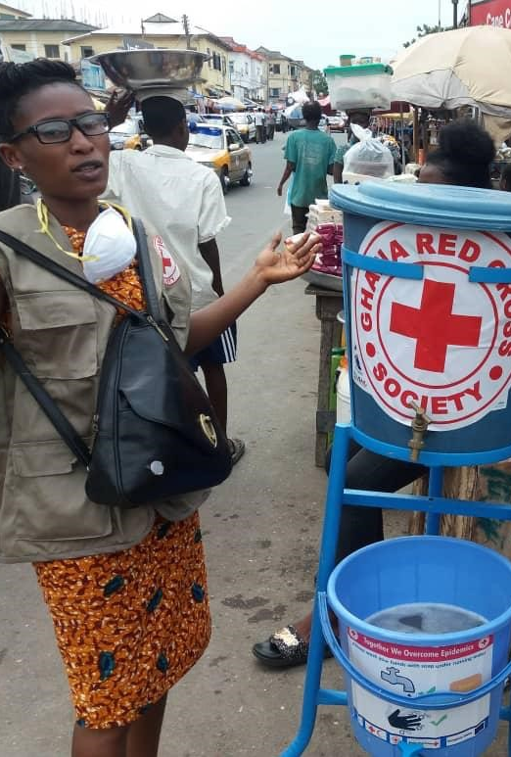
Communities need to be at the centre of the response...
Epidemics start and end in communities
Communities are the experts on their own situation
We need to build trust with communities to be effective & accepted
We build trust by treating communities as partners
Notes:
FACILITATOR NOTES
This is why we still need to find ways to make sure communities can participate in planning and managing the response to Ebola:
Epidemics start and end in communities. If we do not stop the spread of infection at the community level, cases will not stop. But it won’t be our actions that end the epidemic – it will be the actions of community members. Communities, vulnerable groups and most-at risk groups need to be part of the solution to the problem. For example, if communities agree to stop shaking hands and reduce their contact with other people, it is these actions that will slow down transmission of Ebola.
Communities are the experts of their own contexts. Every community has its own challenges, as well as capacities. There is not one approach that fits all contexts. Rather than imposing solutions, it is better to discuss the problem and ask the community how they think it should be addressed. Otherwise we risk conducting activities and providing services that will not be used and accepted, wasting time and resources. For example, ask the people living in slums how they think the risk of Ebola spreading can be reduced. To guarantee and sustain the implementation of protective measures and healthy behaviours it is crucial for the response to understand the very specific local factors that may act as barriers or facilitators for the uptake of public health services and recommendations.
We need to build trust with communities. If communities do not trust us, they will not listen to us, they will not comply with infection prevention measures like staying at home, they will not allow us safe access to communities, they will not report cases, and quite possibly they will not use the clinical services we provide and our interventions will fail.
To build trust, National Societies need to use our networks to go much deeper and work in partnership with communities, listen to their ideas, identify community-led solutions and support these to be implemented.

Slide 39
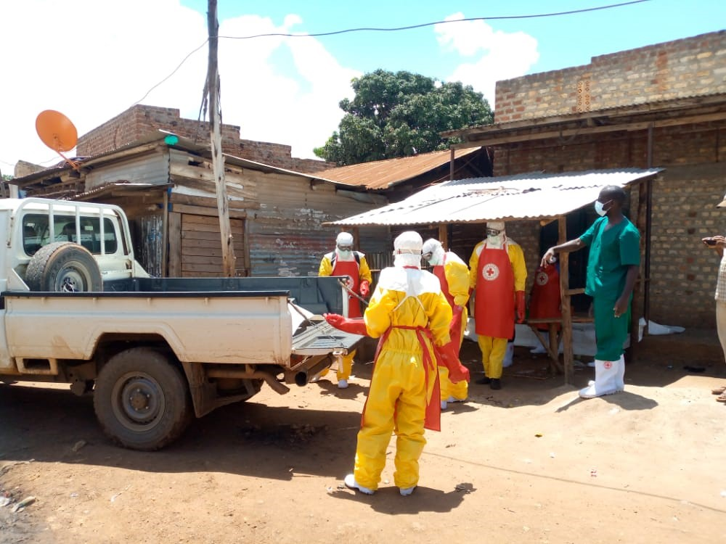
SDB teams adapting processes to cultural norms
Pregnant woman died and family wanted a caesarean to recover the child so the two could be buried separately
SDB teams sat with family to discuss risks and suggest alternative solutions
Husband was given PPE and wiped a banana flower over the body bag. The flower was wrapped in bed sheets and buried in the grave dug for the unborn child. This signified the removal of the baby from the mother’s womb
Family participated safely in the burial
Notes:
FACILITATOR NOTES
Case study from Uganda Red Cross during the EVD outbreak in Mubende from September 2022 – January 2023
A pregnant woman in Mubende died of suspected Ebola
Initial contact with the family over the phone explained the SDB process and why this was important for controlling the spread of the virus
The family claimed their cultural norms didn’t allow them to bury a pregnant woman with an unborn child, and wished for a caesarean to be performed to recover the child so the two could be buried separately.
The family had already dug two graves, one for the child and one for the mother
Performing surgery on a suspected Ebola patient posed an extremely high risk to those involved
The husband of the deceased had agreed to follow the of the SDB team’s recommendation not to conduct the surgery, but the father and brother both threatened to exhume the body if the surgery was not done
The SDB team returned the body to the mortuary so that they could have further discussions with the family. The family were told about the safety precautions that needed to be in place to protect the family, the SDB team and the wider community.
Eventually it was agreed that a ritual could take place which involved the husband wearing PPE and wiping a banana flower (symbolising fertility) along the body bag. The flower was then wrapped in bed sheets and buried in the grave dug for the unborn child. This action signified the removal of the baby from the mother’s womb.
The SDB team then lowered the body of the deceased into the grave and the family joined in the covering of the grave using shovels.

Slide 40
Stages of community participation – where is your NS?
INFORM Noticeboard
Community receives information
INVOLVE Community Meeting
Community provides input to key decisions
EMPOWER
Community Action Plan
The community decides and implements the plan and the NS supports
CONSULT Assessment
Community is asked about their needs and priorities
COLLABORATE Project Committee
Community and NS plan and decide things together
Based on IAP2’s Public Participation Spectrum, 2014​
Notes:
FACILITATOR NOTES
This is to explain that there are different levels of community participation or engagement
The ultimate aim is community ownership and empowerment, where communities make their own plans and implement them with minimal support from the NS
Stage 1 - Inform
Sharing information with communities about who you are and what you are planning to do. This is an essential first step – but is not engagement as it is only one-way sharing of information.
Stage 2 - Consult
You consult communities and collect information on their needs, priorities and opinions. For example when you run FGDs or an assessment. This is the lowest level of community participation and the basic in terms of engagement. You are collecting information from the community, but not really engaging them in making decisions.
Stage 3 - Involve
You involve the community in key decisions about the project. For example holding regular community meetings to present plans and ask for people’s feedback at key stages in the project. This goes beyond consult because you are involving the community throughout the project and asking them to help make key decisions. However, while the community can provide input, it is still the NS who write the plans and makes the final decisions.
Stage 4 – Collaborate
This is where the NS and community manage the project together, in partnership. For example through project advisory committees. Meetings are held regularly and the community can input to all major decisions and oversee the progress of the project. However the final decision making power still rests with the NS – although the community have a much greater say in the final decisions made.
Stage 5 – Empower
This is where the community manage the project and have final decision making power – the NS would support with resources, for example funding, materials or technical support. An example might be a community developing their own Ebola response plan and the NS provides some technical input and funding for the community to implement – but the decisions about what activities take place and how these will be implemented is the community’s decision.

Slide 41
Understanding Communities
WHO
WE ARE

Slide 42
What information do you need to know about communities?
Information needs [What information would people like to receive? What do they need to know?]
Communication channels [How do people like to access information?]
Existing knowledge [What do people know already about disease prevention?]
Local capacities [How did people manage during previous outbreaks?]
Perceptions [What do people think of the NS?]
Notes:
FACILITATOR NOTES
- This provides a brief overview of the types of information you might want to collect as part of a programme assessment to help you plan and integrate CEA approaches and activities
Priority issues & information needs - To understand what issues matter most the community and what they would like to know. Note they may prioritize information that is not part of your programme so you need to think how you would deal with that.
NOTE – the difference between what the community WANTS to know and NEEDS to know. They might not be the same thing!
2. Channels – To help understand where people get their information from, which sources they trust and how well this is shared among the community. This will help you plan how to share programme information, highlight potential barriers and how best to collect feedback and complaints.
Existing knowledge and beliefs – Understand what people think about a specific issue, such as Ebola. For behavior change communication, knowing what information people have heard already, how they reacted to it and why they might be resistant to change can help you develop effective, targeted messaging which is more likely to be listened to and acted upon by the community. Also people are not helpless so it’s important to find out what they are doing already and how they can participate and help shape programme activities – what is the current capacity?
Local capacities – people are not helpless so it is important to know what their strengths are and build on these rather than introducing new approaches that may clash with existing practices. This is about building on the community expertise
Perceptions - To understand community knowledge about the Red Cross and Red Crescent and the reputation of the NS. Will information you share will be trusted and if the community will be open to working with you.

Slide 43
What information do you need to know about communities?
Culture - affects values and beliefs What do people believe causes Ebola?
Power dynamics Who makes decisions?
Structures When do people work? Demographics?
Social cohesion Do people work together? Are community leaders trusted?
Understanding the community helps us ‘do no harm’
Notes:
FACILITATOR NOTES
Culture affects people’s beliefs and values – The culture people live in will affect how they understand and respond to risk – for example, in DRC people believed that Ebola did not exist and that they were being lied to by responders. This will have a huge influence on how people will response to RCRC programmes and activities aimed at preventing disasters or disease. Also different groups in the community might view these differently – for example older people may believe river water is safe to drink because that is what they’ve always done
Power dynamics will also define how different groups are seen within the community – for example, what is the role of women? Are the elderly respected? Is disability accepted or shunned? Again this will affect how you will get people to participate in your programmes. Different groups may also view things differently depending on the socio-cultural environment – youth attitudes may differ from those of the community elders.
Community structures - To understand how a community is structured and identify the best times and methods of reaching different groups. For example, when do people work? What is the main religion, is it mainly old or young people?
Social cohesion - affects how a community works together and whether they trust one another. Whether community leaders are trusted or seen as corrupt? If you are trying to encourage social changes, such as clearing drains or avoiding garbage pile-ups, then how much the community are willing to work collectively will be critical
Understanding these will also help ensure your activities don’t unintentionally put people at risk or exacerbate existing tensions and inequalities.
It’s important to note though that understanding the socio-cultural environment and community structures will take a long time and is very complex. While you can gain an understanding through your initial assessment this must be an on-going process that you constantly adapt to. Be aware also of the differences between demographics – what is true for the elderly may be very different for the youth. Understanding the ‘bigger picture’ and how the socio-cultural environment impacts on a community’s beliefs and behaviours can be the difference between failure and success – because the society and cultural a community operates within will affect how they perceive the NS and interact with the programmes and operations delivered.

Slide 44
Barriers to participation of women
Social and cultural barriers- are women allowed to participate?
Traditional gender roles that dictate women perform home making duties as opposed to decision making
Lack of opportunities for women to participate in decision making
Focus on equality as opposed to outcomes – we measure women’s presence not their participation
Negative attitudes towards women with disabilities - assumption they cannot participate
Notes:
FACILITATOR NOTES
There are some of the barriers that can hinder women’s participation
Socio-cultural barriers - in most patriarchal societies men are the decision makers and it might not be seen as acceptable or normal for women to make decisions and participate actively
Traditional gender roles – women are seen as home makers and men are seen as those in charge of decision-making
Lack of opportunities – if decisions are all made in committee meetings or by traditional leaders, women may not be present when issues are discussed and decided on
Focus on equality as opposed to outcomes – In most cases, in fora such as community meetings, community leaders and humanitarian actors ensure the presence of women as opposed to participation of women. Due to socio-cultural norms, women might not speak up during these meetings as the men are allowed opportunities to make decisions and voice their concerns. As such, this hinders meaningful participation of women
Negative attitudes towards women with disabilities especially women with intellectual and psychosocial disabilities where there is an assumption they cannot participate and people make decisions on their behalf. Lack of accessibility to the venue and some women with disabilities left at home. Lack of sign language interpreters for women with hearing impairments.

Slide 45
Solutions – participation of women
Establish separate participation spaces for women – women’s advisory committees
Consider gender roles and dynamics when engaging communities - avoid morning hours as women could be doing household work
Use communication channels preferred by women
Work with men in the community to ensure they support women’s participation
Hold gender dialogue sessions with equal gender representation
Consult women on the potential obstacles to their participation and determine acceptable ways of overcoming these barriers
Notes:
FACILITATOR NOTES
These are some of the ways we can support better participation of women.
Establish separate participation and decision making spaces for women e.g. women advisory committees and ensuring representation of all women including women with disabilities as they are also left out in spaces for women and in spaces for marginalized groups.
Consult with women to identify potential obstacles to their participation (e.g. if there is a need for child care during meetings, time and place of meetings, time and mobility constraints, how socio-cultural factors, as well as their roles and responsibilities, might affect their participation, etc.). Together with women, determine acceptable ways of overcoming barriers (e.g. if movement is restricted, escorts can be provided). Important to realise the reality of specific groups of women with diverse and very specific needs e.g women with disabilities

Slide 46
Barriers to participation of marginalized groups
Working only with existing community leaders – might mean other groups not represented by leaders are missed
Socio-cultural norms that hinder participation of elderly, persons with disabilities, youth
Discriminatory attitudes towards marginalized groups – believing they have nothing to contribute
We think we don’t have enough time to involve all groups or our approach doesn’t allow for it (donors, time, funding)
Misinformed attitude that categorizes marginalized groups as one, disregarding specific group needs
Lack of mobility and exclusion from mainstream society eg elderly and persons with disabilities
Notes:
FACILITATOR NOTES
Working only with existing leaders and organised groups can reinforce the marginalisation of those who are not represented in these organisations and those who are not organised.
Misinformed attitude that categorizes marginalized groups as one, disregarding specific group needs. For example, people with the most severe impairments, and particularly those that affect mobility and communication, will often be more marginalised than those with minor impairments. People with one type of impairment may not be able to represent those with different impairments – it is important to recognise that ‘disabled people’ are not a homogenous group.
Women and girls with disabilities are also left out in participation of marginalised groups since even in marginalised groups men tend to speak and take lead while women rarely participate in such spaces. Also Women and girls with disabilities have very specific needs and are many times left out in groups where women are participating and where marginalized groups are participating. They are left out in both spaces yet they are more vulnerable in so many aspects eg SGBV, health and wash needs, shelter, single headed house holds.

Slide 47
Solutions – participation of marginalized groups
Create smaller sub-groups to give individuals a chance to speak without the presence of more vocal participants.
Use a range of accessible communication methods in engagement activities and train staff to support this
Consult people from all groups about their communication needs or preferences
Partner with disabled or older people’s organisations if specialist communication is required e.g. sign language interpreters
Ensure that meeting venues are physically accessible and safe for people with mobility limitations or visual impairments
Ensure meeting arrangements support carers’ attendance as well.
Notes:
FACILITATOR NOTES
Create smaller sub-groups in order to give individuals a chance to speak without the presence of more vocal participants. The composition of a working/focus group can support existing dynamics of discrimination. If the group includes both the most powerful and the most marginalised people in a society, then it is unlikely that the latter will be able to fully participate. Sometimes it may actually be the actions of the most powerful that create the greatest problems for marginalised people. If this is the case, it is unlikely that they will talk about it in a mixed group.
Take measures to include and consult ‘hard-to reach’ people with disabilities and older people, and their carers, including those who cannot leave their homes or shelters. Use community outreach and/or partner with representative or specialised age and disability organisations.

Slide 48
Challenges - working with community committees
Might not represent the entire community – committee might not include women, people with disabilities etc
May represent only their own interests – corruption, nepotism
Without incentive, representatives might not be fully committed - poor attendance in meetings
Susceptible to political interference
Difficult to hold community committees to account, unless the community is empowered to do this
Have no choice but to work with them

Slide 49
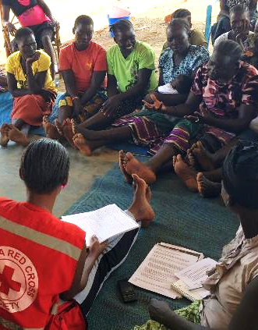
Solutions – working with community committees
Understand community perception of the committee
Establish separate project committees
Work with other groups too – women’s groups
Push for equal gender balance and representation of all groups
Be clear about roles and responsibilities - training
Monitoring and checks are critical
Examples? KOIF in Madagascar and PAC in South Sudan
Notes:
FACILITATOR NOTES
This is one of the biggest mistakes we make – not being clear about selection criteria
Representatives are agreed with the community and represent a cross-section of the population, including women, men, children and marginalized groups. For example, as much as possible ensure community committees have an equal number of men and women.
It is also important to be careful about how community representatives or committees are selected – for example, are representatives selected and voted for by the community or does the Red Cross or community leader pick them? Obviously it is much better if the community select their own representatives in a fair and democratic way
If you work with community committees or representatives it is very important that you monitor with the wider community that they are fulfilling their role. It is not enough to set up the committee or representative and assume it will work. You need to check that information you share does not stop at the level of the committee or representative, that they are collecting feedback from the community and sharing and that the decisions they make have been discussed with the wider community and not just their own views.
For example, in Madagascar the National Society establishes community committees called KOIF. The KOIF identify vulnerabilities in the village and then the whole community prioritise them. The KOIF then develops a village action plan which sets out what the community can do alone, what they need a little support with and what would need a lot of support. These plans are then discussed at community meetings and have to be endorsed by whole community. In one community this worked very well. The KOIF members were well supported by the NS and given training. They eventually took over management of activities and started to implement their own initiatives with little input needed from the NS. For example, they improved the road between the village and the main road which greatly increased access for people. However in another community, the KOIF was not supported by the branch manager and during an FGD we discovered that very few women knew about the KOIF committee – or thought that is was just a Red Cross thing. “KOIF is not even our word”. The KOIF woman representative said she was told by the president to be on the KOIF (not elected) but just gets called to meetings now and again with no warning so she goes but doesn’t have time to collect opinions in advance from other women so just says what she thinks. This highlights the importance of training and monitoring
South Sudan Red Cross sets up a Project Advisory Committee for each project which include a broad cross section of the community. These committees meet regularly to review progress and discuss decisions. As above though some are better at this than others.

Slide 50
Challenges - selection criteria
Relying on community leaders or leaders insist on selecting beneficiaries – then not reaching the most vulnerable
Not verifying lists
Communities don’t understand the selection criteria – causes rumours
Only speaking to direct recipients – causes unrest
Not being able to reach everyone
“ The Red Cross only helps people they know”
South Sudanese refugee during an FGD
Notes:
FACILITATOR NOTES
This is one of the biggest mistakes we make – not being clear about selection criteria
While it is often the easiest option, relying only on community leaders to select beneficiaries opens us up to the risk of not reaching the most vulnerable. There are examples of community leaders selecting their friends or family or even worse, collecting money from people in exchange for adding them to the beneficiary list
If we do not take the time to explain who we are helping and why, it can appear arbitrary to people, especially in situations where everyone is vulnerable. Programmes should have clear selection criteria outlining who will receive assistance. These should be discussed and shared with the community – including and especially those who won’t benefit directly. Where possible, the criteria should be developed in partnership with the community.
Often we only engage with our direct beneficiaries, not other community members. When it comes to selection criteria it is just as important to engage with non-beneficiaries. Those who are receiving support are likely to give us positive feedback…it is those who are not receiving support who will be more honest and will have had a different experience
Impact?
Community don’t trust us
Damages our reputation as impartial – can come across as corrupt or nepotism
Can ‘do harm’ in the community by exacerbating tensions or frictions and put people at risk
How to avoid?
Do-no-harm: be aware of local power structures and social dynamics and how that will impact on targeting processes
Use verification measures / triangulate the information we get from community members – example from Rwanda where whole community has the chance to verify if the right people have been selected
Make sure an explain selection criteria and processes for choosing people – be transparent, post lists of those selected and allow time for people to ask questions, provide feedback or challenge your decisions
Prevent rumours from spreading
Quote collected during FGDs with South Sudanese refugees in Uganda – the community did not know the selection criteria and so made assumptions that the Red Cross was only helping people they knew

Slide 51
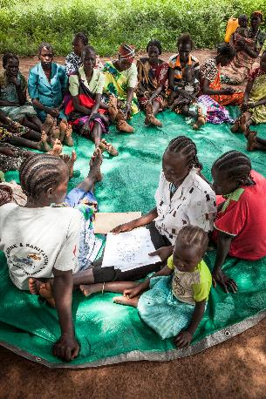
Solutions - selection criteria
Understand community power structures
Don’t rely only on community leaders
Verify lists by checking a percentage
Agree criteria and selection with community groups
Widely and clearly communicate selection criteria
Publish beneficiary lists
Don’t speak only to direct beneficiaries
Establish a feedback system
Notes:
FACILITATOR NOTES
The most important aspect to ensure there is time and space within the planning process to allow communities to provide feedback and make suggestions. You need to plan for this within the planning phase! Often traditional project proposal process is too fast to allow And make sure you listen to what people are telling you.
This is a challenge in the humanitarian sector but it important to not write the whole plan at HQ level but to allow some time for consultation – if this is not possible then try to build some flexibility into your project proposal so you can make adjustment later if what you have planned is not what people really need or want. In Madagascar they have a line in all proposal plans and budgets called ‘community project’ which allows them to respond to needs arising in the community during implementation
Initial orientation and information meetings are held with local communities and provide information on the mandate of the National Society, IFRC and/or ICRC, our Fundamental Principles, expectations for staff and volunteer behaviour and contact details. Make sure you meet with different groups and not just the most visible who come to community meetings.
Indicators are discussed with communities and based on community perceptions of success. It is also possible to discuss with communities the best way to use the available funds. Kenya Red Cross youth project that asked the youth how the money should be spent.
There are lots of participatory planning approaches that you can use, such as the Vulnerability Capacity Assessment or the Participatory Approach for Safe Shelter Awareness (PASSA)
During the planning phase you should also discuss how you will receive and act on feedback and complaints from the community – more on that in the next session.
Programme plans include an exit strategy. This shows respect to community members, ensures their involvement, supports a smoother exit and increases the likelihood that changes implemented during the programme will be sustained.

Slide 52
Recap and closing

Slide 53
Key takeaways for CEA in SDB
Trust is essential for successful SDBs
Understand the local cultural norms and social values concerning death and funerals
Listen to and adapt SDB processes and protocols with communities based on their needs, feedback and context
Consult community leaders, networks and influencers
Communicate clearly and use trusted channels to ensure communities understand what the SDB protocols are and why they are important
Involve the family in the SDB wherever it is safe to do so
Address rumours, misinformation and stigma so they don’t undermine the SDB process
Notes:
FACILITATOR NOTES
Building trust: once communities recognize us as a trusted organisation who will treat their social and cultural values and traditions respectfully, it will hugely influence the success of the SDB. If communities do not trust us, they will not listen to our advice about infection prevention and control, they will not adopt SDB protocols, they will not allow us safe access to their communities, they will not report suspected cases or deaths, and quite possibly they will not go to an Ebola Treatment Unit if they develop symptoms
Understand the local burial customs, social and cultural norms around death and funerals by conducting social science research (e.g. KAP surveys, FGDs, KIIs), or using secondary data, and use this data to inform how SDB processes should be adapted to the local context.
Listen to communities and adapt: Community Engagement is not about ensuring community acceptance of response interventions, but rather adapting response interventions, like SDB protocols, with communities based on their needs, feedback and context – this is essential to remain relevant and trusted, otherwise we will be out of touch with the community and this will increase the likelihood of failed SDBs.
Consult community leaders, networks and influencers – they are important bridges between the community and SDB teams and can provide valuable suggestions on local solutions or adaptations to SDB protocols. They can also champion these protocols in their communities and help to address concerns or questions from the community.
Communicate clearly and use trusted channels – take the time before the SDB is conducted to explain to the family and the community what the SDB protocols are and why they are so important for containing the spread of the disease.
Involve the family in the SDB wherever it is safe to do so – and respond to their concerns or questions in a sensitive and respectful way
Address rumours – be aware of the rumours or misinformation circulating in the community, especially those concerning SDB, and discuss with your teams how these can be addressed either through updating messages or by adapting activities.

Slide 54
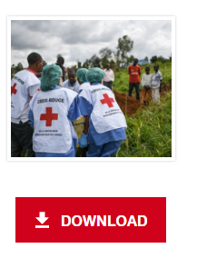
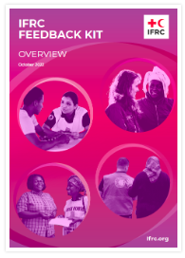
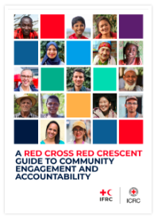
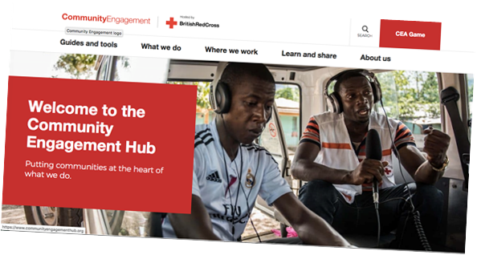
Tools & Resources
Your CEA focal point
CEA hub
CEA Guide & toolkit
Feedback Kit
Ebola: RCCE/ECV ToT
RCCE for EVD library
Social science research:’community feedback
as a case study of evidence uptake and use in the
2018–2020 Ebola epidemic in DRC’
Story of Ebola

Slide 55
Questions?

