Slide 1
CEA Peer-Learning Webinar #7
Georgia On My Mind:
Understanding Community Perceptions

Slide 2
Start Recording
Start Recording!
(If you haven’t already)
Notes:
Hopefully the link works on people’s screens –also post in the chat.
Link to Sign up to the newsletter- http://eepurl.com/hW3GRX

Slide 3
Running Order
Introduction and Welcomes
Georgia Red Cross Perceptions Study
Q+A
AoB + Feedback Survey
Final Reflections

Slide 4
Georgia Red Cross Society
Community Engagement and Accountability
Peer to Peer Learning Session
Ana Lomtatidze
December 2024

Slide 5
Major Achievements
CEA Instituonalization - active integration of CEA approaches in all existing planned programs and projects
Unified Feedback Mechanism – new system launched combining feedback from all communication channels
CEA Assessment tools – Perception studies, PDMs and Exit Survey conducted

Slide 6
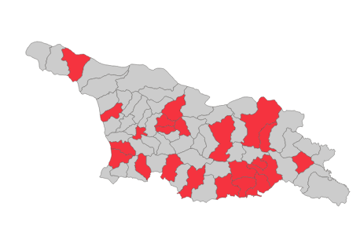
Community Based Routine Immunization and Covid-19 Vaccination - Perception Study
Conducted in frames of the project – “Epidemic Preparedness and Covid-19 Vaccination in Armenia and Georgia”
2 Phases – Aug-Sep 2023 and Jul-Aug 2024
15 Municipalities in Georgia
4498 Individuals interviewed by pool of 100 volunteers
Digital questionnaire – Kobo and Microsoft Forms
Notes:
This area was chosen because perception study was one of the key areas of the project and in general routine immunization represents significant health challenge in Georgia currently

Slide 7
First Steps - Perception Study
Determination of the study aim
Coordination with project staff and IFRC South Caucasus Country Cluster CEA delegate
Development of the digital questionnaire – coordination with IM officer
Mobilization and training of branch staff and volunteers – Introduction to CEA and technical instructions
Notes:
It was not an easy thing to do although managable

Slide 8
Main Challenges - Perception Study
Technical issues – digital questionnaire
Different sample sizes
Sample and target demographic – language barriers, sample bias
Issues during database analysis
Volunteer rotations
Lack of expertise

Slide 9
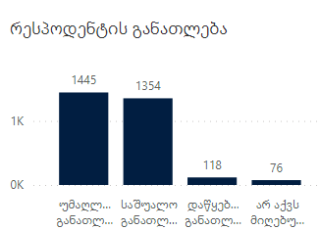
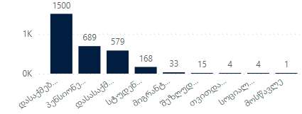
Results - Demographics
Most of the study Participants graduated either university or middle school
Most of the study Participants are employed
Most of the study participants were female

Slide 10
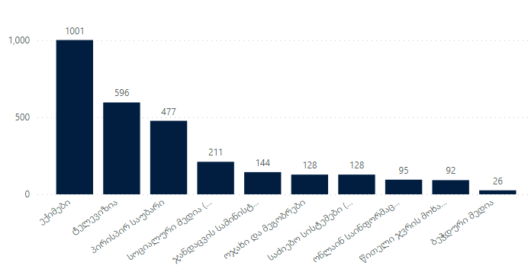
Results – Information Sources
Which informational channel do you trust the most?
72% stated that they had searched for information about immunization at least once in the past year.
46% use television channels, while 20% use Facebook as their source of social media.
Television is primarily preferred as an information source by individuals aged 60-69.

Slide 11
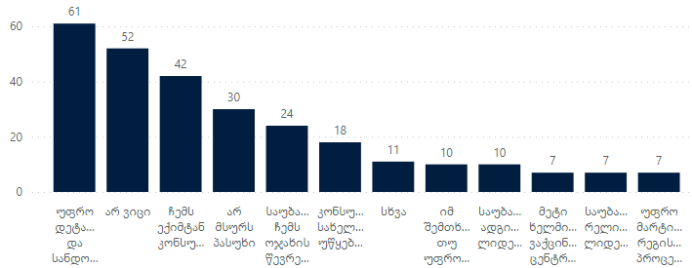
Results – General Attitude Towards Immunization
Only 222 people have a negative attitude toward vaccines, the majority of whom are aged 60-69.
Among these individuals, 44% are not aware of the National Immunization Calendar.
Additionally, 78% are not vaccinated against COVID-19.
What can influence positively your negative attitude towards vaccination?

Slide 12
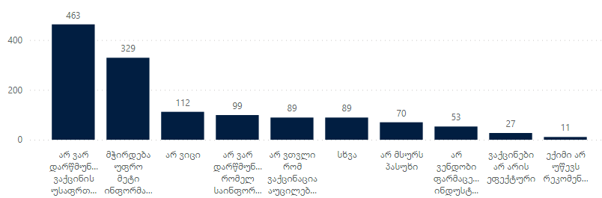
Results – HPV Vaccination
Why is your daughter not vaccinated against HPV?
59% have heard about the HPV vaccine.
Among them, 39% are willing to vaccinate their daughter according to the calendar.
Only 28% have vaccinated their daughter, while 17% are still undecided.
15% question the safety of the HPV vaccine,
11% need more information, and 3% do not consider HPV vaccination necessary.

Slide 13
Key solutions – Perception Study
Strong coordination with CEA and IM Experts, project/program counterparts
More clear definition of sample size to avoid different kind of biases
Internal capacity building – research related trainings, data analysis trainings (Power BI or similar tools), data visualization methods
Notes:
Same sample size for both phases for better analysis purposes
Preferably inclusion of the same interviewer volunteers

Slide 14
Organizational Capacity Building
Increased integration of CEA in different planned programs/projects
Inclusion of the same assessment methods in other sectors – CVA and Ukraine Appeal
Increased understanding of the importance of CEA approaches on the organizational level
Support of digitalization of different activities and services
Evidence based advocacy and reporting – evidence gathered from these assessment tools was used for advocacy and reporting reasons

Slide 15
Future Plans
Integration of CEA into other sectors
Inclusion of CEA in other existing assessment tools
Working on knowledge database development – UFM
Working on development of similar assessment tools for emergency situations
Capacity building – developing expertise in this area
Looking for more user-friendly digital tools

Slide 16
General tips
Internal advocacy efforts
Coordination with internal counterparts - focal points, IM, youth coordinator, branch level staff ect.
Further capacity building
Community Engagement Hub – use of the reference center
Development of the question bank

Slide 17
Questions?

Slide 18
RoE CEA Newsletter
Sign Up to the CEA Newsletter Here
Notes:
Hopefully the link works on people’s screens –also post in the chat.
Link to Sign up to the newsletter- http://eepurl.com/hW3GRX

Slide 19
KoBo Survey
Click Here to Access the Feedback Survey
Notes:
Hopefully the link works on people’s screens –also post in the chat.
Feedback Survey Link: https://ee.ifrc.org/x/OUVFcC7c

Slide 20
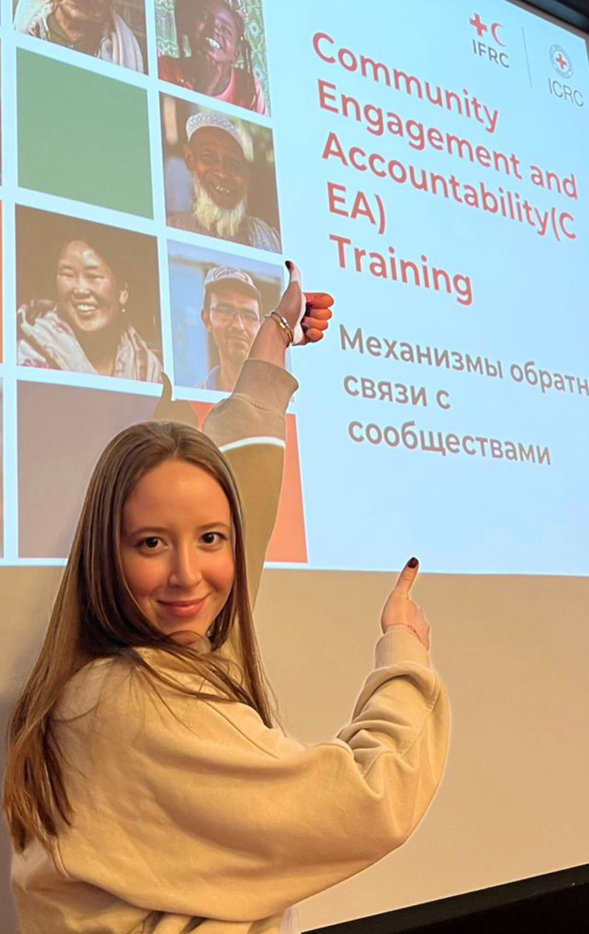

Slide 21
CEA Peer Learning Webinar
Thank you and goodbye – look forward to seeing you again in 2025!

