Slide 1
CEA Peer-Learning Webinar #6 CEA and Climate Perceptions Research: Shedding Light on the Heat

Slide 2
Running Order
Introduction and Welcomes
BRC Heatwave Research Presentation
Q+A
AoB + Feedback Survey

Slide 3
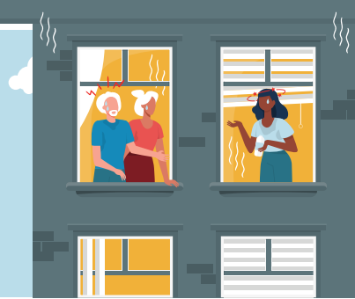
Peer Learning session on BRC’s work on Heatwaves
August 2024
The power
of kindness

Slide 4
Context
We have published reports and resources about the impact of extreme weather events on communities, such as:
Every time it rains, 2022
What the water touched, 2022
Feeling the heat, 2021
In 2021, we conducted public polling to understand people’s perceptions of heatwaves.
Following the hottest day on record in July 2022, we repeated this polling to assess how perceptions have evolved.
The power
of kindness
Notes:
Firstly, it’s important to reiterate that heatwaves are already having devastating impacts on people and communities across the UK. We as first responders have seen an increasing demand for our services as a result of extreme temperatures.
Because of this recognition, and witnessing the effects of the August 2020 heatwave, which caused over 2 and a half thousand excess deaths in England, as well as significant disruptions across the UK. the British Red Cross decided to undertake research on people’s perceptions of extreme heat and their own vulnerability. A research partner interviewed 2,000 UK adults during the summer of 2021 and the results, advice and recommendations for policy makers were shared in a report called ‘Feeling the Heat’. More recently, we collaborated with LSE and Place based Climate Action Network PCAN to assess England’s experience and response to the record breaking 2022 heatwave. We supported the facilitating and delivery of four focus groups across the country and contributed to a policy brief that was launched last month. The findings from this research have been helpful in reconfirming previous studies and informing our future planning.
Last year, we have decided to repeat our nationwide polling from 2021, to assess how the public’s perception of heatwaves has evolved and I’m going to present the results.

Slide 5
Why focus on heat?
Internal convincing on broader climate change
Different pace between policy and practice
Repeat polling was an obvious next step after summer 2022
The power
of kindness
Notes:
Internal:
BRC on a journey:
International vs. domestic.
CCA team on Domestic, embedded in emergency response.
Response mindset generally. Shift required and slow.
Confusion between green/mitigation and adaptation/resilience.
Policy ahead of our ops team.
On heat it’s only been in the last few years BRC was called to respond to heat event.
Increasingly wildfires as well. London 2022.
Flooding work long standing and strong, heat silent killer. So it’s also been silent for BRC, also because the UK has not seen as many extreme heat events as rest of Europe.
Keen to understand general public’s perception of it.
Nonetheless it’s a growing risk for the UK. Even if temperatures not as high, it’s the difference people experience that has potential negative impacts.
Repeat polling:
Record-breaking temperatures of 40 degrees and 3,271 excess deaths1, and the UK government declaring a state of national emergency due to high temperatures for the first time.
Obvious next steps in policy engagement, and insights grounded in evidence much more powerful.

Slide 6
How did we go about the survey?
Questionnaire developed by BRC research & policy
External polling company for fieldwork
Internal research staff for polling results analysis
Policy lead for writing and recommendations
External designers for publishing
The power
of kindness

Slide 7
Identifying research gaps
Update on how the heatwave of 2022 may have affected public opinion and awareness
How severe heat might affect mental health, especially for those living with mental health conditions
Public understanding of keeping cool and keeping homes cool
Proximity to cool, green space
The power
of kindness

Slide 8
Polling
Gender, Age, Ethnicity
Region, city, rural/urban
Children and age
Working status, working outdoors, income status, social grade
Health, mental health
Home ownership status, whether have made changes to their homes against heat
Whether experience impacts from hot weather in the UK
2000 UK adults, weighted to be nationally representative.
No budget for boosting of the polling in specific locations or groups
The power
of kindness

Slide 9
Challenges
Balance between technical language and public understanding
Number of questions for the survey and balance with the depth wanted for policy
Devolved nations / specific cities / specific situations representative figures
Polling dates
Timeline
The power
of kindness
Notes:
Adaptation vs. preparedness and accuracy.
Repeat polling: comparison element from 2021 survey but also wanting to go into some other areas such as adaptation and barriers for adaptation, access to services and green/cool space.
For specific questions, under 50 respondents and therefore we could not extrapolate on the results.
For comparison aimed to do polling same dates as 2 years before, but the weather was really bad and concern it would skew the results so pushed by a week.
Internally viewed as a more discrete piece of research with aim for a ‘short’ policy brief. But similar amount of work, condensed and brief still 12 pages. Condensed timeline made it challenging for staff.
Also needed for the brief to be published in a timely manner before the autumn so that still relevant on people’s mind before the flooding season.

Slide 10
Lessons
More time!
Involve senior colleagues earlier on in the process
Be more targeted if you want specific thematic results
More regionalised results
The power
of kindness
Notes:
Turnaround and capacity was a challenge. Mindful that even if shorter outputs, level of work is not necessarily lesser.
Involve more senior colleagues early on in development of recommendations and understanding of limitations of the data.
No data that we could extrapolate on in terms of specific vulnerabilities such as mental health.
SNAP experience: limited data specific to Scotland we could pull from and ended up relying on other research and extrapolating from our national results.

Slide 11
Next steps
Perception polling on our flooding work
Part of a wider policy approach
Useful for external and internal engagement
The power
of kindness
Notes:
Looking to boost data in Wales and Scotland where strong engagement on flooding with local government + specific areas who have been flooded that our policy work has covered but also crisis response team involved in response.
Previous work on flooding involved qualitative data from focus group discussion in high social flood risk areas. So will be interesting to see how the work shapes up and the comparative elements given the different methodologies.
Given our focus on communities and always to bring this at the core of our policy work, perception studies are really powerful to bring that element in.
However, it’s part of a wider policy approach. We’re now looking to analysis support schemes to people on floodings, currently non-existent on heat, to see how it reaches the most vulnerable and draw lessons for government.

Slide 12
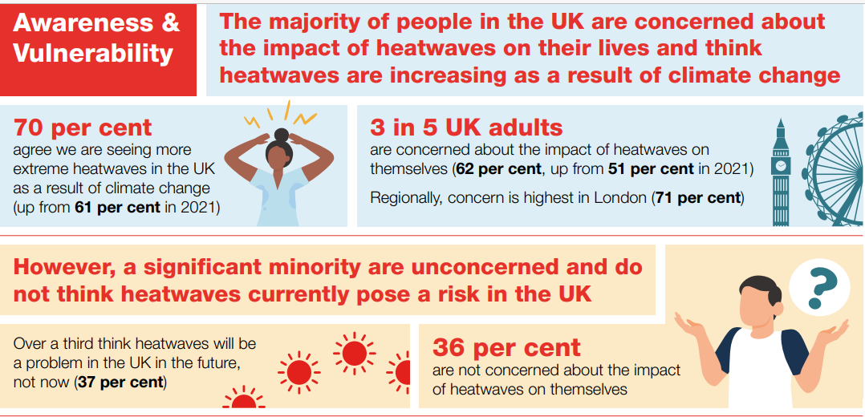
Findings
Awareness and vulnerability –
Concern about heatwaves has increased.
Heatwaves are still seen by many as a problem for the future.
Contrasting results suggest older people may not recognise their vulnerability.
The power
of kindness
Notes:
Significant themes emerged from our polling, predominantly around awareness and vulnerability, individual action and preparedness, home adaptation, access to services and information and the role of the government.
Starting with awareness and vulnerability:
There has been a significant increase in the proportion of people who are concerned about the impact of heatwaves on themselves but over a third still say they’re not concerned. This includes 1 in 3 older people, who do not consider themselves vulnerable.
Majority of people agree we are seeing an increase in extreme heatwaves as a result of climate change, over a third consider them to be a problem of the future.
85-90% of excess deaths are observed in the 65+ age group. However, older people tend to report fewer adverse effects from hot weather and are less likely to report difficulty of keeping their homes cool than younger cohorts. This suggests that older people may not recognise their vulnerability.

Slide 13
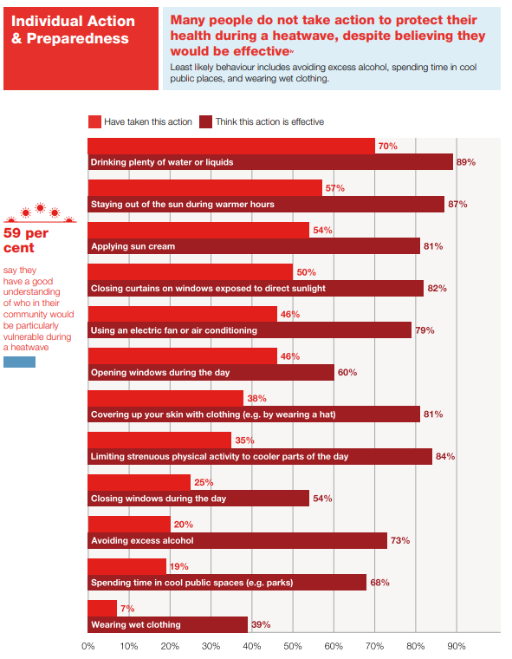
Findings
Individual action & preparedness
There is a clear gap between awareness and action
There seems to be confusion over the best course of action to keep homes cool.
Half of UK adults say that potentially vulnerable neighbours are not prepared.
The power
of kindness
Notes:
Several consistent findings under individual action and preparedness include:
A clear gap between awareness and action. Generally, people know about the effectiveness of measures to protect their health from the impacts of extreme heat, yet far fewer people take action to implement these measures.
There is confusion over the best course of action to keep homes cool. A clear example of this official government guidance to open windows only when air outside is cooler, while nearly half of UK adults tend to keep windows open in severe heat.
Half of UK adults say that potentially vulnerable neighbours are not prepared. Many people would like to see more support provided to ensure that those who are particularly vulnerable to heatwaves are visited by someone who can advise and help them.

Slide 14
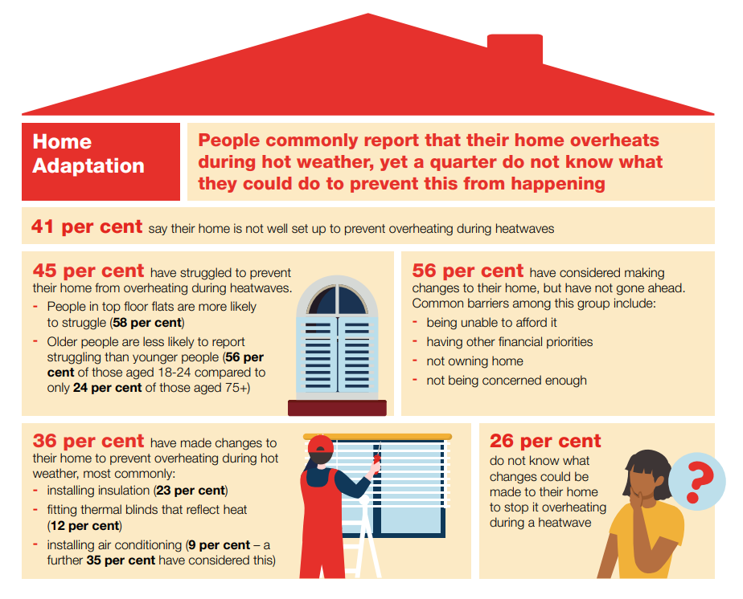
Findings
Home adaptation
Keeping homes cool is a challenge.
Cost is the biggest barrier to people making adaptations to their homes.
Heatwaves have an impact on productivity.
More information about climate-friendly ways to adapt homes could be useful.
The power
of kindness
Notes:
When it comes to home adaptation:
Keeping homes cool is a challenge. Nearly half of UK adults have struggles to keep their homes cool during a heatwave and 2 in 5 say their homes are poorly set up to prevent over-heating. Around a quarter do not know what changes could be made to their homes to prevent overheating.
Cost is also a significant barrier to people making adaptations to their homes. Over a third of people have made at least one change to their home to prevent overheating. More have considered making changes but are yet to do so largely due to financial limitations and not owning their home. A large proportion have reported not having significant enough concern to make adaptations.
Heatwaves have an impact on productivity with around 3 in 5 students and workers seeing their concentration affected by extreme heat. With an increase in home working, cool office spaces are less accessible and therefore are more likely to be affected by heatwaves.
More information about climate-friendly ways to adapt homes could be useful. Currently, one in three people have considered installing air conditioning to protect themselves from the heat. Increased use of air con will result in increased energy bills, put additional pressure on the grid and contribute further to climate change.

Slide 15
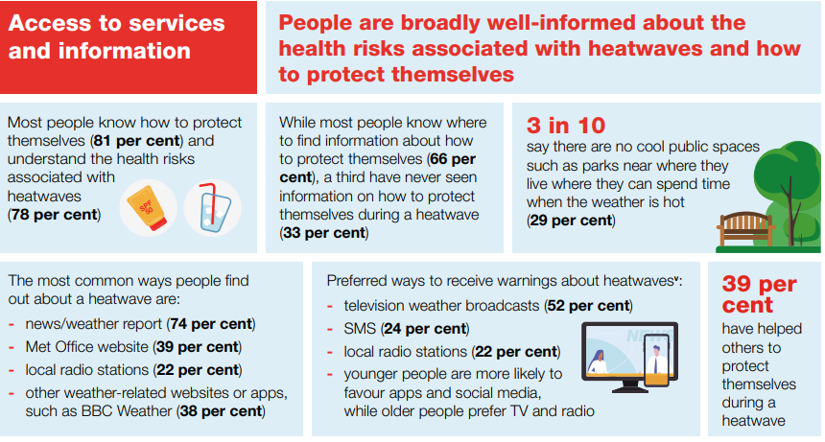
Findings
Access to services and information
Many people are unable to access cool public spaces.
While the majority of people are well-informed, there are substantial gaps in access to information.
Role of government
A significant minority of people think there is a lack of preparedness for heatwaves across the UK
The power
of kindness
Notes:
Regarding access to services and information
3 in 10 people are unable to access cool public spaces, such as parks, where they live. Majority of people agree that spending time in cool spaces is an effective way to protect themselves against heat risk, very few actually do this. Nearly half would like to see more public buildings such as schools and community centres offering a cool space for people.
There are substantial gaps in access to information, despite majority of people being informed. A third of people they have never seen information on how to protect themselves during a heatwave. As our survey was online, this figure does not include those who are digitally excluded.
Role of government
A significant minority of people think there is a lack of preparedness for heatwaves across the UK. Responses to our polling indicate that many people think governments across the UK are unprepared for heatwaves. There is a strong consensus that national and local governments have an important role to play in ensuring people are as prepared as possible, by raising awareness and encouraging people to take action to protect themselves and adapt their homes.

Slide 16
Key Recommendations
Action on awareness, preparedness and adaptation to heatwaves must prioritise those most at risk
A ‘whole of society’ approach to building awareness of heat risk and supporting preparedness is required.
Direct policy intervention is required to enable people most at risk to adapt to heatwaves.
Comprehensive and coordinated risk management for heatwaves should be further prioritised by the UK and devolved governments.
The power
of kindness
Notes:
Based on assessment of polling responses, our expertise and research we have identified key recommendations that should be implemented in order to address the challenges posed by heatwaves, both currently and in future.
Action on awareness, preparedness and adaptation to heatwaves must prioritise those most at risk.
We know there are groups that are disproportionately vulnerable to heatwaves, including older people. However, as discussed, research shows that older people may not be aware of their vulnerability. Therefore, additional research is needed to assess how higher risk groups perceive their own vulnerability, as well as their access to information and services to support them for preparing and adapting to weather related emergencies
A ‘whole of society’ approach to building awareness of heat risk and supporting preparedness is required.
The ‘whole of society’ vision for public engagement included in the GRF indicates the need to enhance awareness and enable greater ownership and action from people who are likely to be most vulnerable to emergencies. Enhanced awareness will require development of appropriate communications for disproportionately affected populations that are informed by and developed by lived experience.
A well-resourced, coordinated, cross-govt communication approach to improve understanding of risk and to support preparedness is required.
Direct policy intervention is required to enable people most at risk to adapt to heatwaves.
In order to prepare for extreme weather emergencies, adaptation to buildings and urban planning is critical to tackle indoor and outdoor heat. Currently, action on this is lagging in the UK.
Targeted support for both adapting homes and improving access to cool spaces for those most at risk is critical in order to address the escalating effects of heatwaves on health and the economy.
Comprehensive and coordinated risk management for heatwaves should be further prioritised by the UK and devolved governments.
We know that many people are not confident that the UK is well prepared, and there is an expectation that national governments should play a leading role in driving action.
Risk of heatwaves currently outweighs the approaches being taken to address them. We are calling for coordinated action across government, sectors, policies, frameworks and timescales in order to build resilience against the extreme weather.

Slide 17
How did we use the results?
Policy engagement
Internal Coms
External Coms
UK Operations
The power
of kindness

Slide 18
Thank you!
For any queries or comments please contact adelinesiffert@redcross.org.uk

Slide 19
Questions?

Slide 20
KoBo Survey
Click Here to Access the Feedback Survey
Notes:
Hopefully the link works on people’s screens –also post in the chat.
Heatwave Survey Link - https://ee.ifrc.org/x/W7JtLlJ6

Slide 21
CEA Peer Learning Webinar
Thank you and goodbye – look forward to having you join us again next time!

