Slide 1

CEA Peer-Learning Webinar #5
CEA in CVA:
Cashing in on Community Feedback

Slide 2
Running Order
Introduction and Welcomes
IFRC / Montenegro Red Cross Presentations
Q+A
Feedback Survey + AoB

Slide 3

Lessons Learned on
Community Engagement and Accountability in CVA
Region of Europe
Fatmanur Bakkalbasi
Notes:
SERVET & MONICA

Slide 4





Overview
Analyze the assessment- FGDs/ feedback data
Discuss the criteria
Implementation/Monitoring
Aim
Assessment
Planning
Evaluation/Learning
Contextual analysis
Needs Assessments
Secondary data review
Satisfaction surveys
Lessons Learned Workshops
Relevant
Accountable
Participatory
Transparent
community centered
Share information
Collect/register and analyze feedback
PDMs including FGDs

Slide 5

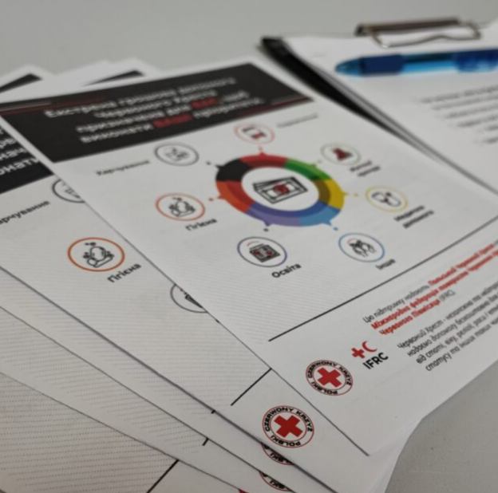
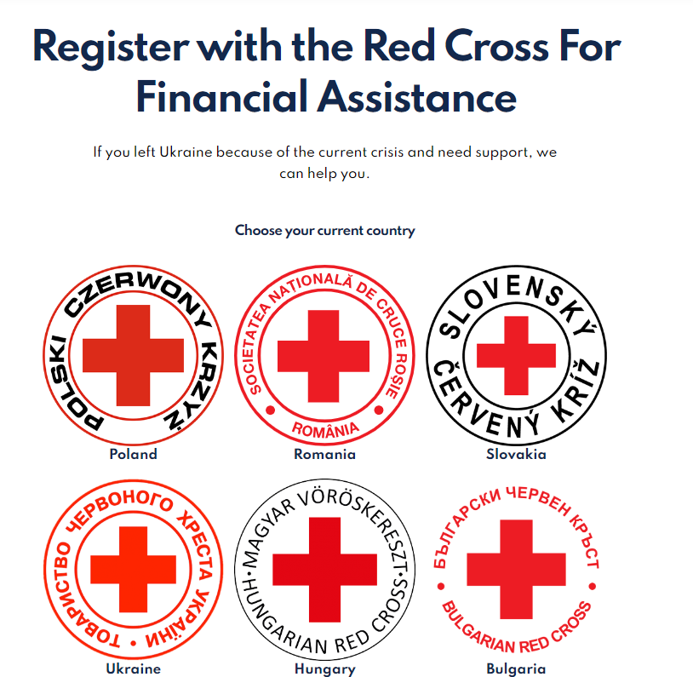
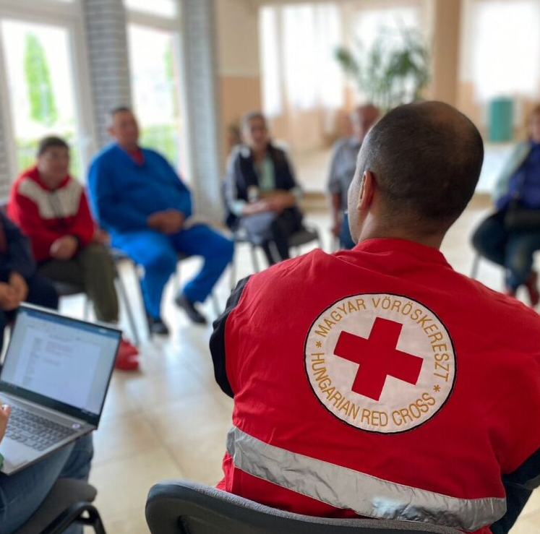

Overview
Information dissemination tools in different languages
Call Centers/
Helpdesks for feedback
Needs assessments to understand community's context, needs, satisfaction
Support for registration, face to face info dissemination
Leaflets, posters, brochures explaining how to register and criteria

Slide 6

Experience & Achievements
CVA paved the way for CEA
  Introducing CEA through CVA
  CEA capacity building with CVA
  Good cooperation and synergy
Effective feedback systems
  Call centers collecting/ registering feedback
  Importance of collecting feedback for NS
  Coding framework
Disseminating information, support reaching target
  Cooperation between differentdepartments/stakeholders
  Creating various materials and reaching people with clear information
  Transparency

Slide 7
Experience & Achievements
4. Immediate response and shaping the future programs
  Feedback, monitoring's, FGDs, social media scrapings
  Live monitoring of the program through feedback
  Feeding the program through community insights
Hiring people from affected community
  Most of the call center staff are people displaced from Ukraine
Digitalization
  Diversity in Digital and Traditional Systems
  Structured feedback
  Introducing new way of working to NSs

Slide 8
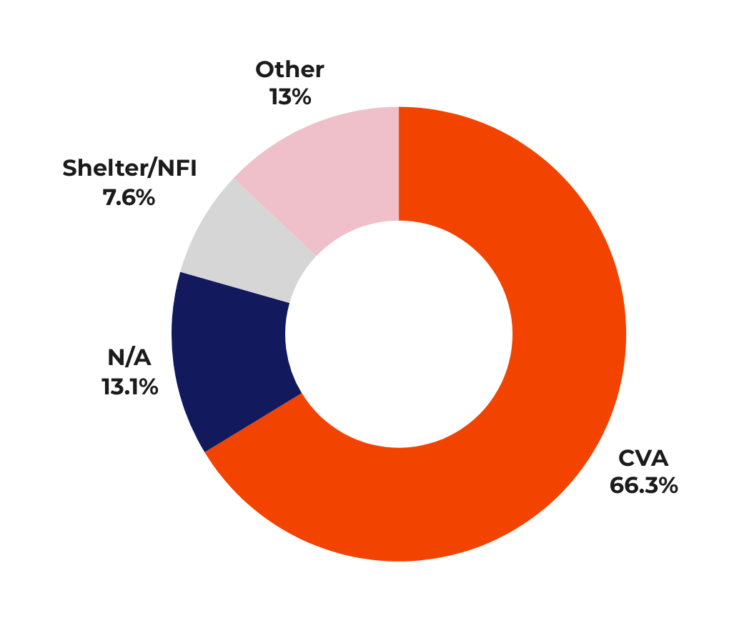



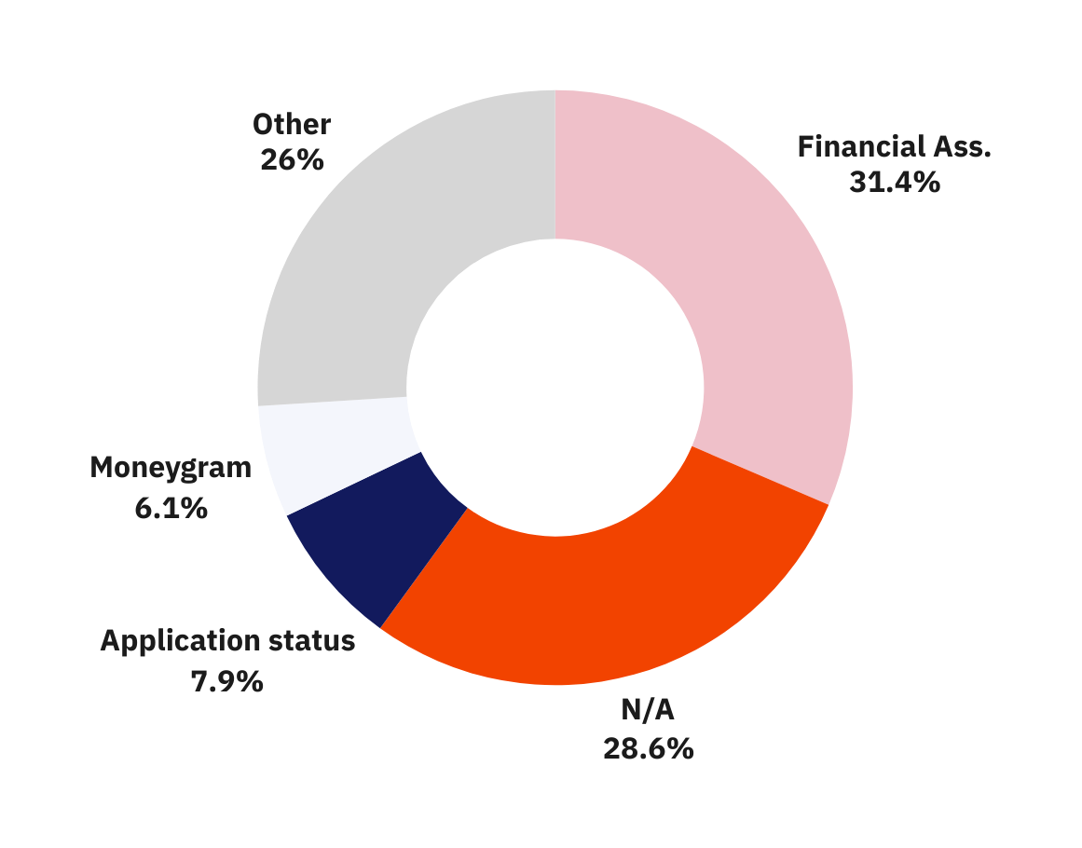




Experience & Achievements
Regional CEA Dashboard data for 11 countries
Regional PDM Dashboard data for 10 countries
%95 of the service receivers were satisfied with the information shared
37.90K
% of the people know how to ask questions or complaints to Red Cross?
%58
%42
25.19K
Know
Don’t know
Leaflets and info sessions reinforced the message, and as a result, NSM saw around a 20% increase in applications from those who hadn't applied initially.
Notes:
PDM: https://app.powerbi.com/groups/me/reports/5f052788-dabf-44ca-b744-c6dbf87aa379/ReportSectionb1f52af9d501f6abc891?ctid=a2b53be5-734e-4e6c-ab0d-d184f60fd917&experience=power-bi
CEA: https://app.powerbi.com/view?r=eyJrIjoiNWE3MTZhODEtMmNmZC00NzczLWJiOTctOWIxZmIxMWFlYmUwIiwidCI6ImQzYWI5NzkwLTZhZTItNGJkOC1hYTVlLTAyODY0NDgzZTdjNyIsImMiOjh9

Slide 9
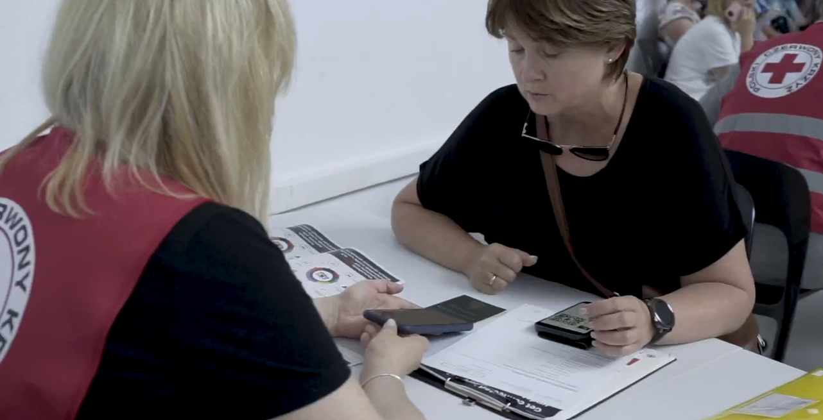

Challenges & Limitations
1. Assessments and context analysis
Lack if early engagement
Limited time, budget,
donor requests
2. Participatory, community centered program design
Lack of flexibility in planning (donor/ government led)
Not agreeing on selection criteria with community
Government led programs
3. Limited information dissemination
Political Sensitivity
Reaching the same community
4. Acting on feedback data
Project limitations
Not registering or analyzing the feedback data
5. Language Barriers
Notes:
Lack of human interaction
More then one hats of program team
Managing sensitive information
Lack of understanding of CEA

Slide 10


Mina Popović
PGI/CEA focal point
Red Cross of Montenegro

Slide 11

CEA and why it must be integrated in CVA
CVA is an empowering mode of assistance – it can help to put decision making power in the hands of communities, so that they can recover from crisis with dignity
Only possible when we ensure the participation and engagement of communities throughout the programme cycle

Slide 12

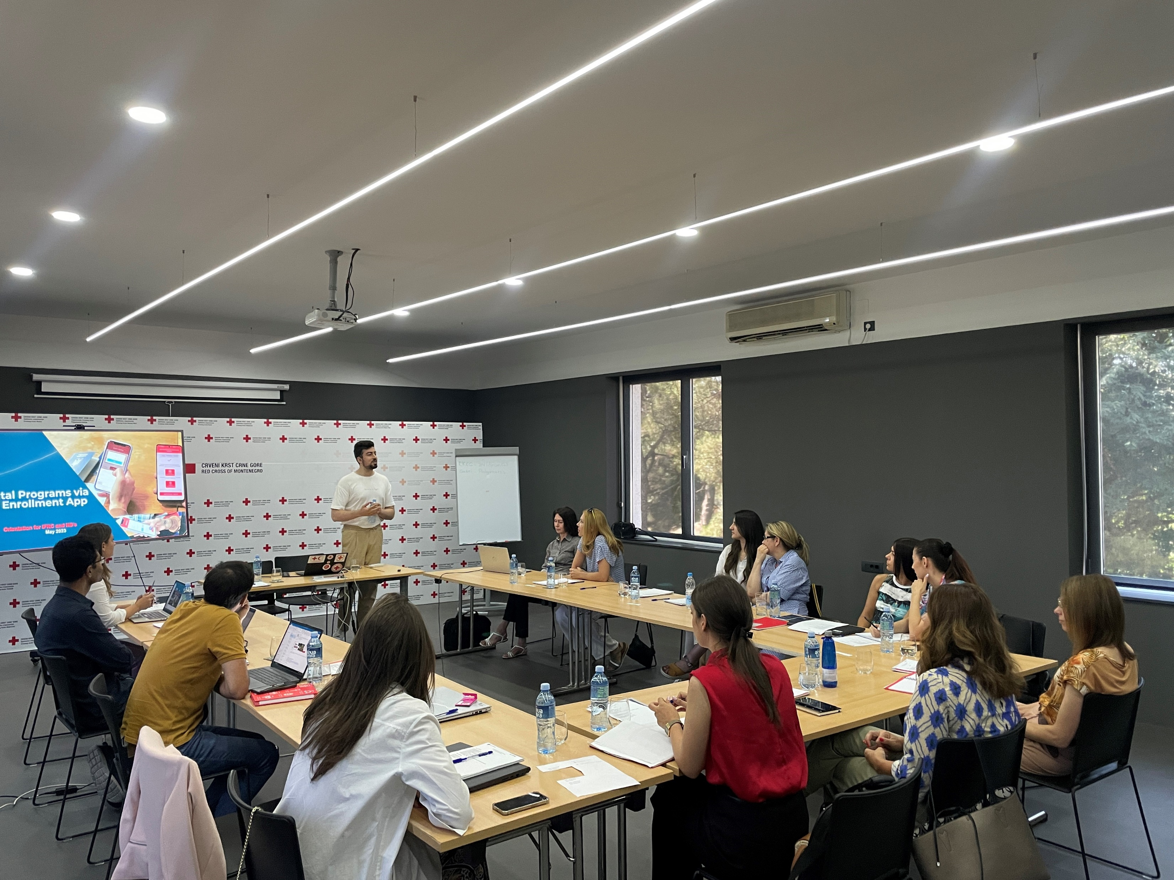
ESPO CRM and Red Rose
Preparation – training received by the IFRC staff, July 2023
Staff and volunteers on the project
3 persons with access
176 cases

Slide 13


Call centre
First call centre for Ukrainians in Montenegro
3 languages
Operator, Mon-Fri 10-16
Trained in receiving sensitive feedback
Communication goes through ESPO CRM
info.ukraine@ckcg.me

Slide 14

Pre-implementation
Before the cash is distributed – staff to explain to the cash recipients
how the distribution process works
why they were selected
how much cash they will receive and for how long
how and when they can access the cash
Extra time to explain the selection criteria to those who were not selected – preventing the possibility of disruption or spread of misinformation/rumours about the Red Cross
Trusted and preferred channels of communication used to share key information with the community before and during the distribution

Slide 15

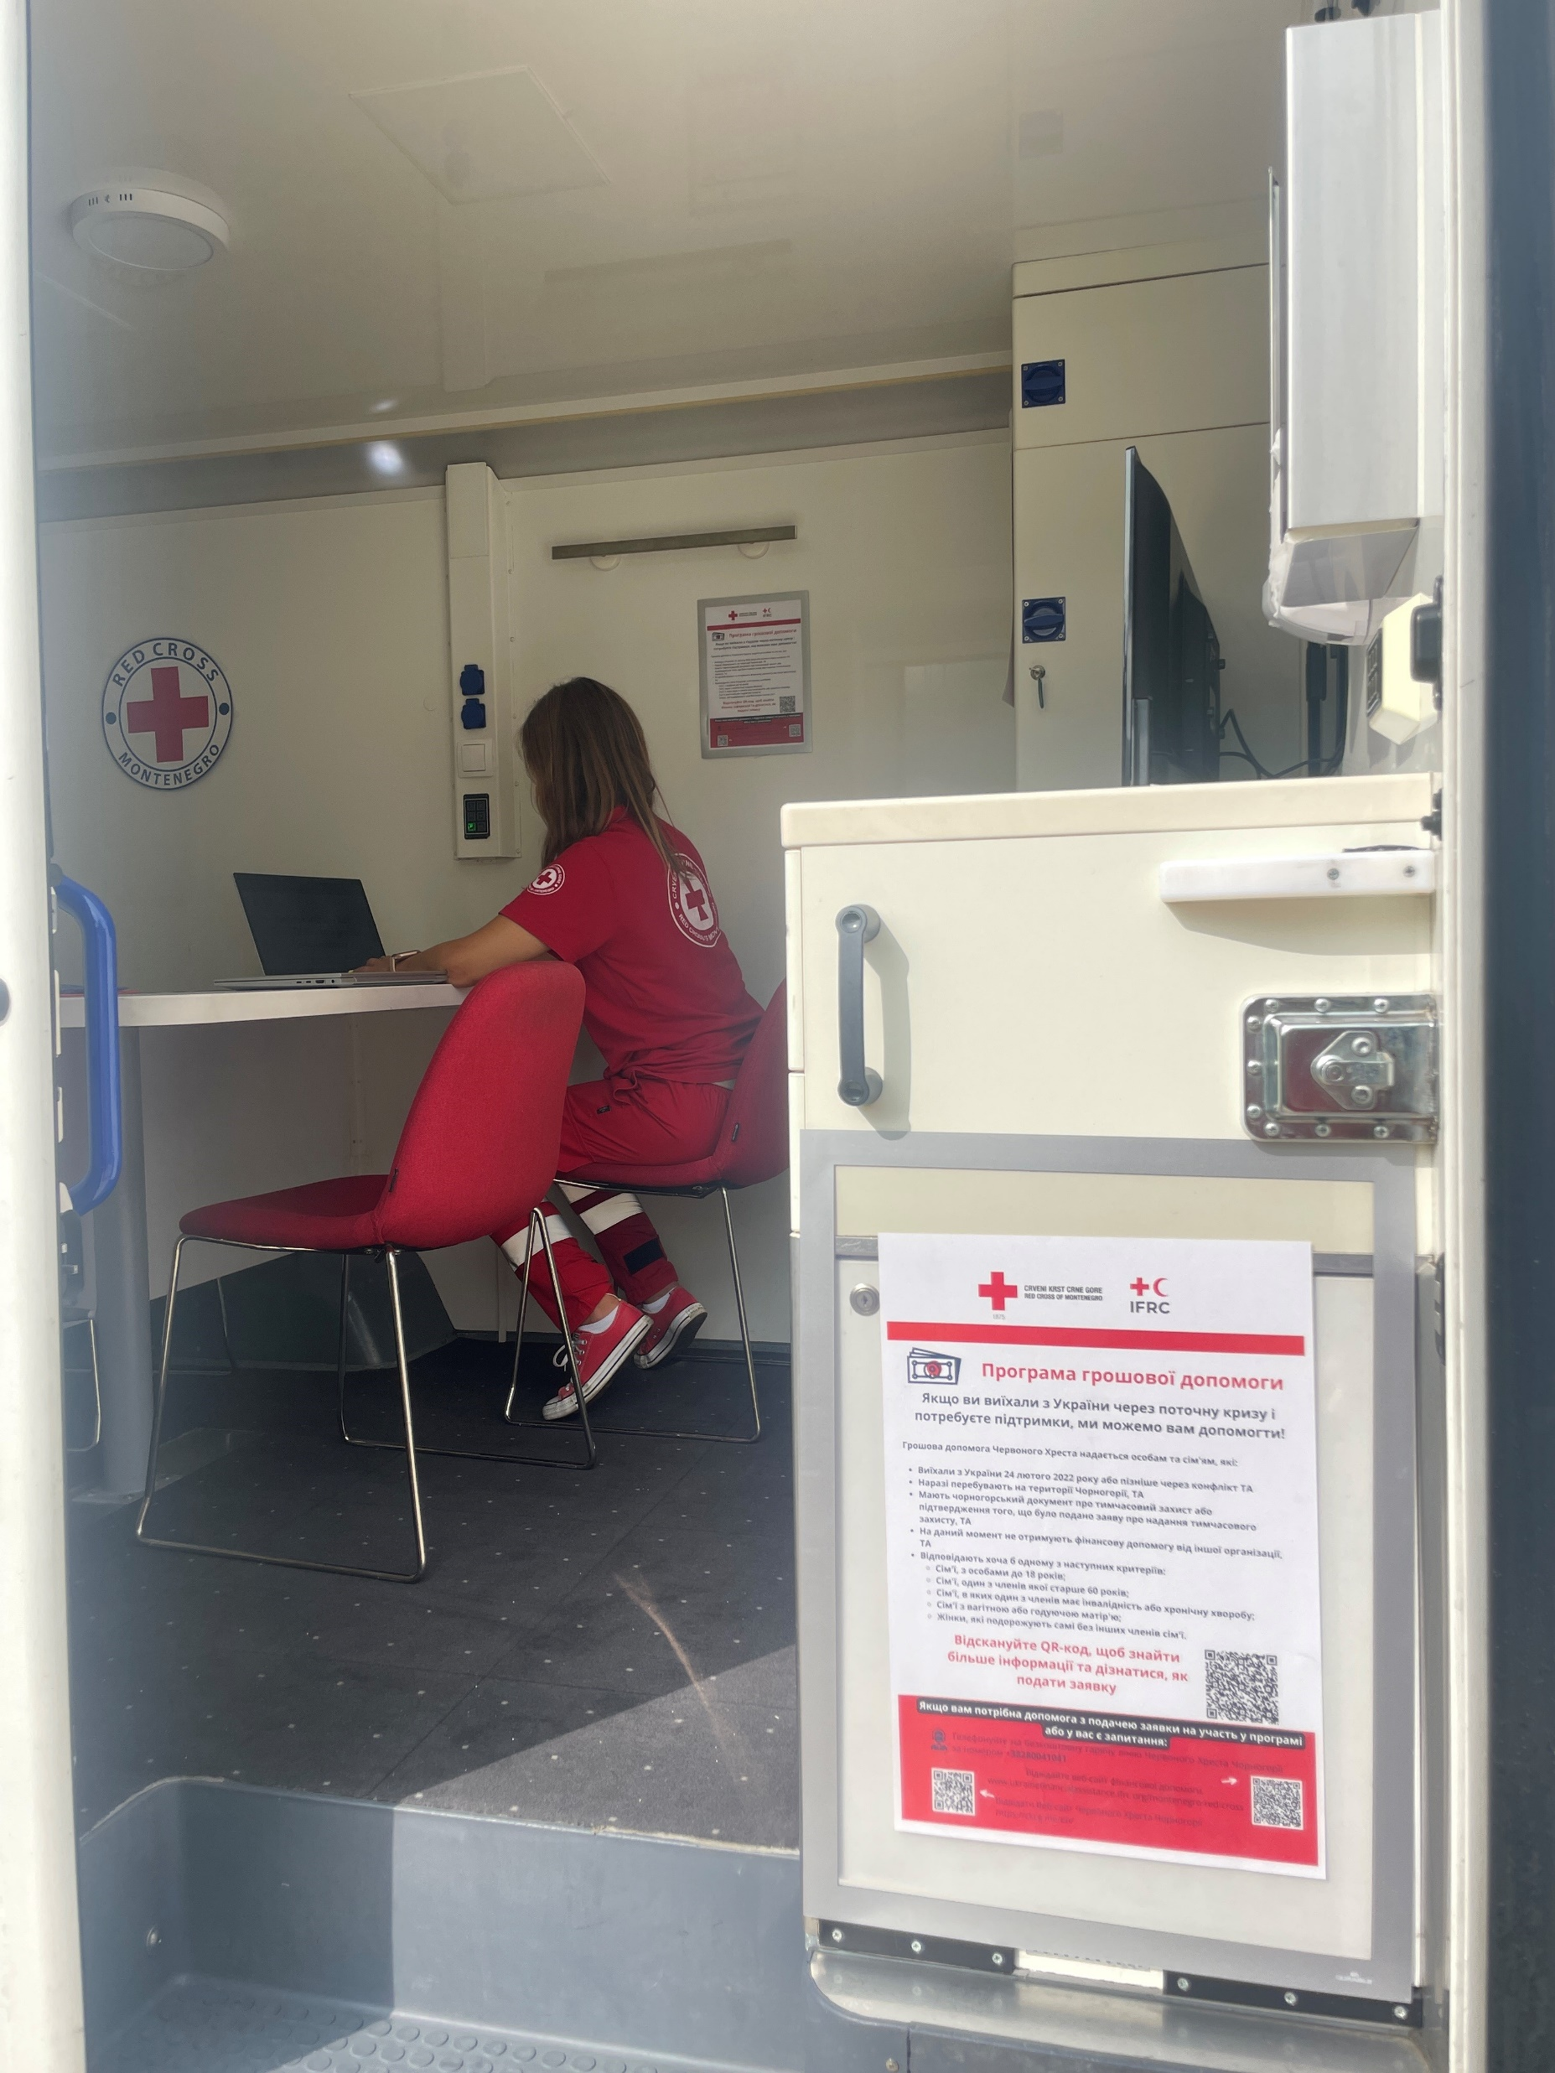
Humanitarian
Service
Points
Local branches functioning as Humanitarian Service points, information desks with a clear process for how to deal with different questions, complaints and feedback
Mobile teams

Slide 16

Communication
What communication is not? A one-way street
Listening to people and discussing with communities how they feel, how we can support them best, and who most needs support
Supporting people to access the practical information they need, in ways they can easily access and understand, to make informed decisions
Effectively sharing with people who we are, what we are doing, how we are working and why (different ways), conducting needs assessments and Post distribution monitoring
Enabled different feedback and complaints mechanism (E-mails, mailboxes, Helpline, social media, questioners)

Slide 17

CEA and Protection, Gender and Inclusion
Contact details of Focal Points for SGBV, child protection, legal and psychosocial support services to refer survivors to
Code of Conduct for staff and volunteers
Good communication skills and how to speak to people clearly and with respect
Answering questions honestly and clearly, including sensitive issues linked to sexual exploitation and abuse, violence or corruption

Slide 18

Key information shared with communities
How much cash is being distributed in each instalment and how many instalments will they receive?
How to access the cash (e.g. distribution dates and times, how to use mobile money, which bankmto go to is using prepaid cards, etc.)
That aid is provided free of charge – to minimise the risk of corruption and sexual exploitation and abuse
What the selection criteria is
How you are selecting people – to demonstrate that this is done fairly and transparently and address any concerns people have about not being included
Why you are not able to help everyone – limited resources, need to prioritize the most vulnerable of the aid is targeted at a specific group

Slide 19


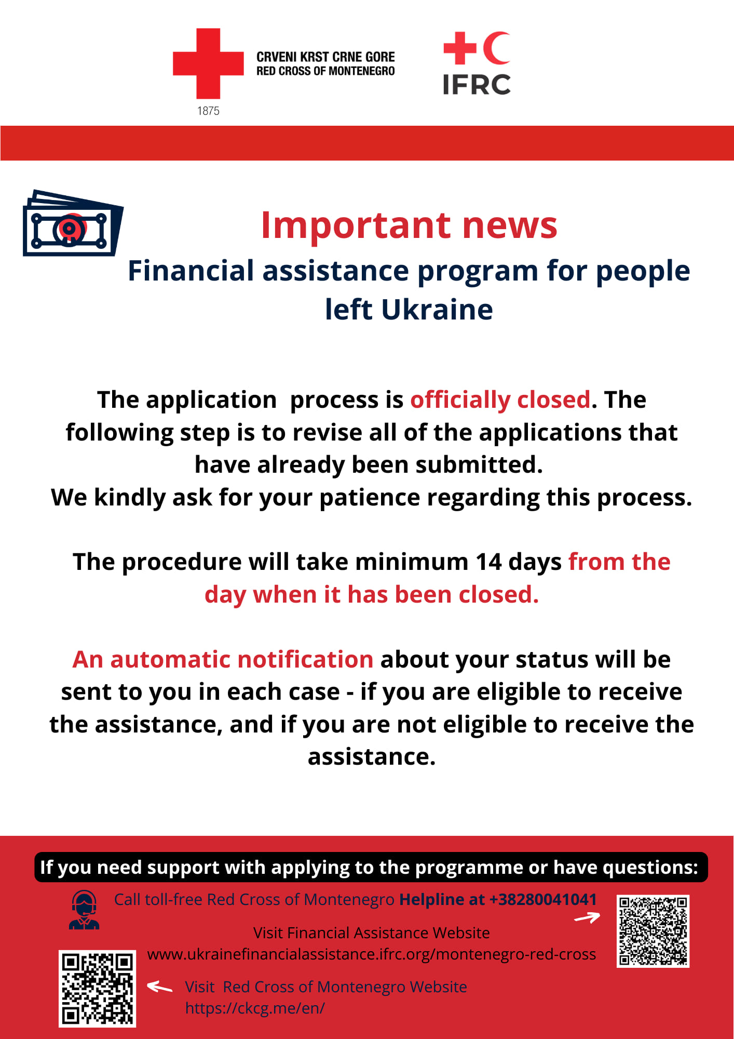
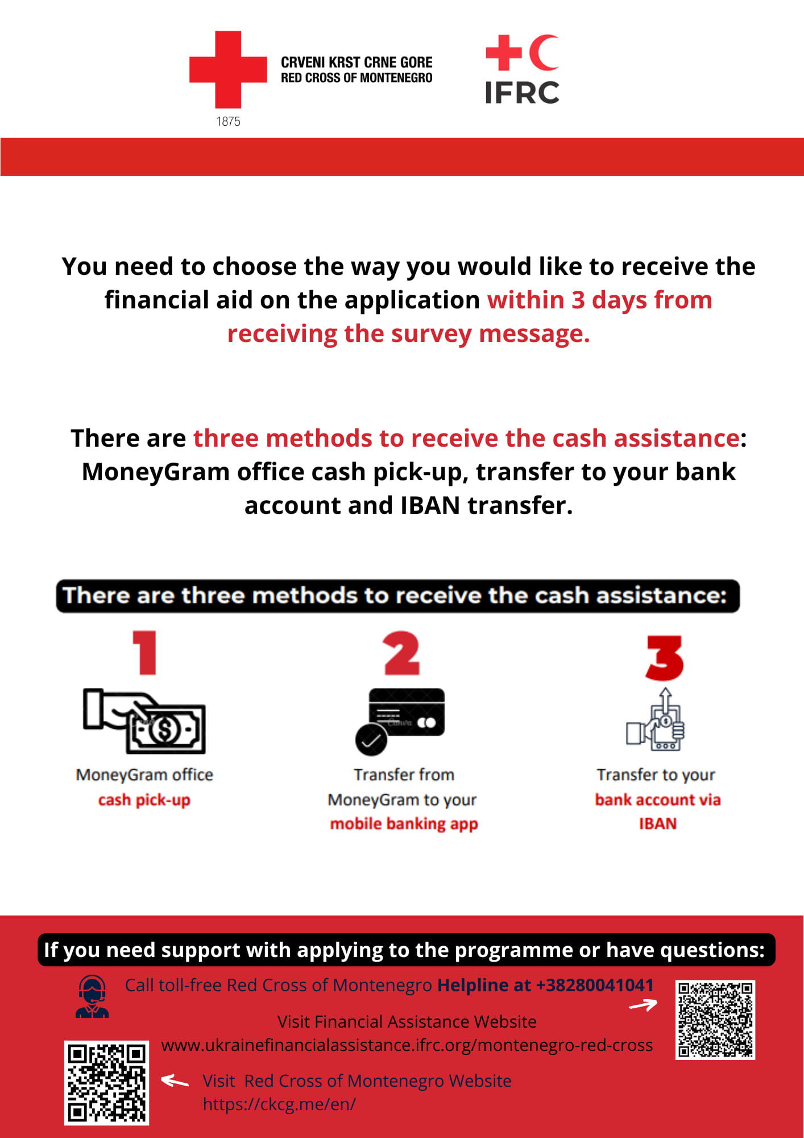
Information sharing
https://ukrainefinancialassistance.ifrc.org/montenegro-red-cross
https://ckcg.me/
https://youtu.be/4d6E8uA7Qk0

Slide 20

Monitoring & evaluation
Regularly reviewing community feedback from multiple sources:
Viber, Telegram
Email
Social Media
Website
Face2Face
Feedback box
Focus group discussions
Key staff in contact with beneficiaries throughout the process
Post Distribution Monitoring

Slide 21
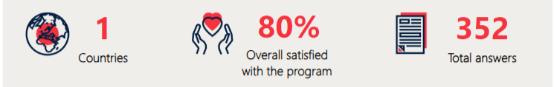


PDM overview
81% Moneygramm; 14% other; 3% IBAN
Did you feel safe when you collected the money? – 2% no (risk of theft, risk of losing money)
Preffered information channels – Viber 45%, Telegram 35%
Future plans
60% plan to stay until the conflict is over
0.8% plan to rellocate to Europe

Slide 22
Recommendations
Digital Literacy
Utilising Feedback
Reaching communities
Include face-to-face interaction
information workshops, home visits by volunteers, mobile office
Use multiple platforms
video tutorial, and call centre
Collaborate with communication teams
Provide information as clearly and transparently as possible
Strong coordination and common approach with branches
Volunteers and people with lived experience
Develop strategies for urban contexts
Register
feedback data
Contextualize coding framework
Close feedback loops
Refer and signpost internally and externally

Slide 23
Questions?

Slide 24
KoBo Survey
Click Here to Access the Feedback Survey
Notes:
Hopefully the link works on people’s screens –also post in the chat.

Slide 25

CEA Peer Learning Webinar
Thank you and goodbye – look forward to having you join us again next time!

