Slide 1
Location
COMMUNITY INSIGHTS
Community Engagement and Accountability Day/Month/Year

Slide 2
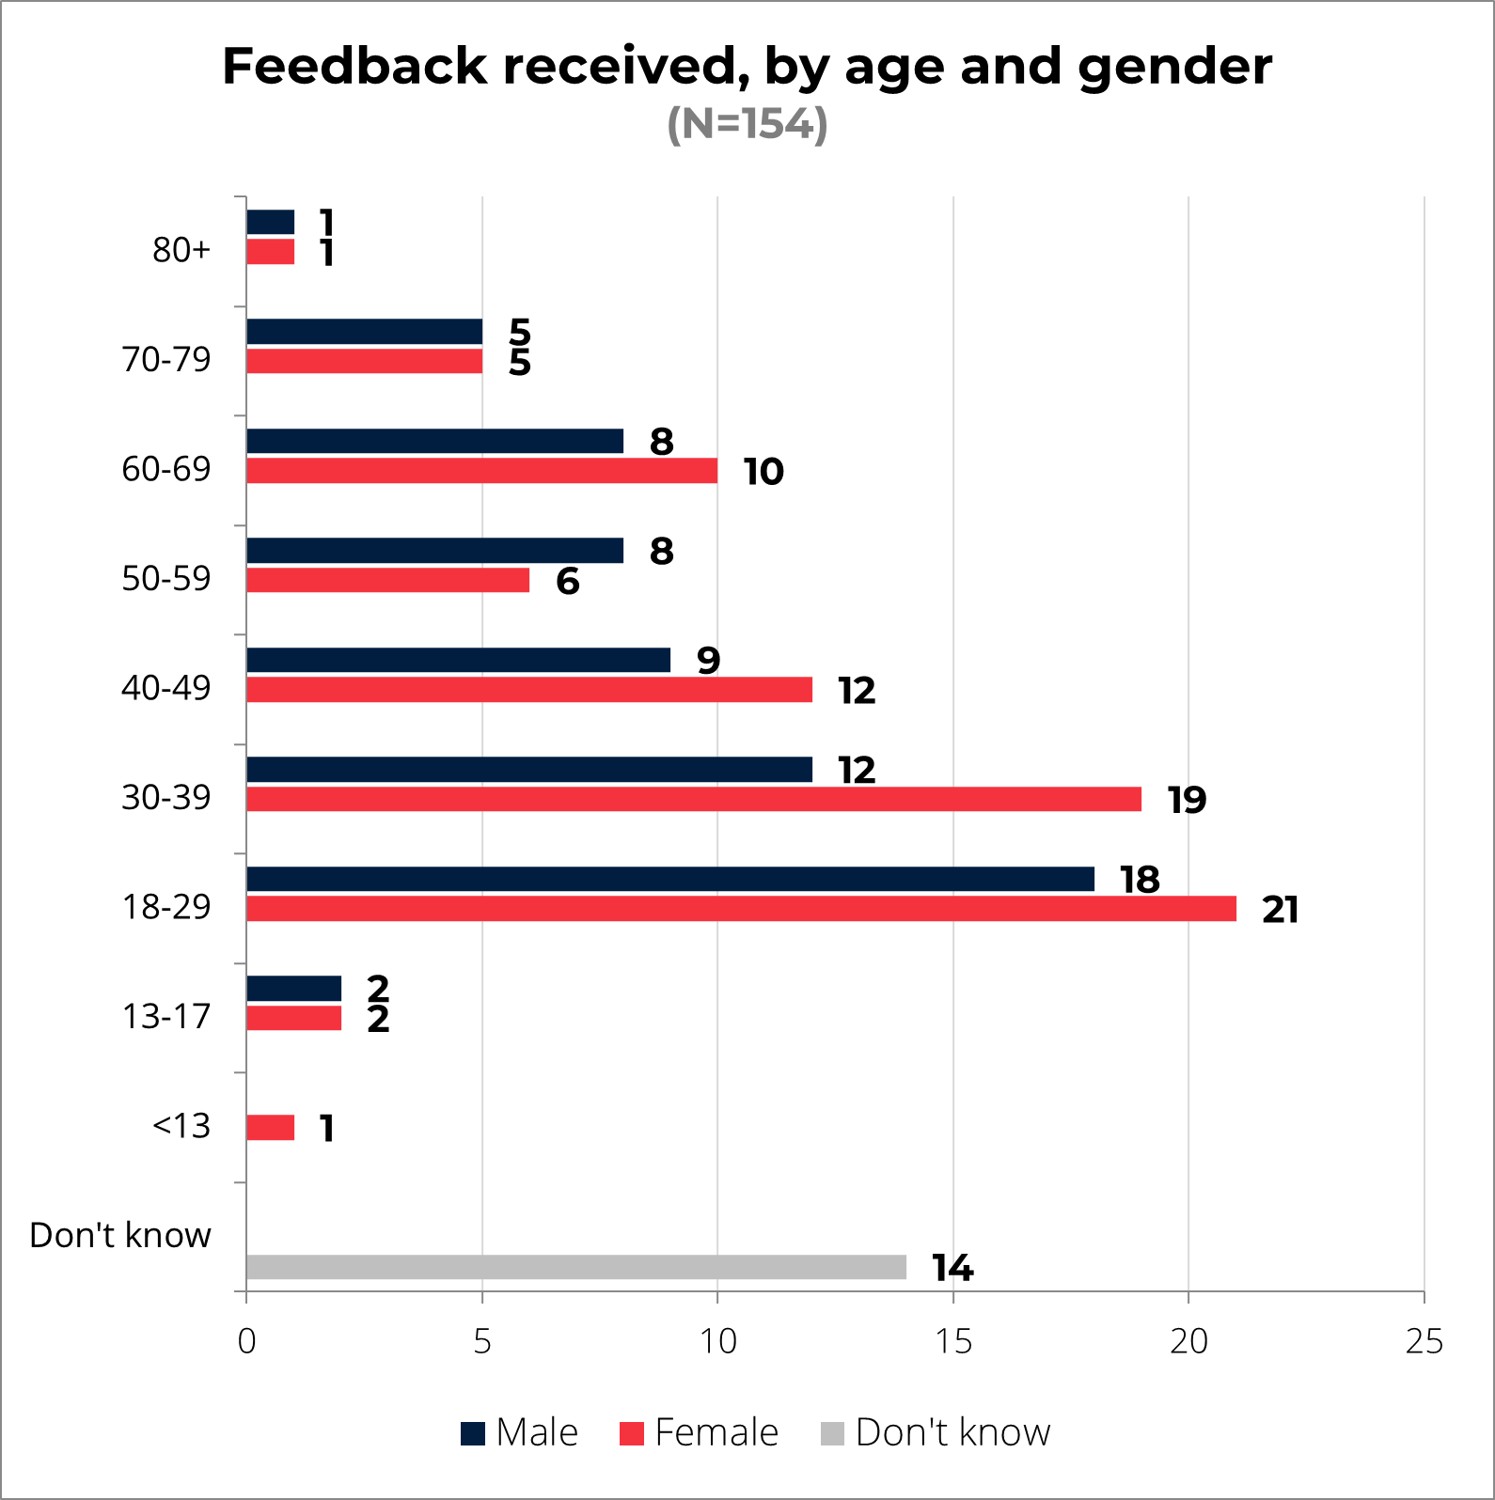
COMMUNITY INSIGHTS
Methodology & Demographics
50% (77) women
40.9% (63) men
9.1% (14) unknown
[Add information] – describe briefly how the insights were collected, when and whom by; mention any limitations or challenges. Present demographics details of community members who shared their insights. Support with icons and charts to facilitate understanding:
The insights were collected through face-to-face feedback collection by ____ volunteers with the support of IFRC. It is important to note that this data is not representative and should be triangulated further.
This report is based on XX community insights collected in XXX between xx and xx Month Year. Out of the total xx nsights, xx were from women, xx from men and xx community members preferred not to share their feedback.
xx community members shared that they have a disability. Nearly one-third of individuals are between 18 and 39 years old. So the data may provide more insights into the opinions of young to middle-aged people.

Slide 3
KEY FINDINGS
General overview
[Add analysis] – summarise the main demographics and types of received feedback, and support the text with charts copied from the coding framework dashboard. The analysis can be very simple and look something like this: Over half of the collected community insights (54%) are requests or suggestions, 19% are incomplete feedback, meaning community members did not want to share any insights or did not give consent to record them. 11% of the collected insights are praise and encouragement for the Red Cross and the work they do. The remaining data consists of questions (7%), observations and beliefs (5%) and 4% concerns.

Slide 4
KEY FINDINGS
Main topics
“
“
Quote
Gender, XX – XX years, location
[Add analysis] – describe the most frequently mentioned topics or highlight any arising/new topics. To support the analysis with concrete examples add more of a human face to the numbers, you can quote insights shared – but ensure no personal data is used.

Slide 5
RECOMMENDATIONS
Finding 1 (add the key finding i.e. Increased requests for first aid trainings)
[Add recommendation] – suggest what should and can be done in regard to the main findings. Work towards the implementation of these recommendations as part of the National Society’s accountability. This part can either be a block of text or bullet points. You can refer to as many findings as you find relevant.
Finding 2
[Add recommendation] – suggest what should and can be done in regard to the main findings. Work towards the implementation of these recommendations as part of the National Society’s accountability. This part can either be a block of text or bullet points. You can refer to as many findings as you find relevant.

Slide 6
Data was collected by:
National Society and Branch
This report was prepared by:
Name, title and email
For more information please contact:
XXX branch: name, email
Cover photo: SIRCS volunteers Elsie, Oliveth and Lincy and SIRCS headquarter staff Jean Uwesi.
Photo last page: SIRCS Malaita team, community members & IFRC support team
Photo credit: Viviane L. Fluck

