Slide 1
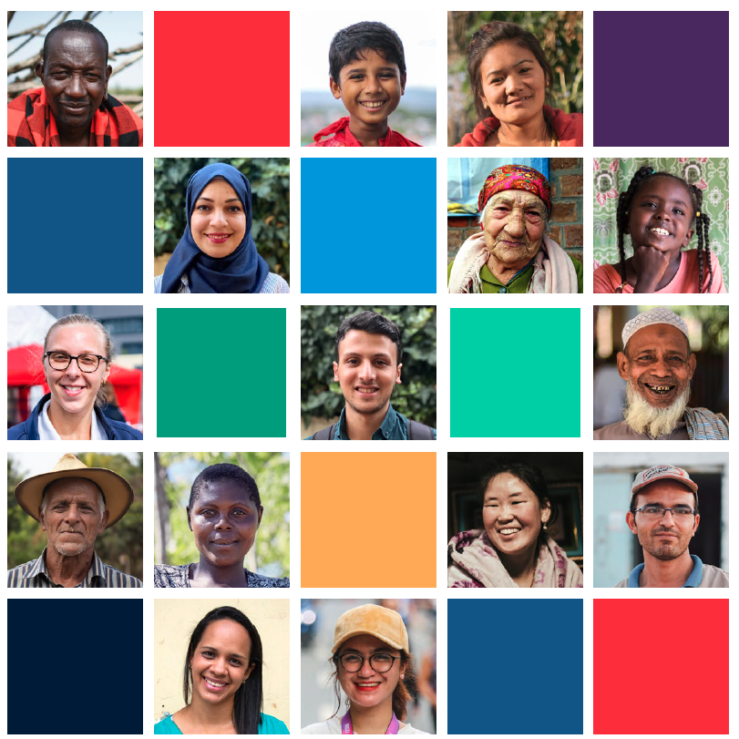
CEA Peer-Learning Webinar #4 Lessons from Kyrgyzstan:
A shot in the arm for vaccine programming

Slide 2
Running Order
Introduction and Welcomes
Red Crescent Society of Kyrgyzstan Presentation
Q+A
Open Forum
Feedback Survey

Slide 3
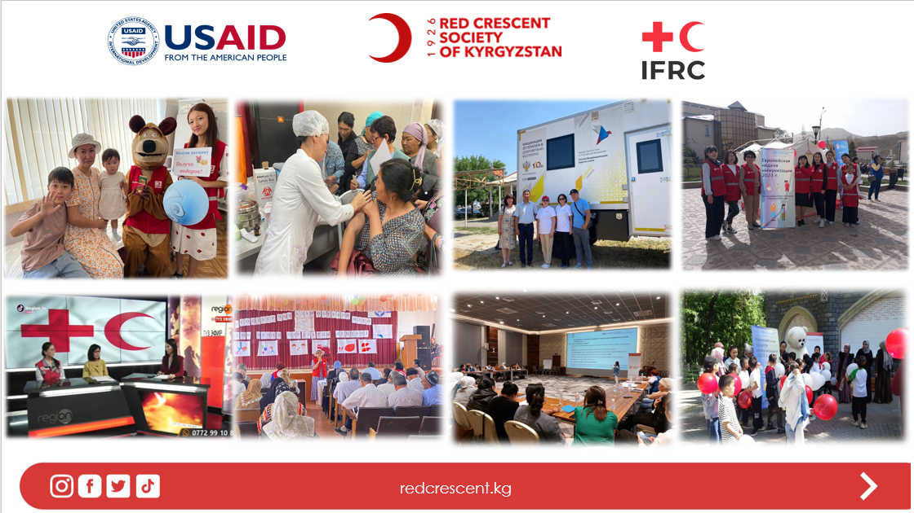
Pivoting from Covid-19 to routine immunization
BHA, Kyrgyzstan 2022-2024
CEA: Asel Kadyrbekova

Slide 4
Outline
Feedback Mechanism
Understanding Community Trust and Needs
Adapting Approach Based on Feedback
Coordination with Ministry of Health
Collaboration with Kyrgyz Medical State Academy
CEA Sustainability

Slide 5
Feedback Mechanism
Perception Survey
“Vaccination against COVID-19”:
trust in medical staff, reported by 34.3% vaccinated respondents
TV being one of the most popular /accessible sources of information
Whatsapp
Social media
Face to face
Mass media
KoboToolbox
Mapping and Referral system
MasterLogsheet/ Action Tracker

Slide 6
Understanding Community Trust and Needs
"Why do you continue working on COVID if it's no longer relevant?”
"Currently, there is a measles outbreak. If a child is vaccinated, do they need to be vaccinated again?“
"Do you have a vaccination calendar for children?“
"It would be great if you could involve healthcare workers in informational sessions"

Slide 7
Adapting Approach Based on Feedback
Change the content of info sessions
Coordinate with Ministry of Health
Collaborate with Medical State Academy
Disseminating information through trusted sources of information
Rise awareness on routine immunization through different activities
Collect, analyze and act on feedback
Trained volunteers supporting BHA were deployed to measles outbreak
COVID-19
Routine immunization

Slide 8
Coordination with Ministry of Health
RCSK’s role:
- social mobilization of trained Red Crescent volunteers
- work with parents who refuse vaccinate their children
- public education aimed at increasing awareness of the importance of vaccinating children
- support in printing and disseminating IEC
- broadcast a video material on TV channel
- conduct Round Tables with medical workers/ religious leaders
-organize open mic sessions, TV
-support in testing key messages
MoH’s role:
- provide medical workers to conduct info-sessions, campaigns in all regions
- provide list of parents who refuse vaccinate their children
- provide IEC to print out
- provide videos to broadcast
- participate in Round Tables, radio, TV

Slide 9
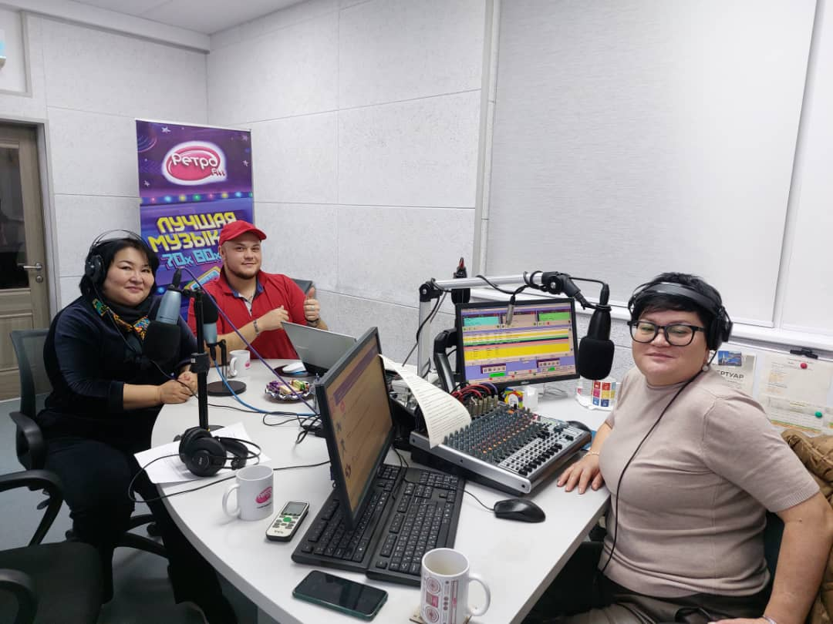
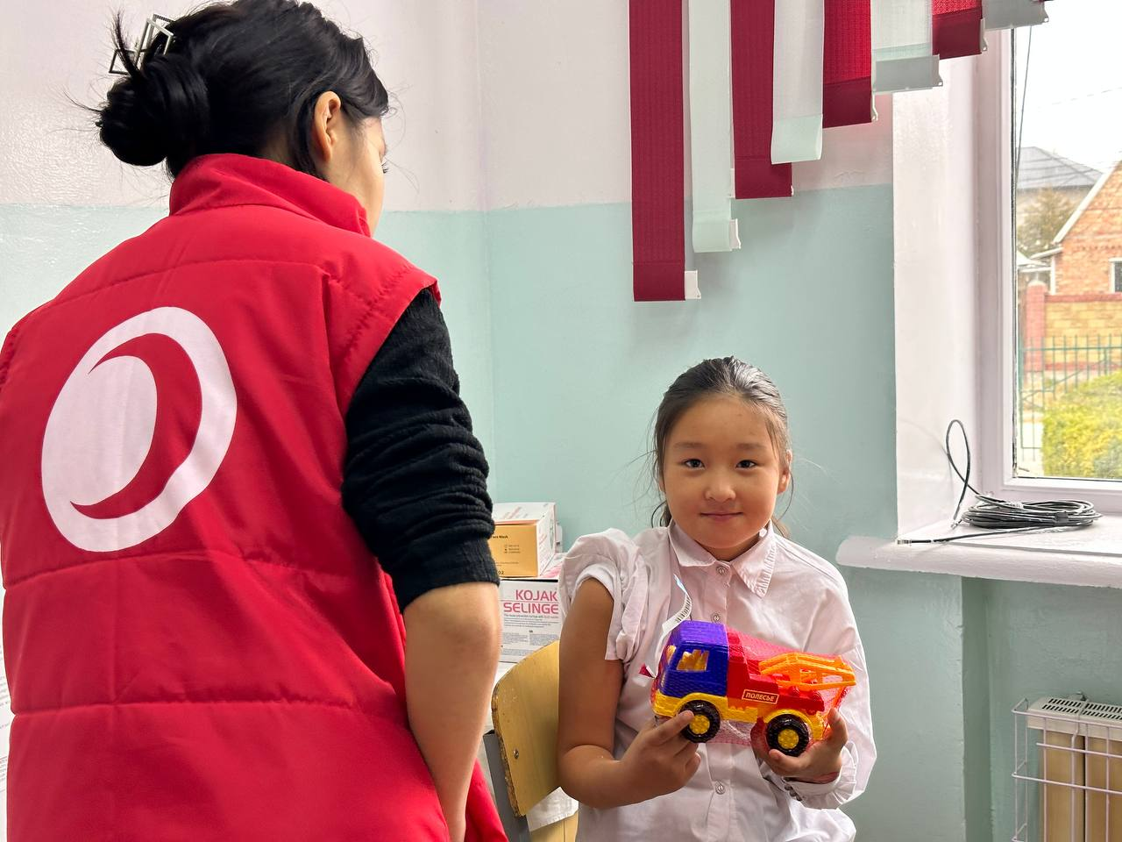
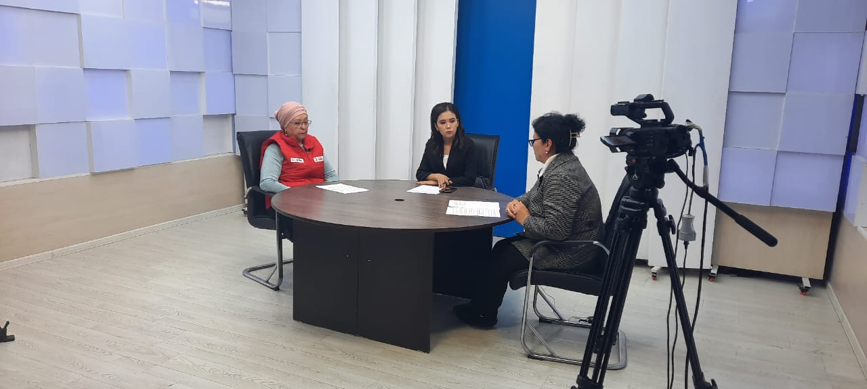

Slide 10
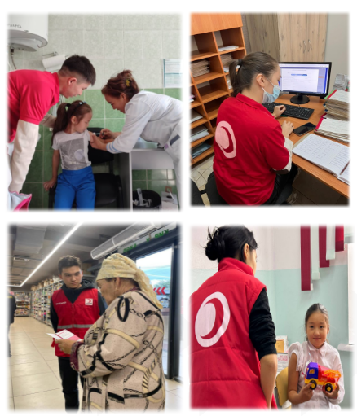
Collaboration with Kyrgyz Medical State Academy
Agreement with the university on voluntarily work of the students
52 students in their 5th and 6th years of study were enlisted to support healthcare workers at vaccination clinics during the measles and rubella vaccination campaign
Enter data into the healthcare system “Emdoo.kg”
Collect feedback
Conduct informational sessions
Notes:
Benefits for both: NS and students

Slide 11
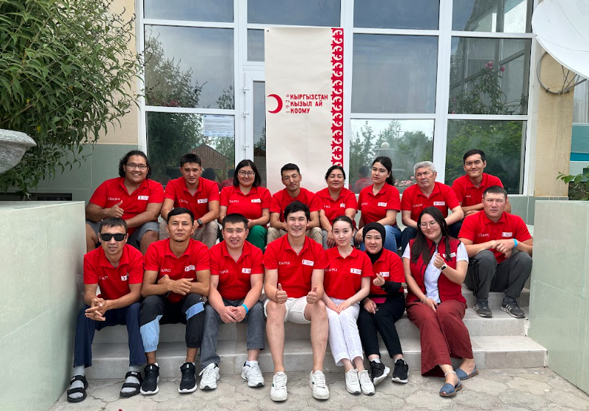
CEA Sustainability
3 CEA/PGI focal points in HQ
14CEA/PGI focal points at branch level
In cooperation with:
ECHO PPP,
CBDRM III, the Swiss Red Cross CBDRM III
Have conducted 3 trainings.
Feedback rooms in HQ and 3 branches
BHA Feedback mechanism set up is adapted and used in National Society
Medical State Academy volunteers continue activities and collect feedback

Slide 12
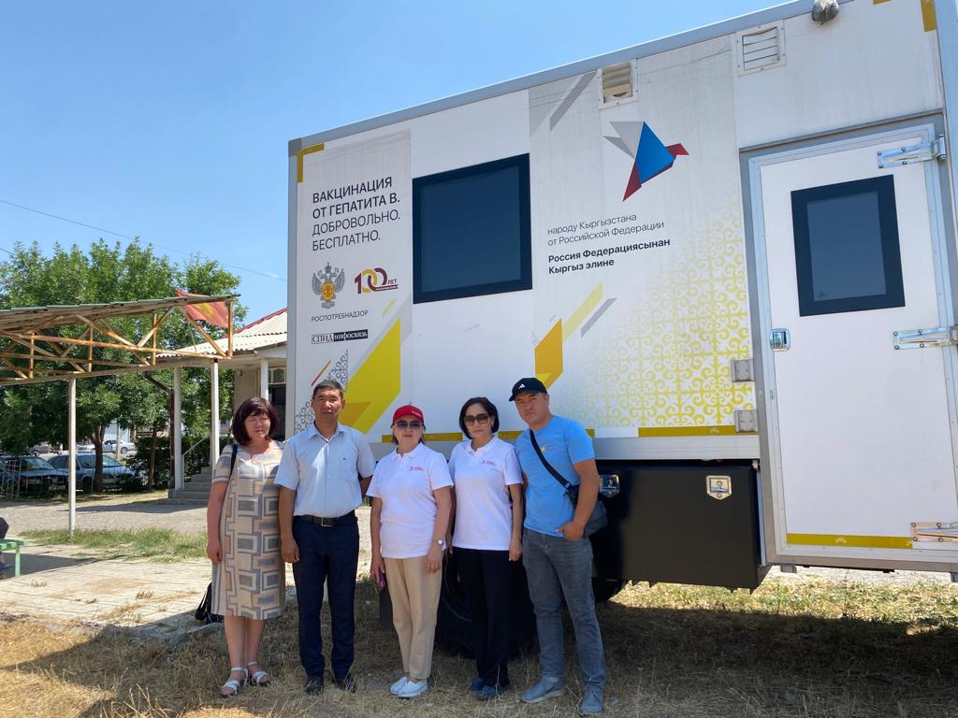
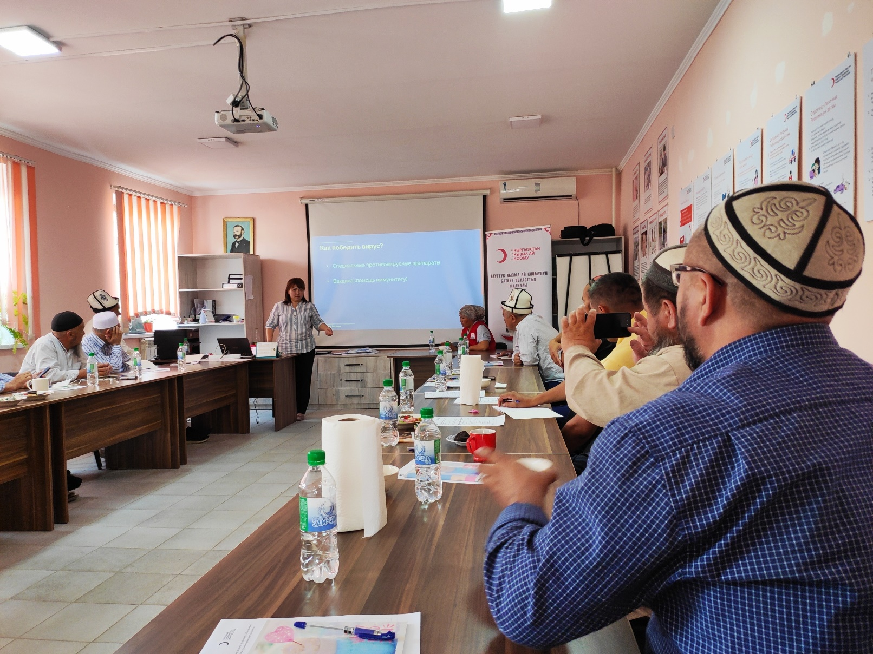
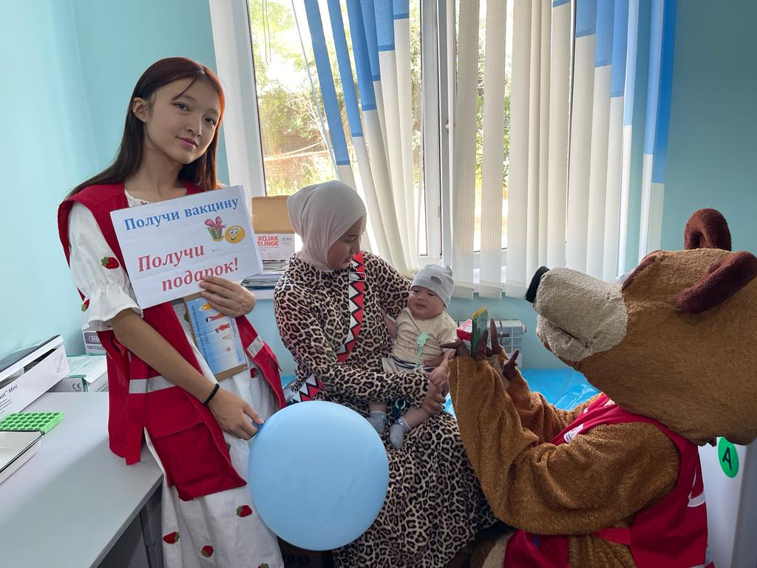
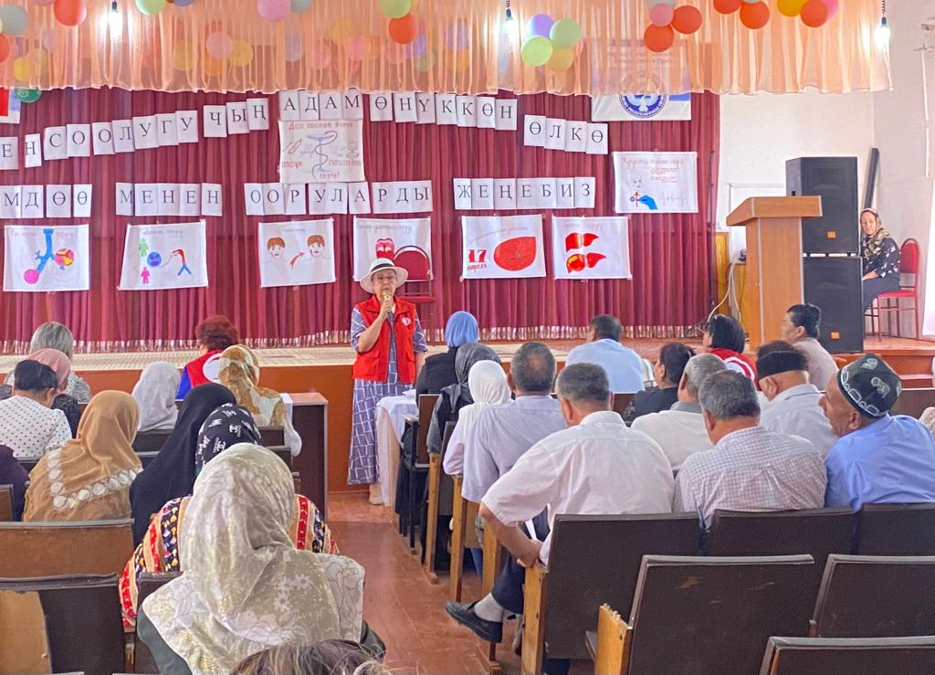

Slide 13
THANK YOU!

Slide 14
Questions?

Slide 15
Open Forum
Any CEA related questions for the group?
Any follow up questions to the presentations?
Any comments, announcements, suggestions, AOB, etc. that you would like to raise while we have this broad expertise present?

Slide 16
KoBo Survey
Click Here to Access the Feedback Survey
Notes:
Hopefully the link works on people’s screens –also post in the chat.

Slide 17
CEA Peer Learning Webinar
Thank you and goodbye – look forward to having you join us again next time!

