Slide 1
CEA Peer-Learning Webinar #3
A Greek Odyssey:
Ten years of CEA in Hellenic Red Cross migration response

Slide 2
Running Order
Introduction and Welcomes
Hellenic Red Cross Presentation
Q+A
Open Forum
Feedback Survey
Notes:
FACILITATOR NOTES
Useful sources of internal and external secondary data
Also domestic/national sources – government data and from other national organisations and NGOs will also be useful.

Slide 3
CEA in Migration
Peer Learning Session #3
A Greek Odyssey: Ten years of CEA in Hellenic Red Cross migration response
15/12/2023

Slide 4
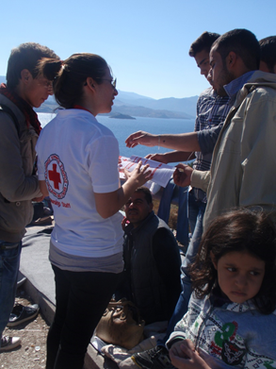
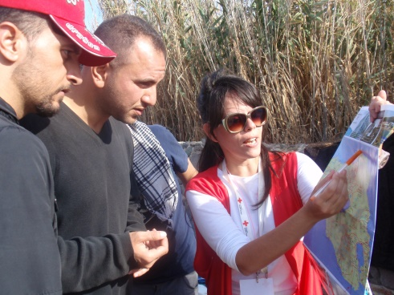
How it started:
2015 – 2017: Mass influx of refugees and migrants
Main CEA activities:
Assessing and meeting information needs of migrants
Risk communication & Community Engagement
Notes:
The migration response is divided in 3 phases: The emergency, the long-term and the “nowadays” phase.
Back in 2015 due to the conflict in Syria and Iraq, and economic and political instability in several Middle Eastern and African states, led to a wide-scale
displacement of migrants in Greece (thousands of people passing cross the borders through sea and mainland)
HRC with the support of IFRC together with PNS’s started responding to the emergency setting through FACT and ERU’s team all over mainland and islands.
Then is when CEA first appears through the provision of life saving and timely information (Risk communication) according to their needs (e.g ppl need to know where they stand and where to find dry clothes so we improvise and find innovative ways to address and inform the people: we use face-to-face communication, maps, posters, loundspeakers)
CEA: 1. Is introduced by IFRC and PNS’s 2.It’s not something new for NS but now is presented in a more systematic way

Slide 5
Challenges
The chaotic and exhausting environment & the vast number of people
Issues in accessing updated, life-saving and relevant information & due to the rapid changes to the migration context
No stable feedback mechanisms on place due to the transitory nature of population
No dedicated HRC CEA staff and volunteers
Limited time and capacity for CEA activities
Notes:
1.Chaotic and complicated context: We had to address to a mass number of ppl (camps of 20.000 migrants), how we make sure that the message has reached everyone?
2. The information changed rapidly from day to day due to national and European policies and context and that resulted in risking providing information to the ppl that was invalid and not updated (e.g by the time the posters were printed and were ready to be disseminated widely to the community, the information had already changed!)
3.The nature of the migrant population: The vast majority of ppl they didn’t want to stay in Greece (was regarded as a transit country, ppl on the move) and that means that is quite challenging to establish feedback mechanisms = One-way communication with the communities
4.Despite the fact that CEA was not something new, the NS still wasn’t familiar with the whole CEA concept (trainings were necessary to take place in order to comprehend in depth the meaning of CEA and that required time)
5.The staff was overwhelmed with other obligations as well / multitask positions-no time for CEA

Slide 6
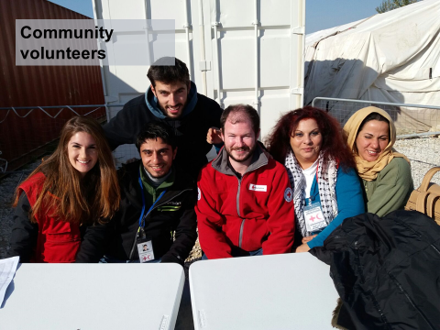
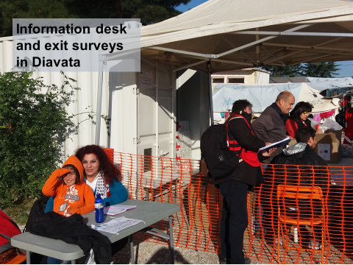
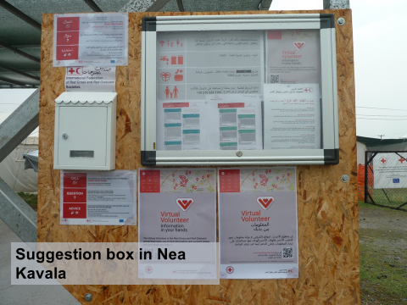
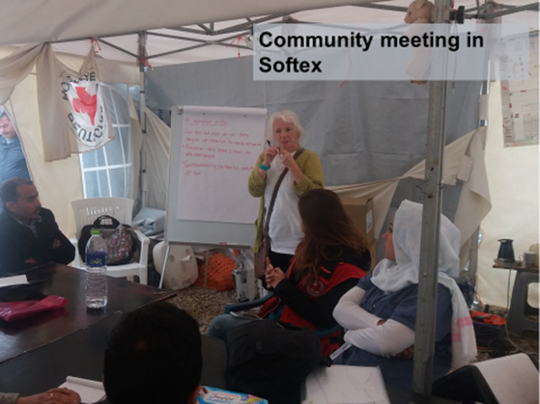
How it evolves:
2017 – 2019: Refugee camps are established all over Greece
Notes:
Over the next 3 years the migration context changes and despite the fact that we are still dealing with a mass number of population, now people stay in camps that allow us to engage better with the communities and build more on CEA activities
Important! Stable feedback mechanisms are established and two-way communication with the communities is achieved (virtual volunteer platform, exit satisfaction surveys, PDM’s etc). We manage to ensure the quality and the improvement of delivering services, we now know and we address better to the ppl’s needs)
Also, key focal persons staff and vol are gradually trained in CEA and get familiar of its necessity and its methodologies = CEA is considered as an integral part of the operational strategy (this is the point were the NS makes the first steps in institutionalizing CEA with approving the position of CEA Coordinator, focal persons, ToT SOP’s)
We focus on communicate transparently and in appropriate, accessible manners about the NS’s principles and values, the aims and objectives of HRC actions and advocacy, what the beneficiaries can expect from us, and how people and communities can participate in and provide their inputs about issues and decisions that affect them.
Picture: Providing timely and accurate information (picture 1: Life-saving information provision to the refugees that have just landed in Lesvos island, picture 2: Providing in a transparent way, information regarding the social services in the MFC Thessaloniki)
Picture: Receiving feedback from the community (picture 2: A suggestion box is set on the Lavrio Refugee Center in order to receive feedback regarding the HRC PSS and medical services, picture 4: Completing a questionnaire in Ritsona refugee camp regarding the HRC NFI’s distributions)
Picture: Engaging the beneficiaries in all the HRC programs (picture 3: Discussing and deciding along with the community in Nea Kavala camp for potential changes in the menu, picture 6: Designing and implementing PSS activities together with the minors in the HRC UAM shelter in Athens)

Slide 7
More challenges… and more opportunities
Multicultural environment, many nationalities and disparity of languages
CEA is regarded as an additional burden
Coordination issues on CEA activities between external actors led to duplications, ppl’s fatigue and credibility issues
Recruitment of intercultural mediators and interpreters
Trainings were conducted, position of CEA coordinator was created, focal persons were appointed
Participation in coordination meetings (CwC, HWG, protection meetings etc)
Notes:
At this phase, the profile of the migrant population changes: ppl come from Middle East and African countries as well and that means that we address to disperse communities, with many nationalities and different cultural and socio-economical backgrounds and needs. The disparity of the languages becomes our major problem since there are no available interpreters for every nationality and we face challenges in accessing and reaching all parts of population (practical issues: e.g one poster need to be translated in more than 18 languages in one community and in the coordination in the community meetings gets chaotic due to participants of different cultural backgrounds, needs and requests)
In order to address to the above challenges CEA methodologies are implemented like engaging with community leaders and volunteers and recruiting cultural mediators that facilitate the communication and the engagement
CEA = separate program: we still lack the comprehension of the fact that CEA is a cross cutting approach, it’s essential part of each project and it’s obligatory
Coordination issues: The ppl is exhausted by the continues surveys of the different actors and the very slow pace in improving services and taking decisions based on the ppl’s needs (credibility issues: e.g “you keep asking us the same questions and you do nothing!”).

Slide 8
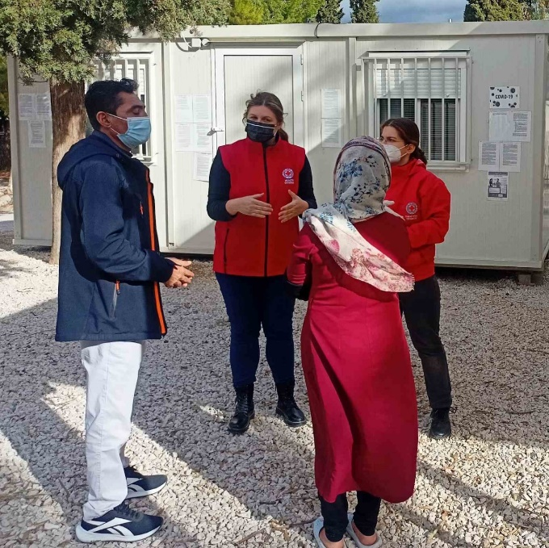
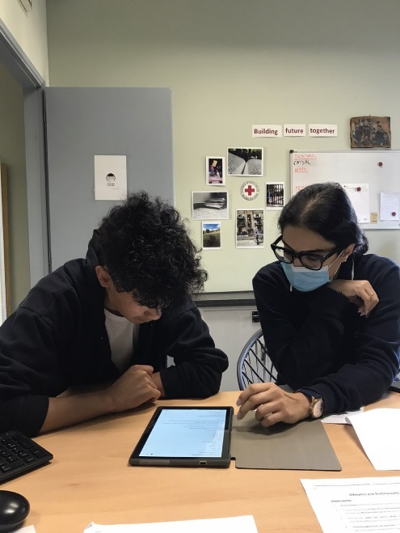
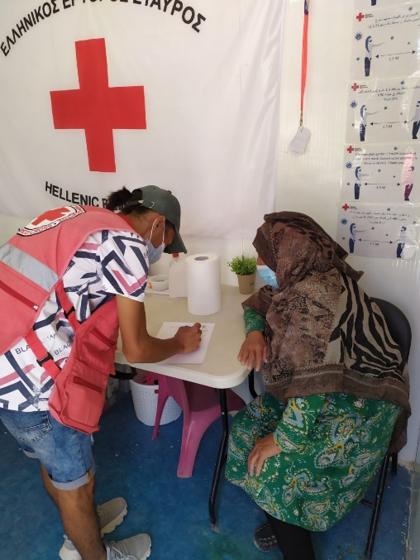
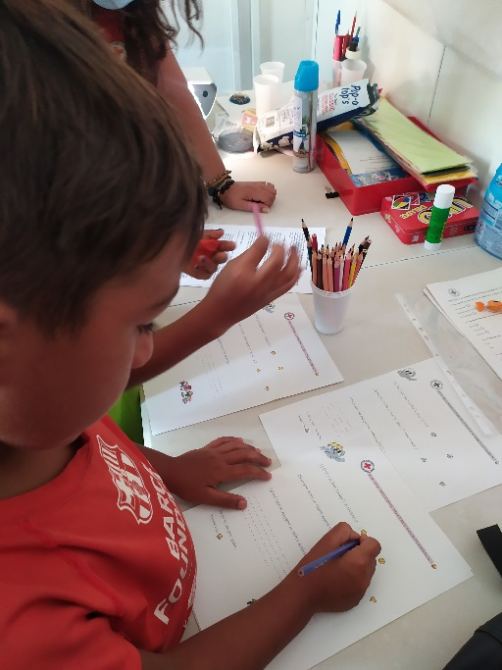
Up until today…
2019-2023: Fewer number of migrant and refugee population, long term CEA activities, Covid-19, Ukrainian crisis
More experience in applying CEA
RCCE(Covid-19 perception surveys)
Ukrainian population
Notes:
The following years the migration context changes: the number of the arrivals is decreased and RCCE is in the frontline due to Covid-19 (information campaigns through face-to-face communication, community meetings, door-to-door info sessions, dissemination of printed material in order to engage with migrant communities and promote safe and healthy behaviors against Covid-19
HRC has gained knowledge and experience in CEA and uses a variety of CEA methodologies e.g large scale surveys to measure the migrants population perception around Covid-19, satisfaction surveys in the health outreach activities, child-friendly questionnaires to get feedback from young ages regarding the PSS activities and in UMS’s family meetings as a two-way communication channel
Ukrainian crisis: A totally different profile of refugee population (stay in shelters and apartments and are difficult to reach and engage) so we have to adjust our methodologies to the population profile e.g a survey on mental health issues is conducted through FGD’s since it’s a more direct method and preferable by the population

Slide 9
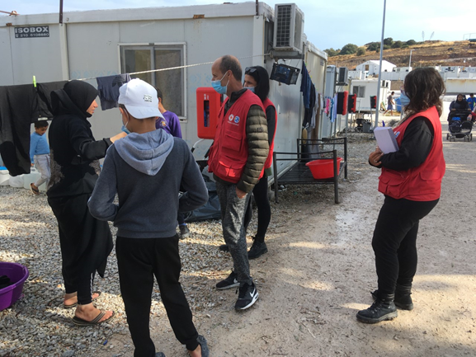
Lessons learned & Recommendations
Each migration crisis has a different context and profile = CEA tools are adjusted accordingly
CEA trainings should always be there
The “feedback culture” was cultivated
The ppl’s engagement in the design and the implementation of the program straightened the ownership & the sustainability & created relationships of trust and reliability
Get the leadership buy-in and make allies
Notes:
Assess the migration context, dive deeper in the profile and the characteristics of the people you’re addressing to and make use of the CEA available CEA adjusting them accordingly to each situation
CEA trainings never stop (information sessions, 2 days trainings, 1hour field sensitization session etc) help staff and vol to understand the value of CEA and how to practically engage with the communities
Set up feedback mechanisms! Give people the opportunity to express their opinions, their suggestion or complaints though systematic and combined feedback mechanisms / that’s how you identify their needs, create tailored programs, answers their questions, gain trust and improve the delivering services
Engage people in the activities: Local volunteers, community leaders etc increased the ownership of the programs and also trust, credibility, acceptance and respect was achieved between HRC and communities
Get the leadership buy in, from the Ops manager to the field staff, advocate for CEA and push to be included in the Ops stategy, engage and appoint staff and volunteers as focal persons

Slide 10
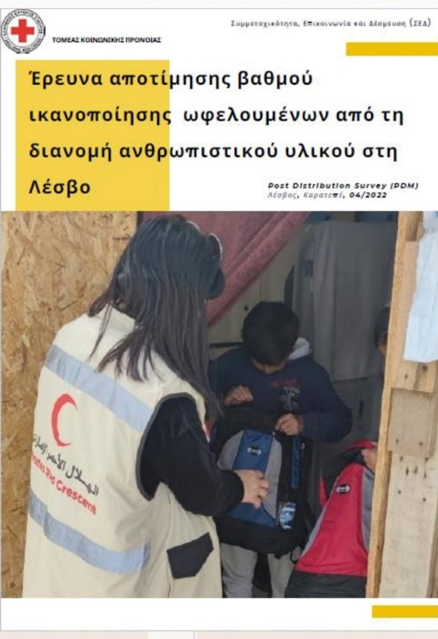
Inspirational final words!
“CEA always finds a way!”
“Adjust according to your context!”
“Institutionalize!”
Notes:
CEA is a mindset, should always be there no matter the budget or the nature of the project and the population and try to adjust the tools according the situation
Each emergency, situation and program can be completely different due to the circumstances, the context and the people in need: Even if you are addressing to a small community or a camp of thousands of ppl, you can still conduct a survey to measure ppl’s needs – what it changes is the methodology
Make CEA obligatory, ensure that CEA will be in the domestic programs even when the migration crisis ends. Push for a simple document of minimum standards, or one indicator that ensure the CEA component

Slide 11
Questions?

Slide 12
Open Forum
Any CEA related questions for the group?
Any follow up questions to the presentations?
Any comments, announcements, suggestions, AOB, etc. that you would like to raise while we have this broad expertise present?
Notes:
BRC Community of Practice?
Also domestic/national sources – government data and from other national organisations and NGOs will also be useful.

Slide 13
KoBo Survey
Click Here to Access the Feedback Survey
Notes:
Hopefully the link works on people’s screens – otherwise also post in the chat and I can send to participants afterwards as well.

Slide 14
CEA Peer Learning Webinar
Thank you and goodbye – look forward to having you join us again next time!

