Slide 1
CEA institutionalisation at the Netherlands Red Cross Case study
17 October 2023 – Europe region meeting
Nikki Buijse & Marily Bronkhorst

Slide 2
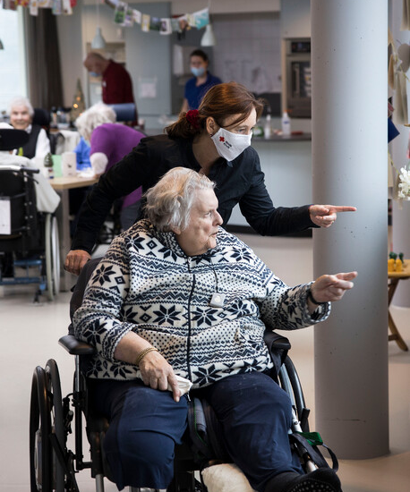
Presentation contents
Why did we start this self-assessment
Process of self-assessment
What barriers did we face
Outcomes of the process & next steps

Slide 3
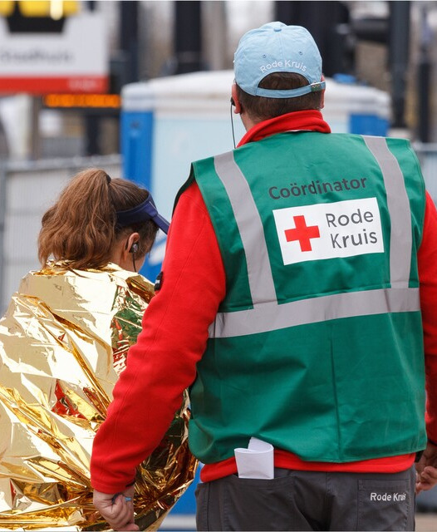
Why start this self-assessment?
Resolution signed in 2019
Focus on crisis management in domestic aid in 2020-2022 (covid, refugees, flood)
2023: implementation of the resolution is part of the domestic aid strategic working plan
In order to make a plan, a self-assessment was needed first

Slide 4
Process self-assessment
Meetings with representatives of every team + representatives of branches and volunteers, D&I, Protection, International
Participants identified by their managers
Duration 1,5 – 2 hours and 0,5 hour for volunteers
Content of conversation
Start with explanation of CEA
Questions on:
Where is your team now
Opportunities for strengthening CEA
Risks / obstacles for strengthening CEA
Specific topics from toolkit in the CEA hub

Slide 5
Process self-assessment
Participants were asked to read and write along with the final report (50% did)
The results and an advice on how to proceed were presented to the MT of Domestic aid and after that to the NLRC-wide MT
Advice builds on outcomes from the conversations, the CEA guide, case studies, etc. Headlines:
Temporary CEA officer to drive institutionalisation
MT sponsor
Strenghtening the feedback mechanism
Raising awareness

Slide 6
Barriers that we faced
Changes in the NLRC MT created some challenges w.r.t. procedure and understanding of CEA
Hesitation by NLRC MT to appoint a CEA officer and specific CEA budget (worry about vulnerability + losing connection with operations)
Hesitation by MT Domestic to start with writing policy / embedding in work instructions and widespread CEA awareness trainings. Assumption that it has to be a ‘living’ topic first (have a few ‘best practices’), before we can formalize impactfully
Branches are working on a lot of essential topics (strengthening the foundation of branches + implementing (other) movement-wide topics). How to prioritize?

Slide 7
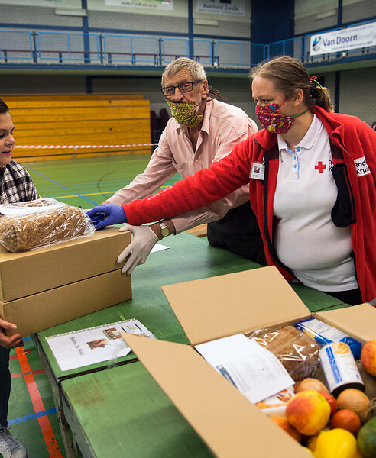
Surprising outcomes
A lot of enthusiastic colleagues and a lot of projects aimed at embedding CEA have started up in the past 6 months – not solely but also inspired by our assessment
CEA is now part of the domestic strategic working plan for the next 2 years and will be part of all team working plans for domestic aid, with each manager taking responsibility

Slide 8
Next steps
CEA in the work plan of every team. With responsibility for every manager (domestic, HQ)
Finding ways to include branches more + learn from and with them
Creating Best Practices (e.g. food + shelter programmes)
Feedback mechanism project
Coordinating and anchoring knowledge & expertise
Keep creating awareness (without formal role)
More expertise exchange with international dept. (e.g. PMER)

Slide 9
Questions?
Feel free to ask them now, or contact us at:
Marily Bronkhorst - mbronkhorst@redcross.nl
Nikki Buijse - nbuijse@redcross.nl

