Slide 1
Community Engagement and Accountability Foundation Training
Module 3
Community feedback mechanisms
Face to face

Slide 2
Community feedback mechanisms
Contents of this session
What is community feedback?
Definition and types of community feedback mechanisms
Steps to set up and run a feedback mechanism
Common challenges
Group exercise
Notes:
FACILITATOR NOTES
This session provides a general introduction to what a feedback mechanism is, why we need them and a high-level look at the steps to set one up
It is important to clarify with participants that due to the limited time available it is not possible to go into the practicalities of setting up and managing a feedback mechanism – including how to use the tools in Tool 15: Feedback Kit
If the National Society and participants are already experienced in feedback mechanisms, you may wish to replace this session with something more practical using Tool 15: Feedback Kit

Slide 3
What are feedback mechanisms?

Slide 4
What is feedback?
QUESTIONS:
Where can I register for assistance?
BELIEFS:
The COVID-19 vaccine will make you infertile
CONCERNS:
I have not received my cash transfer this month
SUGGESTIONS:
You should have a back door on these shelters
PRAISE:
Thanks for these radio shows, they’re very helpful
SENSITIVE:
I had to pay money to be added to the distribution list
Notes:
FACILITATOR NOTES
First ask participants if they can give some examples of the different types of information that can be considered community feedback
Explain community feedback are insights generated by community members and can include any type of information, such as questions, suggestions, concerns, rumours or statements of thanks. It can be received in all kinds of ways, for example as part of an informal conversation with a staff member, via a phone call to a call centre, or in the form of responses to structured surveys.
Community feedback is not different to monitoring data, or assessment data. Anything community members share with us, is community feedback. It can relate to the activities we are conducting, the situation of the community, or other topics relevant to our work, such as public health concerns.
Provide a quick overview of the different types of information that can be considered as community feedback
Questions – what communities needs to know and help us identify information gaps
Suggestions or requests – ideas from the community about what needs to be done about specific issues, or what we could do better or differently
Observations, beliefs and perceptions – what the community understands and thinks about a situation or a disease. This includes rumours but it is important not to dismiss rumours or consider them negative as they us a lot about how the community perceive and understand the situation. These are often not spread intentionally but reflect what people genuinely believe
Encouragement & praise – what communities appreciate, and think should be continued, telling us if we are moving in the right direction
Concerns or incidents – reports about problems people have experienced with our services, or complaints about staff or volunteers breaching the Code of Conduct, or concerns related to other stakeholders

Slide 5
What are feedback mechanisms?
Discuss…
Design
What are the benefits?
Improve quality and impact
To monitor performance
Build trust
Address problems before they escalate
Report sexual exploitation and abuse and corruption
Referral system for volunteers
Any examples?
Hotline for hurricane Dorian in the Bahamas
Vaccine perception surveys for COVID-19
Helpdesks during distributions in Ethiopia
Close the feedback loop
Collect
Share & take action
Referral & analysis
Notes:
FACILITATOR NOTES
FIRST ask if anyone can explain what a feedback mechanism is
Show the circle diagram and explain A feedback mechanism is comprised of the tools and processes that enables community feedback to be received, analysed, shared, acted on, and a response provided to the community explaining what action has been taken
SECOND ask participants to share reasons why they think feedback mechanisms are important
Reasons include:
They help us improve the impact of our work by identifying areas for improvement and supporting us to be more responsive to community needs, which saves us funding and resources in the long term
Listening to and acting on feedback is essential for building trust with people
They act as an early warning system by helping us to address problems before they escalate and threaten implementation or the safety and access of our teams.
They provide a way for communities to safely report cases of sexual exploitation and abuse or corruption by our staff and volunteers
They provide volunteers with somewhere they can refer difficult questions or complaints they can’t easily answer
People have a right to complain, and we have a responsibility to listen – it’s in the Movement Code of Conduct, Principles and Rules for Humanitarian Action and the resolution on community engagement and accountability.
THIRD ask participants if they can share any examples of feedback mechanisms they have been involved in:
How did the mechanism work?
What were the benefits?
What challenges did they face?
Ask participants to share why they think we need feedback mechanisms in responses?
Here are some examples from the CEA Guide, these can be changed for ones from your NS or region
Bahamas Red Cross set up a hotline for hurricane response
Bahamas Red Cross Society (BRCS), with support from IFRC, established a toll-free, anonymous, and confidential telephone hotline to respond to feedback as part of the response to Hurricane Dorian. The hotline is open from 9.30am to 4.00pm Monday to Friday and operated by three staff in English and Creole. Initially, the hotline was set up to respond to issues related to prepaid visa cards distributed as part of the hurricane response and was operated across several mobile phones, held by BRCS and IFRC staff. However, the line proved so popular that it was upgraded to one toll free hotline that could receive multiple calls at once to ensure no call was left unanswered. The aim of the hotline is to solve each case during the call and several measures have been put in place to support this, including training for all hotline operators, development of standard operating procedures, providing hotline officers with briefings and presentations from programme staff, and preparing and regularly updating Q&As. To ensure all feedback is tracked and analysed, BRCS tried several different ways of documenting feedback, including Excel and Kobo Toolbox, but finally found a digital feedback form worked best as it allowed feedback to be logged in one place, regardless of the channel used. Other good practices include establishing clear internal and external referral pathways for feedback that can’t be responded to immediately and separate databases for storing sensitive feedback, which is then handled by PGI staff. All feedback is analysed and shared on a database, which can also be seen by the public. Feedback reports are shared internally and discussed in coordination meetings and follow up discussions are held in community meetings and through focus group discussions.
COVID-19 vaccine perception surveys
National Societies and IFRC around the world have conduced surveys of community perceptions of COVID-19 to understand the communities’ knowledge, questions and communication preferences around COVID-19 and COVID-19 vaccines. This understanding and insights guides health approaches and builds trust in vaccines as our approaches and risk communication is responding to real concerns in the community.
A helpdesk helps support distributions of relief items in Ethiopia
The Ethiopian Red Cross Society (ERCS), with support from Canadian Red Cross, used a drought response to try new approaches to managing community feedback. The National Society added a feedback desk to their distribution plans. Community members were informed about the desk prior to distributions and volunteers trained on how to collect and respond to feedback, questions, and complaints and how to log these so they could be analysed later. A system was also put in place to follow up on issues during monthly monitoring field visits. A common complaint was that the support provided was inadequate, so ERCS was able to use this feedback to justify an increase to the amount provided to each household. The National Society also took the opportunity to explain the selection criteria again and the limitations in funding faced

Slide 6
Types of feedback mechanism
People contact us
E.g., hotlines, helpdesks
We ask for feedback
E.g., FGDs, surveys
Available on demand
Can capture any kind of feedback
Can collect feedback on specific topics
Some cultures prefer to be asked
Needs to be advertised and explained
We rely on people contacting us
Can miss feedback on other issues
Not available when people need it
For permanent feedback mechanisms
If people need to be able to contact us
For tracking perceptions e.g., a disease
When a formal mechanism isn’t possible
The best feedback mechanisms will use a mix of reactive and proactive approaches
Notes:
FACILITATOR NOTES
There are two main ways to collect community feedback. Through a reactive system where people come to us when they have feedback to share (e.g., a telephone hotline), or a proactive system, where we actively solicit feedback (e.g., focus group discussions).
There are pros and cons of both types of mechanism, but both are important and the best feedback mechanisms will use a mix of proactive and reactive methods.
Reactive systems
People contact us when they have feedback to share
Example channels:
Hotline
Helpdesk
Suggestion box
Advantages:
Available when people need to use it – so if they have a question for example, they can reach out to us rather than wait for us to ask them
Can capture feedback on any topics – people are free to share any type of feedback about any issue or topic, not just what we ask them about
Disadvantages:
If people don’t use the system, you don’t get any feedback – it relies on people coming to us
This means it needs to be well advertised so people know about it and how to use it
Purposes best suited for:
Fixing issues in a timely way (e.g., issues with cash transfers)
Providing needed information
Confidential handling of sensitive feedback
If the NS wants to set up a permanent feedback mechanism to cover all programmes, operations and activities
PROACTIVE systems
We actively solicit feedback by asking questions
Example channels:
Focus group discussions
Perception surveys
Key informant interviews
Important to note - Most feedback channels can be used for both ways of collecting feedback. For example: call centres can receive calls but also conduct phone-based surveys, household visits can be used for asking specific questions, but also for recording unsolicited feedback.
Advantages:
Can collect feedback on specific topics – so if we want to know what people think about a disease, about flooding, about the National Society
People might not come forward to share feedback otherwise – some people or some cultures may not feel comfortable sharing feedback unless they are directly asked
Disadvantages:
By asking specific questions, you might miss feedback on other topics - so if we only ask about COVID-19 and people want to share their experiences of receiving cash transfers
People might not be able to report issues when they need to - for example if they witness corruption or have an urgent question about their rights and how to access support, they have to wait for us to come and ask them, they cannot reach out to us at the time
Purposes best suited for:
Understanding the community – understanding beliefs, perceptions, values – for example tracking what people think about Ebola
Monitoring key metrics – such as satisfaction with our services
When it’s not possible to have a permanent formal system like a hotline or suggestion box – making sure we regularly visit communities to ask for feedback means we are still listening to them

Slide 7
Tool 15: Feedback Kit
What’s in it?
Everything you need
to set and run a
feedback mechanism
Tips for creating buy-in
Feedback mechanism design workshop agenda
Deciding the scale of your feedback mechanism
Agreeing roles and responsibilities
Template budget
Designing perception surveys
Design
Choosing the right channels
Training feedback collectors
Skills for effective listening
Example feedback collection forms (paper, KOBO, excel)
Close the feedback loop
Collect
Developing feedback information products
Developing feedback action plans
Feedback action tracker
Share & take action
Referral & analysis
Mapping information flow
Guidance on documenting feedback
Managing sensitive feedback
Tool for analysing feedback data
Coding open feedback data
Training for feedback data analysts
Notes:
FACILITATOR NOTES
Quick overview of the resources within Tool 15 – you do not have to read every item but pick out a few so participants have time to look at the slide and see the full breadth of resources available.
Tool 15: Feedback kit provides the guidance and tools needed to systematically use community insights to improve programmes, operations and work more broadly. It includes the first steps to setting up a basic feedback mechanism, as well as guidance on how to conduct community perception surveys, how to analyse qualitative feedback comments, how to handle sensitive feedback, and ensure all feedback is handled responsibly.

Slide 8
Steps to set up and manage a feedback mechanism

Slide 9
Group exercise (10 mins)
Steps to set up a feedback mechanism
Each group will receive 13 cards with the steps for setting up and running a feedback mechanism
Take 5 mins to discuss to discuss what order they should go in
Notes:
FACILITATOR NOTES
This is intended as a quick exercise to get participants thinking about the process to set up a feedback mechanism
Hand out the feedback steps group exercise cards – make sure you have cut the steps into individual cards and mixed them up
Tell participants they have 10 mins in their groups to decide which order these cards should go in

Slide 10
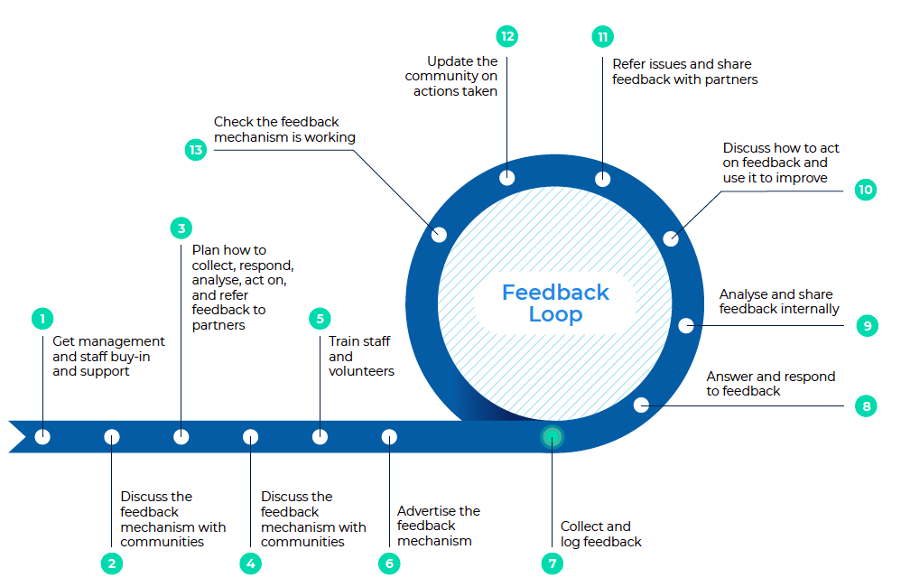
Steps to set up and run a feedback mechanism
Did you agree?
Notes:
FACILITATOR NOTES
Explain steps 1-6 are the steps for setting up a feedback mechanism and steps 7-13 are the ongoing steps or cycle of running a feedback mechanism
Ask participants if they agree with what appears here
Ask if anyone had anything different
HOWEVER – do not enter into a detailed discussion at this stage. Try to remember what people had differently and then address these as you go through the steps. Explain the next part of the session will look at each of these steps in more detail and participants will be able to ask questions and share if they disagree as you go through each step
Get management and staff buy-in and support
A feedback mechanism requires staff time, funding, and a commitment to make changes based on what the community say, so it’s important everyone is on board and understands their role.
2. Discuss the feedback mechanism with communities
It’s critical to involve communities in planning the feedback mechanism, otherwise you risk setting something up that doesn’t work, isn’t trusted, or can’t be used by all groups in the community.
3. Plan the feedback mechanism
Plan how feedback will be collected, responded to, analysed, acted on, and referred if necessary, and what needs to be in place to manage this successfully.
4. Discuss the feedback mechanism with communities (again)
Revisit communities to check the planned feedback mechanism meets peoples’ expectations and they will feel comfortable using it.
5. Train staff and volunteers
It’s important everyone involved in the feedback mechanism understands how it works and what their role is, for it to run smoothly.
6. Advertise the feedback mechanism
Communities need to know the feedback mechanism exists and how to access it.
7. Start collecting and logging feedback
Now the feedback mechanism is known about in communities and your teams are trained you can start collecting and logging feedback from the community.
8. Answer and respond to feedback
When possible, feedback should be responded to immediately. Training and having a frequently asked questions guide can help volunteers to answer common questions on the spot. Questions that can’t be answered immediately should be logged and responded to later – don’t make an answer up. Issues that require a change or action should be discussed in team meetings – see step 10 below. Response times will depend on the context but should not be more than 2 weeks. Sensitive feedback should be referred quickly and acted on immediately.
9. Analyse and share feedback internally
Feedback should be analysed regularly – ideally once per week if possible. All feedback, regardless of how it was received (e.g., face-to-face through volunteers or via a telephone hotline), should be logged in the same place so it can be analysed regularly for trends. For example, consolidate all feedback in a database, such as excel, where you can code different types of feedback and track responses and actions. Sensitive feedback should be stored and handled separately. Regularly share updates on community feedback with the full operations team, including with volunteers.
10. Discuss how to act on feedback and use it to improve
Make feedback a standing agenda item in operations meetings with enough time to present the feedback trends and decide how to act on them. Community feedback should be seen as a part of monitoring and reviewed alongside other monitoring data and included in situation reports.
11. Refer and share feedback issues with partners
Refer feedback that goes beyond the scope of the National Society or concerns other agencies or organizations. For example, by sharing feedback in external coordination meetings or mapping other organization’s feedback mechanisms or focal points
12. Update the community on actions taken
Taking action is the best response as it shows the response has listened – but still tell people what action was taken to reinforce trust in the feedback mechanism.
If feedback can’t be acted on, it’s important to tell people this and explain why nothing can be done or they’ll lose trust in the response.
How updates and responses are provided depends on community preference, the type of feedback, and response capacity. For example: specific questions or complaints can be answered directly to the individual who made them, common issues raised by lots of people, can be responded to publicly through a community meeting or noticeboard, while sensitive feedback should always be responded to confidentially, by a trained expert
13. Check the feedback mechanism is working
Carry out regular checks to make sure the feedback mechanism is working, and people still feel comfortable using it.

Slide 11
Step 1: Get management and staff buy-in and support
Why?
Requires staff time and funding
Needs everyone’s commitment to make changes
How?
Explain the benefits to management
Involve key teams in the planning:
Programmes and operations staff
Information management
IT
PMER
PGI
HR and legal
Notes:
FACILITATOR NOTES
Get management and staff buy-in and support
A feedback mechanism requires staff time, funding, and a commitment to make changes based on what the community say, so it’s important everyone is on board and understands their role. If management support the feedback mechanism this sends a strong message to the rest of the organization.
Highlight the benefits a feedback mechanism provides and point out that communities will have feedback even if there is no feedback mechanism, so better to have a system in place to manage feedback positively and use it as a tool for improvement
Discuss the feedback mechanism in meetings and workshops, explaining why it’s needed and collecting input on how it should work.
Involve the following key teams early:
Programme and operations staff, including the best way to share feedback findings so they can be easily understood and acted on
Information management to help manage and visualize feedback data so it can be used for tracking and decision-making
IT staff if specific equipment or technology is needed
PMER so feedback data can be included in monitoring
PGI staff to ensure safe and confidential processes for managing and referring sensitive feedback and serious complaints
HR and legal staff to support investigations into complaints about SEA or fraud and corruption by staff or volunteers.

Slide 12
Step 2: Discuss the feedback mechanism with communities
Why?
The community are the end users – if we don’t involve them the mechanism may not get used
How?
Include questions about feedback in assessments
Discuss with the community their preferred methods to provide feedback and get responses
Consider the needs of different groups
Discuss options for sensitive feedback
Notes:
FACILITATOR NOTES
2. Discuss the feedback mechanism with communities
It’s critical to involve communities in planning the feedback mechanism, otherwise you risk setting something up that doesn’t work, isn’t trusted, or can’t be used by all groups in the community.
Ask people what they want from a feedback mechanism, their preferred ways of providing feedback, how they would like to receive responses and what mechanisms exist already in the community for resolving issues
Not everyone will want to share feedback the same way, so speak to different groups, including men, women, girls and boys, older people, people with disabilities, and any marginalized or at-risk groups
Sensitively discuss with different groups how they would feel safe and comfortable sharing sensitive feedback linked to SEA, violence, or corruption. See the PSEA manual98 for more guidance and the policy and resources on child safeguarding

Slide 13
Step 3: Plan the feedback mechanism
Use preferred channels
Accessibility and confidentiality
Consider your own capacity
Hotlines, helpdesks, volunteers, committees etc
How to collect
How to respond
How to analyse
Ensuring action
Referrals & advocacy
Planning resources
Immediately if possible - FAQs
Record all feedback
Clear response times
Public or private
Always respond
Best response is action
Staffing
Equipment & software
Funding for the first 12 months
Where to refer?
How to refer?
Contact details
Discuss feedback in coordination meetings
Log in a database
Review and track regularly
Sensitive feedback should be stored separately
Plan how to share feedback, who with, and when
Discuss in team meetings
Share feedback reports widely
Notes:
FACILITATOR NOTES
3. Plan the feedback mechanism
This is an important step where you think through the journey your feedback will make from the point it is collected, to when it is acted upon. This is where you plan how the feedback mechanism will work, once its up and running (the loop part or steps 7-12 in the feedback loop graphic we looked at on slide 10)
3.1 Collecting feedback
Use the channels preferred by the community, but also consider the capacity within the National Society, programme, or operation in terms of time, funding, and human resources
Start with one or two channels (ideally one reactive and one proactive) and check they work, and build up gradually if needed
Options for receiving feedback include help desks, telephone hotlines, volunteers, focus group discussions, community committees, community meetings, social media etc
Consider which channels are accessible to which community groups and allow people to share sensitive feedback or serious complaints safely.
3.2 Responding to feedback
When possible, feedback should be responded to immediately. Training and having a frequently asked questions guide can help volunteers to answer common questions
Questions that can’t be answered immediately should be logged and responded to later – don’t make an answer up
Response times will depend on the context but should not be more than 2 weeks. Sensitive feedback and serious complaints should be referred quickly and acted on immediately
If feedback can’t be acted on, it’s important to tell people this and explain why nothing can be done or they’ll lose trust in the mechanism
How a response is provided depends on community preference, the type of feedback, and National Society capacity. For example:
Specific questions or complaints can be answered directly to the individual who made them
Common issues raised by lots of people, can be responded to publicly through a community meeting or noticeboard
Sensitive feedback or serious complaints should always be responded to confidentially, by a trained expert
Taking action is the best response as it shows the National Society has listened – but tell people what action was taken to reinforce trust in the mechanism.
3.3 Analysing and acting on feedback
All feedback, regardless of how it was received (e.g., face-to-face through volunteers or via a telephone hotline), should be logged in the same place so it can be analysed regularly for trends. For example, consolidate all feedback in a database, such as excel, where you can code different types of feedback and track responses and actions
Sensitive feedback and serious complaints should be stored and handled separately
Ensure all feedback is stored safely and meets data protection guidelines
Look for differences based on location, age, gender etc
Plan how feedback will be discussed and acted on. For example, it could be a standing agenda item in team and management meetings with enough time to present the feedback trends and decide how to act on them
Community feedback should be seen as a part of monitoring, and reviewed alongside other monitoring data
Regularly share updates on community feedback across the National Society, including with volunteers.
3.4 Referrals and advocacy based on feedback
Plan how to refer feedback that goes beyond the scope of the National Society or concerns other agencies or organizations. For example, by sharing feedback in external coordination meetings or mapping other organization’s feedback mechanisms or focal points
Plan how sensitive feedback and serious complaints will be referred and managed internally. This should be linked to relevant policies, such as Prevention of Sexual Exploitation and Abuse, Child Protection, Fraud and Corruption, Whistleblowing and Code of Conduct100
People sharing sensitive feedback or serious complaints may need follow-up support, such as mental health and psychosocial support, medical care and legal or social assistance so work with PGI colleagues to do a mapping of specialist services for referrals. See the PGI toolkit101 and PSEA manual102 for more guidance on this.
3.5 Planning resources
Ensure there is enough staff to successfully run the feedback mechanism, including feedback handlers and data input and analysis. This might include staff and volunteers who will hear feedback as part of their work in communities
Identify any equipment and resources needed, such as laptops, software, telephones, quiet office space, transportation, and training costs etc
Ensure the feedback mechanism can be delivered within the resources available, and if not, advocate for more resources or scale it down
Include a mix of men and women in the feedback collection team
Ensure enough funding for at least the first 12 months of operation.

Slide 14
Step 4: Discuss the feedback mechanism with communities (again)
Why?
Confirm it meets community expectations
People will feel comfortable using it
How?
Present and discuss the mechanism during community meetings or focus group discussions
Ask community volunteers for their opinions on the proposed mechanism
Notes:
FACILITATOR NOTES
4. Discuss the feedback mechanism with communities (again)
Revisit communities to check the planned feedback mechanism meets peoples’ expectations and they will feel comfortable using it.
Discuss the proposed feedback mechanism during community meetings or focus group discussions and identify any areas for improvement
Discuss the feedback mechanism in meetings with community volunteers as another means of checking for any potential problems.

Slide 15
Step 5: Train staff and volunteers
Why?
Everyone needs to understand how the mechanism will work, and what their role is
How?
Brief all staff and volunteers on how the mechanism works – address any fears
Train those involved in running the mechanism – including soft skills like listening and empathy
Training on protection and PSEA can help staff and volunteers to manage sensitive feedback
Notes:
FACILITATOR NOTES
5. Train staff and volunteers
It’s important everyone involved in the feedback mechanism understands how it works and what their role is, for it to run smoothly.
Brief all staff and volunteers on how the feedback mechanism works so they can explain it accurately to communities. Address any concerns or fears staff have that feedback will be used to criticize their work and stress it is a tool to help the organization improve
Train all those involved in running the feedback mechanism on how it works and what their role is. Include training on soft skills such as listening and communication for those involved in collecting feedback
Training on protection and PSEA can help staff and volunteers to better recognise and respond to sensitive feedback and serious complaints.

Slide 16
Step 6: Advertise the feedback mechanism
Why?
Communities need to know the mechanism exists and how to access it
How?
Use trusted and preferred communication channels
Explain how the system works
Make it clear feedback is welcomed
Confirm sensitive feedback is confidential
Notes:
FACILITATOR NOTES
6. Advertise the feedback mechanism
Communities need to know the feedback mechanism exists and how to access it.
Advertise the feedback mechanism through communication channels commonly used by the community, for example radio, social media, community committees, posters, through community volunteers etc
Make sure communities understand they have a right to provide feedback and that even negative feedback is welcomed as it helps the National Society to improve its services
Stress there will be no negative consequences if people complain
Manage expectations by being clear about what type of feedback the system can respond to and how long it will take to respond
Assure people sensitive feedback and serious complaints are welcomed and will be handled safely and confidentially.

Slide 17
Step 7: Check the mechanism is working
Why?
To check people still feel comfortable using it
Identify opportunities for improvement
How?
Analyse feedback received for potential issues:
Declining feedback
Missed issues
Differences in the amount of feedback from different locations or groups
Are you receiving sensitive feedback?
Ask the community
Included indicators to measure the mechanism’s performance
Notes:
FACILITATOR NOTES
7. Check the feedback mechanism is working
Carry out regular checks to make sure the feedback mechanism is working, and people still feel comfortable using it.
If the amount of feedback received is declining over time or other monitoring is highlighting issues not being raised through the feedback mechanism, this could be a sign the mechanism is not working as well as it should
Look for differences in the amount of feedback received from different locations or groups. For example, if less feedback is received from women this could indicate they are not comfortable with the mechanism
Discuss with communities if they are still comfortable with the way feedback is collected, responded to, and acted upon
Include indicators to monitor the feedback mechanism’s performance
If no sensitive feedback or serious complaints are received, don’t assume this means there are
none – discuss the issue again with communities to check they feel safe to share this type of feedback.

Slide 18
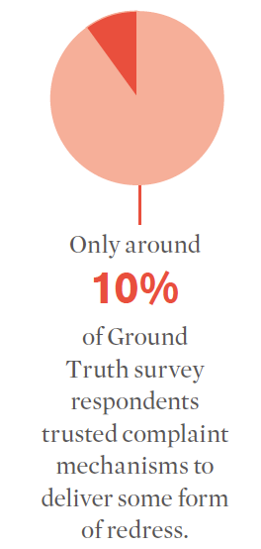
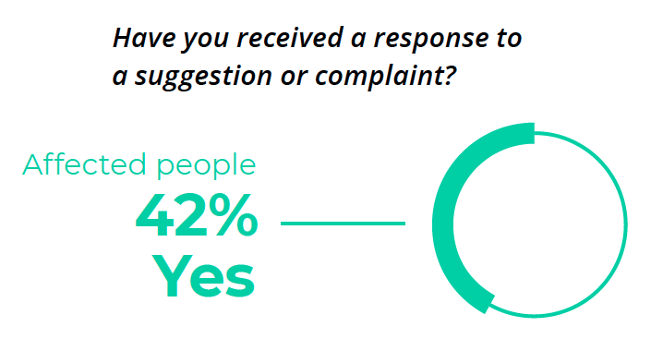
What is the biggest challenge of running a feedback mechanisms?
Discuss…
Acting on feedback!
Notes:
FACILITATOR NOTES
BEFORE showing the slide content, ask participants if they know what some of the main failures or challenges are with feedback mechanisms?
What challenges have people in the room experienced?
The main challenge is making sure that we act and make changes based on the feedback we receive. Feedback is useless unless we act on it.

Slide 19
Community feedback mechanisms
Key takeaways
Feedback mechanisms help us improve the quality of our work and build trust with communities
Communities should be involved in designing feedback mechanisms
Feedback mechanisms need careful planning – especially how feedback will be analysed, shared, acted on and responded to
If we do not act on and respond to feedback, we will lose the trust of communities
Don’t forget Tool 15: Feedback kit!

Slide 20
Questions?

Slide 21
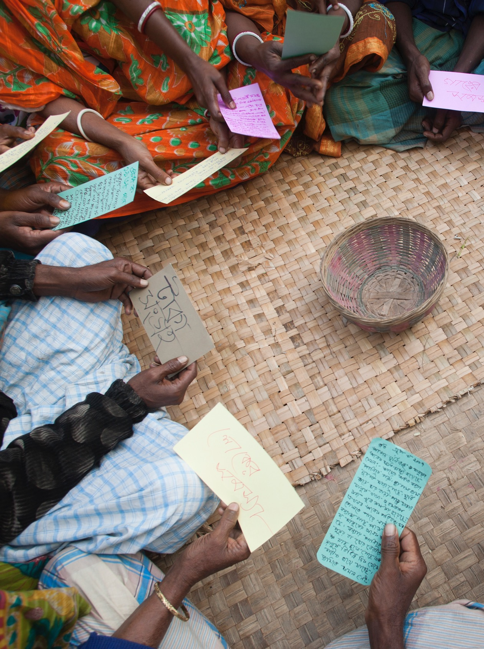
Group exercise (45 mins)
Feedback scenario
Read the feedback scenario in your groups
Prepare your answers to the task about how you will set up a National Society feedback mechanism
Be ready to present to the Secretary General in 45 mins
Notes:
FACILITATOR NOTES – SEE SEPARATE FEEDBACK SCENARIO FACILIATOR NOTES AND PARTICIPANT HANDOUT
As this is the first time participants will do a scenario-based exercise on the fictional Alexa Red Cross National Society, take some time to explain the scenario, why it is being used, and some do’s and don’ts. See the facilitator notes.
Take time to explain the task clearly in plenary. Use the facilitator notes.

