Slide 1
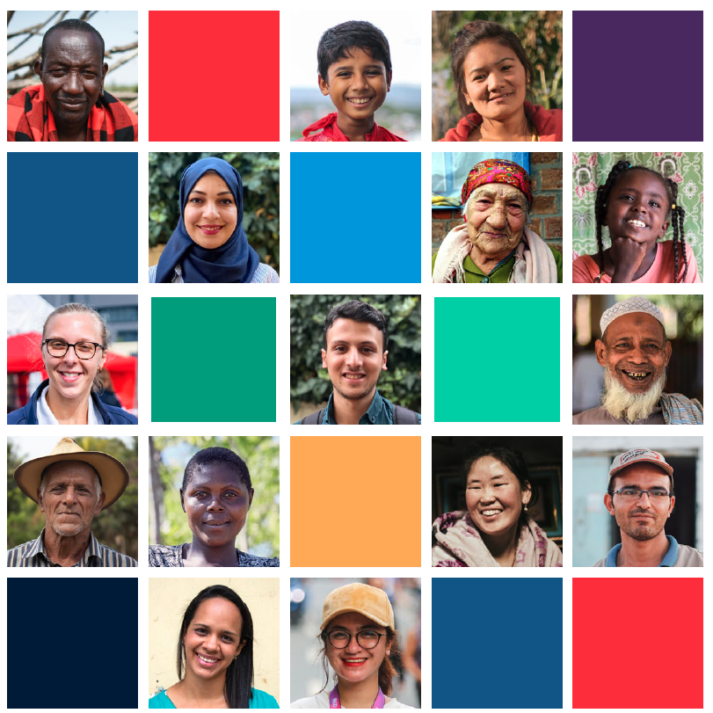
Community Engagement and Accountability Foundation
Training
Module 1
Introduction to CEA
Online

Slide 2
Introduction to CEA
Contents of this session
What is community engagement and accountability and why is it important?
Examples of community engagement in action
Internal and external commitments to accountability
Different roles and responsibilities
How well are we engaging communities?
Group exercise
Notes:
FACILITATOR NOTES
- Quickly run through the main topics that will be covered in this session

Slide 3
What is CEA?

Slide 4
What is CEA?
Discuss…
Notes:
FACILITATOR NOTES – Chat and verbal
BEFORE showing the definition, ask if anyone can explain what community engagement and accountability means to them in their work or sector. Ask participants to post in chat or verbally
Show the diagram on the slide, which presents the four core community engagement and accountability approaches, and how they can help us be accountable to the people we serve.
Read the full definition of CEA from the CEA Guide:
Community engagement and accountability is a way of working that recognises and values all community members as equal partners, whose diverse needs, priorities, and preferences guide everything we do. We achieve this by integrating meaningful community participation, open and honest communication, and mechanisms to listen to and act on feedback, within our programmes and operations. Evidence, experience, and common sense tells us when we truly engage communities and they play an active role in designing and managing programmes and operations, the outcomes are more effective, sustainable, and of a higher quality.
Explain:
Participation is is about making decisions together with the community about how programmes and operations are designed, managed and implemented and where possible we support communities to lead and shape their own solutions and changes, on their own terms
Open, honest regular communication is about ensuring communities understand who we are and what we are doing in their community and have the information they need to make decisions and take action to protect and improve their lives, communities, and health
Feedback mechanisms support us to receive, analyse, respond to, and act on, community questions, complaints, requests, suggestions, beliefs, rumours and praise. This can be about the services and support we provide, beliefs about a specific topic or issue related to our work (for example a public health concern), or about the behaviour and conduct of our staff and volunteers
Community understanding is about ensuring we understand the communities we are working with, including the situation they live in and their needs, priorities, opinions and capacities – and the wider social, cultural, political, economic and environmental influences that affect their lives.
Together these four core community engagement approaches help us to ensure
The support we provide is relevant, useful and timely and meet people’s needs
Our programmes and operations are driven and owned by communities
That we treat community members with dignity and respect, seeing them as equal partners with valuable knowledge and capacities
Our interventions do not have negative consequences – such as damaging local markets through aid distributions or fuel tensions between different groups
A key point to make is that the Red Cross Red Crescent was started to help communities, so if we are not meeting community needs, preferences and priorities, we are not meeting our own mandate.

Slide 5
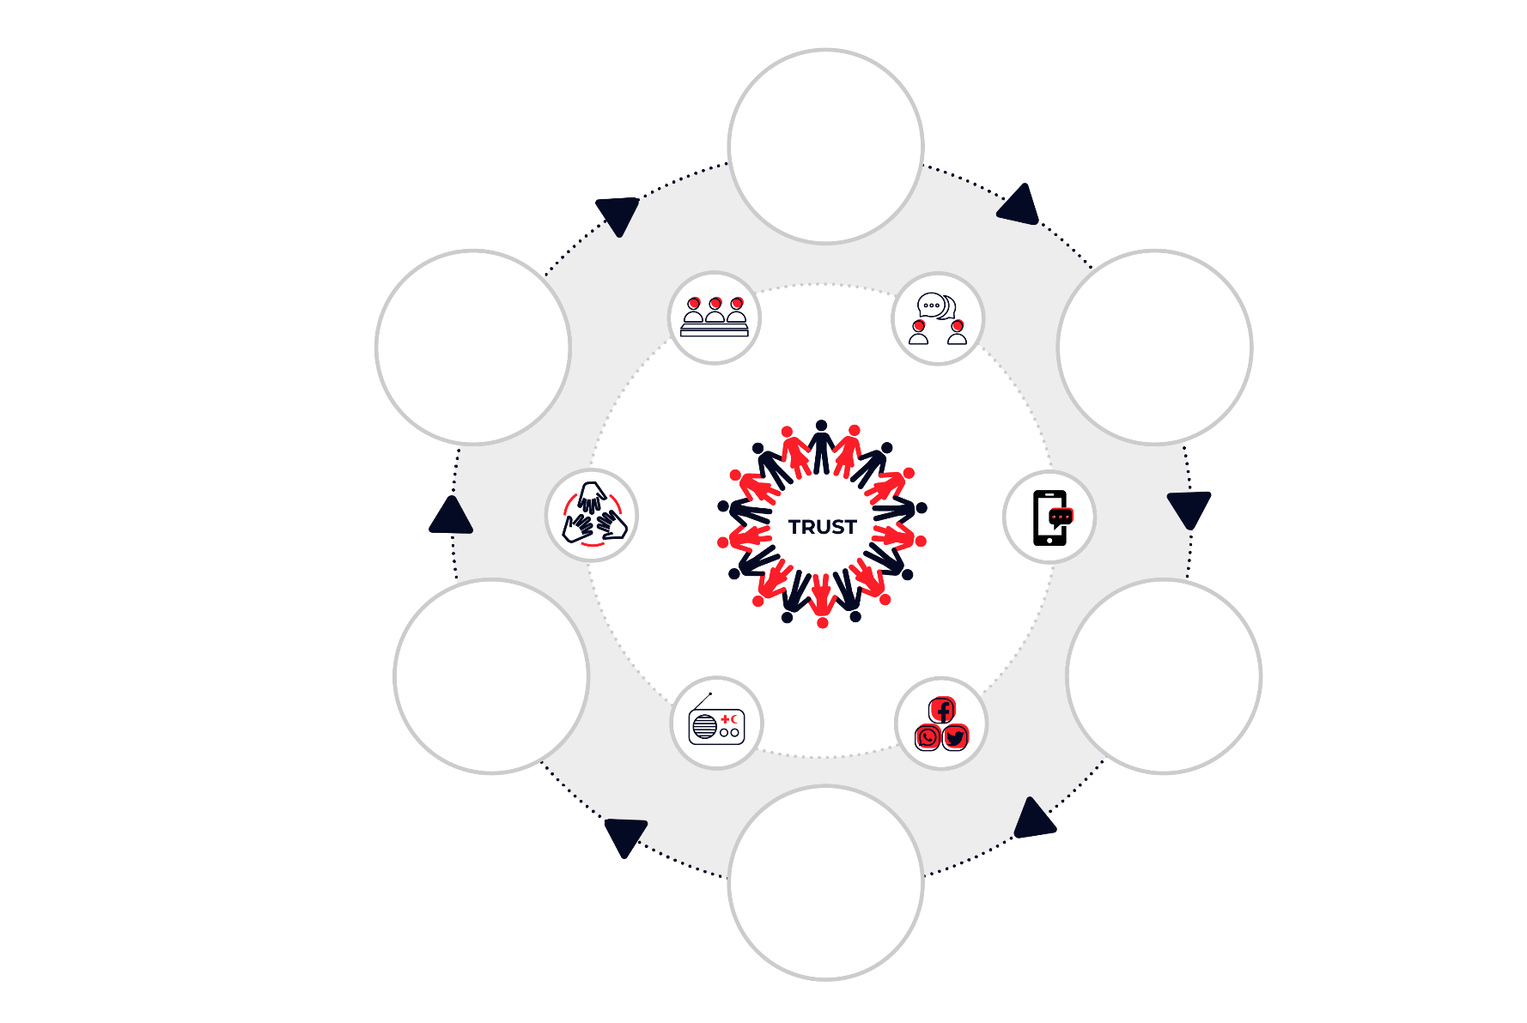
COMMUNITY ENGAGEMENT
AND ACCOUNTABILITY
UNDERSTAND
people’s needs,
capacities,
and context
Community engagement
encompasses multiple
approaches and ways of
working collaboratively with
people and communities.
ENGAGE
communities in
creating solutions
ENABLE
communities
to drive positive
changes
PARTICIPATION
FEEDBACK
COMMUNICATION
ACT
on what people tell us
COMMUNICATE
often, openly,
and honestly
A community-centred approach requires interventions to be sensitive to context, agile and receptive to change.
Community engagement is an iterative process
LISTEN
to feedback
and understand
perceptions
Notes:
Community engagement encompasses multiple approaches and ways of working collaboratively with people and communities.
It entails an iterative process that integrates meaningful participation, open and honest communication, and mechanisms to listen and act on feedback.
It promotes community action in support of health, humanitarian and development outcomes.
How?
Understand the context, challenges faced in implementing prevention measures, and local capacities
Engage community leaders and groups to identify, plan and implement local solutions; Agree roles & responsibilities
Ensure communities have the information they need about the programme or the issue of concern, so that they can take action
Support community groups to communicate, monitor and improve solutions being implemented
Listen to people insights and take action to respond to needs, concerns and perceptions
Support communities to lead their way to live positively and healthy

Slide 6
Different name – same aims
Community engagement and accountability (CEA)
Using meaningful community participation, open and honest communication, and mechanisms to listen to and act on feedback to improve accountability to the people we serve
Accountability to Affected People/Populations (AAP)
Communication with communities (CWC)
Risk communication and community engagement (RCCE)
As above, with a focus on using communication and participatory approaches to encourage positive and healthy behaviours in health programmes or epidemics
Communication for development (C4D)
Notes:
FACILITATOR NOTES
There are lots of different names for community engagement and accountability, but they largely all mean the same thing - the process of working in a transparent and participatory way with communities that improves the quality of programmes and operations.
The Red Cross and Red Crescent Movement has chosen to use CEA
In the UN you’ll more commonly hear it called AAP or accountability to affected people, which is the same thing as CEA
Communicating with Communities is an older term which is not used anymore – it largely died out because the term suggested too much focus on information sharing as opposed to participation
C4D or communication for development tends to be used by UNICEF and is more focused on participatory approaches to behaviour change in health and WASH programmes
RCCE This is a term used primarily in public health emergencies by WHO and UNICEF. It has grown in prominence since EBOLA and COVID. IFRC has adopted it to ensure alignment with the main partners in epidemics response, although RCCE approach is grounded on CEA approaches. It refers to community engagement in epidemic response, including CEA approaches and processes that aim at providing timely, relevant and actionable information, seeks to ensure we work collaboratively with communities to promote social and behaviour changes and to encourage community-led solutions

Slide 7
What community engagement and accountability is not…
Something new
We’ve always engaged with communities, but we don’t always do it as well as we should
A separate programme or activity
It’s a way of working that should be part of all programmes and operations
One person’s job
We all have a responsibility to ensure we engage communities well in our work
An extra burden or box to be ticked
It’s critical to the quality and impact of what we do
Notes:
FACILITATOR NOTES
It is important to clear up some common misconceptions about community engagement and accountability first:
Community engagement and accountability is not…
Something new – the Red Cross Red Crescent has always worked with communities, but we don’t always do it as well as we should and adopting a more systematic approach could improve quality and prevent gaps in how we engage communities
A separate programme or activity – community engagement is a mindset or a way of working that should be part of everything we do, integrated within all our work
One person’s job – accountability cannot be outsourced to one person or department; we all have a responsibility to ensure we engage communities well in our work
An extra burden or box to be ticked – it’s part of our core commitments and critical to the quality of our work and the impact we can have.

Slide 8
Setting the scene (10mins)
In your groups, each person has 1 minute to share an example of a time when something went wrong in your work because there was not enough engagement with the community
Select one example and discuss…
Why did this happen?
What were the consequences?
What could have been done differently?
Notes:
FACILITATOR NOTES – Breakout rooms – 10mins in the breakout room / 5 mins plenary
This is a group exercise to get participants thinking about how community engagement and accountability relates to their work.
Participants will need to go into their relevant breakout rooms for this activity so be careful in managing their time. Instruct everyone to take a screenshot or picture of this slide before going into their breakout rooms. Facilitators can also drop the instructions and questions into the chat.
Everyone should limit their response to 60 seconds SHARP to ensure everyone gets to share.
First ask each person to share a story from their own work when things have gone wrong because there was not enough engagement with the community. Ask each participant to share an experience of what went wrong (5mins)
Each group should select one of the examples shared and then discuss the reasons why community engagement was not as good as it should have been, what the consequences were and what they could have done better (5mins)
Each group to share their example in plenary (60 seconds each) (5mins)

Slide 9
Examples of CEA in Action
Notes:
Facilitator notes
- The next few slides will look at the CEA approaches we discussed during the definition – Open, honest communication, Participation, Feedback and complaints, and Community understanding in more detail. Explaining what these are and giving examples from around the Movement to bring them to life

Slide 10
CEA in Action:
Communication
Transparency prevents corruption in Malawi
Malawi Red Cross trained volunteers to communicate clearly what aid items people would receive and how to complain to stop corruption by community leaders
They used house visits, community meetings, telephone hotline, helpdesks and suggestion boxes
Using social media to communicate about vaccines in Bangladesh
Bangladesh Red Crescent used Facebook to share trusted information about COVID-19 vaccines with it’s 87,000+ followers
Posts included images, live sessions with experts, animations and videos to answer vaccine questions and encourage uptake
Notes:
FACILITATORS NOTES – Chat and verbal
First ask participants of how they have included open, honest communication with communities in their programmes or operations
Take responses both verbally and in chat and if no one responds, ask someone yourself (and make a point that if no one responds, you will cold call people randomly. Also good to cold call people with their videos off to get them back on their toes).
While someone is sharing verbally, see if there are responses in chat and read/respond to them when the verbal response is wrapped up
Explain open, honest regular communication is about ensuring communities understand who we are and what we are doing in their community and have the information they need to make decisions and take action to protect and improve their lives, communities, and health. For example,
Community meetings to introduce the National Society and explain ways of working
Noticeboards in communities with information on program aims and timelines
Sending SMS with information on the aid items people can expect to receive
Sharing timely, accurate information during an epidemic epidemic through the most trusted channels, to support people to adopt practices that reduce the spread of infection and to reduce fear, stigma, and panic by addressing rumours and misinformation
Interactive radio chat shows to encourage safe practices and answer people’s questions
These examples are from the CEA Guide and can be exchanged for ones from your region, country or National Society
Good communication in Malawi helps tackle corruption by community leaders
During focus group discussions for a resilience programme, Malawi Red Cross Society (MRCS) was made aware of issues with community leaders replacing names on distribution lists, made worse by a cultural reluctance to complain in Malawi. So as part of a cyclone response, the National Society implemented three simple measures to stop this practice happening:
1. Volunteers were trained on community engagement approaches, including people’s rights, what information to share with communities and how to collect and respond to feedback
2. Awareness sessions were held to explain the objectives of the response, who would be supported, the items being distributed and how people could confidentially share any complaints or concerns. This information was also shared tent to tent by volunteers
3. Feedback and complaints systems were set up including suggestion boxes, a telephone line and face to face with MRCS volunteers. Help desks were also established during all distributions so that any problems on the day could be captured and resolved quickly.
By ensuring people knew their rights and entitlements and how they could safely and confidentially complain, MRCS was able to prevent several cases of corruption or intimidation by community leaders. As well as rolling out training to all volunteers, MRCS is now briefing community leaders too, to ensure they understand MRCS’ mandate and zero-tolerance approach to corruption. Read the full case study - https://communityengagementhub.org/wp-content/uploads/sites/2/2020/04/MRCS-fighting-corruption-case-study.pdf
Bangladesh Red Crescent Society overcomes COVID-19 barriers to communicating
Traditionally Bangladesh Red Crescent Society (BDCRS) would use face-to-face methods to communicate with communities. However, the National Society had to scale up its use of social media when COVID-19 placed limitations on how people could meet. The National Society monitored comments on its social media accounts to understand what specific concerns people had and follow up posts were created to address their questions. For example, when BDRCS’ announced the vaccination campaign on its Facebook page, people had many questions about registrations and eligibility criteria, so a follow-up post replied with all the details. Before sharing publicly, posts and messages are sent to BDRCS and IFRC staff, volunteers, and their family and friends, to test whether they are understood and adjusted if needed. BDRCS’ Facebook page is a ‘Facebook verified’ source of information on the pandemic, with each post having an average reach of 87,372 people. Posts include images with text, animation, Facebook live sessions with experts, and other videos to encourage people to register for vaccinations and provide information. Questions received from the public are either answered or referred to the Bangladesh Government’s vaccination hotline number.

Slide 11
CEA in action: Participation
Community advisory committees in Turkey
Turkish Red Crescent establishes Advisory Committees to oversee their community centres
Members include the local community, migrants, TRCS staff, local authorities and other vulnerable groups
Meet monthly to discuss needs and how to improve services at the community centres
Community-based Action Teams (CBATs) lead COVID-19 response in Indonesia
Indonesian Red Cross provided community groups with cash grants to implement their own COVID-19 activities
CBATs trained on COVID-19 and community engagement and decided how to use funding to meet the most important needs in their community i.e., handwashing points, masks, contact tracing etc
Notes:
FACILITATOR NOTES - Chat and verbal
First ask participants of how they have supported community participation in their programmes or operations
Take responses both verbally and in chat and if no one responds, ask someone yourself (and make a point that if no one responds, you will cold call people randomly. Also good to cold call people with their videos off to get them back on their toes).
While someone is sharing verbally, see if there are responses in chat and read/respond to them when the verbal response is wrapped up.
Explain Participation is is about making decisions together with the community about how programmes and operations are designed, managed and implemented and where possible we support communities to lead and shape their own solutions and changes, on their own terms. For example:
Working with community project committees and meeting regularly to make decisions about the programme
Holding regular community meetings to update on progress, collect feedback, and agree on next steps with the community.
Working with communities to agree selection and vulnerability criteria for support, and then agreeing together who qualifies for that support
Supporting communities to implement their own activities with just funding or technical support from the NS
These examples are from the CEA Guide and can be exchanged for ones from your region, country or National Society
Advisory committees strengthen services and social cohesion in Turkey
To ensure Turkish Red Crescent Society (TRCS) community centres are providing services relevant to people’s needs, advisory committees have been formed at each community centre, comprising members of the local community, migrants, and other vulnerable groups. The committees meet once a month, and bring together the National Society, local government, and community members. They are an opportunity to discuss how to adjust community centre activities and to advocate on wider issues to relevant stakeholders. At the first meeting, a one-pager to explain the objectives, responsibilities and working modalities of the committee was discussed and agreed.
Community Based Action Teams in Indonesia plan their own COVID-19 response activities
Palang Merah Indonesia (PMI) – the Indonesian Red Cross – regularly work through Community Based Action Teams (CBATs) in Communities. These volunteer groups are trained as first responders in a disaster and act as the link between the National Society and the wider community. To support communities to lead their own response to COVID-19, PMI provided cash grants to CBATs, which they could use depending on the specific needs in their community. PMI provided a broad list of activities the grants could be used for, including contact tracing, health promotion, mask and handwashing station production, disinfection, or surveillance, but the decision on how to use the funding sat with the community. CBATs received orientations and training online, using Zoom and WhatsApp, which covered guidance on the grant, budgeting and monitoring, and prevention of COVID-19. To ensure full community participation in the process, PMI also provided training to CBAT members on how they could receive input, suggestions, and complaints, on how the grants were being used from the wider community.

Slide 12
CEA in action:
Feedback mechanisms
Hotline to manage cash feedback in Lebanon
Lebanese Red Cross (LRC) set up a feedback hotline to answer questions about a cash programme
Two operators with mobile phones in the disaster management team responded to queries about eligibility, lost cash cards, challenges with pins
Hotline was expanded by PMER team to cover more LRC programmes and responses
WhatsApp in Peru to respond to COVID-19 feedback
Peru Red Cross used a WhatsApp business line to answer Venezuelan migrant questions about the pandemic and respond to requests for help
Operators equipped with FAQ and key messages to answer questions and respond to misinformation
Notes:
FACILITATORS NOTES - Chat and verbal
First ask participants if they have any examples of feedback mechanisms in their programmes or operations
Take responses both verbally and in chat and if no one responds, ask someone yourself (and make a point that if no one responds, you will cold call people randomly. Also good to cold call people with their videos off to get them back on their toes).
While someone is sharing verbally, see if there are responses in chat and read/respond to them when the verbal response is wrapped up.
Explain feedback mechanisms support us to receive, analyse, respond to, and act on, community questions, complaints, requests, suggestions, beliefs, rumours and praise. This can be about the services and support we provide, beliefs about a specific topic or issue related to our work (for example a public health concern), or about the behaviour and conduct of our staff and volunteers. Examples include:
Telephone hotlines where people can call and ask questions or share concerns
Community helpdesks during activities or at regular times
Suggestion boxes in communities where people can post written feedback
Running surveys either face to face or online or by phone to ask questions about people’s satisfaction with a programme or what they think about specific issues
Volunteers are trained to listen to feedback and/or ask questions during activities such as house-to-house visits or health promotion sessions
Social media, such as Facebook, Twitter or WhatsApp can be used to collect feedback and ask specific question
These examples are from the CEA Guide and can be exchanged for ones from your region, country or National Society
Growing a pilot National Society feedback mechanism
In 2014, the Lebanese Red Cross Society (LRCS) piloted a small hotline to support a cash and voucher assistance (CVA) project, supported by British Red Cross. Initially managed by the disaster management team, it was soon handed over to the PMER team as the number of calls grew. The mechanism has now been systematized and rolled out to cover most LRCS programmes and operations and the number of calls has grown each year. The most common calls are requests for assistance, programme related issues, requests for information, positive and negative feedback, and a relatively small number of formal complaints. LRCS advertises the feedback mechanism through a variety of channels including SMS, during activities in communities, posters and flyers and through partner organizations. Key benefits from the feedback mechanism include LRCS can now respond much more quickly to problems, such as lost cash cards or liquidity issues with agents. Programme staff also report the information provided by the mechanism is extremely useful to assess and adapt their services to better meet peoples’ needs. Some of the feedback mechanism’s success is attributed to the fact it started small and has been continually improved and adapted based on experience. Read the full case study - https://communityengagementhub.org/wp-content/uploads/sites/2/2020/04/PMER_CRM-CaseStudy.docx
Using WhatsApp in Peru to respond to COVID-19 questions and requests
When the COVID-19 pandemic forced the Peruvian Red Cross (PRC) and IFRC to suspend face-to-face activities with the Venezuelan migrant population, they needed to find a new remote way to provide assistance and respond to feedback. A previous assessment had found that 78 percent of Venezuelan migrants in Peru have access to a mobile phone and 99% use WhatsApp and Facebook to receive information. So, a WhatsApp business line was set up to answer questions or doubts about the pandemic, provide information on prevention, and identify, monitor, and address rumours or fake news related to COVID-19. A set of key messages on COVID-19 prevention and response, along with a question-and-answer sheet, were prepared in advance to be used by the WhatsApp line operators. Initially the line was launched with two community engagement operators, but later medical staff were brought in to support with certain questions. A WhatsApp group was also created between operators to help coordinate replies and guidelines developed to log and track responses. Since its launch, the line has proven very popular and now responds to a much wider range of enquiries, including supporting the Peruvian population.

Slide 13
Why is CEA important?

Slide 14
Why do we need to engage communities?
Discuss…
To understand the community context and needs
For better, more effective programmes and operations
To build trust, access and acceptance with communities
To strengthen community ownership and resilience and and support community-led solutions
To uphold our own commitments
Notes:
FACILITATOR NOTES – Chat
BEFORE showing the answers on the slide:
Ask participants if they can think of reasons why we need to engage communities in our work
Ask them to type their reasons in the chat box but NOT press the send button
After some time, check with everyone and when enough people have typed, ask them to press the send button
Go through the list and debrief
There could be more correct reasons than those on the slide, but the five on the slide are the main ones
Why do we need to engage communities?
1. To understand the community context and needs
We need to engage with all groups and individuals in the community to understand their specific needs, preferences, and context. If we assume we know what people need or how things work in their community, we risk getting it wrong and providing support that doesn’t help, or even worse, doing harm. For example, by inflaming existing tensions or excluding already marginalized groups.
2. For better, more effective programmes and operations
Nobody knows the community better than the people who live there. When we draw on that local knowledge and expertise to plan and manage programmes and operations, we’re much more likely to get it right and provide support that is useful, timely, relevant and of a high quality. Listening to community feedback gives us an early warning when things aren’t working and provides valuable insights on how we can improve.
3. To build trust, access, and acceptance with communities
Open, honest communication and listening and acting on what people tell us, is a mark of respect which builds trust. Without trust people may not want to speak to us, use our services, believe the information we share or welcome our volunteers and staff safely into their community. When people don’t trust us, our ability to help them becomes harder and even impossible.
4. To strengthen community ownership and resilience
People affected by crisis are not helpless. They are usually the first responders in a crisis and have knowledge, skills and capacities which can help to ensure aid is relevant and sustainable. When we design and manage programmes and operations in partnership with communities, it facilitates local ownership and self-reliance. When we don’t engage them, we are treating them as passive recipients of aid, which undermines our efforts to strengthen community resilience.
5. To uphold our own commitments
Working in partnership with communities is at the core of who we are. We commit to involving people in the management of aid, holding ourselves accountable to those we seek to assist, and building on local capacity in the International Red Cross and Red Crescent Movement’s Code of Conduct in Disaster Relief. The Principles and Rules for Red Cross and Red Crescent Humanitarian Assistance commit to including transparent communication and feedback mechanisms in emergency responses. In December 2019, the first set of ‘Movement-wide Commitments for Community Engagement and Accountability’ was approved at the Council of Delegates (see page 21).

Slide 15
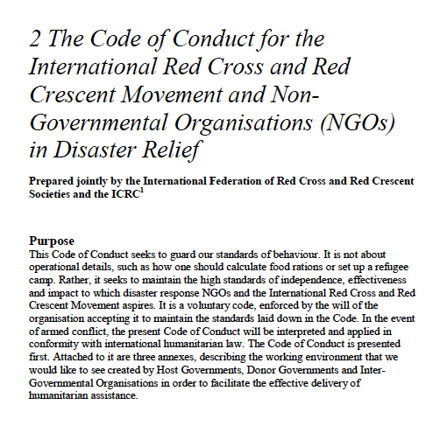
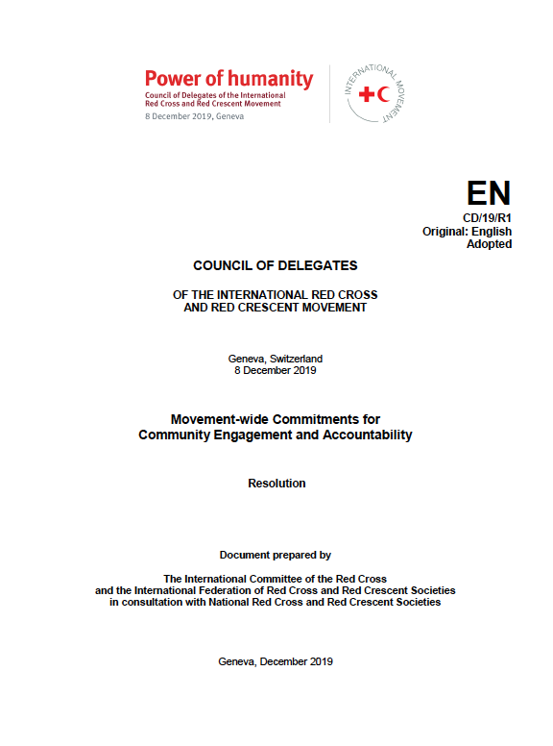
What are our commitments?
Movement Code of Conduct in Disaster Relief
Principles and Rules for Red Cross Red Crescent Humanitarian Assistance
Movement-wide Commitments for Community Engagement and Accountability
Adopted at the 2019 Council of Delegates
Seven overarching, strategic commitments to be more accountable to those we serve
All members of the Movement – every National Society, ICRC Delegation and IFRC office – is responsible for upholding these commitments
Applicable to all staff and volunteers
Notes:
FACILITATOR NOTES
Within the Movement there are organisational commitments to community engagement and accountability
The Code of Conduct for the International RCRC Movement and NGOs in Disaster Response Programmes states:
“Ways shall be found to involve programme beneficiaries in the management of relief aid”
“We hold ourselves accountable to both those we seek to assist and those from whom we accept resources”
The Principles and Rules for RCRC Humanitarian Action state:
Principle 9. We ensure that our assistance is appropriate, efficient, effective, and accountable, and we support the transition from relief to recovery for disaster affected people.
Rule 5 on Quality and Accountability, which includes:
5.4 National Societies and the International Federation consider themselves as accountable to disaster-affected people and shall involve them in needs assessment and decision-making to ensure that assistance is appropriate and meets their needs and priorities.
5.5 National Societies and the International Federation shall work to put in place transparent communication, feedback and complaints mechanisms which invite disaster affected people to share concerns regarding the assistance provided. The National Societies and the International Federation shall ensure appropriate follow up on feedback.
The Movement-wide Minimum Commitments for Community Engagement and Accountability (CR/19/R1) were adopted at the Council of Delegates on 08 December 2019. These overarching, strategic commitments aim to ensure a consistent approach to how we engage with and are accountable to people and communities across the Movement. All members of the Movement, including every National Society, ICRC delegation and IFRC office, is responsible for meeting and upholding these commitments and they are relevant and applicable to all staff and volunteers throughout the Movement regardless of their role

Slide 16
The Movement-wide Commitments for CEA
Commitment 1: Integrate community engagement and accountability
Commitment 2: Understand the context
Commitment 3: Greater participation
Commitment 4: Listen to, respond, and act on feedback
Commitment 5: Greater transparency
Commitment 6: Strengthen knowledge, skills and competencies in community engagement and accountability
Commitment 7: Coordinate our approaches to community engagement and accountability internally and externally
Notes:
FACILITATOR NOTES – OPTIONAL SLIDE or go through quickly
The Movement-wide commitments cover seven key areas
These commitments are the basis for the 18 minimum actions for community engagement and accountability which this training focuses on. The actions set out how to put these high-level commitments into practice in our work.
The commitments in full
Commitment 1: All Movement components commit to integrating community engagement and accountability in their strategies, policies and procedures
Commitment 2: All Movement components commit to regularly conducting an analysis of the contexts they work in to better understand and address the diversity of needs, vulnerabilities and capacities of the people and communities they seek to serve and assist
Commitment 3: All Movement components commit to facilitating greater participation of local people and communities, including National Society volunteers, and helping them to apply their knowledge, skills and capacities to find appropriate and effective solutions to their problems.
Commitment 4: All Movement components commit to systematically listening to, responding to and acting on feedback from the people and communities we aim to serve.
Commitment 5: All Movement components commit to greater transparency in our communications and relationships with people and communities we aim to serve.
Commitment 6: All Movement components commit to strengthening knowledge, skills and competencies in community engagement and accountability at all levels, and systematically incorporating this learning into our work.
Commitment 7: All Movement components commit to coordinating their approaches to community engagement and accountability when working in the same context, including with relevant external partners, in order to increase coherence and consistency, avoid duplication and improve effectiveness and efficiency.

Slide 17
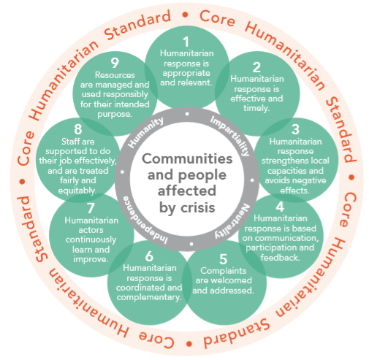
What’s happening outside the Movement?
The Core Humanitarian Standard
IASC Commitments on Accountability to Affected People
Grand Bargain
OCHA’s four non-negotiables
Notes:
FACILITATOR NOTES - OPTIONAL SLIDE, DEPEINDING ON PARTICIPANTS
The Movement is not alone in its efforts to strengthen community engagement and accountability. There are several global initiatives also working to support this aim. These shared commitments support joint working on improving community engagement across agencies and mean our partners are also working hard to improve accountability. These include:
The Core Humanitarian Standard
The Core Humanitarian Standard on Quality and Accountability (CHS) sets out nine commitments that organisations and individuals involved in humanitarian response can use to improve the quality and effectiveness of the assistance they provide. They cover the quality and relevance of humanitarian aid, accountability to affected people, coordination, learning, people management and prevention of sexual exploitation and abuse and fraud and corruption. The Red Cross Red Crescent minimum commitments and actions for community engagement and accountability are aligned with the CHS.
Interagency Standing Committee Commitments on Accountability to Affected People
The Inter-Agency Standing Committee (IASC) is the primary mechanism for coordinating the work of agencies involved in humanitarian assistance. Its Commitments on Accountability to Affected People bind responders to inform, as well as solicit, hear and act on the voices, priorities and feedback of affected people (including in relation to complaints and allegations of SEA), and to ensure that different groups within the affected population can play an active role in decision-making.
Grand Bargain Commitments
The Grand Bargain, launched during the World Humanitarian Summit in Istanbul in May 2016, is a unique agreement between some of the largest donors and humanitarian organizations who have committed to better humanitarian outcomes for affected populations through enhanced efficiency, effectiveness, and greater accountability, in the spirit of Quid pro Quo as relevant to all. Originally the Grand Bargain had eight workstreams, with two focusing on localization and participation. In 2021, the Grand Bargain 2.0 framework was approved, which sees localization and the participation of affected communities as one of two enabling priorities and accountability and inclusion one of the four outcome pillars.
OCHA
Has four ‘non-negotiables’ which appear in the TOR for all humanitarian coordinators and must feature in all humanitarian response plans – this includes AAP, gender, PSEA and protection

Slide 18
Roles and responsibilities

Slide 19
Who is responsible for CEA?
Zoom poll…
Leadership
Include CEA in policies and strategy
Programme & ops staff
Add CEA to plans and budgets
Support services
Allow enough flexibility to respond to community needs
Branches & volunteers
IFRC, ICRC & PNS
Be the link between the NS and the community
Provide support and funding to NS for CEA
Allocate staff time and funding for community engagement
Make decisions and adapt services based on community feedback
Integrate CEA into HR processes
Engage communities in branch activities
Institutionalize CEA in your own organization
Notes:
FACILITATOR NOTES – Zoom poll & chat or verbal
Launch the zoom poll:
Who is responsible engaging communities?
Only programmes and operations staff
PMER
Leadership
Volunteers
All of us (correct answer)
Explain that everyone can play a role in helping to strengthen community engagement
Click through the list and if time allows pause on each blue box and ask for suggestions on what that group’s specific responsibilities might be to CEA – how can they support CEA in their role?
This list is not exhaustive, but just gives an idea of how different roles and departments can help improve accountability
Ask if anyone wants to add any roles of responsibilities not included here
There is a more comprehensive list in the CEA Guide and throughout the training we can look at how different roles and teams can play a part in strengthening community engagement and accountability

Slide 20
How well are we engaging communities?

Slide 21
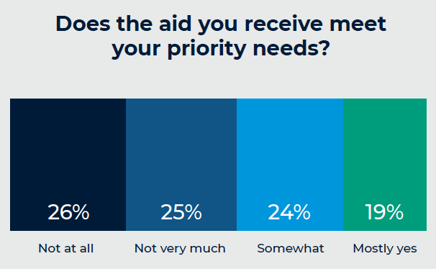
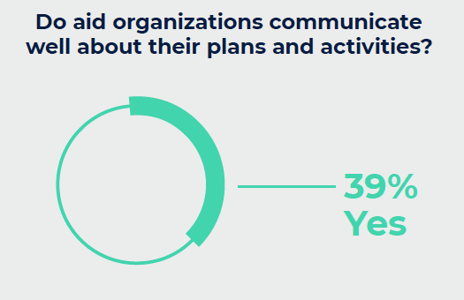
Some room for improvement…
Data collected by Ground Truth Solutions for the ‘Grand Bargain 2018 Field Perspectives’ and the ‘State of the Humanitarian System 2018’ reports
Notes:
FACILITATOR NOTES
Unfortunately, global evidence shows there are still significant gaps in how aid organisations engage communities, despite increased awareness and commitments to accountability.
The findings here were collected by Ground Truth Solutions and represent the views of nearly 10,000 people across 10 countries affected by disaster and crisis.
As they suggest:
51% of aid provided does not meet people’s priority needs – that means half of what we do is not meeting the main needs in communities. This represents a massive waste of time, human resource and funding on the part of aid agencies
61% of people said that aid agencies are not very good at sharing information about their plans and activities
While the number of feedback mechanisms have increased in recent years…these do not always lead to a response or changes in our programmes. While 93% of aid agency staff were confident people would receive a reply if someone complained – only 42% of people actually did get a response when they submitted a complaint or suggestion, showing our feedback mechanisms are not as effective as we think

Slide 22
Why is there a gap between commitments and practice?
Do any of these sound familiar?
We can’t change the programme now; the proposal is already with the donor…it’s too late to make changes.
We know what people need in an emergency. We must act quickly to save lives!
We understand communities because we have community-based volunteers
But we always engage with the community anyway
Notes:
FACILITATOR NOTES – Raise hands
Show each comment one by one and ask participants to raise their hand (virtually, using the hand raise button) if they have ever heard the statement, or said it themselves
Discuss each statement and ask if people have managed to overcome these challenges of rigid donors, lack of time, and assumptions that we already know what people need
Explain this training will try to provide practical solutions to overcome these common challenges, but also ask participants to continually challenge themselves not to make assumptions about what communities think or need

Slide 23
Where to get help…
Online platform hosted by British Red Cross
One-stop shop for CEA resources
In English, French, Spanish and Arabic
https://communityengagementhub.org/
CEA Guide & toolkit – revised in 2021
Step-by-step guidance to strengthen community engagement, with tools, templates and checklists to help you
Both on the community engagement hub
Notes:
FACILITATOR NOTES
There are lots of sources of support on community engagement and accountability within the Movement. Two of the most useful are:
The Community Engagement Hub
The Community Engagement Hub is a free online platform, hosted by British Red Cross, that provides a ‘one stop shop’ for community engagement and accountability.
The hub contains over 300 resources and includes training packages, an e-learning game, an interactive map, a chat forum as well as tools, guides, and case studies on a range of topics from feedback mechanisms to radio programmes.
Funded by the UK Foreign, Commonwealth and Development Office, the Hub is available in English, French, Spanish, and Arabic. If you have any questions or suggestions about the hub, please contact Laurel Selby LSelby@redcross.org.uk
The CEA Guide and toolkit
This training is based on the CEA Guide and toolkit
They provide guidance and tools to adopt a more systematic and reliable approach to engaging with and being accountable to communities.
They do not replace existing good practices, but rather help to address any gaps or weaknesses where they exist.
The CEA toolkit includes templates, checklists, and detailed guidance notes on specific aspects of CEA. Practical tools and training packages support the guide, which are linked to throughout.
The guide is organized in seven modules, which can be used individually as needed:
An introduction
Movement-wide commitments
Institutionalization of CEA
Minimum actions to achieve good community engagement throughout the programme cycle
Community engagement in emergencies
Community feedback mechanisms
Working with protection, gender and inclusion and behaviour change and risk communication as closely-related areas

Slide 24
Questions?

Slide 25
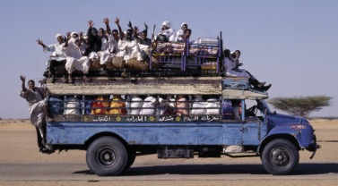
Group exercise (25 mins)
Bus service scenario
Read through the bus service scenario in your groups
Answer the 3 questions at the bottom of the scenario – on your group’s Jamboard
Be ready to feedback on your work in 25 minutes
Notes:
FACILITATOR NOTES – Breakout rooms and Jamboard
See the separate Intro to CEA Bus Service Scenario facilitator notes and participant handout

