Slide 1




How to Use Social Media to
Better Engage People
Affected by Crises
A brief guide for those using social media in humanitarian contexts
Notes:
Written mainly for Red Cross and Red Crescent staff, but also a resource for a wider audience.
Produced jointly by ICRC and IFRC
In addition to input and feedback from National Societies, we received input from 2 UN agencies, 5 other NGOs/humanitarian organisations, Twitter and Facebook.

Slide 2
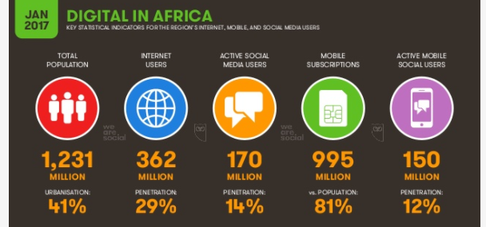
Less than one in three people across Africa has access to the internet today, however
mobile social media use in Africa increased by nearly 50% in 2016
Notes:
However, 7 of the 10 fastest growing internet populations in the world are in Africa, with the number of users reported in Ethiopia more than tripling versus the numbers we reported last year. Fewer than one in three people across Africa has access to the internet today though, and current growth trends suggest we’ll be well into the 2020s before we see internet penetration levels across the continent pass the 50% mark.
On a more encouraging note, though, mobile social media use in Africa increased by nearly 50% in 2016, although at just 12% penetration across the region, there’s still plenty more room to grow.

Slide 3
Seven out of 10 internet users in Africa now log onto Facebook
Notes:
From 2015 statistics https://social.ogilvy.com/wp-content/uploads/Social-Media-in-Africa_Infographic.pdf
And a recent article 2017: https://www.forbes.com/sites/tobyshapshak/2017/04/05/facebook-has-170m-african-users-mostly-on-mobile/#50c1c7a453dc
Which social media platform should I use?
There has been a 42% growth in monthly active users since 2015,

Slide 4
Why use Social Media CEA?
Social media and messenger services (Whatsapp) are consistently mentioned as one of the main information channels for IDPs and refugees.
Notes:
Only 33% of of aid recipients say aid agencies consulted them on their needs prior to the start of programmes. (SOHS)
More than 60% of refugees in Turkey Greece and Austria say they do not have information on available support. (MMP)
SOHS = State of Humanitarian System 2015
MMP = Mixed Migration Platform
Right: The importance of social media as an information source depends on whether people are on the move or not. People who are on the move assign more importance to the information they receive through social media whereas disaster affected people who stay at their normal place of residence tend to rely more on other information channels. This depends on the country as well.
For some Africans, the newsgroups within WhatsApp alone have become a primary source of news and entertainment.

Slide 5
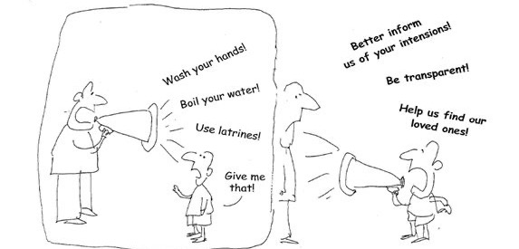
Social media is more than just posting messages!
Affected people express themselves and connect with each other on social media.

Slide 6
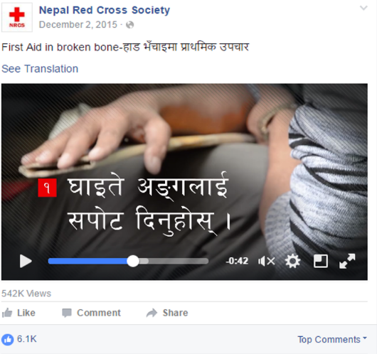
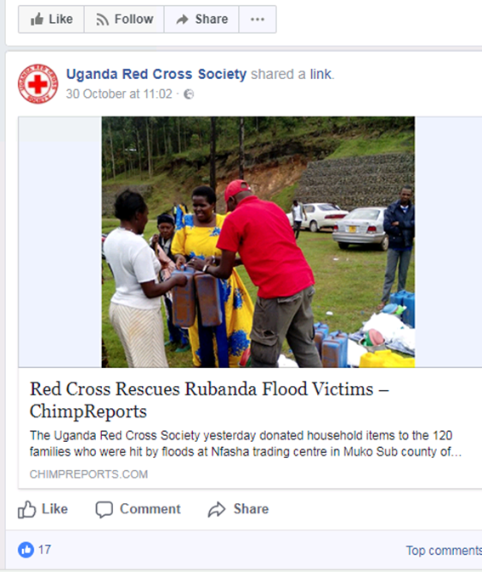
Social media CEA is about information FOR affected populations, not ABOUT them or about our organisation solely

Slide 7
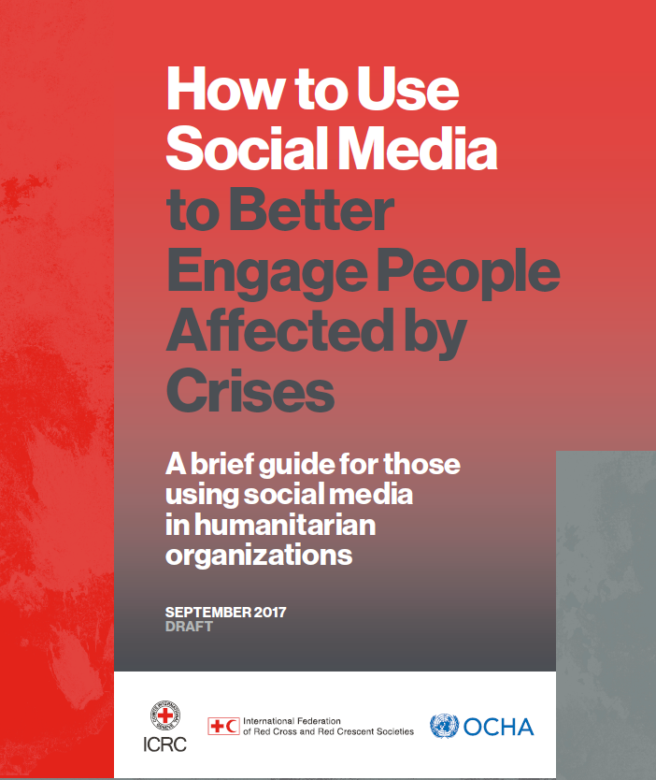

Our guide:
How to Use Social Media
to Better Engage People Affected by Crises
Important social media platforms
Tips to build proximity and trust
Social media listening
Preparedness
Emergency response
How to measure success and failure
Many examples!
Notes:
Written mainly for Red Cross and Red Crescent staff, but also a resource for a wider audience.
Produced jointly by ICRC and IFRC
In addition to input and feedback from National Societies, we received input from 2 UN agencies, 5 other NGOs/humanitarian organisations, Twitter and Facebook.

Slide 8
3 key tips:
Build trust and proximity
Provide relevant, content in appropriate format
Create feedback loops with programmes and increase accountability
Notes:
Written mainly for Red Cross and Red Crescent staff, but also a resource for a wider audience.
Produced jointly by ICRC and IFRC
In addition to input and feedback from National Societies, we received input from 2 UN agencies, 5 other NGOs/humanitarian organisations, Twitter and Facebook.

Slide 9
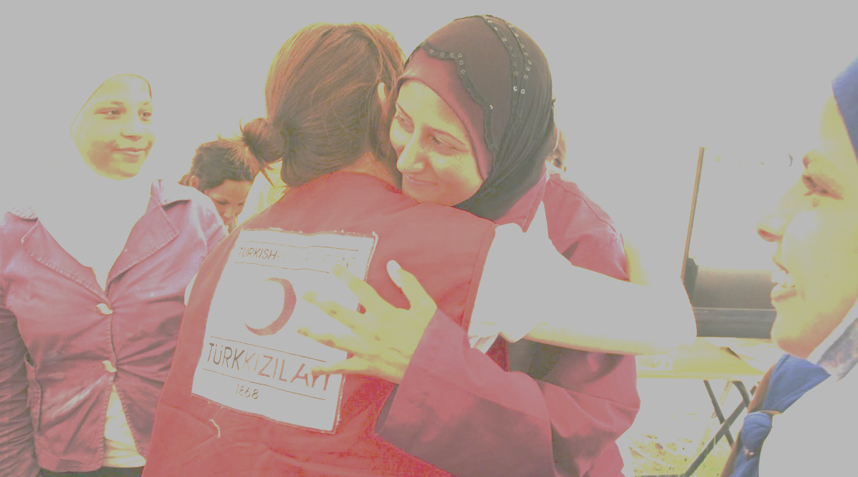
Trust, proximity and actionable content

Slide 10
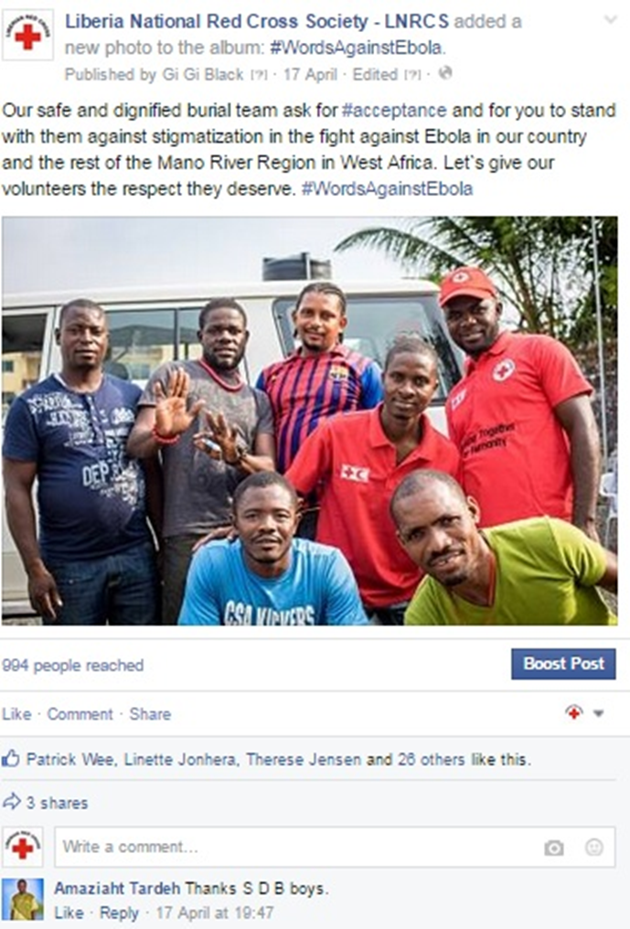
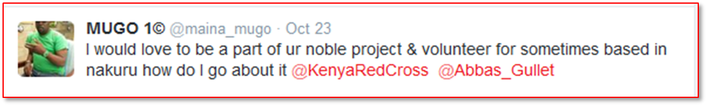
Do you trust me?
People don‘t trust anonymous organizations.
Online and offline, people are more likely to trust people with whom they have personal bonds
Notes:
People don‘t trust anonymous organizations with whom they have had no prior experience.
Online and offline, people are more likely to trust people with whom they have personal bonds (family/friends), those with a good reputation (civil society personalities, celebrities, media).

Slide 11
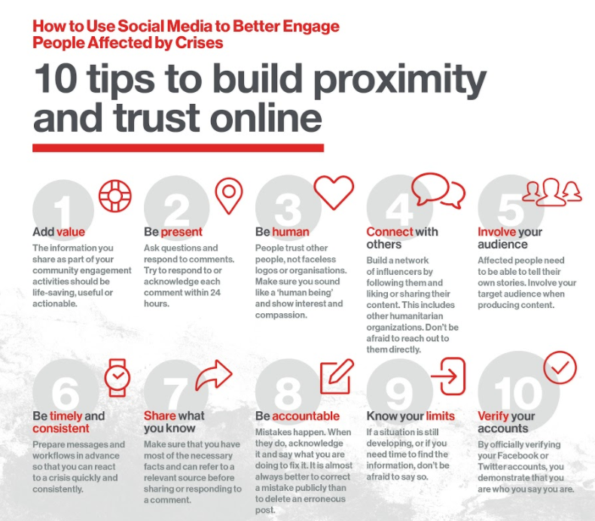

Slide 12
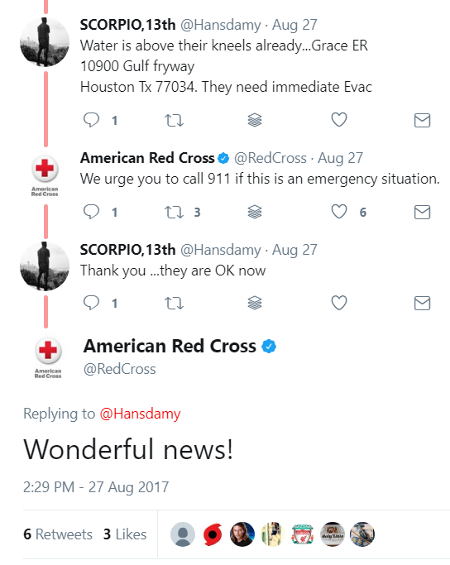
3 out of 10 tips to build proximity and trust online
Be human: A personable communication style tends to be most successful on social media.
Notes:
People trust other people, not faceless logos or organizations, so make sure to sound like a “human being” and show interest and compassion.
This is another recent example from the US. Think about it: there was no real need for the American Red Cross to respond to this. Saying „wonderful news“doesn‘t add a lot to this conversation. However, they showed that they care. And that is very important to building trust in the long term.

Slide 13
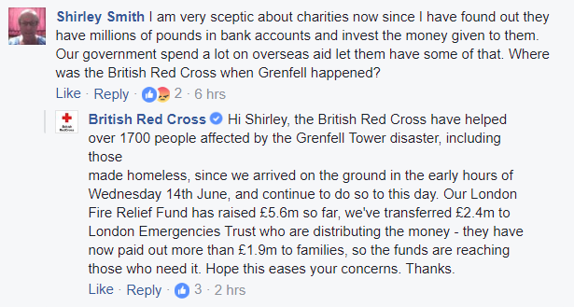
3 out of 10 tips to build proximity and trust online
Listen and be present:
Demonstrate that you are willing to engage in a dialogue with others. Ask questions and respond to comments. Try to respond to or acknowledge each comment within 24 hours.
Notes:
We all receive criticism online. It is legitimate that people ask questions about what we do with the money that we receive. This is a good example of an answer from the British Red Cross. By answering comments quickly – it only took 4 hours to respond to this question – the British Red Cross shows that they are transparent and that they are listening. The answer was probably part of their message library of prepared messages. However, as you can see, they personalized it a bit by adding the name of the person asking the question.

Slide 14
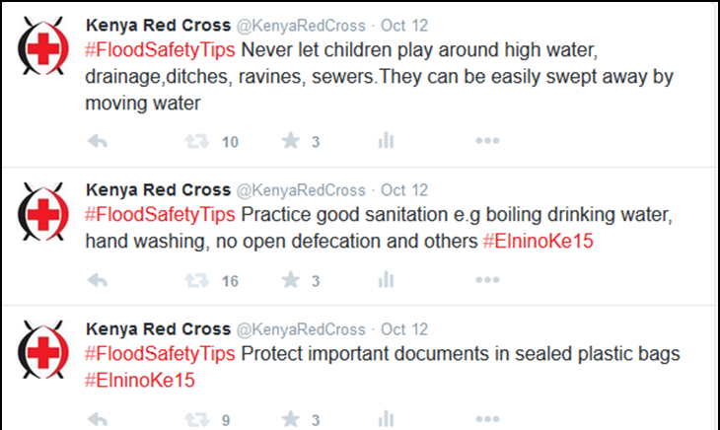
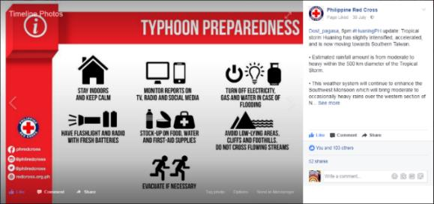
Add value:
information should be life-saving, useful or actionable.
Notes:
The first is a Facebook post from the Philippines Red Cross that shows how you can combine prepared messages (on the left) with current context (on the right). The information is very specific and relevant at the time it was posted. Please also note how PRC included links to all their social media profiles at the bottom right, which is a smart way to increase awareness of these channels.
The second is a facebook post that was shared through IFRC global FB account geo-targeting users in a specific area of Bangladesh hit by flooding. The post combined pre-created visuals and useful / actionable messages that were produced by a group of organizations such as BBC media actions, Red Crescent and others. This shows how it is important to havepre-packaged content which can be tailored and shared at crucial times.

Slide 15

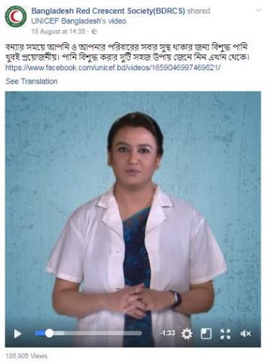
Exercise: Read the example and ….
What makes this a good examples?
Circle the parts of the example that you think are important steps for the success of this approach.
Which of the identified steps would be the most difficult in your country? Why?
Notes:
NOTE for presenter: either give people 10 minutes to discuss this in groups or discuss in plenary.

Slide 16
Relevant, timely and lifesaving content
Example: Bangladesh
Bangladesh is one of the most disaster prone countries in the world. To ensure fast and consistent information in a crisis, aid organizations worked together to harmonize key messages for disaster preparedness and response across all organisations and channels. This process took about two years and included signoff of all key messages by the government.
After the government had approved the messages, aid organisations turned the messages into different formats such as videos, images with text, and cartoons.
These content items were then tested to see whether they were easily understandable and to find out what resonated most with the target audiences. The process showed that videos with a doctor as well as cartoons were among the most effective ways to get the messages across.
The aid organisations then approached Bangladesh’s top Facebook pages - many of which belong to the media - and defined a simple workflow through which they could share the prepared content in an emergency.
In addition, platform members used Facebook ads to increase the reach of their messages.
Notes:
Here is an example of a more complex scenario for delivering relevant, timely and lifesaving content.
NOTE for presenter: Either discuss the example together or print the example and ask particpants to discuss it for 10 minutes in groups.

Slide 17
Example: Bangladesh
Bangladesh is one of the most disaster prone countries in the world. To ensure fast and consistent information in a crisis, aid organizations worked together to harmonize key messages for disaster preparedness and response across all organisations and channels. This process took about two years and included signoff by the government of all key messages.
After the government had approved the messages, aid organisations turned the messages into different formats such as videos, images with text, and cartoons.
These content items were tested to see whether they were easily understandable and to find out what resonated most with the target audiences. The process showed that videos with a doctor as well as cartoons were among the most effective ways to get the messages across.
The aid organisations then approached Bangladesh’s top Facebook pages - many of which belong to the media - and defined a simple workflow through which they could share the prepared content in an emergency.
In addition, platform members used Facebook ads to increase the reach of their messages.

Slide 18
Good practices in the Bangladesh example
Focus on being prepared: two-year initiative, independent from an active emergency
Buy-in by government and large group of stakeholders, including private sector influencers.
Shared investment in a message library: consistent messaging builds trust in messages and reduces confusion and stress in a crisis. This leaves actors with more time to respond to unexpected events.
Messages were tested and optimized for different media and target audiences
Workflows were established and tested ahead of an emergency
Ads were used strategically to increase reach
Notes:
In the guide we are touching on all these elements and give more examples and resources for how to do this. Now let’s move on to the last key concept in the guide. Feedback loops.

Slide 19

Social media listening

Slide 20

Scanning & monitoring: WHY?
Understand context (what is happening where?)
Produce relevant content & feedback to programmes
Find out about gaps in assistance and information
Receive feedback on our activities

Slide 21
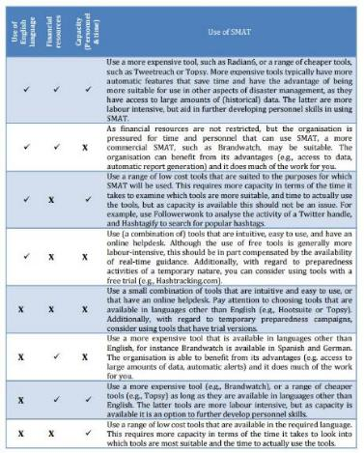


Scanning & monitoring: HOW?
Comparative Review of Social Media Analysis Tools for Preparedness
(2015)
@PrepareCenter
On page 6 of the guide
Notes:
Looks at language, costs and capacity
From 2015 (close to being outdated) but still relevant
Multi-stage project with more deliverables due
Follow: @PrepareCenter

Slide 22

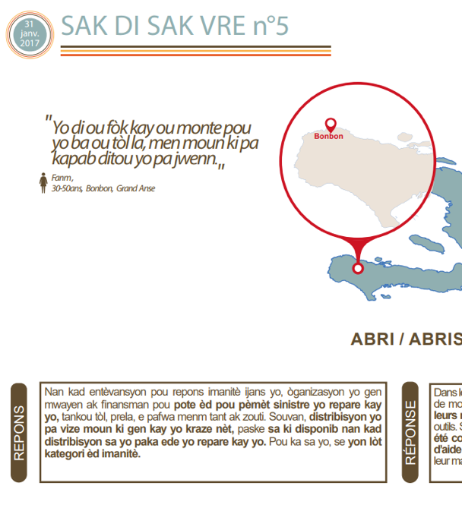
Counter rumours
In local language(s)
For humanitarian and affected
population
Input and output through all available channels (social media is not a silo!)

Slide 23

Making feedback loops work: Haiti case
Some people did not trust water purification
The CEA team collected questions and rumours
The CEA team produced online and offline materials to explain why purification was needed
Programme teams adopted messages
Notes:
Internews CEA staff discovered that some people did not trust water purification tablets because they made the water taste funny.
The CEA team collected questions and rumours about water purification and discussed these with WASH teams.
Together with local community leaders and programme staff, the CEA team produced online and offline materials explaining that the water is safe and why water purification was needed. Local media helped spread the messages online and on-air.
Programme teams adopted messages related to these rumours and integrated them into their activities.

Slide 24
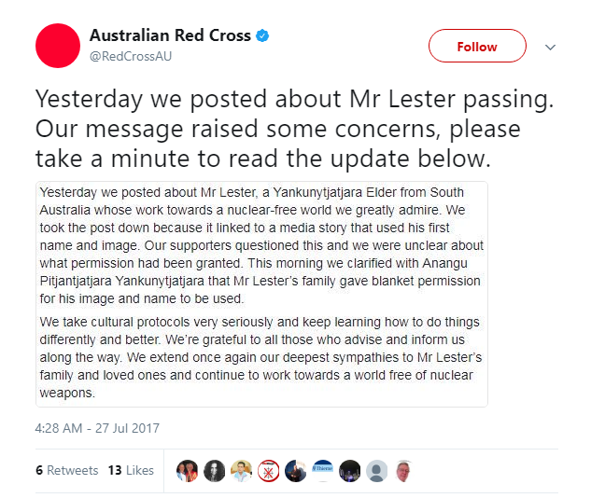
Responding to comments and the visible feedback loop
Using feedback internally is not enough, you also need to show what you are doing with it.
Notes:
By communicating about how they used the feedback, the Australian Red Cross demonstrates that they take feedback seriously and have reacted appropriately. This demonstrates to their social media audience that AuCross is listening and can be trusted to follow up.

Slide 25

Feedback Loops: Important tasks within your organization
Preparation BEFORE a crisis is key!
Get to know your programme colleagues and their needs
Establish a mechanisms through which you provide them with feedback
Manage and define expectations
Chapter 5
of the guide

Slide 26
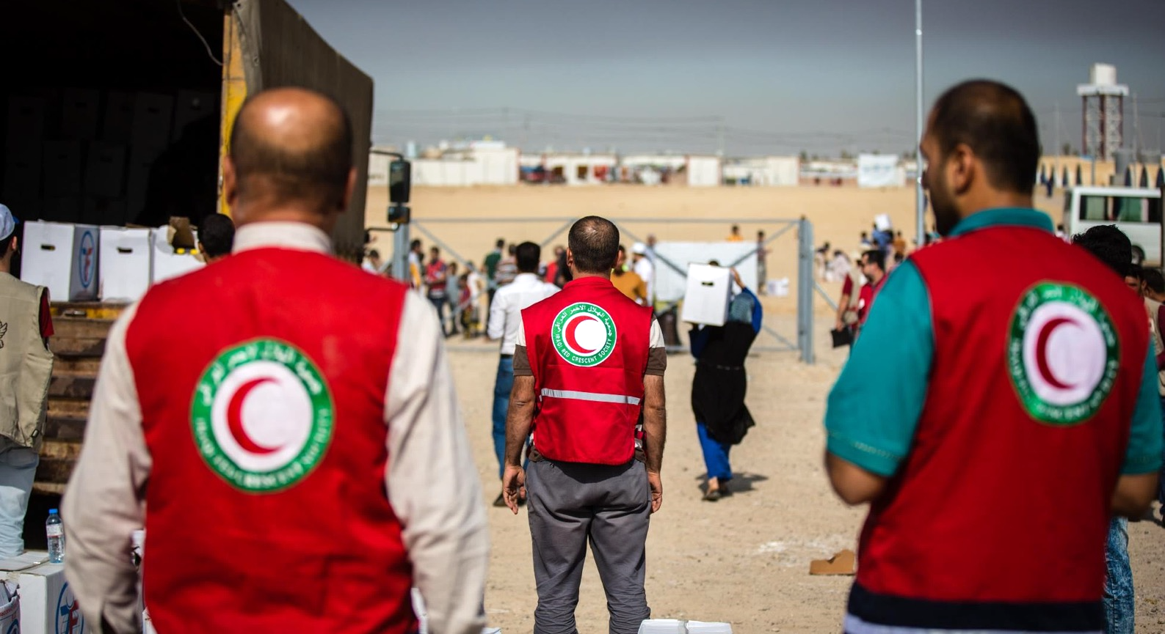
Working with programme
colleagues
Preparation, preparation, preparation!
Know what your programme colleagues do in an emergency and understand what they need
Involve them in preparing relevant content for their area of expertise.
Demonstrate that you can add value
Notes:
CEA is about integrating feedback into programmes and improving programmes to meet the needs of the affected communities. You can only do that if you workl closely with programmes. In the guide we go over some of the basics of building a good working relationship with programmes.

Slide 27
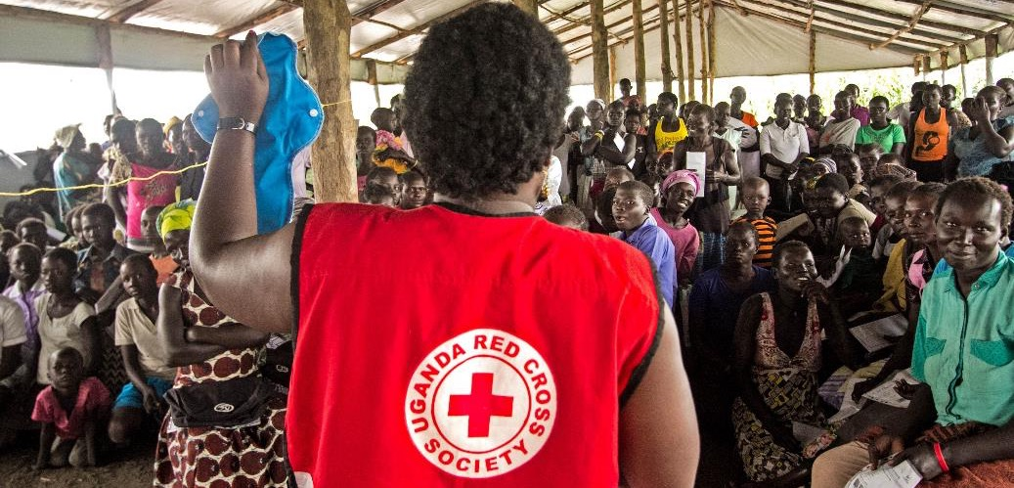
Emergency response: what now?

Slide 28
Tips to help you engage with people during emergencies:
Produce timely, actionable and useful content that meets your audience’s needs – first listen!
Respond: people demand and expect answers
Make the feedback loop visible
Manage expectations: if too busy, say so on social media
Identify new influencers
Check rumours when monitoring and scanning
If you can’t’ help, who can?
Notes:
- By listening to the affected people you will know what their most urgent information needs are

Slide 29
People in emergencies needs ADVICE AND INFO ON HOW TO:
Find safety and stay safe.
Access assistance, from water, food or shelter to medical support, education and job opportunities.
Reconnect with family members and friends in the immediate aftermath of a crisis.

Slide 30
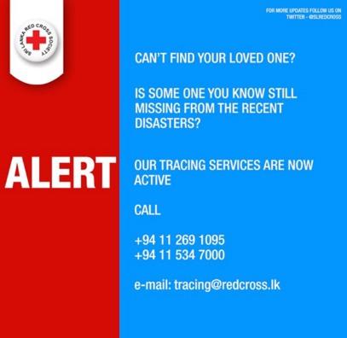
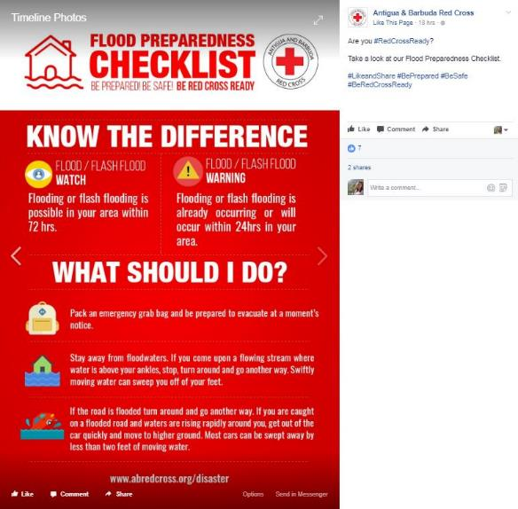
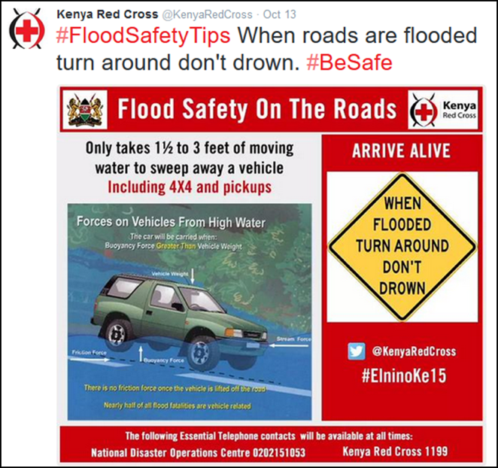
Visual is better
No need for perfection.
See Facebook live video here

Slide 31
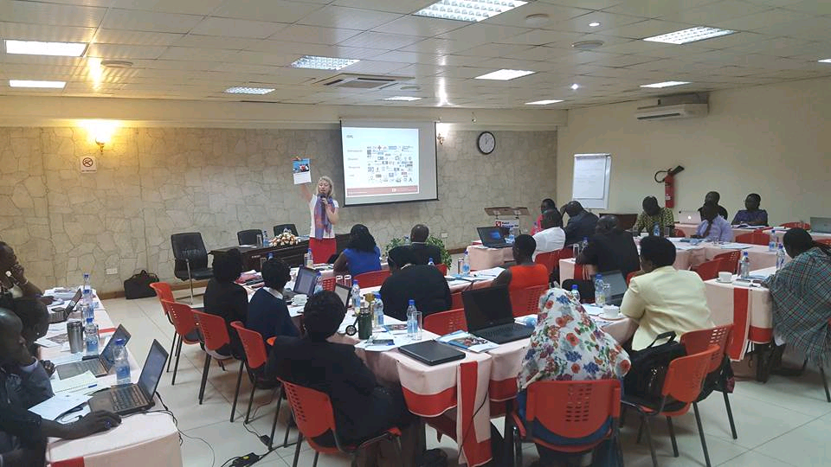
Avoid images like this

Slide 32

How do I measure success?

Slide 33
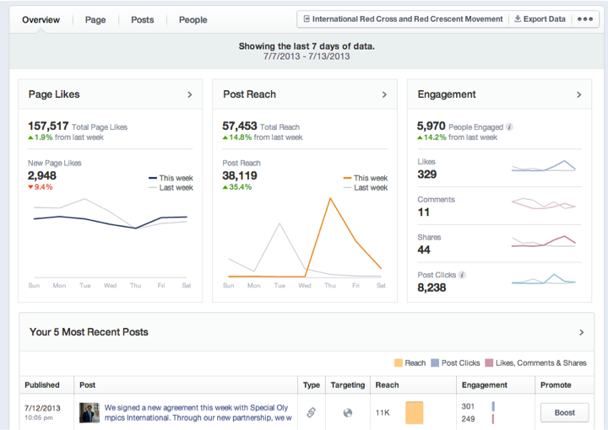
Facebook (free)
http://www.facebook.com
Available for all Facebook pages
Overview of key metrics and demographic data.
Help you target content to your audience

Slide 34
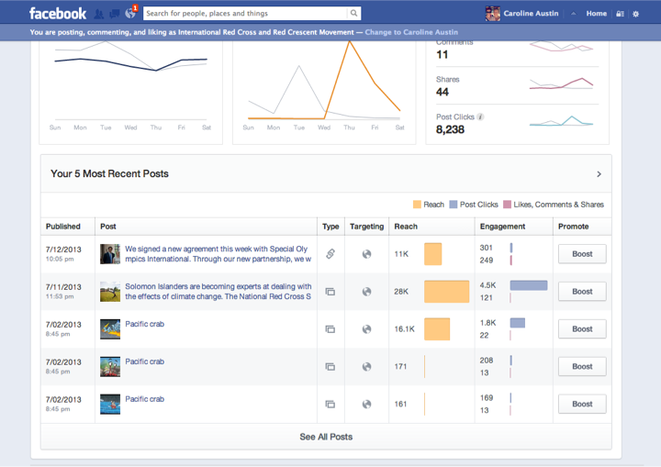
Notes:
Facebook (free)
http://www.facebook.com
Available for all Facebook pages
Overview of key metrics and demographic data.
Help you target content to your audience

Slide 35





Increase in engagement with your content (i.e. number of likes, shares and comments).
Quality of engagement: have you received more/less specific, actionable questions as opposed to generic, two-word responses?
Growth of social media audience (i.e. number of followers).
Social media monitoring or direct feedback via social media, which has informed and/or led to changes in programming.
Change in type and number of questions/comments
Number of people who have read documents you published.

Slide 36
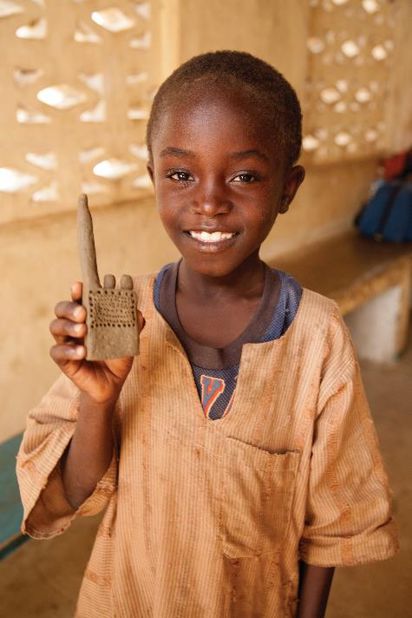
Questions?

