Slide 1
Community Engagement and Accountability, Migration Response, Europe Regional Workshop 9-10 March 2017, Budapest
Francesca Basile Silvia Piscitelli

Slide 2
GROUND TROUTH - THE GOAL
To enable National Societies to use Ground Truth’s feedback methodology to track the perceptions of migrants and host communities in countries of transit or arrival, such as Turkey, Greece and Italy, and destination countries, such as Denmark, Finland, Germany and Sweden.
Enabling migrants and host communities to provide regular feedback and respond to that feedback in a swift manner
Meet their operational objectives by reducing the vulnerability and suffering of migrants through the provision of core services, and the promotion of social inclusion and acceptance of migrants.

Slide 3
FEEDBACK CYCLE
Design
Data collection
Analysis
Dialogue
Course correction

Slide 4
DESIGN - HoW we did it
Which feedbacks do we want to receive?
Three group discussions
Which is the correct way to ask for feedbacks?
Questionnaire tailored to the different contexts
Short term projects
Long term projects
Transit

Slide 5
The questionnaire
Q1. Are your basic needs met?
Q2. Do you have the information you need to get help?
Q3. Do you understand your asylum procedure?
Q4. Are people’s opinions taken into account by the people working in this centre / safe point?
Q5. If you have a problem, do you talk about it with the people working in this centre / safe point?
Q6. Do you feel safe here?
[Question 7 not to be asked from people staying in Tendopoli or visiting a safe point!]
Q7. Do you think the skills you learned here will help you in your future?

Slide 6
DATA COLLECTION
DIFFERENT CONTEXTS
DIFFERENT APPROACH
DIFFERENT DURATION OF THE PROJECS
SETTIMO TORINESE
Emergency response (camp)
Extraordinary Reception centre (CAS)
Protection system for asylum seekers and refugees (SPRAR)
ROMA
Humanitarian presidium
CATANIA
Safe point
DATA COLLECTORS
Red Cross Staff (italians and migrants)

Slide 7
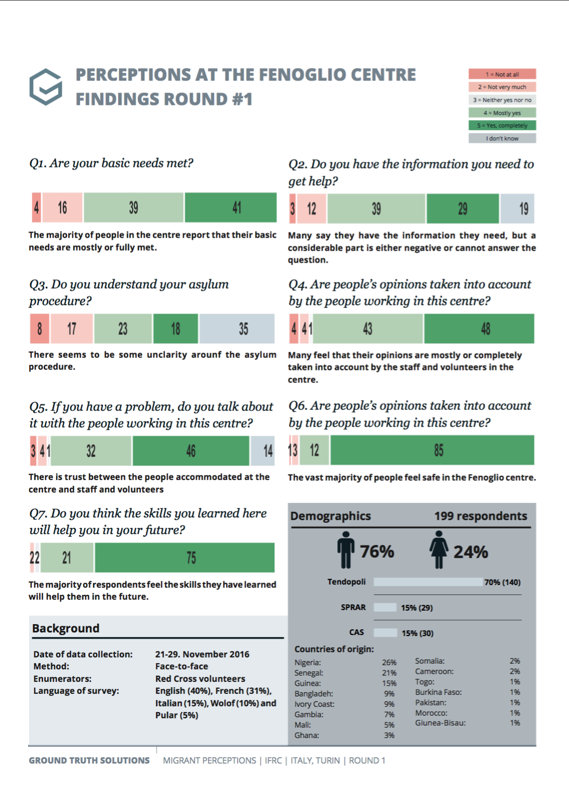
ANALYSIS

Slide 8
DIALOGUE
- When service users feel heard and believe that their opinions matter, they participate more actively because it benefits them to do so.
- By communicating feedback results, your reality can further raise awareness about its services among actual and potential communities.
- One outcome of the dialogue can be concrete targets, against which success can be evaluated through further rounds of feedback collection.
- Improvement of core services and staff awareness, and the promotion of social inclusion and acceptance of migrants.
BENEFICIARIES
COMMUNITY
NEW DATA COLLECTION
STAFF AND SERVICES

Slide 9
COURSE CORRECTION - ACTIONS
2° ROUND OF DATA COLLECTION
CLOSING OF FIRST PART
toolkit
SPREAD OF THE ACTIVITY
Design
Data collection
Analysis
Dialogue
Course correction

