Slide 1
Strengthening Community Voices in Decision Making: A Regional Perspective
Sheu Jeen Lee
Senior Officer, Beneficiary Communications
IFRC Asia Pacific
Notes:
Today I will be giving a very brief presentation on regional perspectives in strengthening community voices in decision making.
We heard yesterday an excellent presentation from John on the auxiliary role of RCRC and how we can be a humanitarian bridge for communities to raise their voices and influence government and even international policy. As auxiliaries to the govt, we have a responsibility to listen and include the voices of people who sometimes may be excluded from certain agendas or activities.

Slide 2
Session overview
Reinforce international commitments on community-level implementation and participation, and the importance of community voices in influencing decision making
Provide a regional overview of civil society and community participation in disaster management laws in Asia Pacific
Present a national perspective on legal frameworks for DM in Bangladesh and how these can promote citizen empowerment and active participation

Slide 3
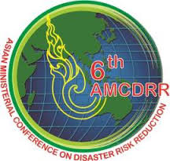
International commitments on community-level implementation and participation
What
Requires empowerment and inclusive, accessible and non-discriminatory participation in order to be efficient and effective.
Who
Stakeholders such as women, youth, vulnerable groups, civil society organisations, Red Cross Red Crescent, governments, media, private sector and academia
How
Encourage active participation in processes that contribute to decision-making, planning and implementation of policies and programmes at all levels
Notes:
Global events that have been held in recent years. All of these global frameworks and declarations have a few things in common. They all say that in order for DRR and sustainable development to be effective, this requires an all-of-society approach, engagement and partnership. And this includes with stakeholder groups such as…
And how should we do this? By encouraging ….
Now this ties in exactly to point # 8 in the DRR Law Checklist on the engagement of civil society, private sector, scientific institutions and communities in RR decisions and activities.

Slide 4
Why include community voices in decision making?
Recognise potential of diverse resources and capacities
Address local needs and context
Build confidence and pride in being able to make a difference
Enhance capacities and efforts
Innovative and sustainable solutions
Create sense of ownership and commitment
Notes:
Ensure that decision making is sensitive to local needs and contexts
And this could be from women, youth, indigenous people, and so on
Being able to make a difference and actually influence and shape policies and actions
When people are involved in decision making, it automatically provides a feeling of ownership and commitment
When people are empowered, they can almost self organise and enhance capacities and concerted efforts to pursue disaster preparedness as well as bigger development responsibilities at the local level
Ultimately a bottom up process can lead to innovative and sustainable solutions for communities

Slide 5
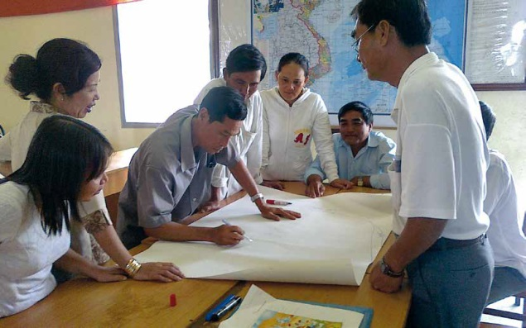
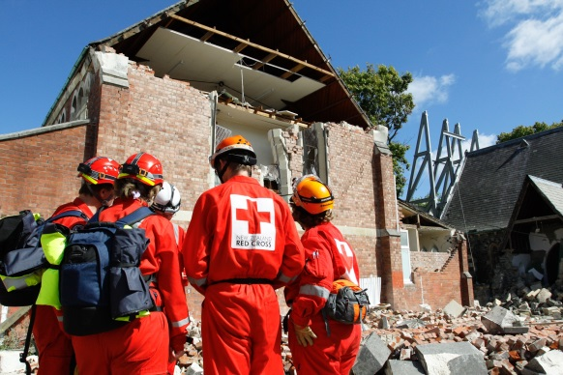
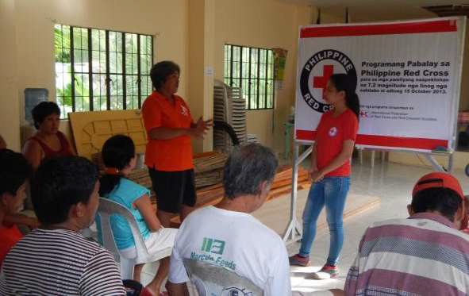
Regional perspectives from Asia Pacific
Vietnam
Right for communities to access information and participate in development of local plans, but no specific roles of organisations
New Zealand
Broad purposes and objectives for community participation, but means of participation not specified
Philippines
Includes involvement and participation of stakeholders and institutions with specific roles and responsibilities
Participation of civil society and communities under DM laws
Notes:
Legislative mandates for the participation of communities and civil society in DRM systems are one mechanism that can encourage or require national and local governments to be more inclusive in practice. In countries where the DRM law requires the government to include civil society and communities in the DRM system the method of inclusion partly depends on the style of the law. In some framework laws, detailed mechanisms for participation are left to regulations, policies or plans.
Vietnam’s new DRM law includes a right for communities to access information and participate in the development of local plans – This is great, but it will be interesting to see how it can be upheld (maybe through implementing decrees)
In New Zealand, for example, the DRM law includes broad purposes and objectives for civil society and community participation with the aim to “encourage and enable communities to achieve acceptable levels of risk.” However, in part due to the principle based nature of the law, the means of participation is not further specified. In New Zealand, the concept of community is generally equivalent to a municipality or local government area (except for the distinct Maori indigenous communities, which are perceived as separate), and these elected governments are required to consult with their communities.
In the Philippines, civil society and/or communities are specifically included in DRM institutions. The DRM law mentions in its objectives “promoting the involvement and participation of all sectors and stakeholders concerned at all levels, especially the local community.” The Office of Civil Protection is charged with creating an enabling environment for substantial and sustainable participation of civil society organizations (CSOs), private groups, volunteers and communities, and recognizing their contributions in the government’s DRR efforts, while the local civil protection offices and barangay (neighbourhood) committees have similar responsibilities. This is matched by mandated representation of CSOs and the Philippines National Red Cross on the national and local councils established by the DRM law. Even more locally, the barangay committees are required to “facilitate and ensure the participation of at least two CSO representatives from existing and active community based people’s organizations representing the most vulnerable and marginalized groups in the barangay.”
Most of the sample countries include some provisions for representation of civil society and/or communities in their DRM laws. This recognizes that moving to a whole-of-society approach to DRR cannot be achieved by governments alone, and that the input of civil society and National Societies, as part of their auxiliary role to the public authorities, is a key part of such a strategy. More particularly, for communities, this recognizes their right to be involved in their own risk management. However, community and civil society participation in the DRM system at all levels would be greatly enhanced in many cases by more specific and defined roles mandated by the DRM laws.

Slide 6
National perspective: Legal frameworks for DM in Bangladesh
Standing Orders on Disaster 2010
National Disaster Management Plan (2010-2015)
Detailed roles and responsibilities for each ministry involved in DM
Specific tasks to ensure active participation of women, PWDs, youth, religious leaders, NGOs, CBOs, media, and vulnerable groups in DM awareness, assessment processes and plans
Mandates national radio, TV, newspapers and other media to broadcast awareness and education initiatives on prevention, preparedness and response – information provision
Ensures contribution of civil society including volunteers and CBOs, scientific community and private sector in development and implementation of plans
Design of programmes to consider needs of women, elderly, PWDs and other disadvantaged groups.
Notes:
Standing Orders 2010
NDM Plan – Civil society, including volunteers and community-based organizations, the scientific community and the
private sector are vital stakeholders in disaster management. DM&RD will ensure contribution of all
actors in the development and implementation of the plan to build disaster resilient nations and
communities.
4.2.1.3 Design and implement livelihood support programmes for at risk communities, particularly women, the elderly, the disabled and other disadvantaged groups.

Slide 7
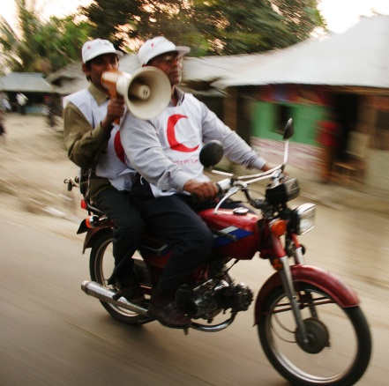
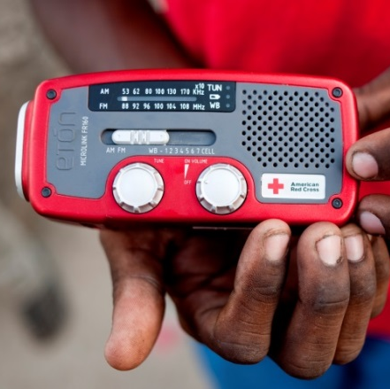
Good practice: How laws can promote citizen empowerment and active participation
Right to Information Act 2009
Right to information, with the aim to promote transparency, accountability and good governance
Community Radio Policy 2008 and National Strategy for Implementation
CR as a platform for community-driven communication, mobilization and channelling of communities’ ideas, initiatives, and resources
Provisions for community participation and inclusion of disadvantaged groups in management, programming, content and broadcasting
Articles on information disclosure and complaints mechanisms
Empowered citizens by enabling access to information, services and entitlements – improve lives and livelihoods and ultimately hold local governments to account
Specific roles and responsibilities for national and local committees to oversee implementation
Notes:
Objective is to drive “empowerment of common people’ through ensuring people’s right to free flow of information. The Act also aims to reduce corruption and ensure good governance, transparency and accountability in all public and private organizations.
RTI Act has empowered citizens, by enabling access to information for particularly vulnerable groups, allowing them to access services and entitlements, and hold local governments to account – ultimately improving their own lives and livelihoods
By virtue of RTI Act, the poor and indigent women of remote villages are now getting information of government safety net programs including VGD, VGF cards and maternal health vouchers. Farmers and fishers are now seeking and getting information which promotes their lives and livelihoods. Environmentalists are using RTI Act as a tool to ensure accountability in environmental governance. Victims of natural disasters are getting information about relief and rehabilitation. Even the peoples of marginalized and excluded communities like dalits are now getting information and enjoying their rights.
With support from NGOs, people have started using the Act to obtain their entitlements under public schemes that provide vulnerable groups with health care, food, education, and other services. Otherwise, all too often the benefits from these schemes never reach the people that they are designed to help.
used the RTI Act to obtain information from the government in order to hold their local government bodies to accounts and improve their living conditions
Under the same umbrella of rights to free flow of information, community radios is a powerful tool to reach out to communities and provide a voice for vulnerable groups. to become full-fledged partners in the development process of Bangladesh.
Community participation and inclusion of disadvantaged groups:
The need for active community participation in management, programme preparation, content creation, broadcasting and evaluation, with special attention to the inclusion of socio-economic and geographically disadvantaged groups, particularly women, as “key indicators” of success.
Programming/Content Guidelines:
• Programming should reflect the special interests of the community to be served “on areas of development
such as agriculture, both adult and children education, gender, primary health, environment, social
welfare, current market prices, demand for agro-products, rural and community development, infant care,
maternity health, family planning, income generation etc.”
Even if you have a good set of laws and policies it does not mean that implementation will be effective – laws are only as good as their implementation – are communities aware of and understand the laws, are these laws linked to the DM Act and Standing orders and how do they reinforce and support each other?
Some considerations and we see this globally as well is how to ensure that these fantastic laws and policies are well implemented, and that actions are translated right down to the community level
Pose the question back to the audience to think about how well these laws are working practically. So apart from the success stories we just heard, have there been any challenges in implementation? Look forward to hearing more during discussions in WG session

Slide 8
Key messages
Engagement must be a multi-stakeholder process and inclusive of all groups within communities
Good disaster management governance must be transparent and accountable
Civil society organisations, NGOs and BDRCS play a critical role in channelling community voices from the ground up to inform higher level policy and advocacy
Notes:
Implementation of RTI, as earlier indicated, is much more difficult than adoption of the Act; it is a multi-stakeholder challenge; it requires a comprehensive approach; and it will yield result only when there is a full-fledged and committed ownership of all stakeholders, especially internalization of the benefits of the concept of the right to information by the demand side as well as the supply side - those who need the information and those who hold them.

Slide 9
THANK YOU

Slide 10
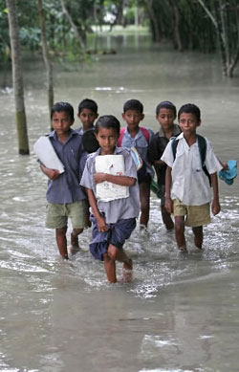
Common considerations in implementation?
Lack of awareness of the legislation and dissemination among communities
Unequal access for different groups based on factors such as gender and economic class
Lack of integrated legislation – cross sectoral

Slide 11
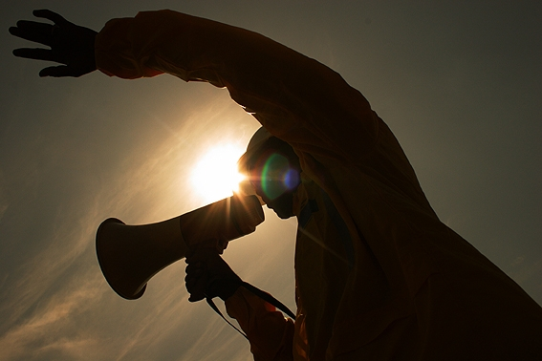
Good practice: How laws can promote citizen empowerment and active participation
Right to Information Act 2009
Ensures people’s right to information, with the aim to promote transparency, accountability and good governance
Contains articles on information provision/disclosure and complaints mechanisms
Empowered citizens by enabling access to information, services and entitlements – ultimately holding local governments to account and improving their own lives and livelihoods
Community Radio Installation, Broadcast and Operation Policy 2008 and National Strategy for Implementation
Developed in consultation with national and local govts, UN, CSOs, NGOs and radio practitioners
Using community radio as a platform for community-driven communication, through the mobilization and channelling of communities’ ideas, initiatives, and resources.
Includes provisions for community participation and inclusion of disadvantaged groups in management, programming, content and broadcasting
Specific roles and responsibilities for national and local committees to oversee implementation
Notes:
Objective is to drive “empowerment of common people’ through ensuring people’s right to free flow of information. The Act also aims to reduce corruption and ensure good governance, transparency and accountability in all public and private organizations.
RTI Act has empowered citizens, by enabling access to information for particularly vulnerable groups, allowing them to access services and entitlements, and hold local governments to account – ultimately improving their own lives and livelihoods
By virtue of RTI Act, the poor and indigent women of remote villages are now getting information of government safety net programs including VGD, VGF cards and maternal health vouchers. Farmers and fishers are now seeking and getting information which promotes their lives and livelihoods. Environmentalists are using RTI Act as a tool to ensure accountability in environmental governance. Victims of natural disasters are getting information about relief and rehabilitation. Even the peoples of marginalized and excluded communities like dalits are now getting information and enjoying their rights.
With support from NGOs, people have started using the Act to obtain their entitlements under public schemes that provide vulnerable groups with health care, food, education, and other services. Otherwise, all too often the benefits from these schemes never reach the people that they are designed to help.
used the RTI Act to obtain information from the government in order to hold their local government bodies to accounts and improve their living conditions
Under the same umbrella of rights to free flow of information, community radios is a powerful tool to reach out to communities and provide a voice for vulnerable groups. to become full-fledged partners in the development process of Bangladesh.
Community participation and inclusion of disadvantaged groups:
The need for active community participation in management, programme preparation, content creation, broadcasting and evaluation, with special attention to the inclusion of socio-economic and geographically disadvantaged groups, particularly women, as “key indicators” of success.
Programming/Content Guidelines:
• Programming should reflect the special interests of the community to be served “on areas of development
such as agriculture, both adult and children education, gender, primary health, environment, social
welfare, current market prices, demand for agro-products, rural and community development, infant care,
maternity health, family planning, income generation etc.”
…promote people’s empowerment, in order to build a platform for community-driven communication and sustainable development, through the mobilization and channelling of communities’ energies, ideas, initiatives, and resources.

