Slide 1
CEA in Greece
Feedback mechanisms

Slide 2
Suggestion box in Nea Kavala

Slide 3
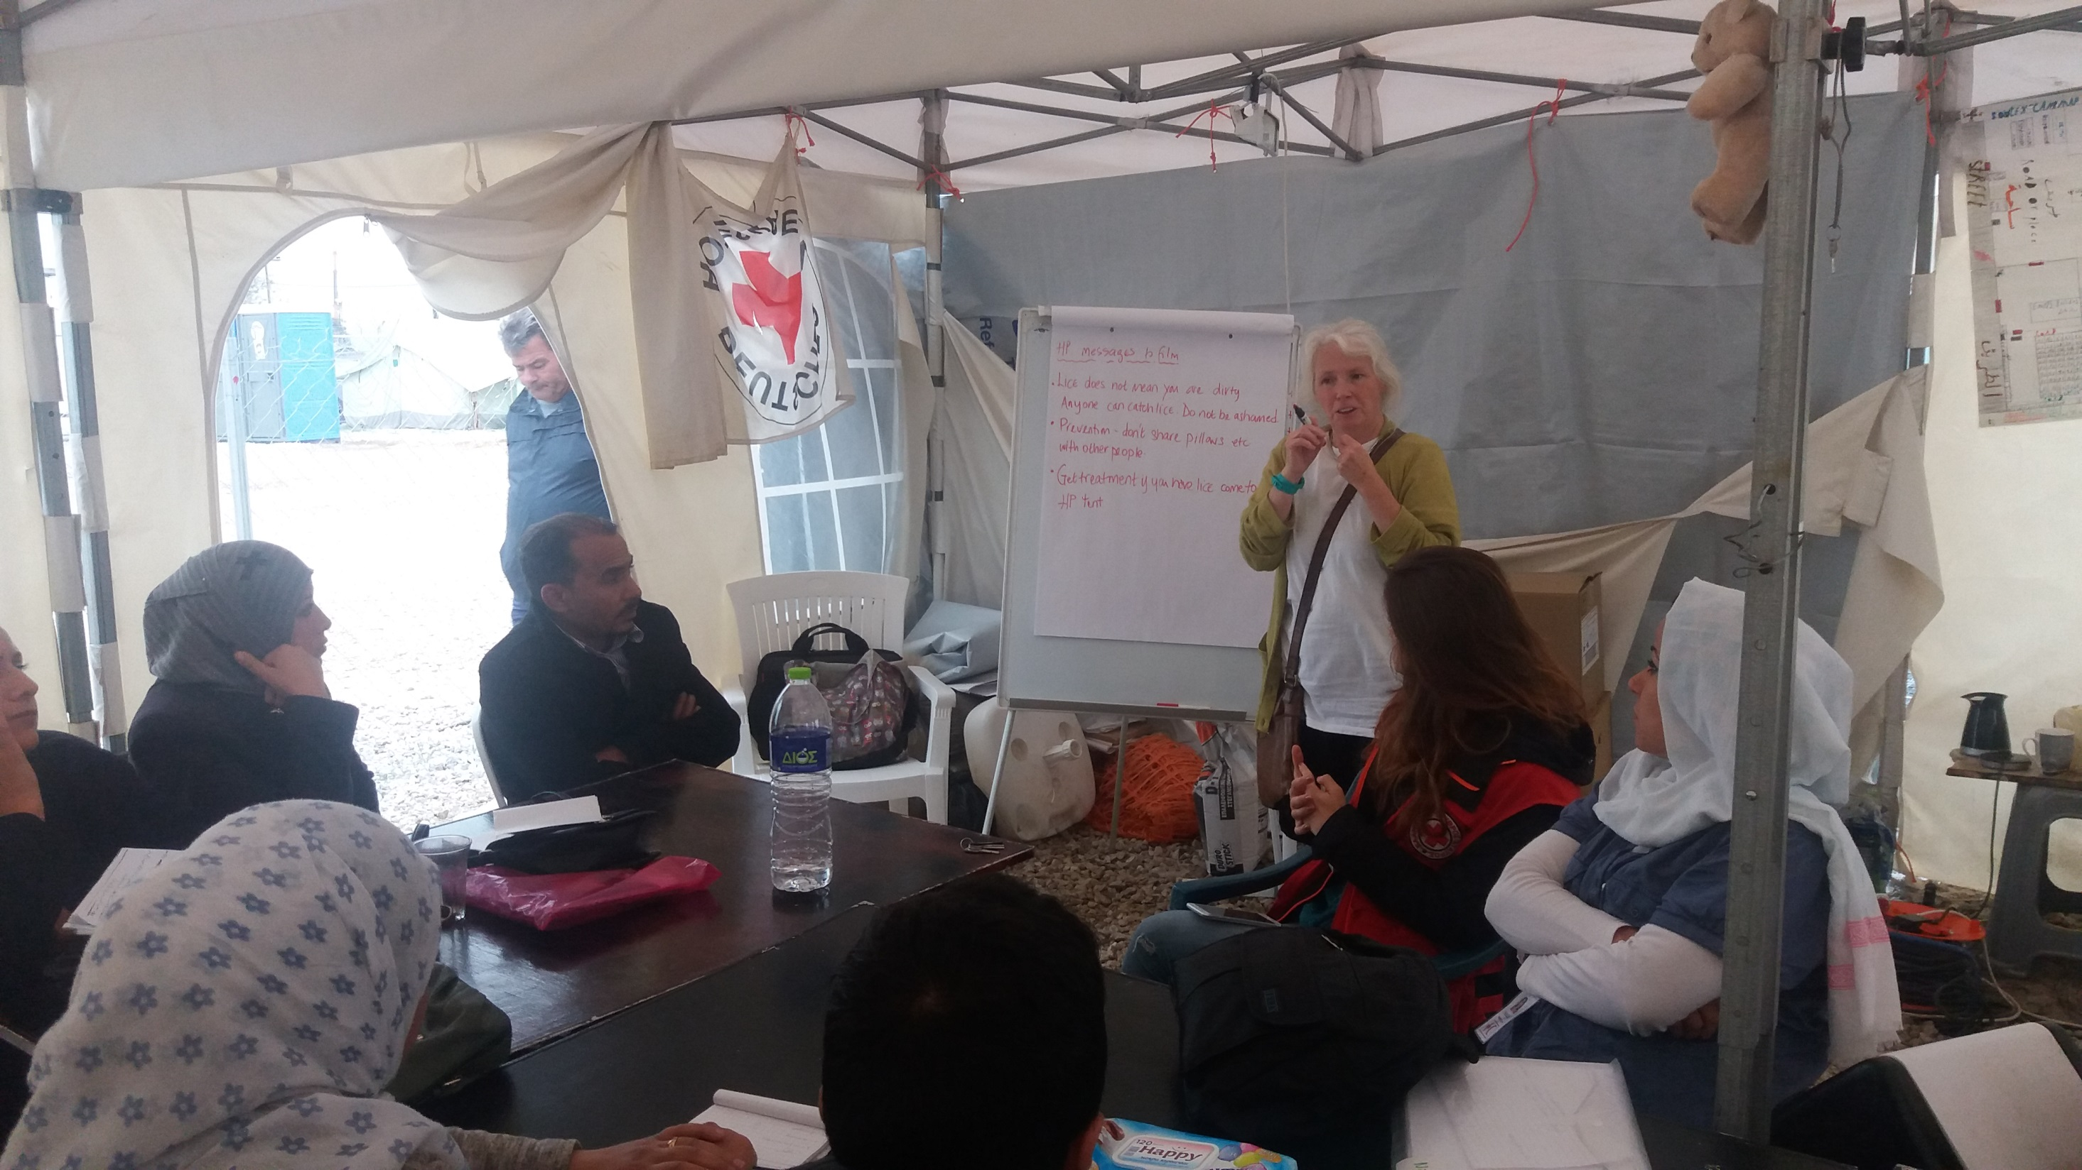
Community meeting in Softex
Community meeting

Slide 4
Community
volunteers

Slide 5
Helpline and face to face support in Oreokastro

Slide 6
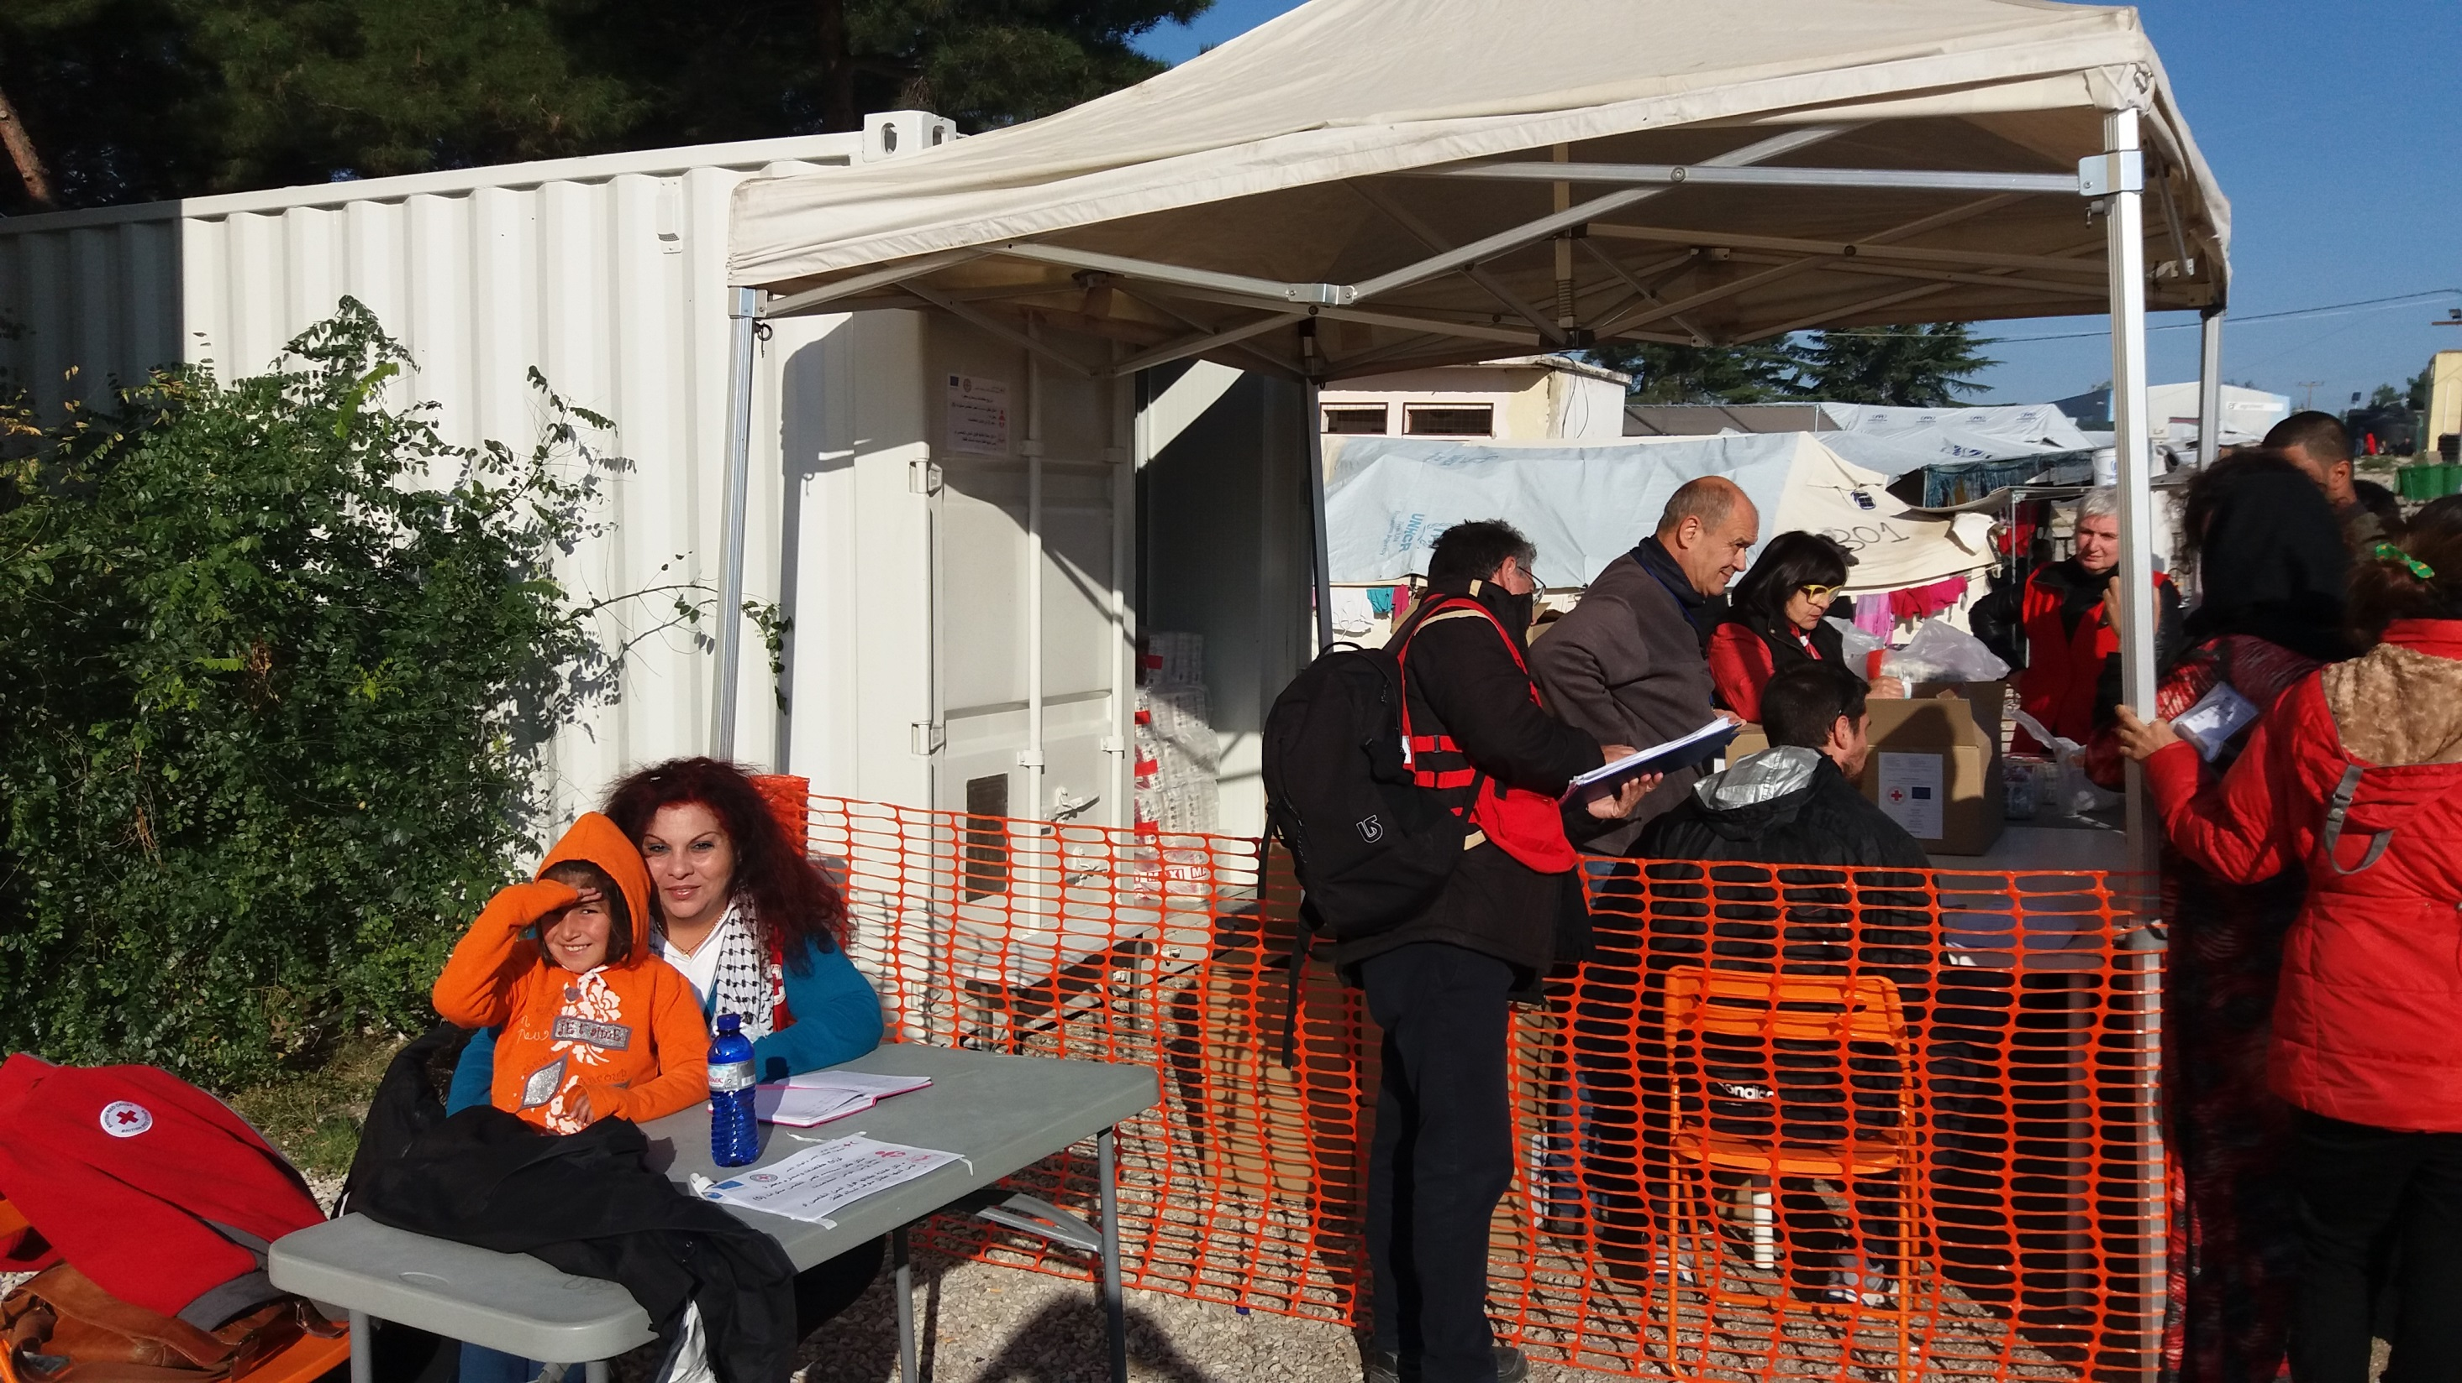
Information desk and exit surveys in Diavata

Slide 7
Informal feedback!

Slide 8
Methods
Written
Suggestion boxes, surveys, feedback forms
Verbal
Information kiosks, face-to-face, volunteers
Group
Community meetings, focus groups

Slide 9
What to do with feedback
Share, share, share – with colleagues, sectors, other actors
Turn feedback into action
If change is not possible, escalate and advocate
Feedback to beneficiaries – what did you do with their comments and concerns? What will happen now? Will anything change?

Slide 10
Challenges
Overcoming objections – people don’t always want to hear complaints
Making something happen – sometimes things cannot be changed
Consolidating various streams of engagement – it can be tough to manage a lot of interactions

Slide 11
Thank you
© International Federation of Red Cross and Red Crescent Societies, Geneva, 2014.
Any part of this presentation may be cited, copied, translated into other languages or adapted to meet local needs without prior permission from the International Federation of Red Cross and Red Crescent Societies, provided that the source is clearly stated. Requests for commercial reproduction should be directed to the IFRC Secretariat at secretariat@ifrc.org
All photos used in this presentation are copyright of the IFRC unless otherwise indicated.
This presentation was written and developed by Jamie Sport and produced in March 2017.
This presentation and relevant resources are available on FedNet at fednet.ifrc.org

